Slide 1
Employee Data Analysis using Excel
STUDENT NAME : SIVARANJANI. M
REGISTER NO: 122204055
DEPARTMENT: BCOM CS
COLLEGE: SHRI KRISHNASWAMY COLLEGE FOR WOMEN

Slide 2
PROJECT TITLE
Employee GENDER Analysis using Excel

Slide 3


AGENDA
Problem Statement
Project Overview
End Users
Our Solution and Proposition
Dataset Description
Modelling Approach
Results and Discussion
Conclusion
3/21/2024 Annual Review

Slide 4

PROBLEM STATEMENT
It affects not only physical health but also mental health and may lead to , isolation, depression and suicidal attempts.
Gender analysis examines the different roles, rights, and opportunities of men and women as well as relations between them. It also identifies disparities, examines why such disparities exist, determines whether they are a concern, and looks at how they can be addressed.
Consequences of inadequate gender data are dire: social and economic policies are less impactful, opportunities to improve project design are missed, and a blind eye is turned to stubborn inequalities in gendered social and economic realities.7 Feb 2022

Slide 5

PROJECT OVERVIEW
Men and women's equal balance is required for a fair and productive working environment, more commonly than not. Gender diversity in a workplace means that men and women are hired at a comparable rate, paid evenly, and given the same working opportunities with equal promotions.
Gender diversity is about acknowledging and respecting that there are many ways to identify outside of the binary of male and female. Presenting as gender diverse is not about attention seeking or receiving special treatment, it is about being one's authentic self.
Gender equality prevents violence against women and girls. Gender equality helps prevent violence against women and girls and makes our communities safer and healthier. It is a human right and it is good for the economy.
.

Slide 6

WHO ARE THE END USERS?
The current global labour force participation rate for women is just under 47%. For men, it's 72%. That's a difference of 25 percentage points, with some regions facing a gap of more than 50 percentage points.

Slide 7

OUR SOLUTION AND ITS VALUE PROPOSITION
"PIVOT" often refers to a strategic shift or adjustment in business, project management, or personal strategy. In a business context, a "pivot" involves changing direction or altering a company's strategy based on market feedback or performance. This might include altering product offerings, targeting a new customer segment, or modifying business models to better align with market demands. The goal of a pivot is usually to improve outcomes, address challenges, or capitalize on new opportunities for growth and success.
Notes:
Pivot

Slide 8
Dataset Description
🔹 Employee = kagle
🔹Nine Feature
🔹 Employee I'd
🔹Name = text
🔹 Data = number
🔹 Employee type
🔹 Performance level
🔹Gender
🔹 Female and male
🔹 employee rating numerical

Slide 9

THE "WOW" IN OUR SOLUTION
Unbiased Hiring Practices: Utilize neutral language in job
postings and implement blind hiring to minimize bias.
2. Training and Education: Organize workshops on gender sensitivity, unconscious bias, and diversity.
3. Equal Pay and Benefits: Ensure fair compensation and benefits for all employees, regardless of gender
4. Support Networks: Establish employee resource groups for women and non-binary individuals.
5. Flexible Work Arrangements: Offer adaptable work arrangements to accommodate different needs.
6. Leadership Opportunities: Encourage women and non-binary individuals to take on leadership roles.
7. Safe and Inclusive Workplace: Foster an environment where everyone feels comfortable and respected.
3/21/2024 Annual Review
9

Slide 10
MODELLING
DATA COLLECTION:
IN edunet dash board downloading the data sets while using the kaggle
FEATURE:
Identifying the employee ID
Identifying employee names
Identifying employee performance
Identifying employee gender
:DATA CLEANING:
1) To find the missing value
2 ) To the filtering the missing value
GENDER ANALYSIS:
Pivot table
Separating the gender
Graph
Filter remove
Pivot summary
Data visualization
10

Slide 11
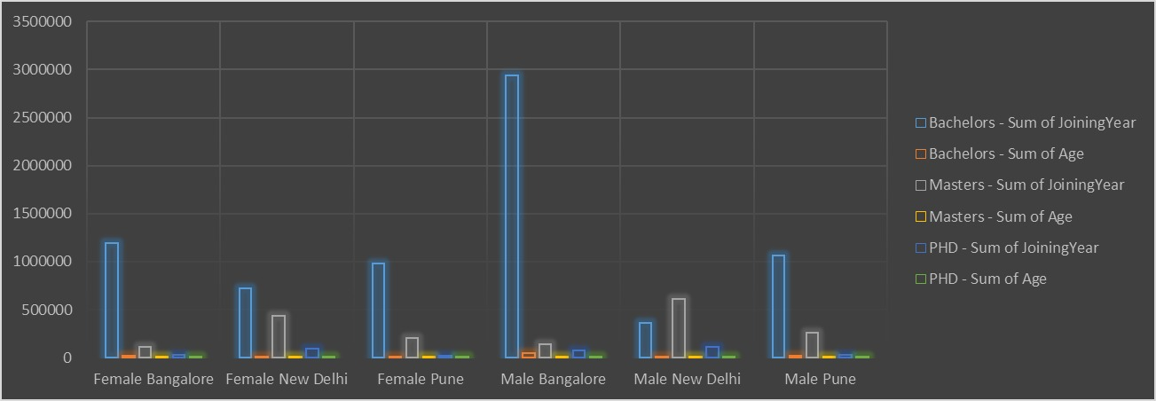
RESULTS
11

Slide 12
conclusion
Gender equality in the workplace is crucial for a thriving organization. By fostering inclusivity, addressing biases, and promoting diversity
Enhance innovation and creativity
Improve employee satisfaction and retention
Boost reputation and competitiveness
Ensure fair treatment and opportunities

