Slide 1

WHOLE SALE CUSTOMER DATA VISUVALIZATION
WELCOME

Slide 2
WHOLESALE CUSTOMER DATA
TEAM NM ID – NM2023TMID02278
TEAM MEMBERS
SIVAMANI S
SUBASH R
NARMATHA R
GOKULA PREETHI S
SANGEETHA C

Slide 3
CONTENTS
Wholesale customer data
Wholesale marketing
Stock Marketing
Data analysis
Solution
Dashboard
Story
Conclusion

Slide 4
Wholesale Customer Data
The dataset refers to clients of a wholesale distributor.
It includes the annual spending in monetary units (m.u) on diverse product categories.
Merchant Wholesaler.
Full-Service Merchant Wholesalers.
Limited-Services Merchant Wholesalers.

Slide 5

“Wholesale Marketing“
The stock market is device for transferring money from the impulsive to the patient from the overreacting to the disciplined.

Slide 6

“Stock Marketing”
A stock market, equity market, or share market is the aggregation of buyers and sellers of stocks (also called shares), which represent ownership claims on businesses; these may include securities listed on a public stock exchange, as well as stock that is only traded privately, such as shares of private companies which are sold to investors through equity crowdfunding platforms. Investment is usually made with an investment strategy in mind.

Slide 7

“Data Analysis”
Data analysis is a process for obtaining raw data, and subsequently converting it into information useful for decision-making by users. Data is collected and analyzed to answer questions, test hypotheses, or disprove theories.

Slide 8

“Solution”
Businesses that sell products wholesale can use a wholesale marketing strategy. Wholesalers typically sell large quantities of products to retailers at low prices, who then sell that product in retail stores. Wholesale marketing targets retailers, to grow the client base of wholesalers.

Slide 9
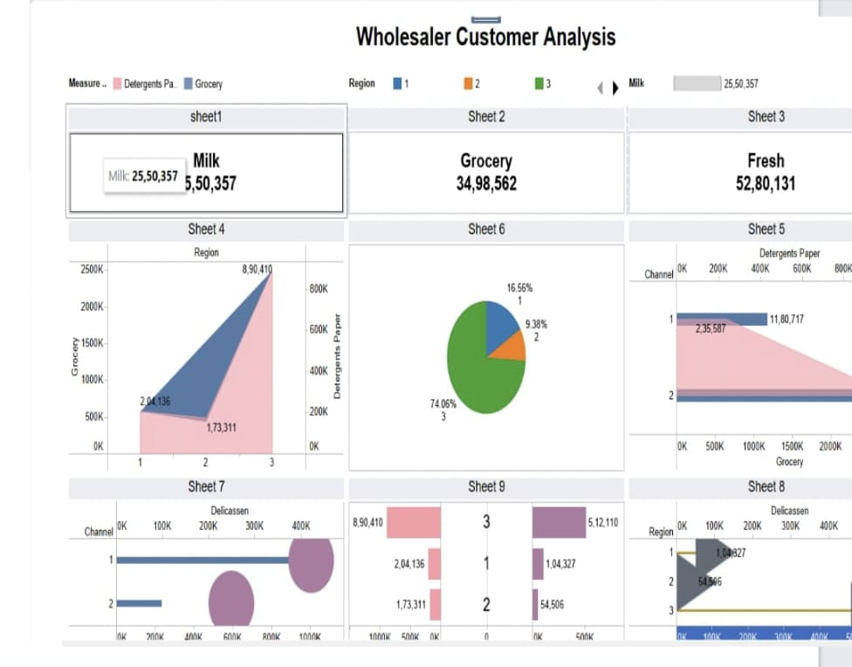
“Dashboard”

Slide 10
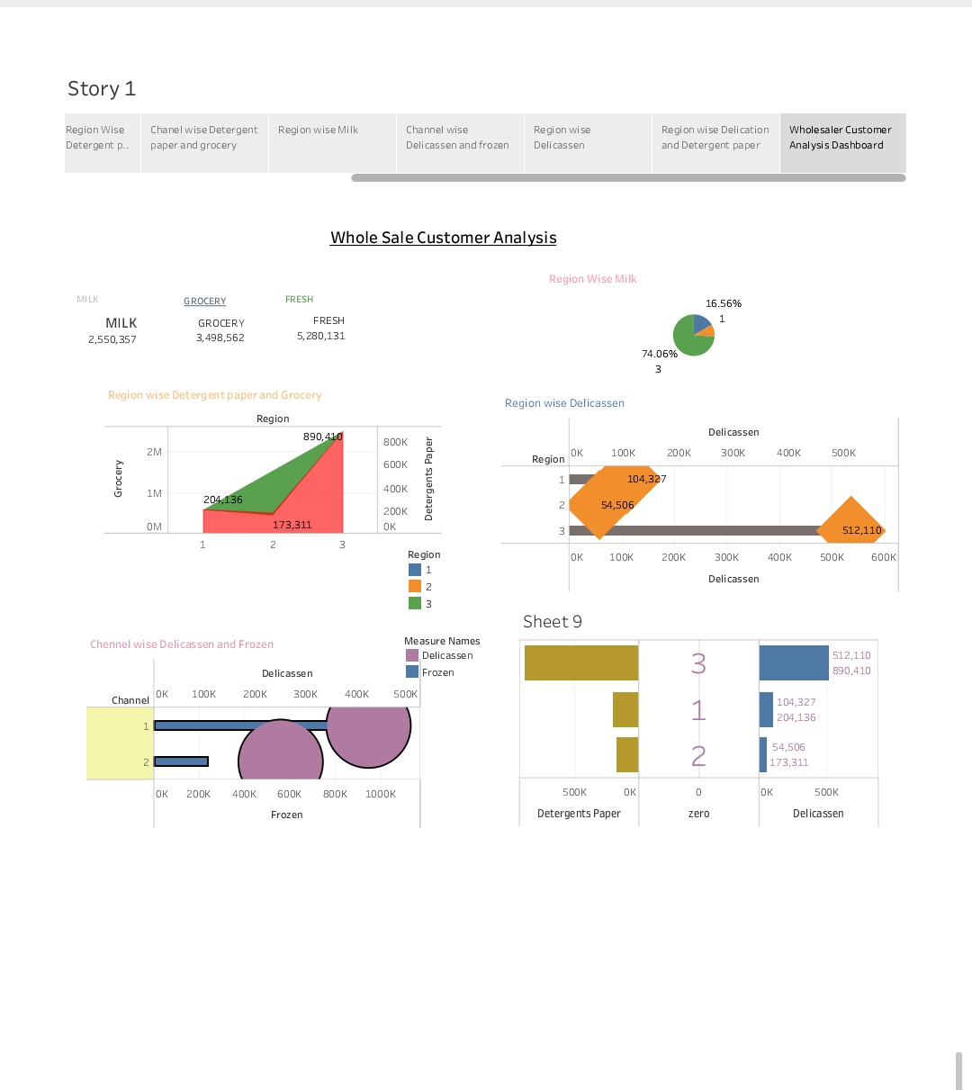
“Story”

Slide 11

“Conclusion”
What constitutes a real, live human being is more of a mystery than ever these days, and men each one of whom is a valuable, unique experiment on the part of nature are shot down wholesale.

