Slide 1
Monocular Depth Estimation and Object Classification
Title Page
Corporate Gurukul
Group 14

Slide 2
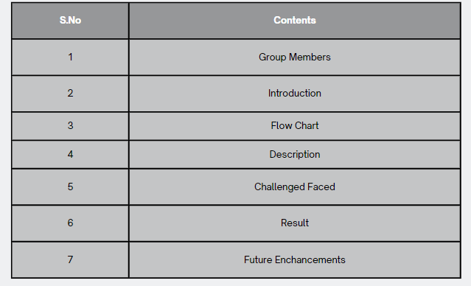
Index
Title Page
S.No
Contents

Slide 3






Title Page
Group Members
Team Members
Group 14
Aditi
Group Leader
Anwesh
Developer
Saisamrath
Developer
Siva Adithya
Documentation
Divyanshu
Deployment
Naga Sekhar
Data collection and splitting

Slide 4
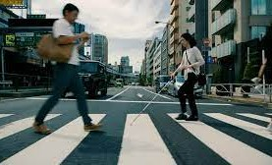
Title Page
Group Members
Introduction
Monocular Depth Estimation and Image classification
Introduction
With just little aid to the visually impaired existing currently, there is need to implement a device that helps in daily activities. This project is made with an aim of helping a person with detecting the object in front of them, with impaired eyesight and without the need of a companion. A method, which uses object detection on the images sent from the user end. The resultant object or person is then transmitted to the impaired person in the form of signal.
The goal of this project is to develop a software which can receive signals from a camera, detect the closest object and send back audio cues so that the user can avoid the obstacle.

Slide 5
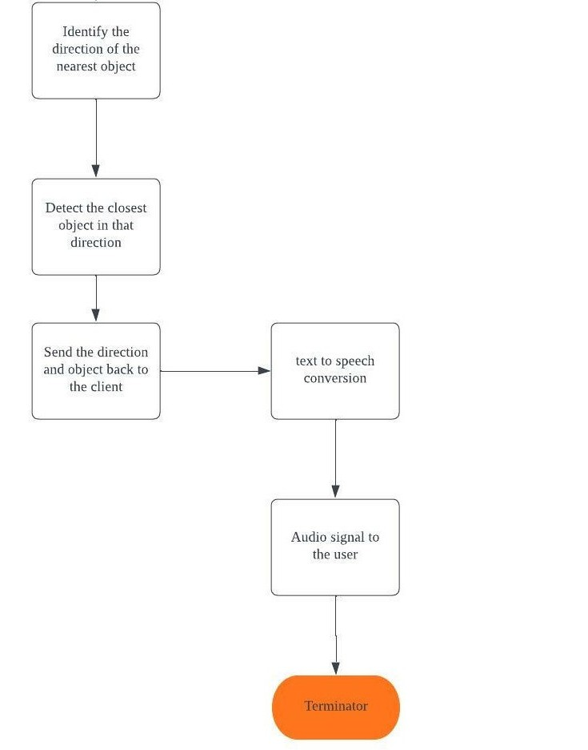
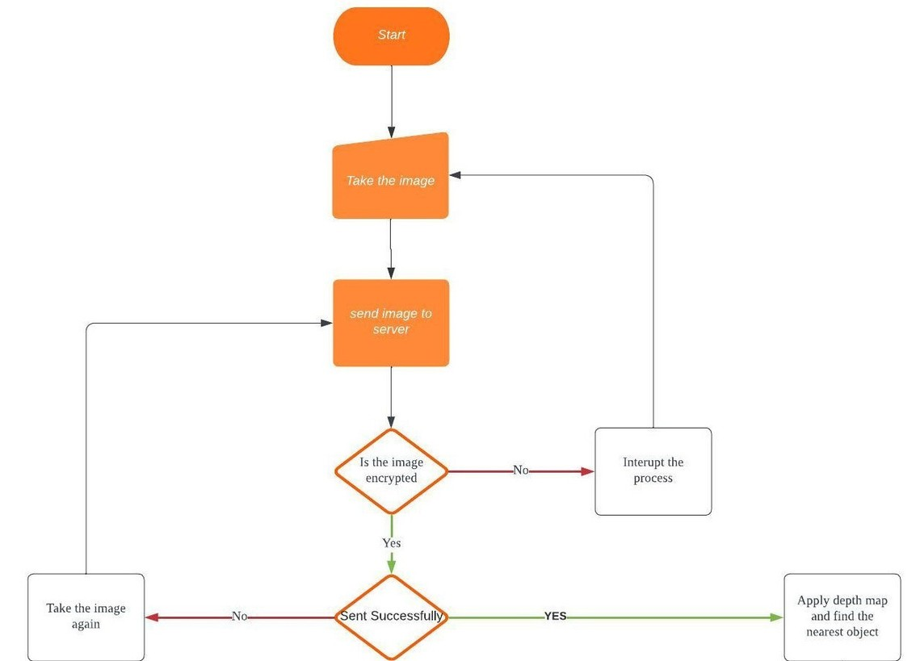

Slide 6

Title Page
Group Members
Introduction
Description
Technology
Technology Used
The technology that is used in the project is a part of computer vision. We used monocular depth estimation using a MiDaS model to generate a depth map using which the system can identify the nearest object. The system then uses a classification model to identify the image and send audio message on what the image is. MiDaS_Small model is used for the depth estimation due to its size and inference time.

Slide 7
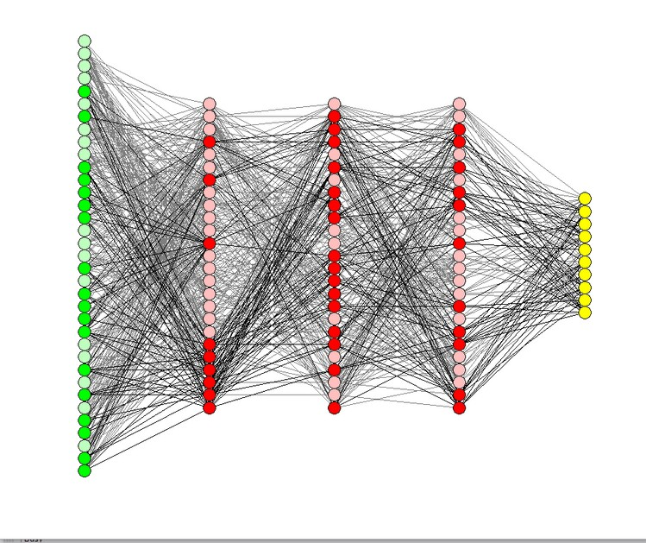
Title Page
Group Members
Introduction
Description
Models
Models
Depth Estimation
Object Classification
Depth estimation is done with the help of MiDaS_Small model. This model has the fastest inference speed.
The object detected is classified using convolutional neural networks.

Slide 8
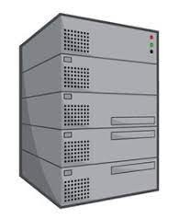
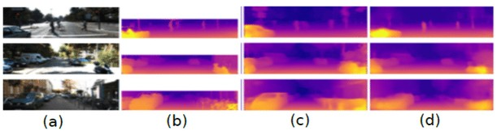





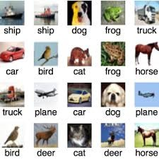

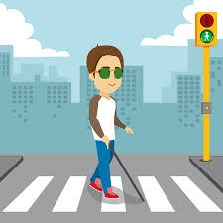



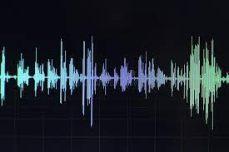
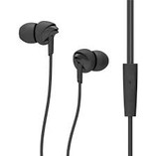

Title Page
Proprietors
Introduction
Description
Diagrammatic representation
Diagramatic Description

Slide 9
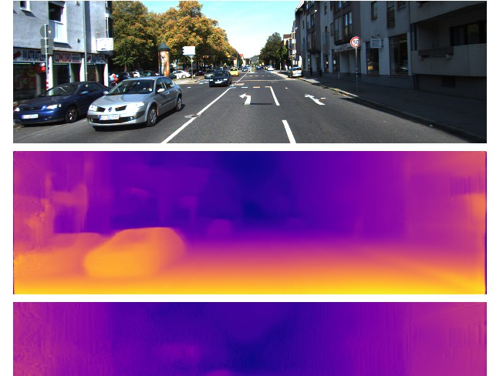
Title Page
Group Members
Introduction
Description
Working of the software
Working
A depth map of the image is generated
The brightest portion of the image is the closest object
The Image is segmented into three sections (left, middle and right
The segment in which the closest object is detected is sent for classification
Using CNN the object is classified as bike, car, person, animal, fire hydrant, traffic signs, bench or unknown object.
The label and the direction it is present in is given out as an audio message

Slide 10

Title Page
Group Members
Introduction
Description
Challenges Faced
Challenges Faced
Challenges
Finding Dataset
Lack of Adequate Data
No proper Hardware device
Finding a suitable dataset to train and test the model was the first hurdle in this project.
Since the project consists of a model being trained from scratch the lack of adequate data was the next obstacle.
The biggest challenge faced was the lack of a hardware device due to budget and time constraint.

Slide 11

Title Page
Group Members
Introduction
Description
Challenges faced
Results
Learnings
Learnings
This project gave us a better understanding of how computer vision works, where it can be used and how it works. We also learnt how to collect datasets, what to look for and where to look. We explored a few object detection models like RCNN, SSD and YOLO and got an understanding of what they do and how to use them. But ultimately we learnt about monocular depth estimation and how to develop an object classification model using CNN.

Slide 12

Title Page
Group Members
Introduction
Description
Challenges Faced
Results
Accuracy
Results
The classification model gave an accuracy of 55.8% when tested. The low accuracy is mainly due to the lack of sufficient data for some labels for the model to learn from.

Slide 13
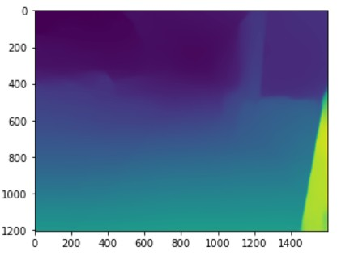
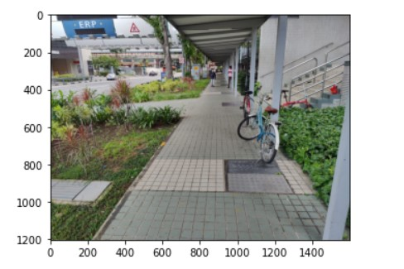

Title Page
Group Members
Introduction
Description
Challenges Faced
Results
Output
The output of the depth estimator is a depth map
Input Image
The output of the classification model is the class label and the direction

Slide 14

Title Page
Group Members
Introduction
Description
Challenges faced
Results
Future Enhancements
Future Enchancements
Future Enhancements
The software currently works on images only. This can be changed in such a way that the model classifies objects in a video.
This way object classification is done in real time improving the quality of usage.

