Slide 1
mongodb
Non relational database

Slide 2


Slide 3
mongodb
MongoDBMongoDB stores data in JSON-like documents, which makes the database very flexible and scalable
You can download a free MongoDB database at https://www.mongodb.com.

Slide 4
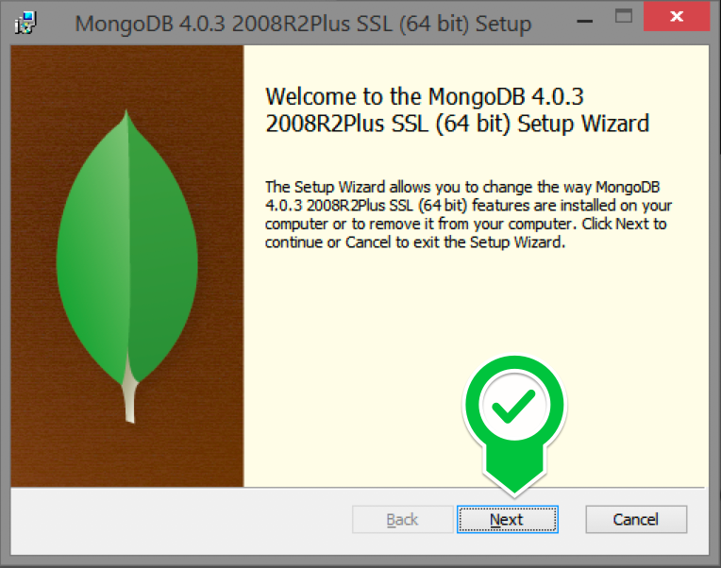

Slide 5
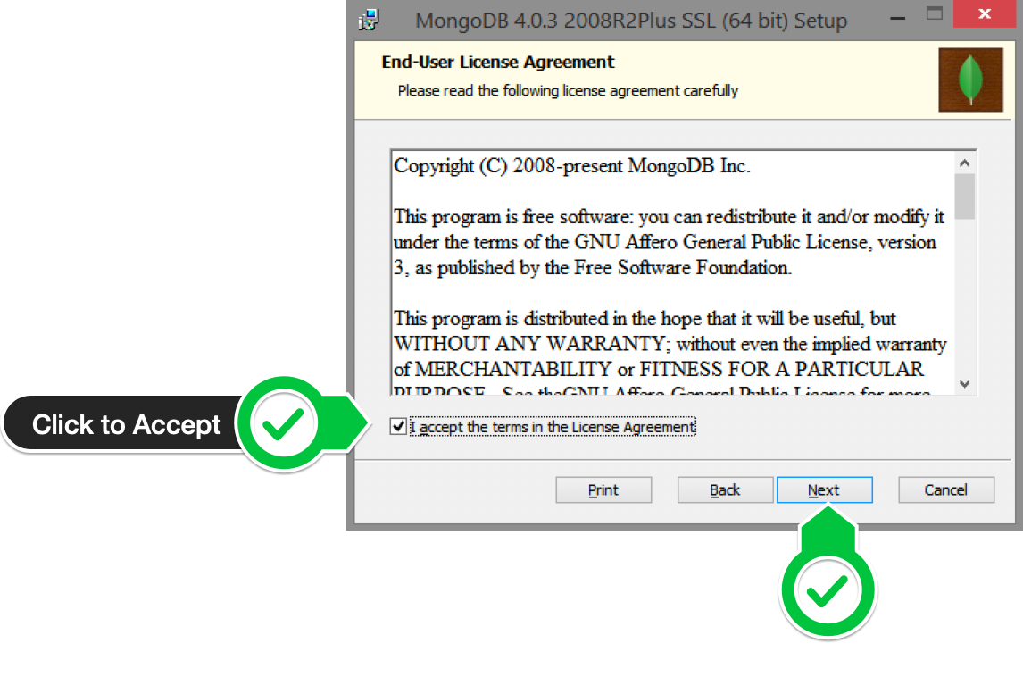

Slide 6
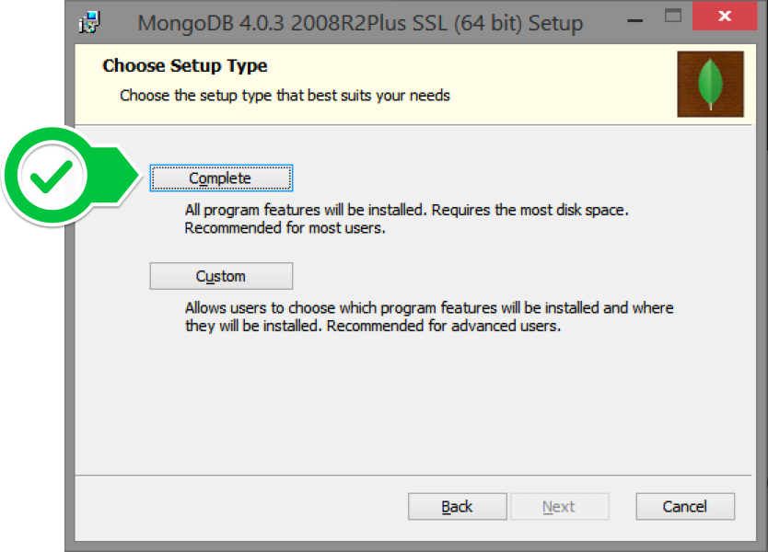

Slide 7
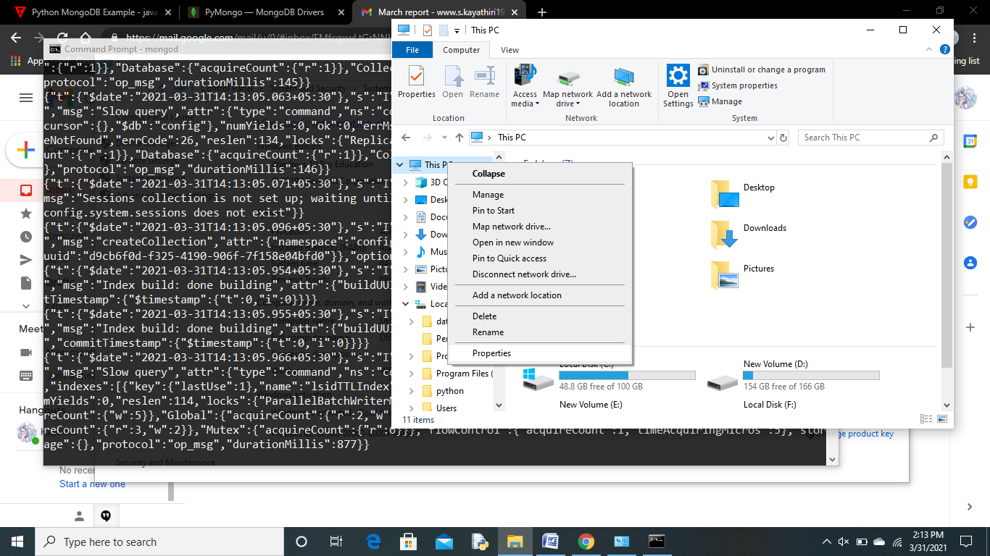
Server set up

Slide 8
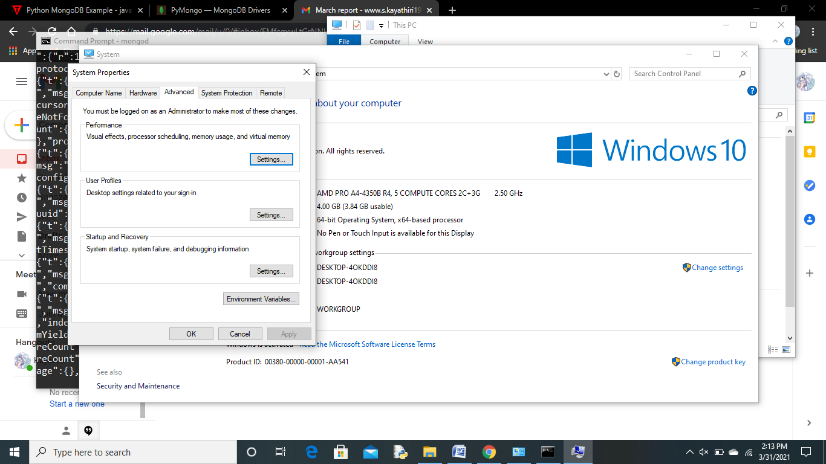
Advance system sett

Slide 9
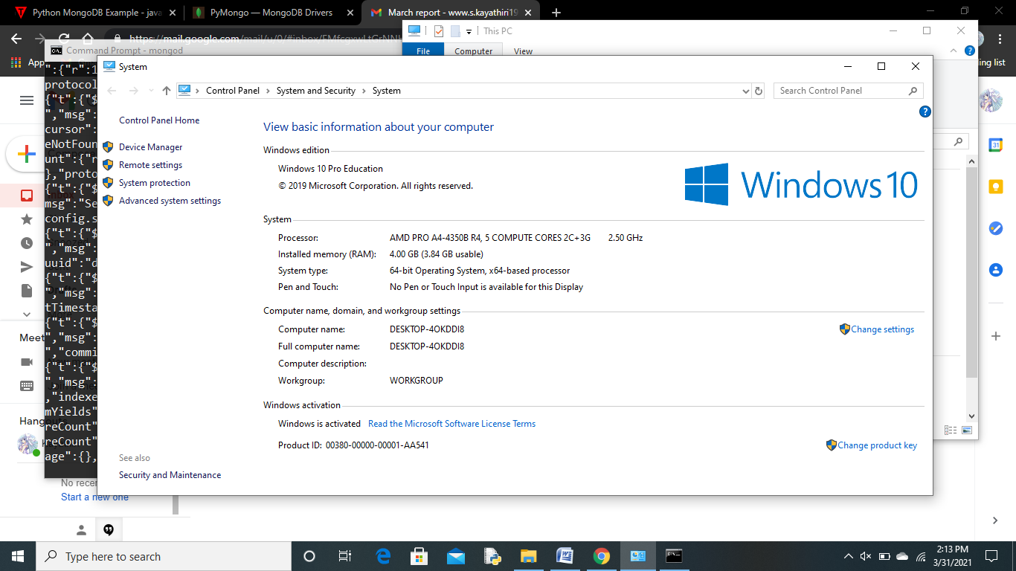

Slide 10
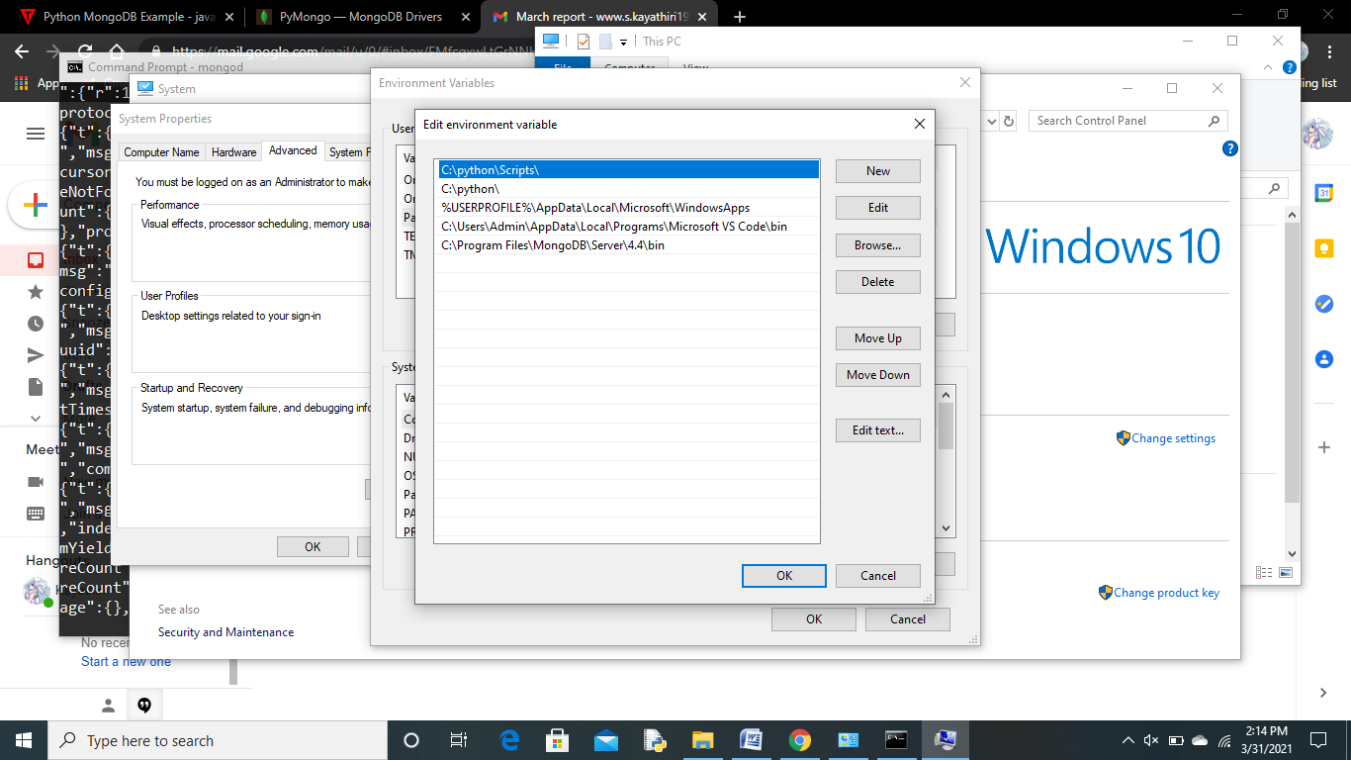
Path-new r edit

Slide 11
MongoDB - Create Database
MongoDB use DATABASE_NAME is used create database
use mydb
>switched to db mydb

Slide 12
pymango
PyPython needs a MongoDB driver to access the MongoDB database.

Slide 13
Relational concept- MongoDB equivalent
Database Database
Tables Collections
Rows Documents

Slide 14
use PIP to install "PyMongo".

Slide 15
Create a database called "mydatabase"
import pymongo
a = pymongo.MongoClient("mongodb://localhost:27017/")
b = a[“siva"]
#pymongo
Pymongo
def MangoClient(a):

Slide 16
Connection and view existing database
import pymongo
myclient=pymongo.MongoClient("mongodb://localhost:27017/")
print(myclient.list_database_names())
Output
['Mymdb', 'admin', 'config', 'local']

Slide 17
View collections
Import pymongo
myclient=pymongo.MongoClient("mongodb://localhost:27017/")
mndb = myclient["Mymdb"]
print(mndb.list_collection_names())

Slide 18
Insert Document
import pymongo
myclient = pymongo.MongoClient("mongodb://localhost:27017/")
mndb = myclient[“siva"]
mycol = mndb[‘c1']
mydict = { "ID": "2", "Name": "Ramana" }
x = mycol.insert_one(mydict)
print(x)

Slide 19
Output
−<pymongo.results.InsertOneResult object at 0x000002CA92A920C0>

Slide 20
Check inserted id
mydict = { "name": "Peter", "address": "Lowstreet 27" }
x = mycol.insert_one(mydict)
print(x.inserted_id)

Slide 21
Find Documents
import pymongo
myclient = pymongo.MongoClient("mongodb://localhost:27017/")
mndb = myclient["Mymdb"]
mycol = mndb['newmongocoll']
for x in mycol.find():
  print(x)

Slide 22
output
{'_id': ObjectId('5ef8b6f92d192421b78d32cb'), 'ID': '2', 'Name': 'Ramana'}

Slide 23
Insert multiple documents
import pymongo
myclient = pymongo.MongoClient("mongodb://localhost:27017/")
mydb = myclient["mydatabase"]
mycol = mydb["customers"]
mylist = [
{ "name": "Amy", "address": "Apple st 652"},
{ "name": "Hannah", "address": "Mountain 21"},
{ "name": "Michael", "address": "Valley 345"},
{ "name": "Sandy", "address": "Ocean blvd 2"},
{ "name": "Betty", "address": "Green Grass 1"}, { "name": "Richard", "address": "Sky st 331"}, { "name": "Susan", "address": "One way 98"}, { "name": "Vicky", "address": "Yellow Garden 2"}, { "name": "Ben", "address": "Park Lane 38"}, { "name": "William", "address": "Central st 954"}, { "name": "Chuck", "address": "Main Road 989"}, { "name": "Viola", "address": "Sideway 1633"}
]
x = mycol.insert_many(mylist)
#print list of the _id values of the inserted documents
:print(x.inserted_ids)

Slide 24
Insert Multiple Documents, with Specified IDs
mylist = [
{ "_id": 1, "name": "John", "address": "Highway 37"},
{ "_id": 2, "name": "Peter", "address": "Lowstreet 27"},
{ "_id": 3, "name": "Amy", "address": "Apple st 652"},
{ "_id": 4, "name": "Hannah", "address": "Mountain 21"},
{ "_id": 5, "name": "Michael", "address": "Valley 345"},
{ "_id": 6, "name": "Sandy", "address": "Ocean blvd 2"},
{ "_id": 7, "name": "Betty", "address": "Green Grass 1"},
{ "_id": 8, "name": "Richard", "address": "Sky st 331"},
{ "_id": 9, "name": "Susan", "address": "One way 98"},
{ "_id": 10, "name": "Vicky", "address": "Yellow Garden 2"},
{ "_id": 11, "name": "Ben", "address": "Park Lane 38"},
{ "_id": 12, "name": "William", "address": "Central st 954"},
{ "_id": 13, "name": "Chuck", "address": "Main Road 989"},
{ "_id": 14, "name": "Viola", "address": "Sideway 1633"}
]

Slide 25
Find all in collections
import pymongomyclient = pymongo.MongoClient("mongodb://localhost:27017/")
mydb = myclient["mydatabase"]
mycol = mydb["customers"]
for x in mycol.find():
print(x)

Slide 26
query
import pymongo
myclient = pymongo.MongoClient("mongodb://localhost:27017/")
mydb = myclient["mydatabase"]
mycol = mydb["customers"]
myquery = { "address": "Park Lane 38" }
mydoc = mycol.find(myquery)
for x in mydoc:
print(x)

Slide 27
Finding document with ‘s’
import pymongo
myclient = pymongo.MongoClient("mongodb://localhost:27017/")
mydb = myclient["mydatabase"]
mycol = mydb["customers"]
myquery = { "address": { "$gt": "S" } }
mydoc = mycol.find(myquery)
for x in mydoc:
print(x)

Slide 28
Start with ‘s’
import pymongo
myclient = pymongo.MongoClient("mongodb://localhost:27017/")
mydb = myclient["mydatabase"]
mycol = mydb["customers"]
myquery = { "address": { "$regex": "^S" } }
mydoc = mycol.find(myquery)
for x in mydoc:
print(x)

Slide 29
limit
import pymongo
myclient = pymongo.MongoClient("mongodb://localhost:27017/")
mydb = myclient["mydatabase"]
mycol = mydb["customers"]
myresult = mycol.find().limit(5)
#print the result:
for x in myresult:
print(x)

Slide 30
update
import pymongo
myclient = pymongo.MongoClient("mongodb://localhost:27017/")
mydb = myclient["mydatabase"]
mycol = mydb["customers"]
myquery = { "address": "Valley 345" }
newvalues = { "$set": { "address": "Canyon 123" } }
mycol.update_one(myquery, newvalues)
#print "customers" after the update:
for x in mycol.find():
print(x)

Slide 31
sort
import pymongo
myclient = pymongo.MongoClient("mongodb://localhost:27017/")
mydb = myclient["mydatabase"]
mycol = mydb["customers"]
mydoc = mycol.find().sort("name")
for x in mydoc:
print(x)

Slide 32
Delete
import pymongo
myclient = pymongo.MongoClient("mongodb://localhost:27017/")
mydb = myclient["mydatabase"]
mycol = mydb["customers"]
myquery = { "address": "Mountain 21" }
mycol.delete_one(myquery)

Slide 33
Delete all starts with ‘s’
import pymongo
myclient = pymongo.MongoClient("mongodb://localhost:27017/")
mydb = myclient["mydatabase"]
mycol = mydb["customers"]
myquery = { "address": {"$regex": "^S"} }
x = mycol.delete_many(myquery)
print(x.deleted_count, " documents deleted.")

