Slide 1


Data Mining Project#4
Siva Chandra Kakarlapudi

Slide 2
Title: Predicting Hotel Booking Cancellations
Introduction:
Dataset Overview:
Comprehensive hotel booking dataset containing crucial features related to customer reservations. This data set is from DataCamp
Objective:
Binary Classification Task:
The primary goal is to predict whether a hotel booking will be canceled or not.
The chosen predictive data mining techniques for predicting hotel booking cancellations are Decision Tree and Random Forest.
Decision Tree:
Justification: Decision trees offer interpretability, allowing easy understanding of the decision-making process. They handle non-linear relationships well and provide insights into feature importance.
Random Forest:
Justification: Random Forest, an ensemble of decision trees, addresses overfitting and enhances predictive accuracy. It combines multiple trees, reducing the risk of individual tree biases and increasing robustness.
These techniques were selected for their balance between interpretability and accuracy, crucial considerations for predicting hotel booking cancellations.

Slide 3
Dataset Features:
Customer Information:
Demographic details such as 'adults', 'babies', 'is_repeated_guest'.
Booking history features including 'previous_cancellations', 'previous_bookings_not_canceled'.
Booking Details:
Reservation specifics like 'lead_time', 'arrival_date_week_number', 'arrival_date_day_of_month', 'arrival_date_month'.
Stay duration parameters: 'stays_in_weekend_nights', 'stays_in_week_nights'.
Pricing and Rate Information:
'avg_daily_rate', 'required_car_parking_spaces', 'total_of_special_requests'.
Booking Channels and Agents:
'booked_by_company', 'booked_by_agent'.
Hotel and Meal Preferences:
'hotel_City', 'hotel_Resort', 'meal_BB', 'meal_FB', 'meal_HB', 'meal_No_meal'.
Market and Distribution Segments:
'market_segment_Aviation', 'market_segment_Complementary', 'market_segment_Corporate', 'market_segment_Direct', 'market_segment_Groups', 'market_segment_Offline_TA_TO', 'market_segment_Online_TA', 'market_segment_Undefined'.
'distribution_channel_Corporate', 'distribution_channel_Direct', 'distribution_channel_GDS', 'distribution_channel_TA_TO', 'distribution_channel_Undefined'.
Reserved Room Types:
'reserved_room_type_A', 'reserved_room_type_B', 'reserved_room_type_C', 'reserved_room_type_D', 'reserved_room_type_E', 'reserved_room_type_F', 'reserved_room_type_G', 'reserved_room_type_H', 'reserved_room_type_L'.
Deposit and Customer Types:
'deposit_type_No_Deposit', 'deposit_type_Non_Refund', 'deposit_type_Refundable'.
'customer_type_Contract', 'customer_type_Group', 'customer_type_Transient', 'customer_type_Transient-Party'.

Slide 4
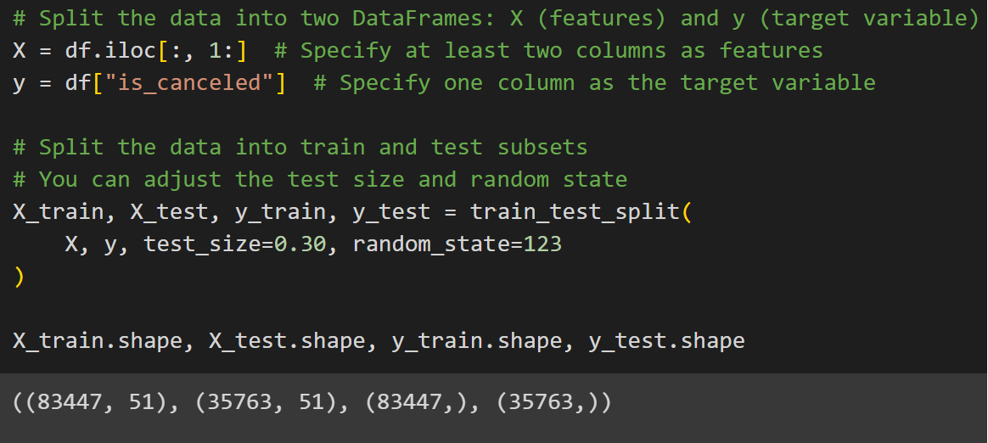
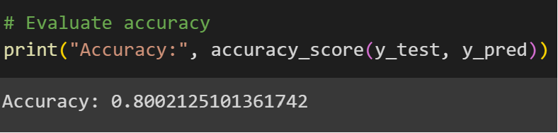
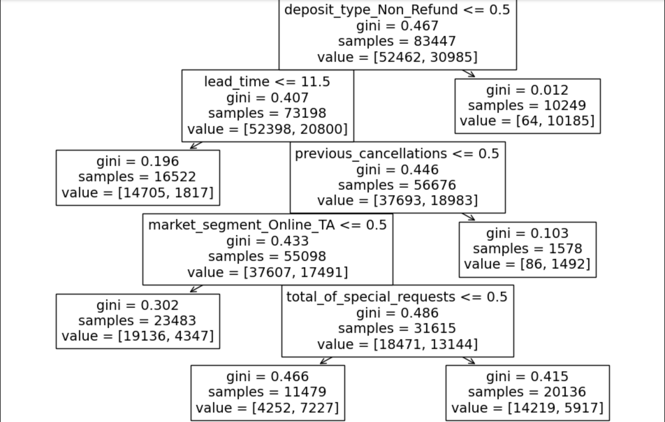
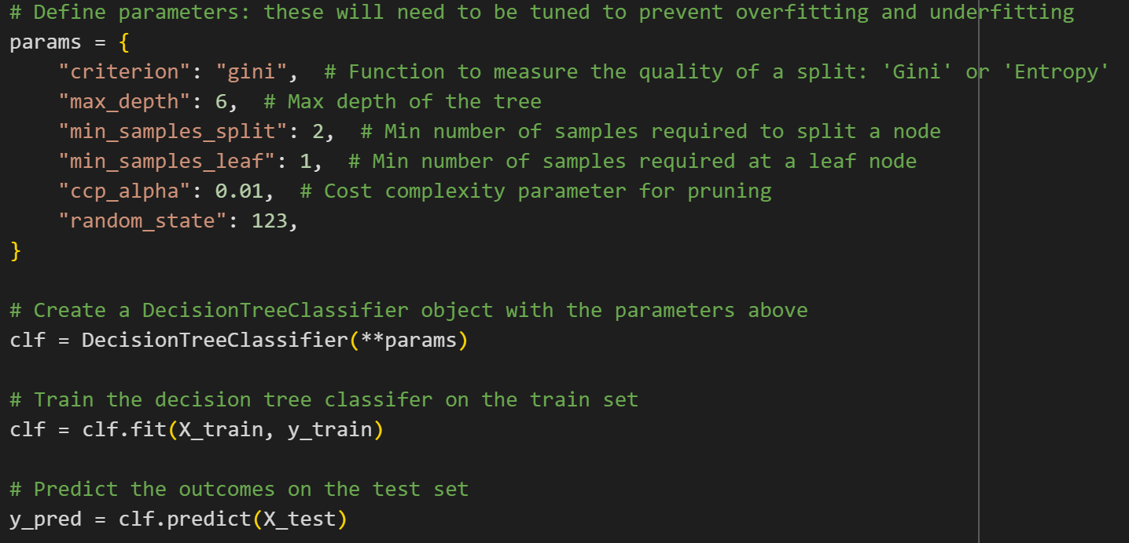
Splitting the dataset:
Accuracy of the Decision Tree on test data:
Decision Tree:

Slide 5
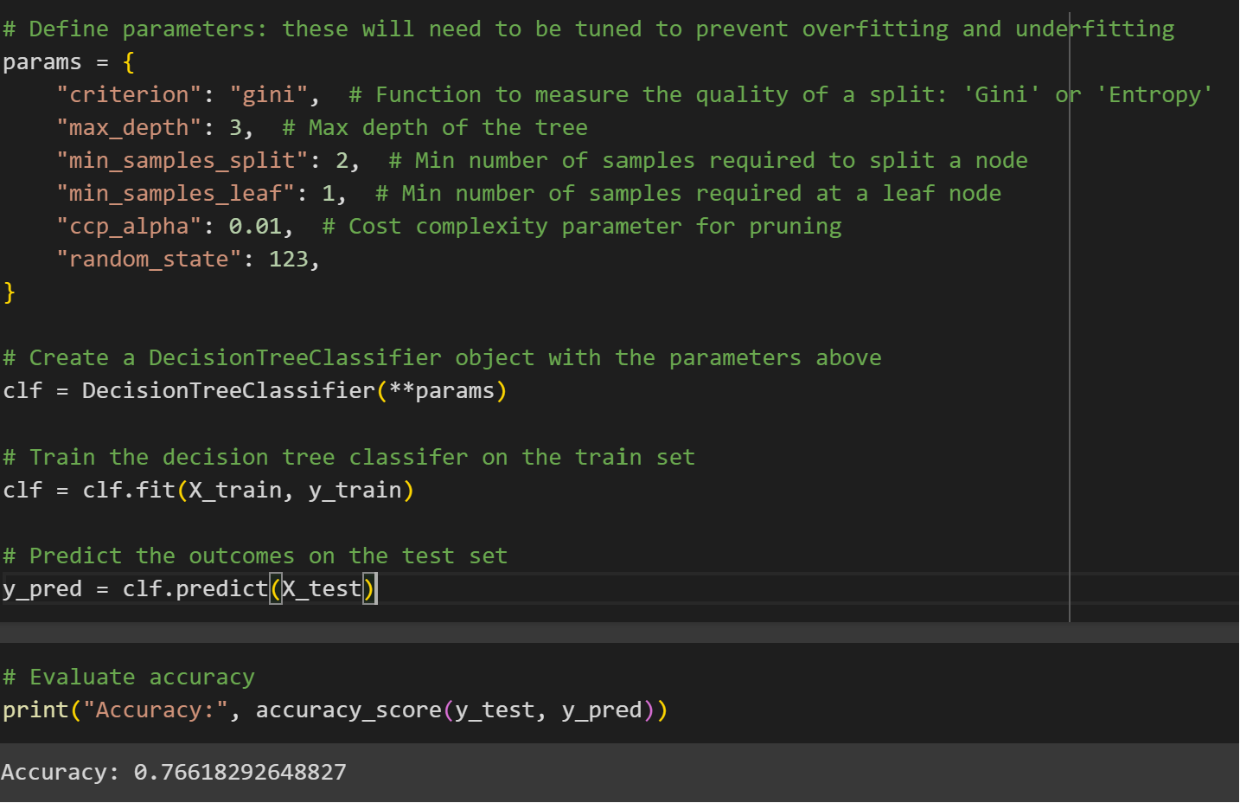
Condition: The condition for splitting the data at the root node is based on the feature "deposit_type_Non_Refund" being less than or equal to 0.5.
Gini Impurity: The Gini impurity is a measure of how often a randomly chosen element would be incorrectly classified. In this case, the Gini impurity at the root node is 0.467.
Samples: There are 83,447 samples (data points) in the dataset that reach the root node.
Class Distribution (Value): The distribution of the target variable (in this case, predicting whether a booking will be canceled or not) in the samples is given by the "value" parameter. There are two classes represented:
Class 0 (Not Canceled): 52,462 samples
Class 1 (Canceled): 30,985 samples
Decision tree with depth 3
As we reduced the depth of the tree the accuracy went down to 0.766

Slide 6
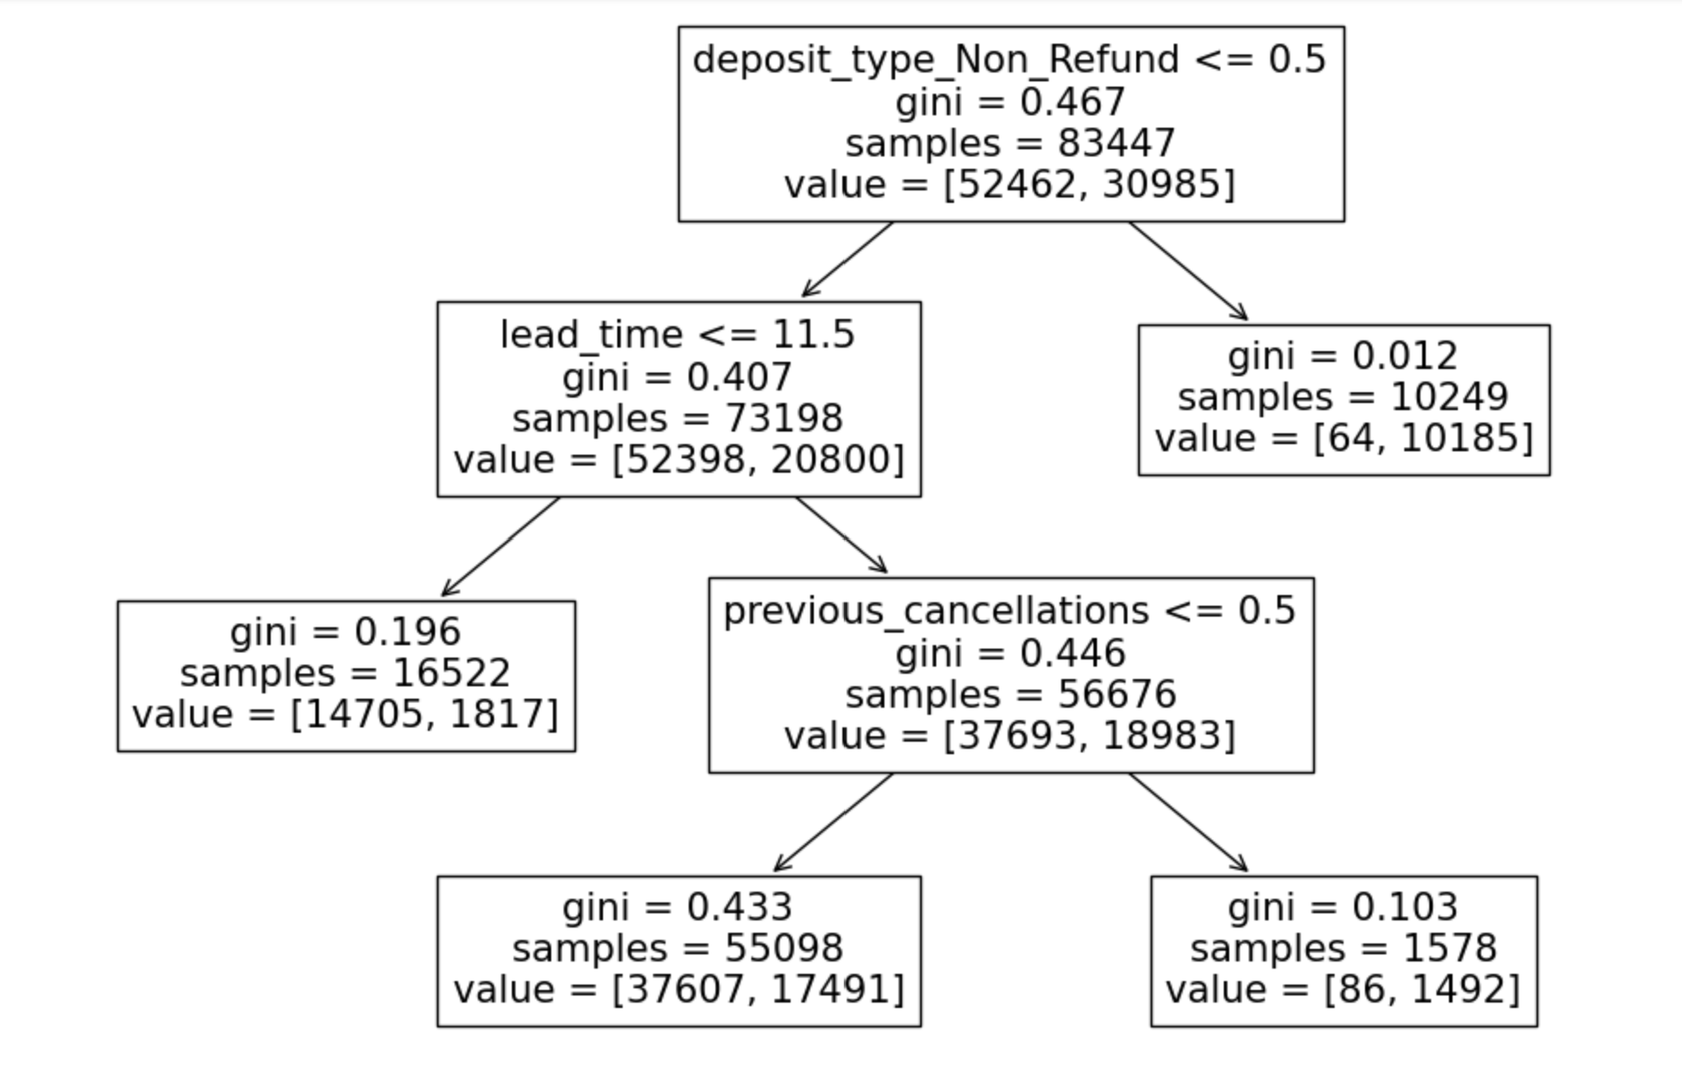
As we reduced the depth of the tree the decision tree is not using features like Market segmentation and total_of_special_requests as splitting criteria

Slide 7
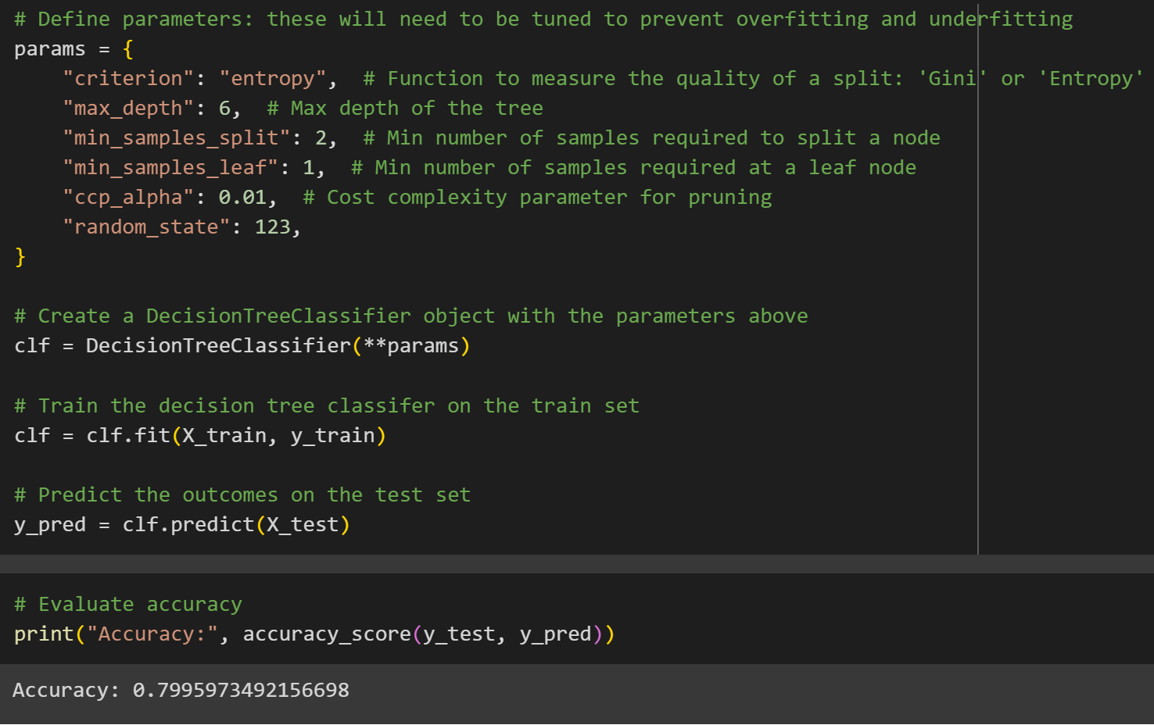
Our accuracy again went up by increasing the depth of the tree and using ‘entropy’ as a function to measure the quality of a split

Slide 8
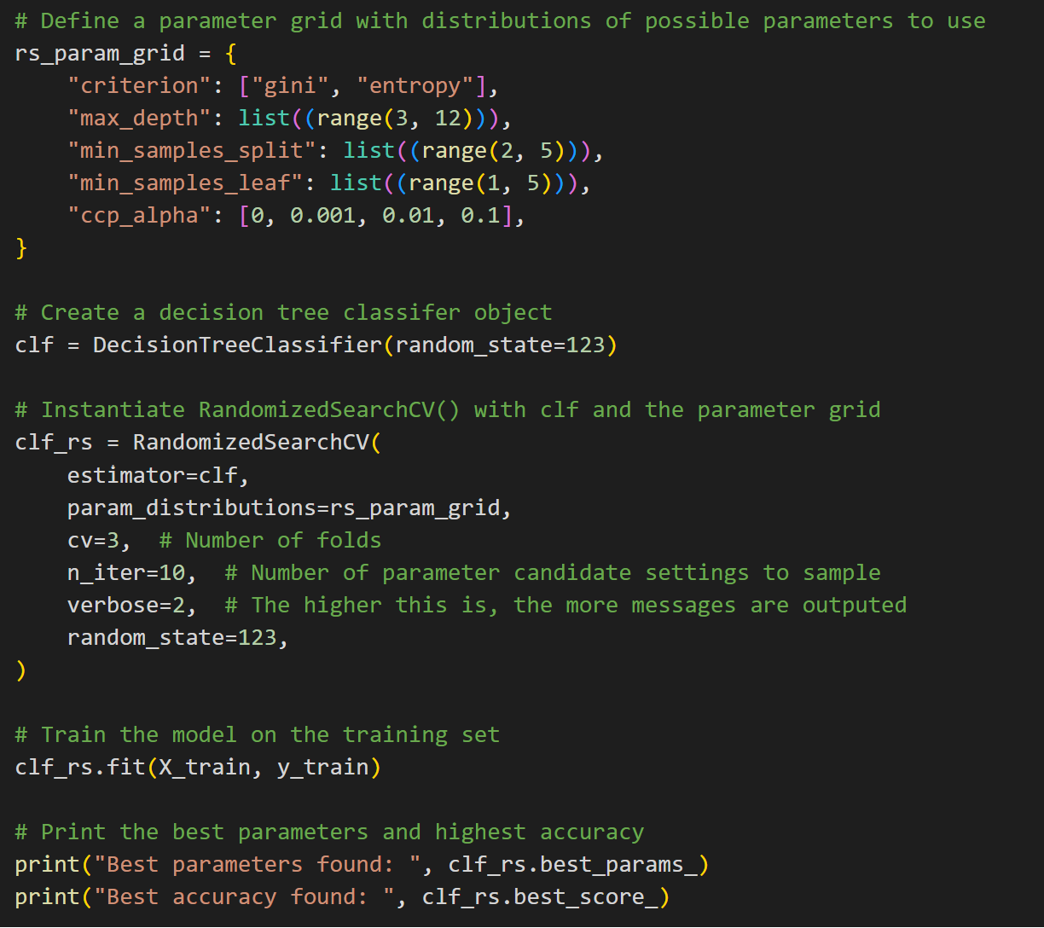
Hyperparameter tuning to find the best set of features:

Slide 9
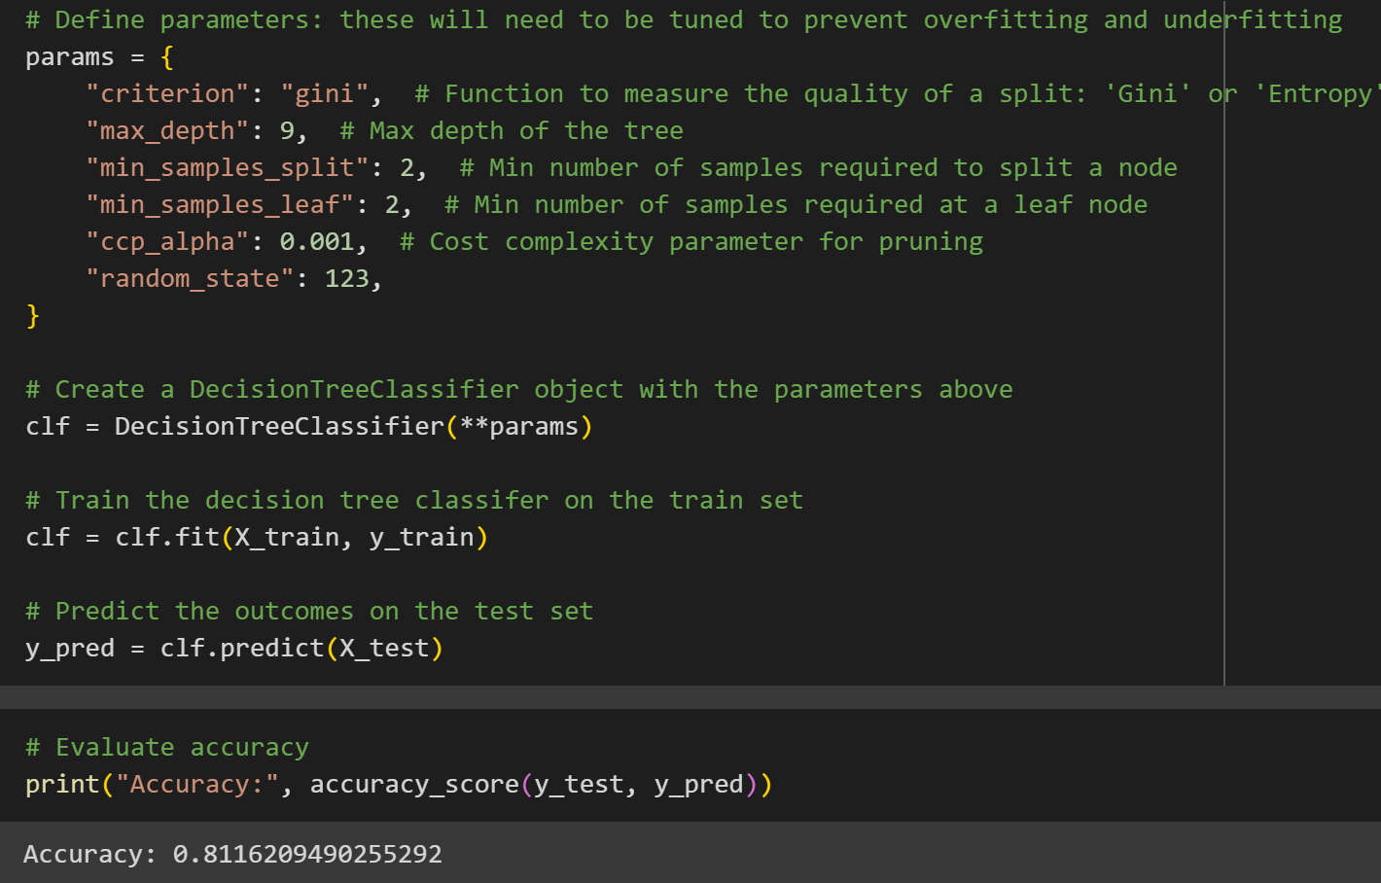
We got a better accuracy by training the model with
the parameters obtained through tuning.
An accuracy of 81% for your Decision Tree classifier indicates that the model is correctly predicting the outcome (canceled or not canceled) for approximately 81% of the samples in your dataset.

Slide 10
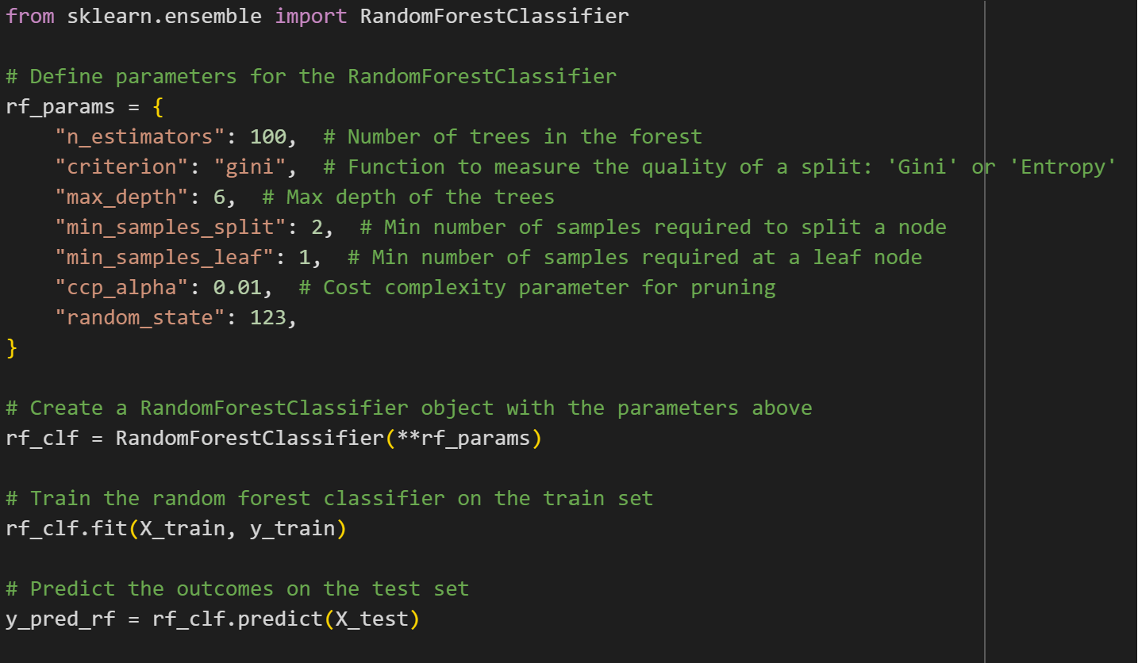
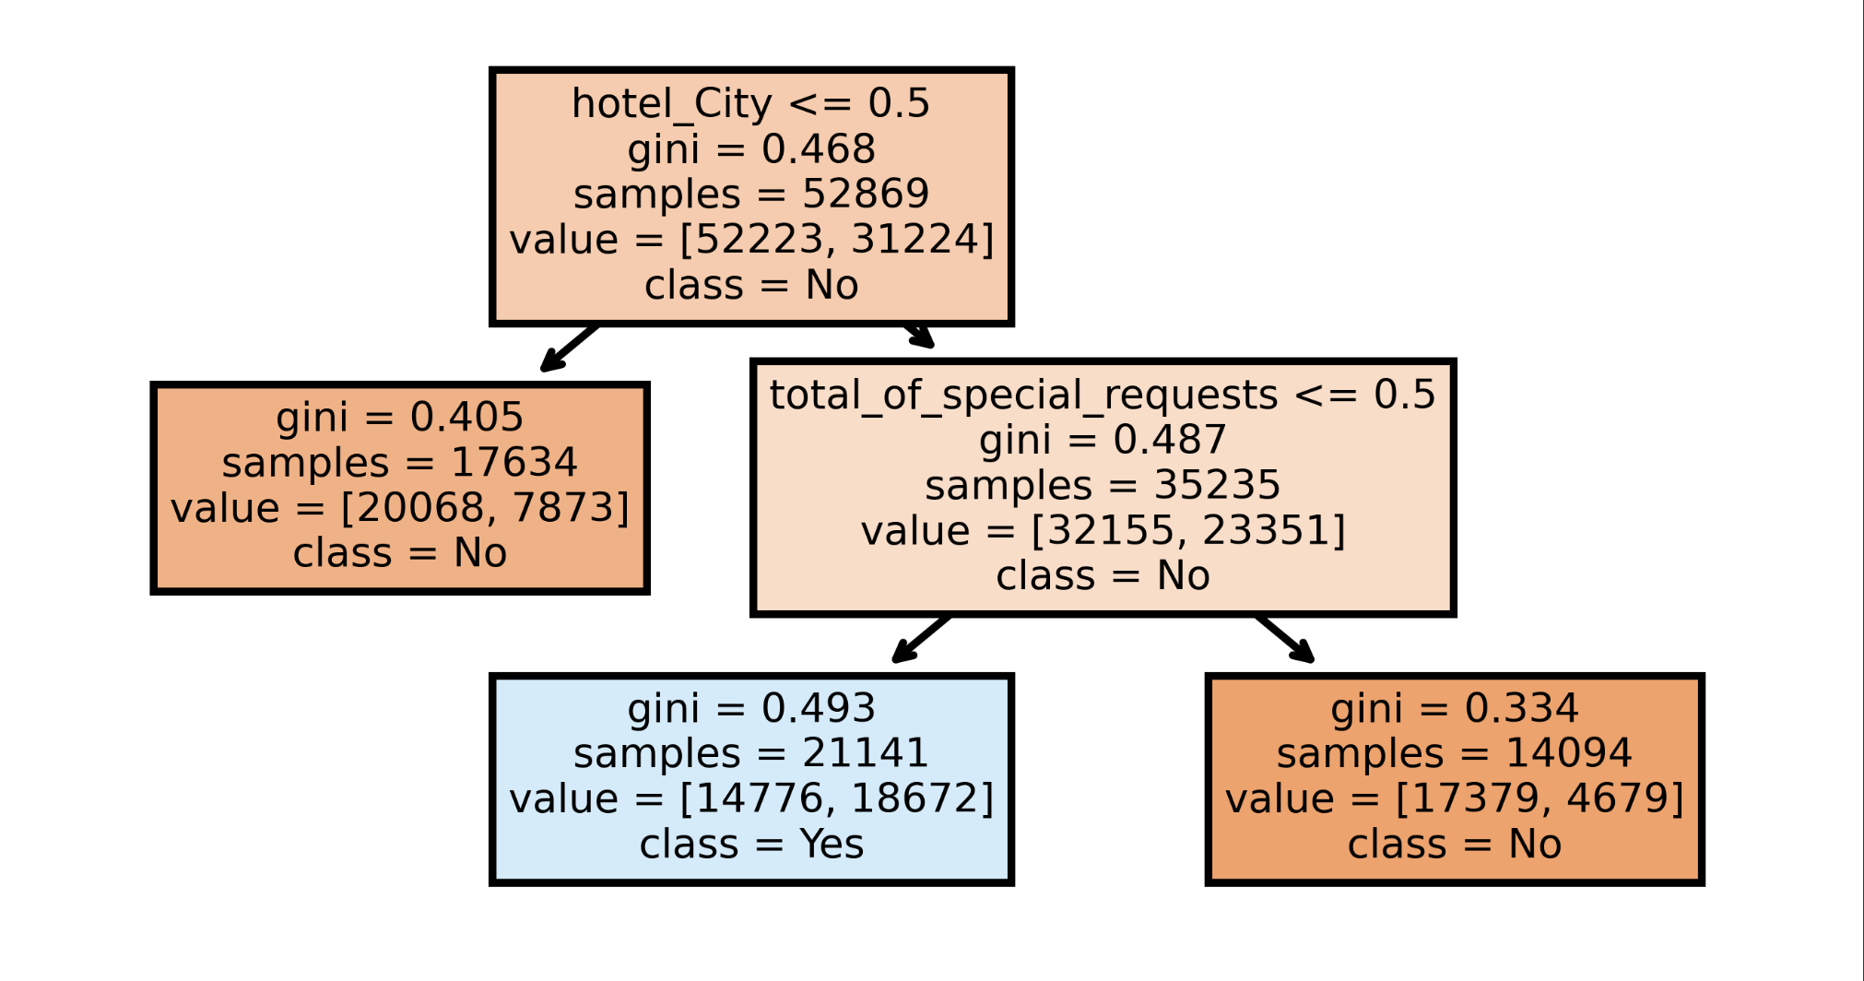
Here class No represents Not Cancelled and class=Yes represents Cancelled. So blue leaf node represents Cancelled as the no of samples with Yes are more than the no of samples with No class

Slide 11
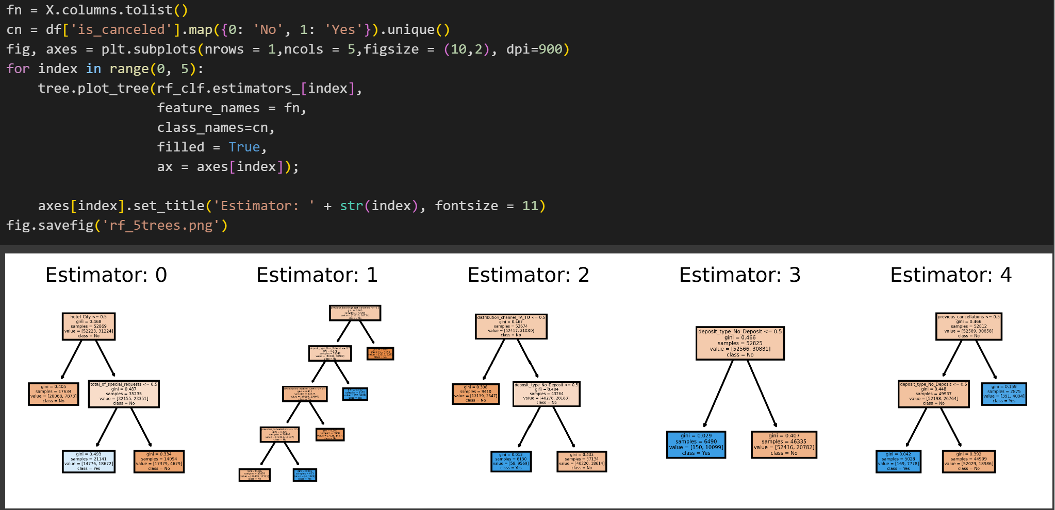
These are the first five trees built by the RandomForestClassifier

Slide 12
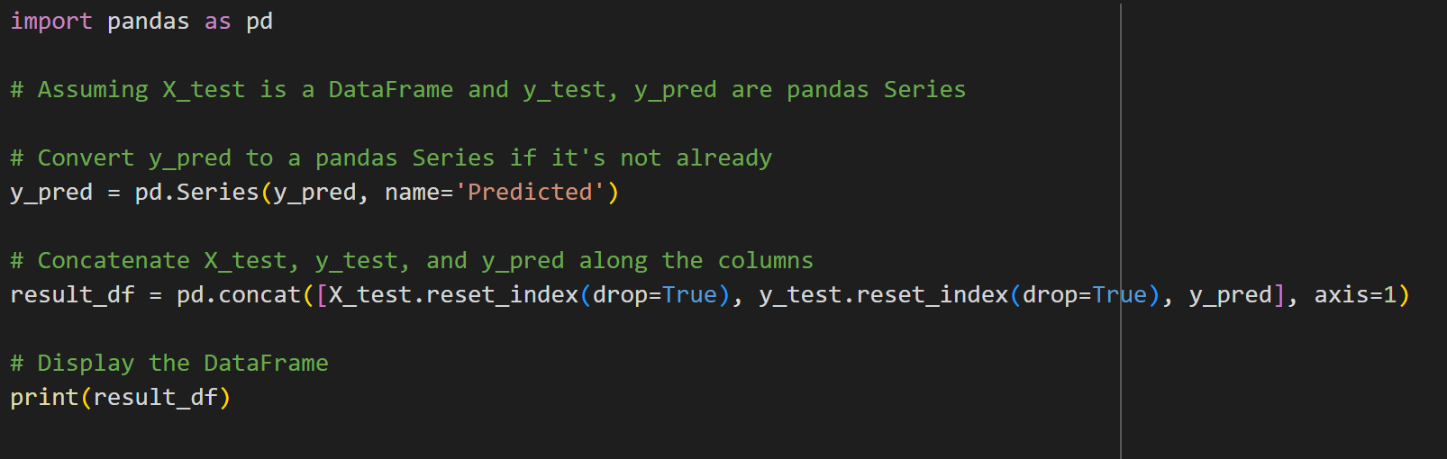
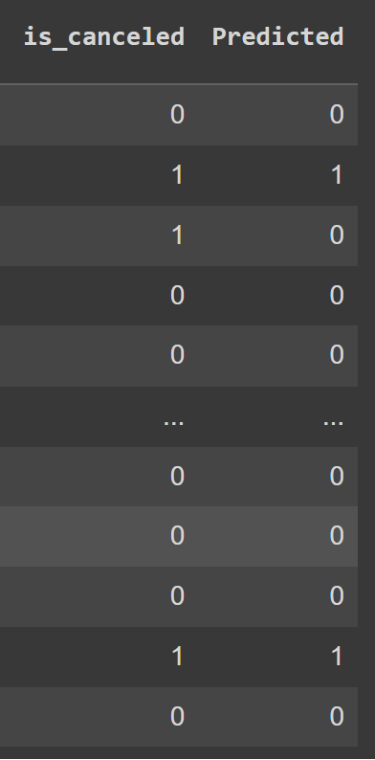
This code showed the predicted values and collected values together. As we can see predictions are mostly correct. So we could use this model to predict where a hotel booking gets cancelled or not potentially saving lot of maintenance costs for the hotel owners.

