Slide 1
SIVA JEGADEESH C B
NMID :58E655611A0C976BD6A4BA66436074F2
Course : Generative AI for Engineering (E2324)
Madras Institute of Technology Campus, Anna University
EquiPred – Advanced Equipment Disease Prediction for Industrial Maintenance

Slide 2
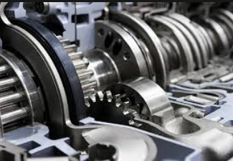
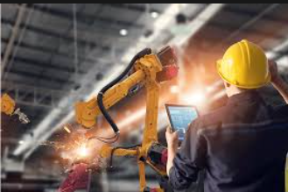
PROJECT TITLE
Equi-Pred
Advanced Equipment Failure Prediction for Industrial Maintenance

Slide 3


AGENDA
Problem Statement
Project Overview
Who are the End users?
Solution and value proposition
The wow in the solution
Modelling
Results

Slide 4

PROBLEM STATEMENT
An industrial facility wants to minimize downtime by predicting when equipment is likely to fail. The goal is to develop an AI-based predictive maintenance system that can analyze equipment data to forecast potential failures.

Slide 5

PROJECT OVERVIEW
Data Collection and Preprocessing: Initially, sensor data was collected from an IoT sensor dataset. This data underwent preprocessing techniques such as handling missing values, outlier detection, and normalization using Standard Scaler. Correlation analysis was employed to identify important features.
Model Training and Evaluation: Multiple machine learning models, including Decision Tree, Random Forest, Logistic Regression, K-Nearest Neighbors (KNN), Gradient Boosting, and Stacking, were trained on the preprocessed dataset. Performance metrics like Accuracy, Precision, Recall, and F1-Score were compared across all models to determine the best-performing one.
Model Selection: KNN emerged as the optimal predictive maintenance model due to its superior performance across all evaluation metrics.

Slide 6
PROJECT OVERVIEW - CONT
Building the KNN Model: A KNN model was constructed using the chosen features and trained on the entire dataset to predict equipment failure.
Integration with Flask: The trained KNN model was saved using pickle and then integrated into a Flask application. This integration facilitated real-time monitoring using test data.
Frontend Development: A user-friendly form was developed using HTML and CSS to gather test data from users. Flask functionality was implemented to receive this test data, forward it to the KNN model for prediction, and display the results.

Slide 7
PROJECT OVERVIEW - CONT
Alert System Implementation: An alert system was incorporated into the Flask application to indicate equipment failure probability based on model calculations. This allowed for timely maintenance actions to be taken.
Dashboard Creation: A dashboard was developed using a visualization library like Plotly or Dash. It provided an overview of equipment failure probabilities through a pie chart and listed equipment requiring immediate maintenance in a table, along with their health status.

Slide 8

WHO ARE THE END USERS?
Maintenance Personnel : Those responsible for maintaining the equipment monitored by the system would use it to identify potential failures and plan maintenance activities proactively.
Operations Managers : Managers overseeing the day-to-day operations of the equipment would use the system to monitor equipment health and make decisions about scheduling maintenance and allocating resources.
Data Analysts : Analysts tasked with analyzing equipment performance data could use the system to gain insights into trends, patterns, and potential areas for improvement.

Slide 9
WHO ARE THE END USERS?
Quality Assurance Teams : Teams focused on ensuring product quality and reliability could use the system to monitor equipment performance and identify any issues that may affect product quality. System Administrators : Administrators responsible for maintaining and managing the system itself would use it to monitor system health, troubleshoot any issues, and ensure smooth operation.
Executive Stakeholders : Senior executives and decision-makers within the organization may use the system to gain high-level insights into equipment health and performance, helping them make strategic decisions about resource allocation and investment in maintenance and upgrades.

Slide 10
YOUR SOLUTION AND ITS VALUE PROPOSITION
The solution offers a comprehensive predictive maintenance system integrating advanced machine learning models with real-time monitoring capabilities. By harnessing IoT sensor data and applying sophisticated preprocessing techniques, our system accurately predicts equipment failures before they occur.
Its user-friendly interface, powered by Flask and enhanced with alert systems and interactive dashboards, empowers maintenance personnel and operations managers to proactively address potential issues, optimizing equipment uptime and minimizing downtime costs.
With the ability to identify critical maintenance needs and provide actionable insights, the solution delivers tangible value by maximizing operational efficiency, ensuring product quality, and ultimately reducing maintenance expenses.

Slide 11

THE WOW IN MY SOLUTION
1. Proactive Predictive Maintenance: The solution empowers organizations to move from reactive to proactive maintenance strategies by accurately predicting equipment failures before they happen, saving time and resources while maximizing uptime.
2. Real-Time Monitoring and Alerts: With real-time monitoring capabilities and integrated alert systems, the solution ensures timely intervention, allowing users to address potential issues swiftly and prevent costly downtime.
3. Actionable Insights and Decision Support: By providing actionable insights through interactive dashboards and comprehensive analytics, the solution enables informed decision-making, optimizing resource allocation and driving operational excellence.
11

Slide 12
MODELLING
Data Preparation : This includes collecting sensor data from IoT devices and preparing it for analysis. Data cleaning techniques such as handling missing values, outlier detection, and normalization are applied to ensure data quality.
Feature Selection and Engineering : Relevant features are identified through techniques like correlation analysis and domain knowledge. Additionally, new features may be created to enhance the predictive power of the model.
Model Selection : Multiple machine learning models such as Decision Tree, Random Forest, Logistic Regression, K-Nearest Neighbors (KNN), Gradient Boosting, and Stacking are trained on the preprocessed data. Evaluation metrics like Accuracy, Precision, Recall, and F1-Score are used to compare the performance of these models and select the best-performing one.
Hyperparameter Tuning : The selected model's hyperparameters are tuned using techniques like grid search or random search to optimize its performance further.
12

Slide 13
MODELLING
5. Training the Model : The chosen model is trained on the entire dataset using the optimized hyperparameters to make predictions about equipment failure probabilities.
6. Integration with Flask : The trained model is saved using pickle and integrated into a Flask application to enable real-time monitoring. Flask functionality is implemented to receive test data, forward it to the model for prediction, and display the results.
7. Testing and Validation : The entire system undergoes rigorous testing with various test cases to ensure its functionality, reliability, and accuracy.
8. Deployment and Monitoring : Once the model is trained and tested, it is deployed into production, where it continuously monitors equipment health and provides alerts for potential failures. Monitoring mechanisms are put in place to ensure the model's performance remains optimal over time.
13

Slide 14
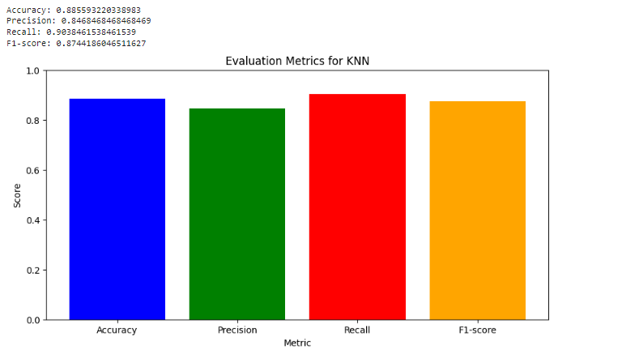
RESULTS
14

Slide 15
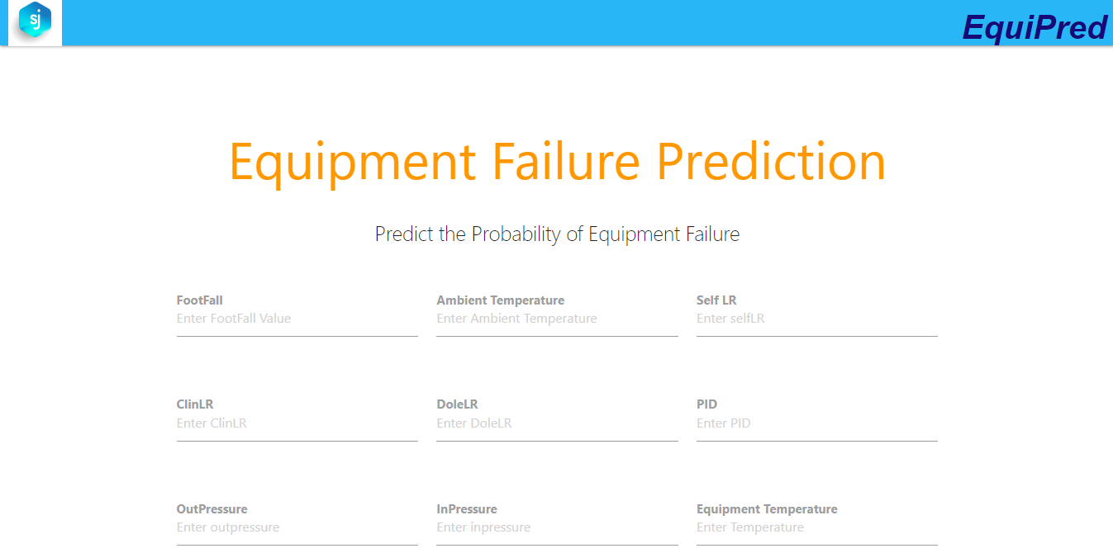
RESULTS
15

Slide 16
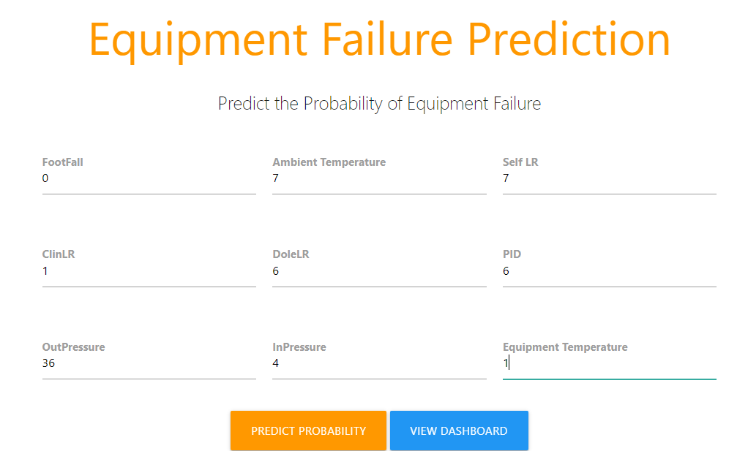
RESULTS
16

Slide 17
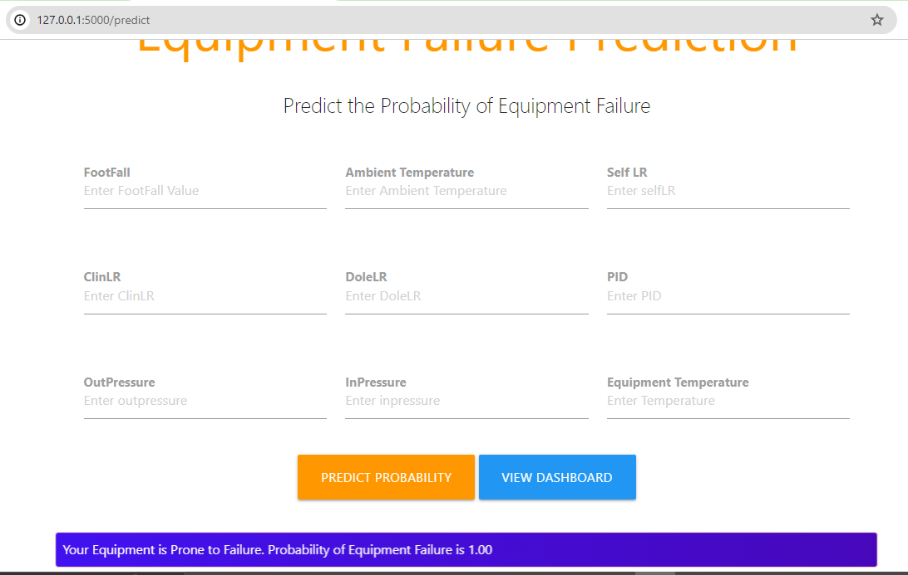
RESULTS
17

Slide 18
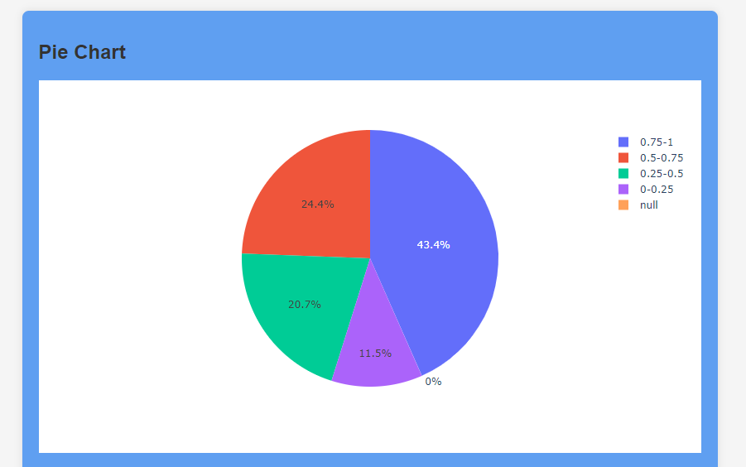
RESULTS
18

Slide 19
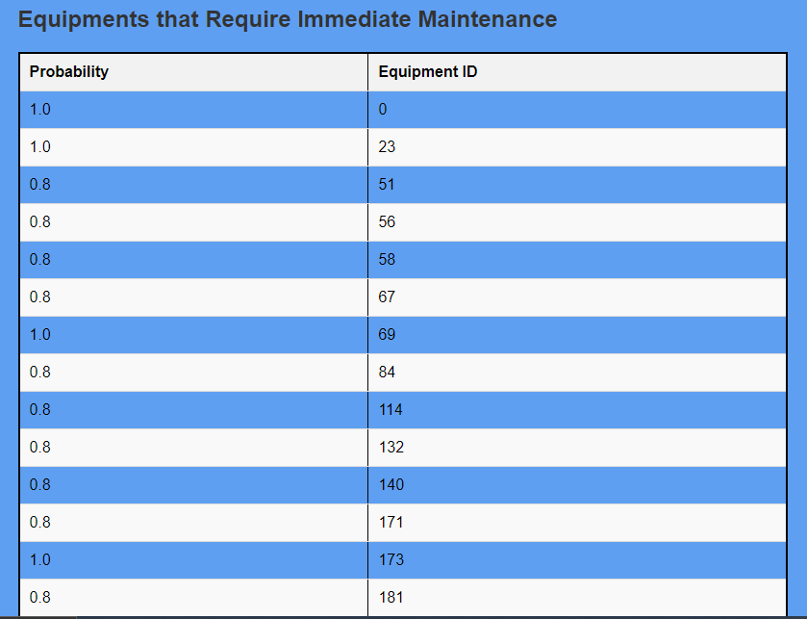
RESULTS
19

Slide 20
THANK YOU
20

