Slide 1
SOLR INDEX

Slide 2
TYPES
DELTA SOLR Index
It will index small changes only in DB.
FULL SOLR Index
It will index all the data’s in DB.
OPERATIONS:
Preprocessor
nohup sh di-preprocess.sh /opt/apps/IBM/WebSphere/CommerceServer80/instances/ETRSTAGE/search/pre-processConfig/MC_10001/Oracle -dbuser WCS_EDIT_APP -dbuserpwd ******* -instance ETRSTAGE -localename en_US -fullbuild true &
Build index
nohup sh di-buildindex.sh -masterCatalogId 10001 -dbuser WCS_EDIT_APP -dbuserpwd ***** -instance ETRSTAGE -localename en_US -fullbuild true -solrConnTimeout 500 &

Slide 3
wc-dataimport-preprocess-fullbuild.xml
wc-dataimport-preprocess-deltaupdate.xml
Preprocessing
wc-data-config.xml ---→ defines the JDBC configuration and SQL statements
http://host:port/solr/MasterCatalog_CatalogEntry_en_US/dataimport?command=full-import (Data Import Handler)
Preprocess
Process the data into
temporary tables
Build Index
DIH
updates the information in the Master Index

Slide 4
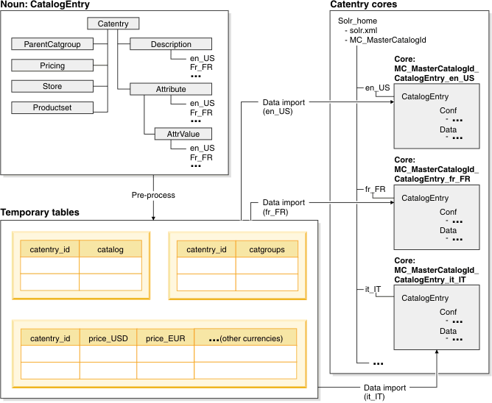
Preprocessing and index-building
The following diagram illustrates the relationship between preprocessing and index building in

Slide 5
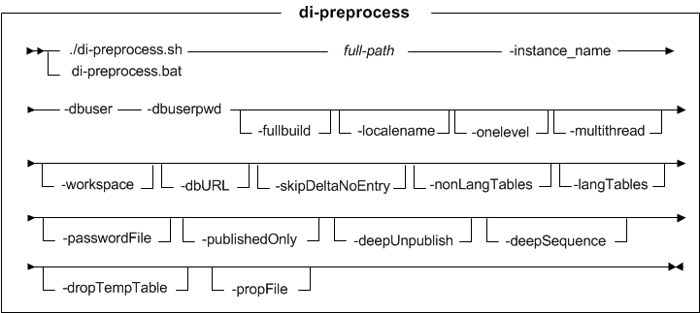
PREPROCESSOR Query format :

Slide 6
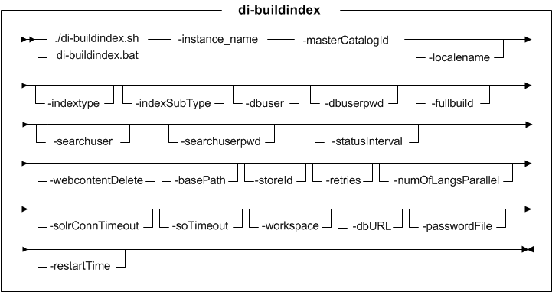
BUILD INDEX Query format :

Slide 7
EXIT CODE :
EXIT CODE : 3
Reason : preprocessor completed with error. Need to follow below steps After completeing job. Run the below query in stage DB. If record is found. Truncate the table. And rerun the solr index full job. Select * from TI_delta_catentry Select * from TI_delta_catgroup Delete * from TI_delta_catentry; Delete * from TI_delta_catgroup; Commit; Note - After executed the query don't forget to give the COMMIT.

Slide 8
Solr
index full completed with exit code : 1
Reason: Please check in log there is any IO Exception need to restart stage solr server and again need to re run build index manually. Please find the below command for run build index manually. Example error (SEVERE: error: IOException occured when talking to server at: http://g1t7198.austin.hpicorp.net:9084/solr org.apache.solr.client.solrj.SolrServerException: IOException occured when talking to server at: http://g1t7198.austin.hpicorp.net:9084/solr)
./di-buildindex.sh -masterCatalogId 10001 -dbuser WCS_EDIT_APP -dbuserpwd **** -instance ETRSTAGE -fullbuild true -localename en_US & Need to run above command in /opt/apps/IBM/WebSphere/CommerceServer80/bin locatin (4723 server)

Slide 9
Solar Index, Build Index: 1
Issue(Connection Time Out Exception) ran the below command manually Path: /opt/apps/IBM/WebSphere/CommerceServer80/bin/ Command: nohup sh di-buildindex.sh -masterCatalogId 10001 -dbuser WCS_EDIT_APP -dbuserpwd **** -instance ETRSTAGE -localename en_US -fullbuild false -solrConnTimeout 500 &

Slide 10
Solr Count Check:
Live : http://g1t7195.austin.hpicorp.net:9083/solr/admin/cores
http://g2t5181.austin.hpicorp.net:9083/solr/admin/cores
Stage : http://g1t7198.austin.hpicorp.net:9084/solr/admin/cores
http://g2t5178.austin.hpicorp.net:9084/solr/admin/cores

Slide 11
EG :
Structured
http://g1t7198.austin.hpicorp.net:9084/solr/MC_10001_CatalogEntry_en_US/select?q=catentry_id:694470
Unstructured
http://g1t7198.austin.hpicorp.net:9084/solr/MC_10001_CatalogEntry_Unstructured_en_US/select?q=catentry_id:694470

Slide 12
THANK YOU

