Slide 1
Semantic Analysis
By Ben Stewart S
Siva Kailash S

Slide 2
Steps Involved
Collecting dataset
Preprocessing the data
Feature extraction
Adding labels
Naive Bayesian Classification
Training and testing the model
Text categorization

Slide 3
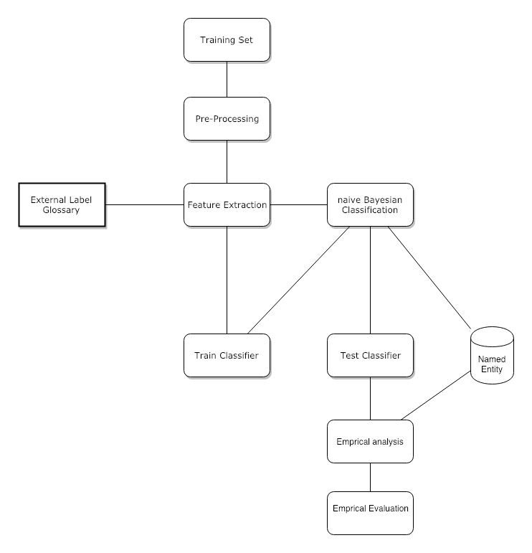
Block Diagram

Slide 4
Pre Processing
This involves collecting data from the dataset, loading the data, removing duplicate tuples, white spaces and plotting the length of each post (blog post).
df.drop_duplicates(subset="text",inplace=True)

Slide 5
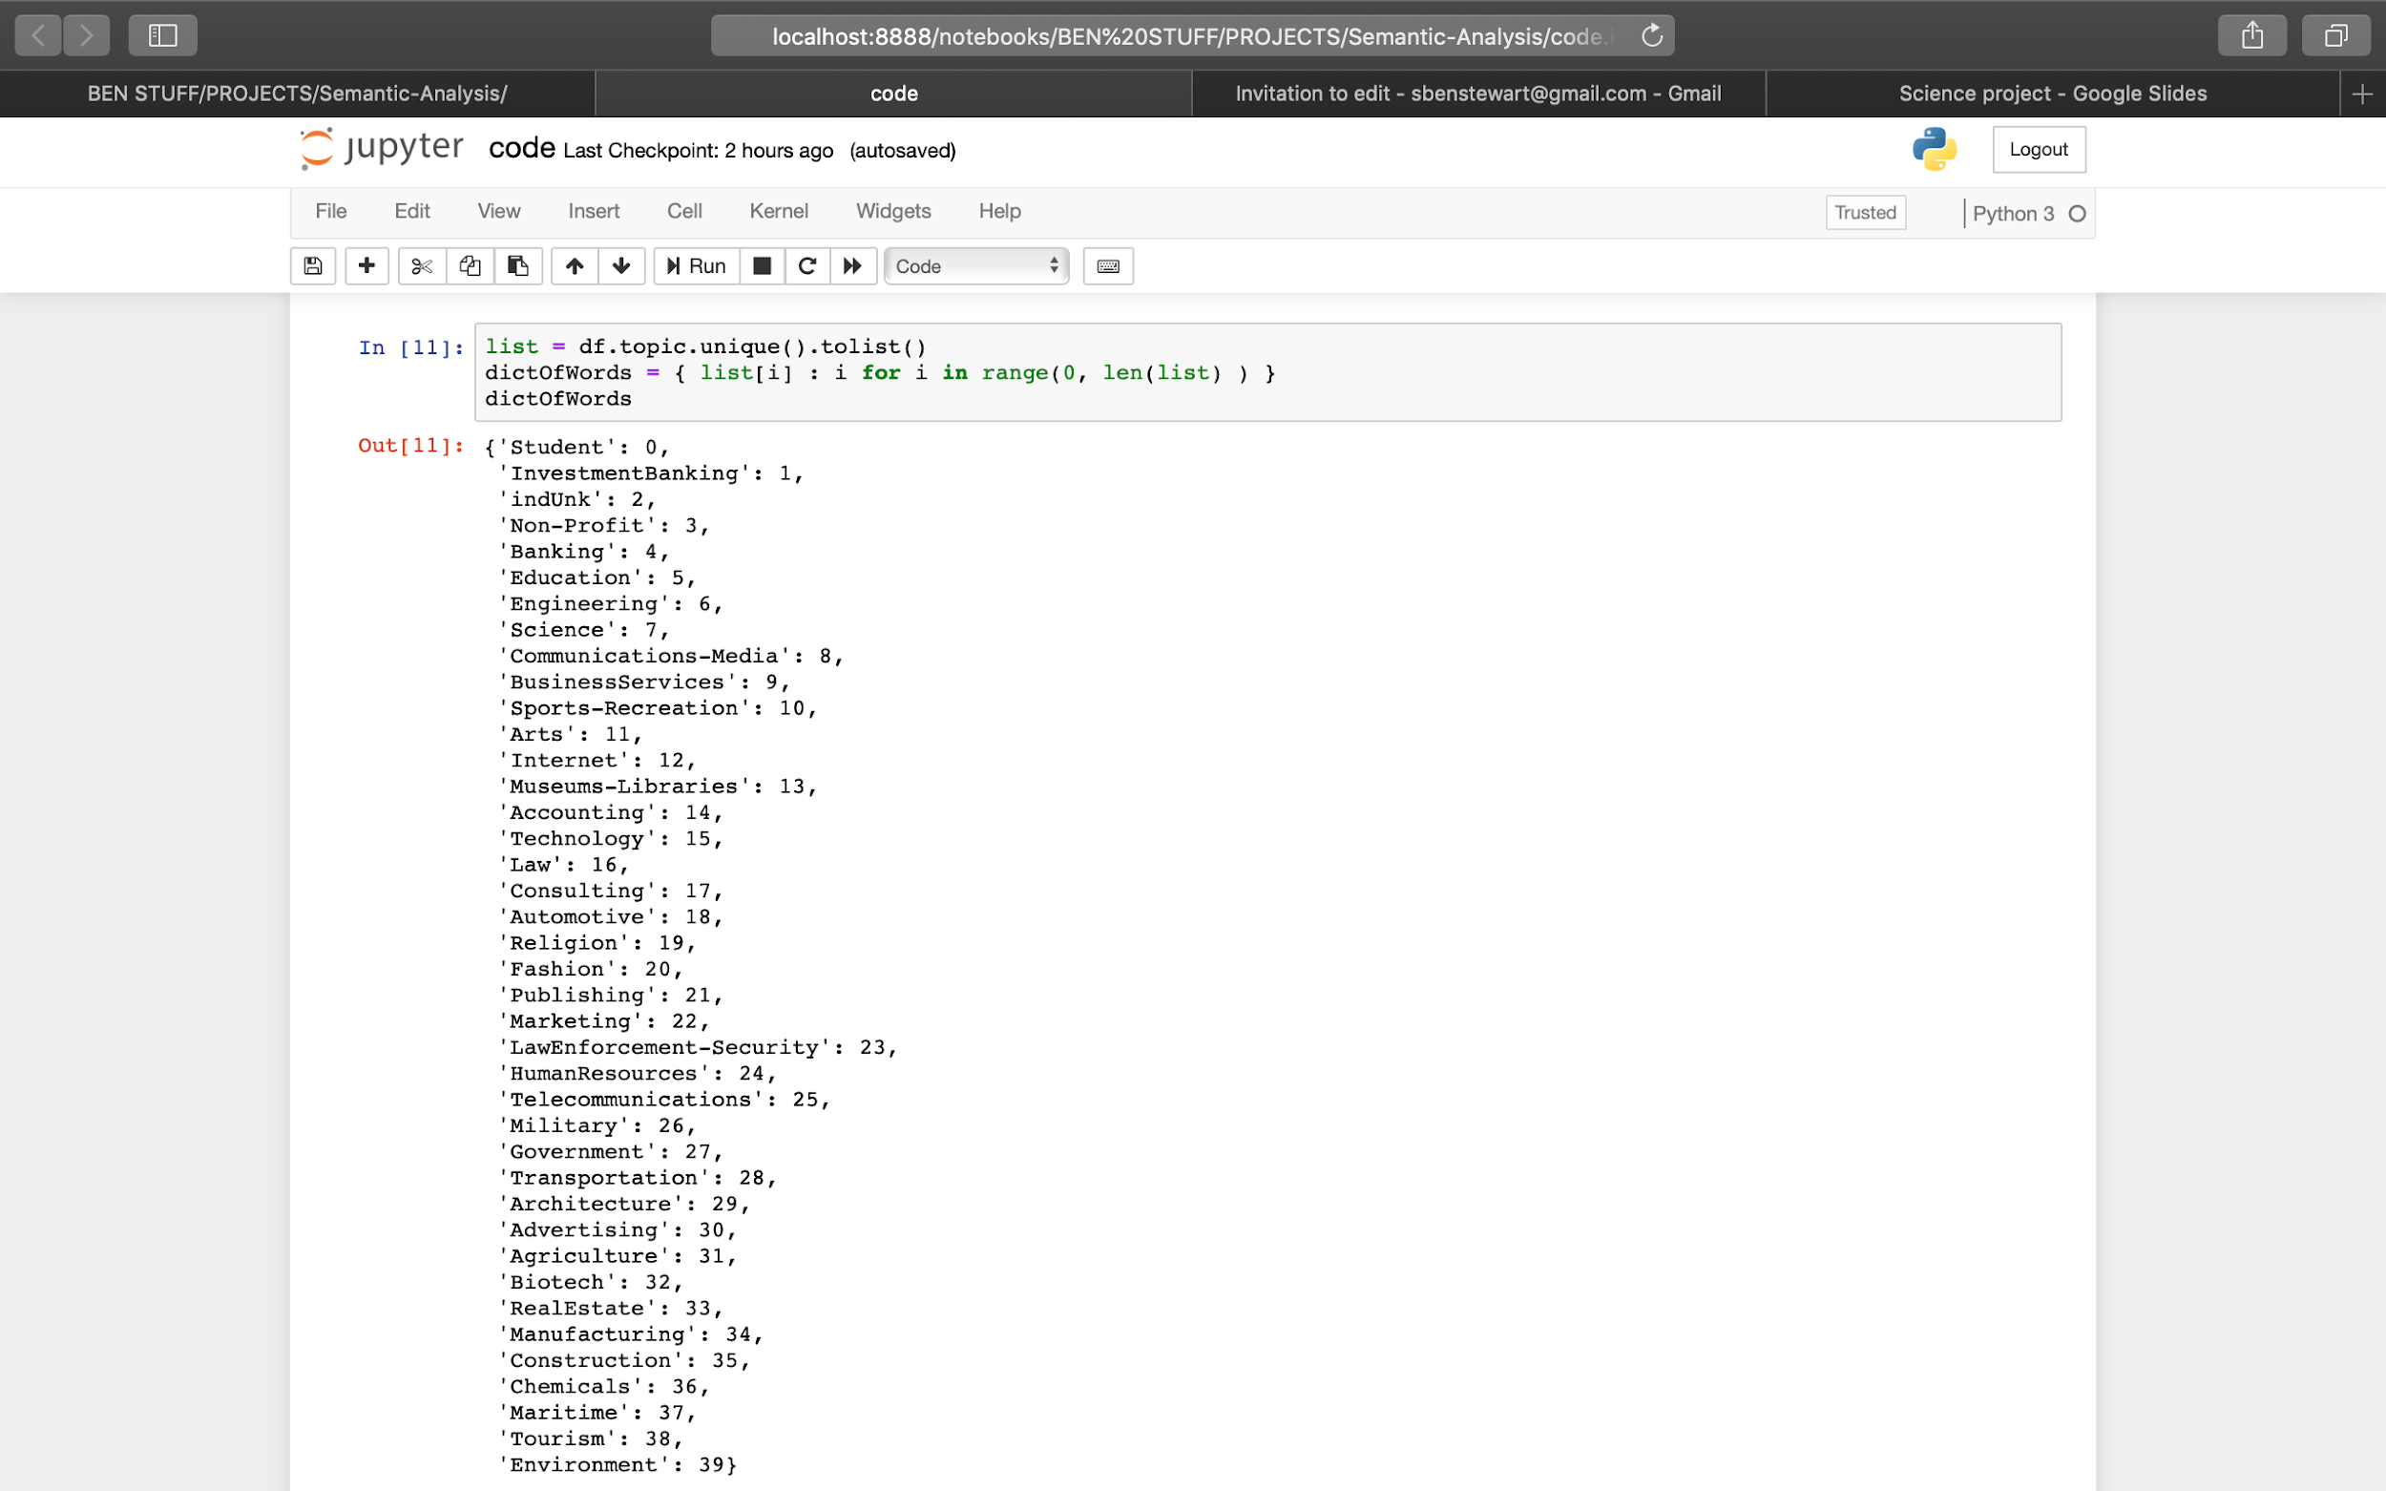
The Labels

Slide 6
Load and Train Model
from sklearn import linear_model, naive_bayes, metrics, svm
from sklearn.model_selection import train_test_split
X_train, X_test, y_train, y_test = train_test_split(counts, df['topic'], test_size=0.33, random_state=0)
from sklearn.naive_bayes import MultinomialNB
model = MultinomialNB().fit(X_train, y_train)

Slide 7
Testing
Once the model is ready we need to test the model on untrained data so that we could get the efficiency of the model. On training the data we got a accuracy of 35 %, which is 12x greater than random prediction.
predicted = model.predict(X_test)

Slide 8
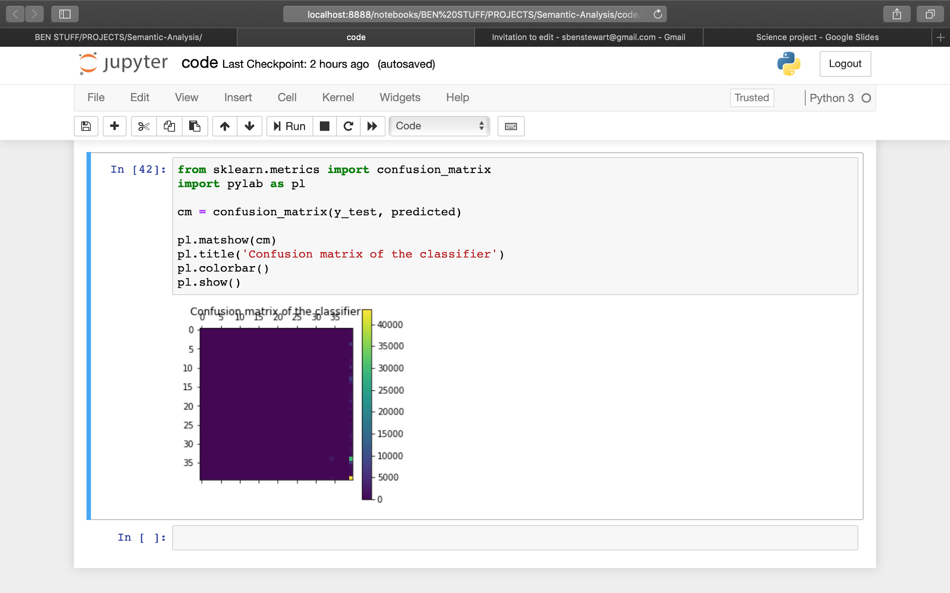
The OUTPUT

Slide 9
Conclusion
Now we have a model that produces 35% which is a bit low (considering the huge size of the dataset). However this can be reduced by reducing the no of dimensions of the dataset or by converting the linear dimensions to multi dimensional non-linear dimensions (i.e. instead of going to a label of 1*40 we can go to a label consisting of dimensions like x*y (where x * y = 40)). This may increase the complexity of the model but also increases the accuracy of it as well.

