Slide 1
Semantic Analysis
By Ben Stewart S
Siva Kailash S

Slide 2
Steps Involved
Preprocessing the data
Feature extraction
Adding labels
Naive Bayesian Classification
Training and testing the model
Adding NE and re-train
Comparison
Text categorization

Slide 3
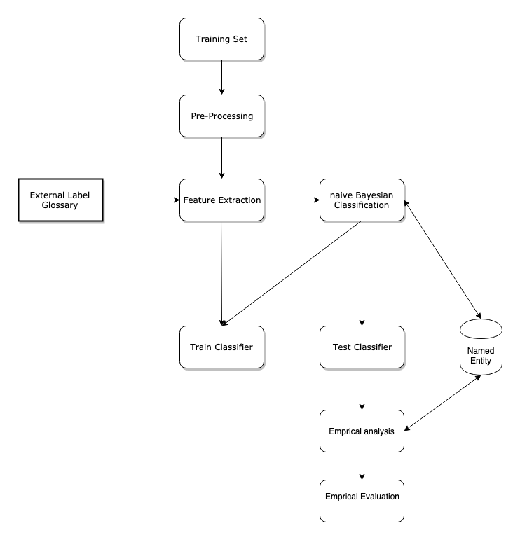
Block Diagram

Slide 4
Pre-processing
This involves collecting data from the dataset, loading the data, removing duplicate tuples, white spaces and plotting the length of each post (blog post).
df.drop_duplicates(subset="text",inplace=True)

Slide 5
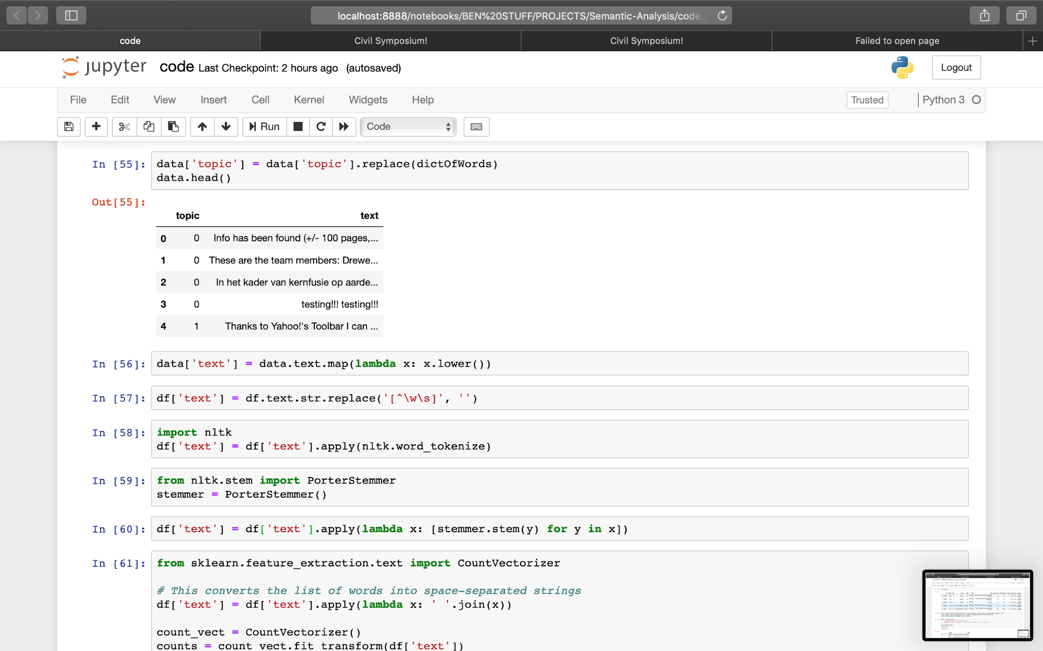
Pre-processing

Slide 6
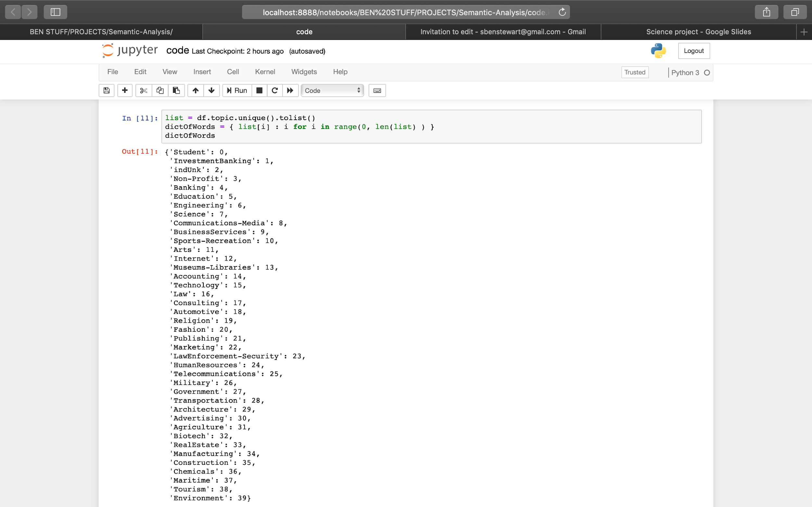
The Labels

Slide 7
Load and Train Model
from sklearn import linear_model, naive_bayes, metrics, svm
from sklearn.model_selection import train_test_split
X_train, X_test, y_train, y_test = train_test_split(counts, df['topic'], test_size=0.33, random_state=0)
from sklearn.naive_bayes import MultinomialNB
model = MultinomialNB().fit(X_train, y_train)

Slide 8
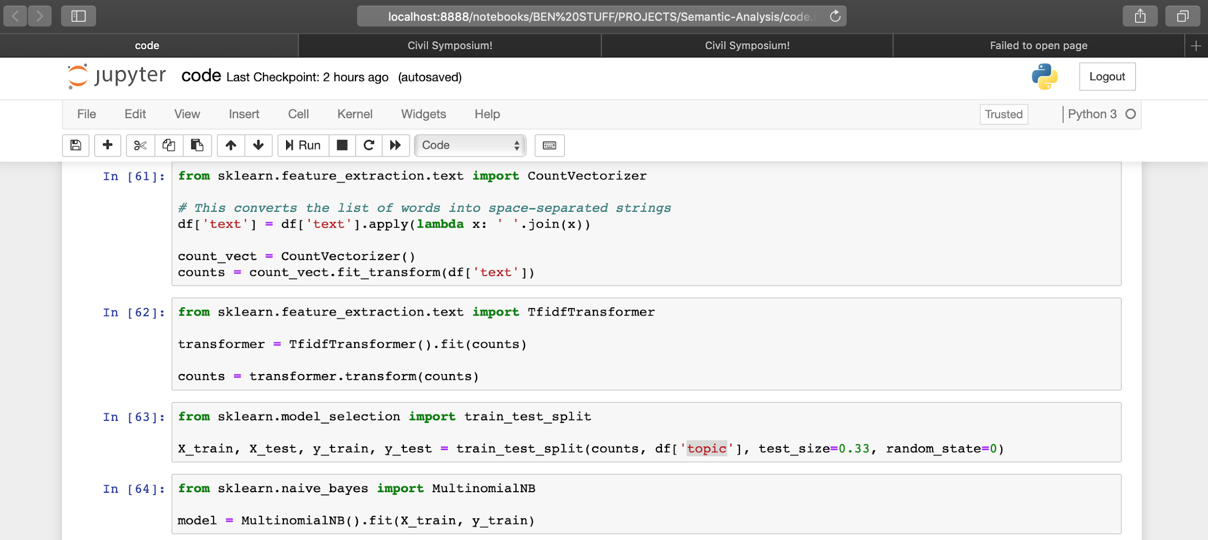
Load and Train

Slide 9
Testing
Once the model is ready we need to test the model on untrained data so that we could get the efficiency of the model. On training the data we got a accuracy of 35 %, which is 12x greater than random prediction.
predicted = model.predict(X_test)

Slide 10
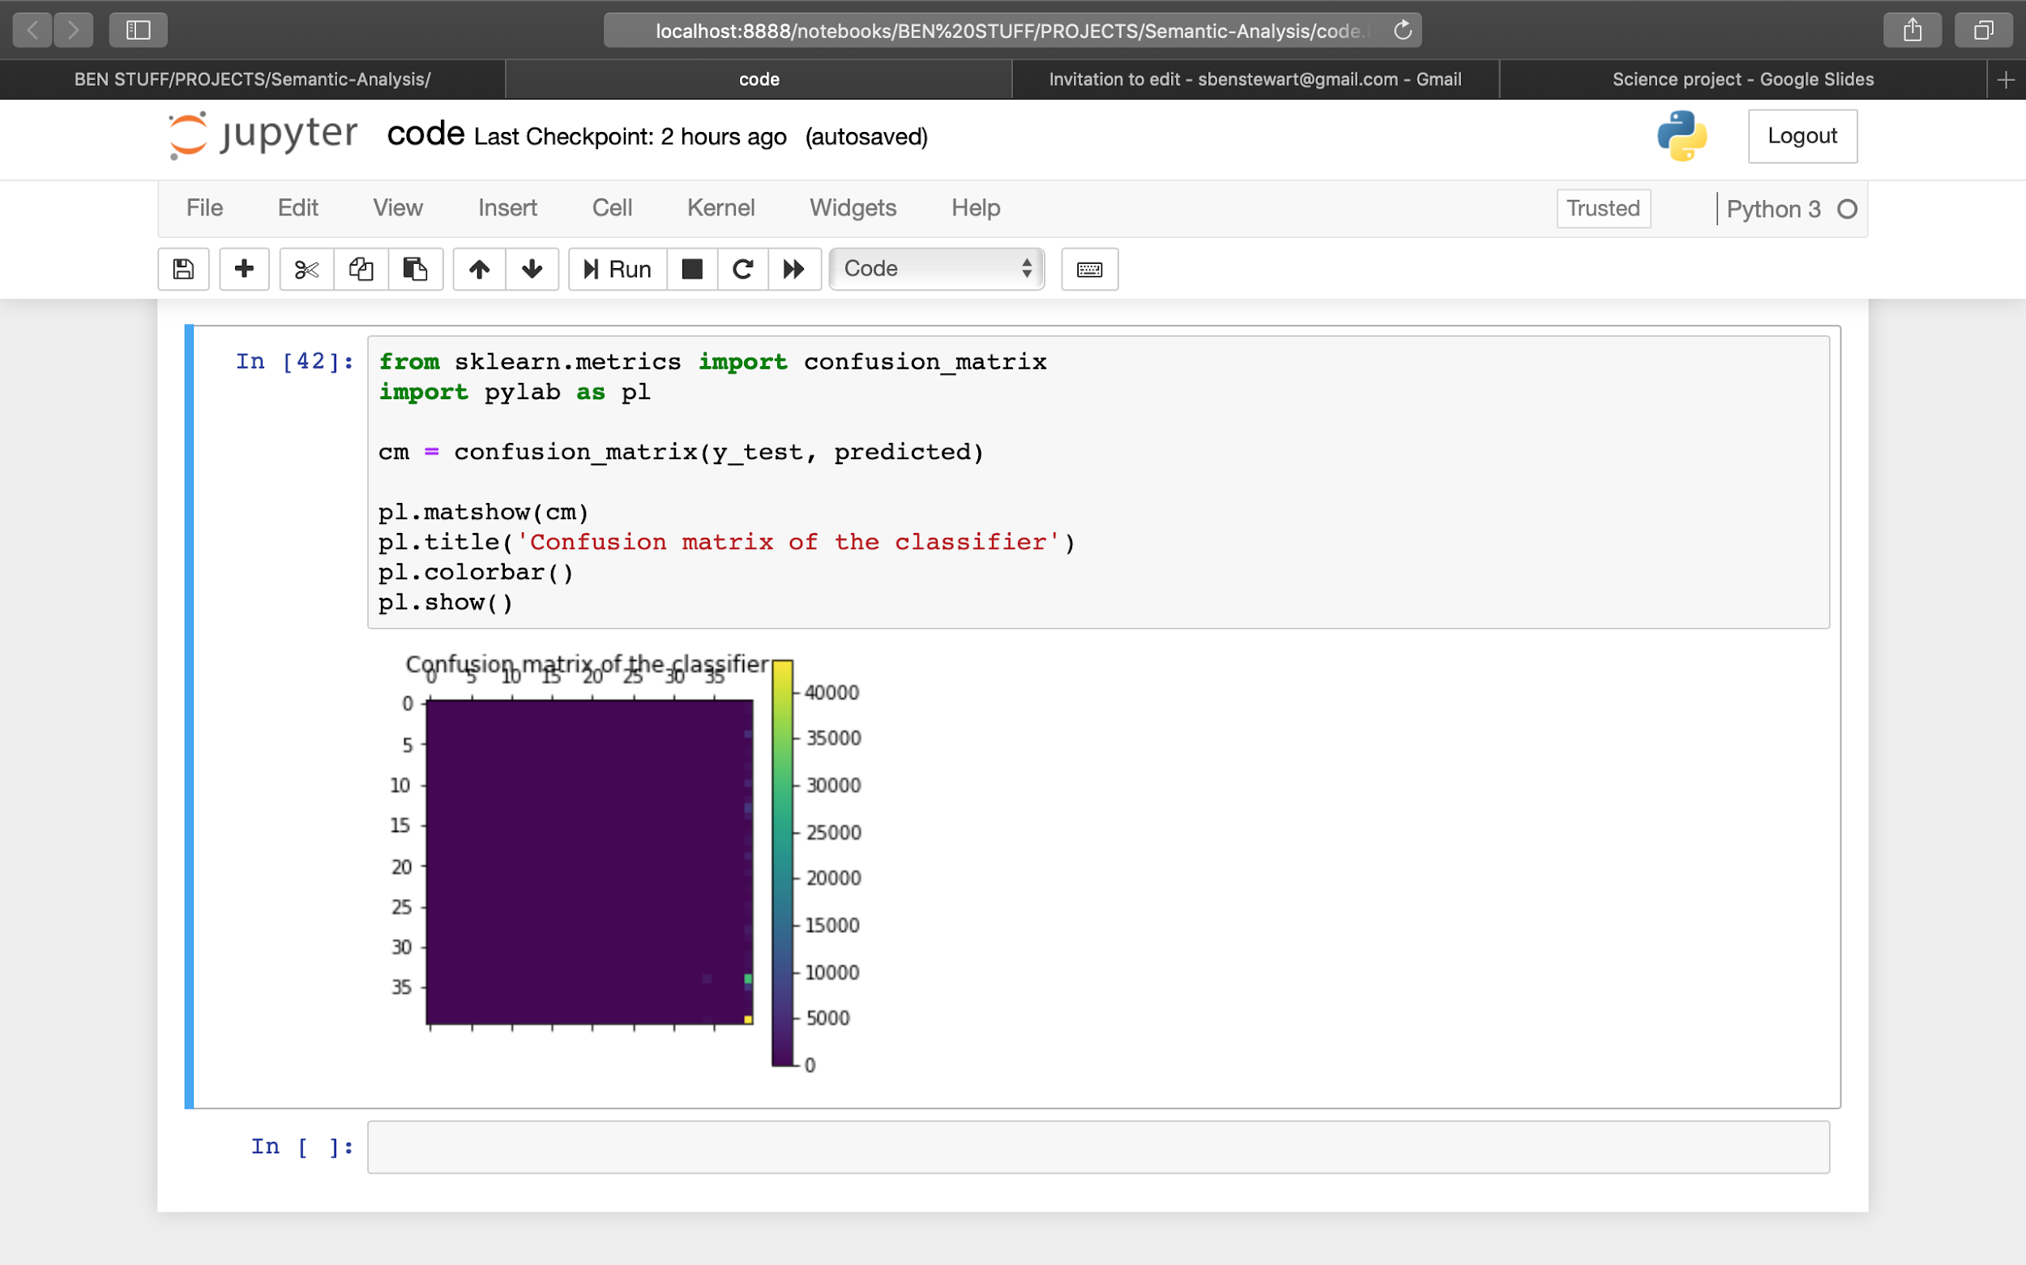
Initial Confusion Matrix

Slide 11
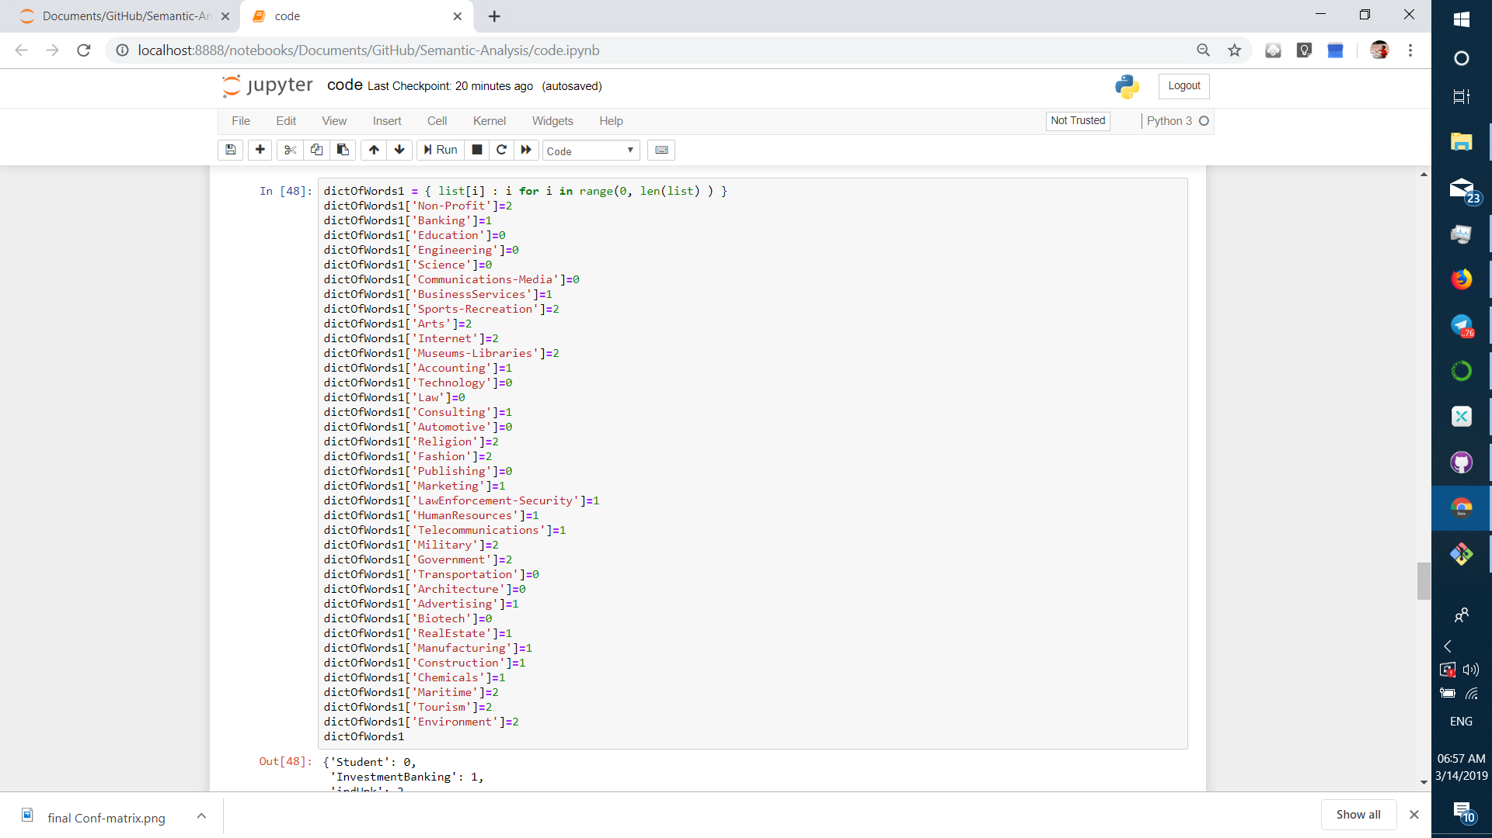
NE Generation

Slide 12
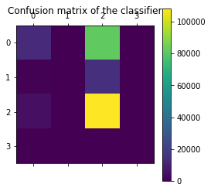
Final Confusion Matrix

Slide 13
Comparison and Conclusion
The dimensions are reduced and the model got about 54% accuracy (considering the size of the data as well as the native slang of the users ). The model is verified for classifying custom text.
Some of the applications of the system are
Content management of blogs.
Analyse the users and the blogs.
Targeted advertisements based on the content.

