Slide 1

Embedded Systems
Under Guidance of:
M. Uma Maheswar Rao Sir
Team Members:
A.SIVA KARTHIK
A.MOHANA MADHUMITHA
B.DIVYA
SK.KARISHMA NAZMOON
22NE1A0405
22NE1A0403
22NE1A0418
22NE1A0433

Slide 2
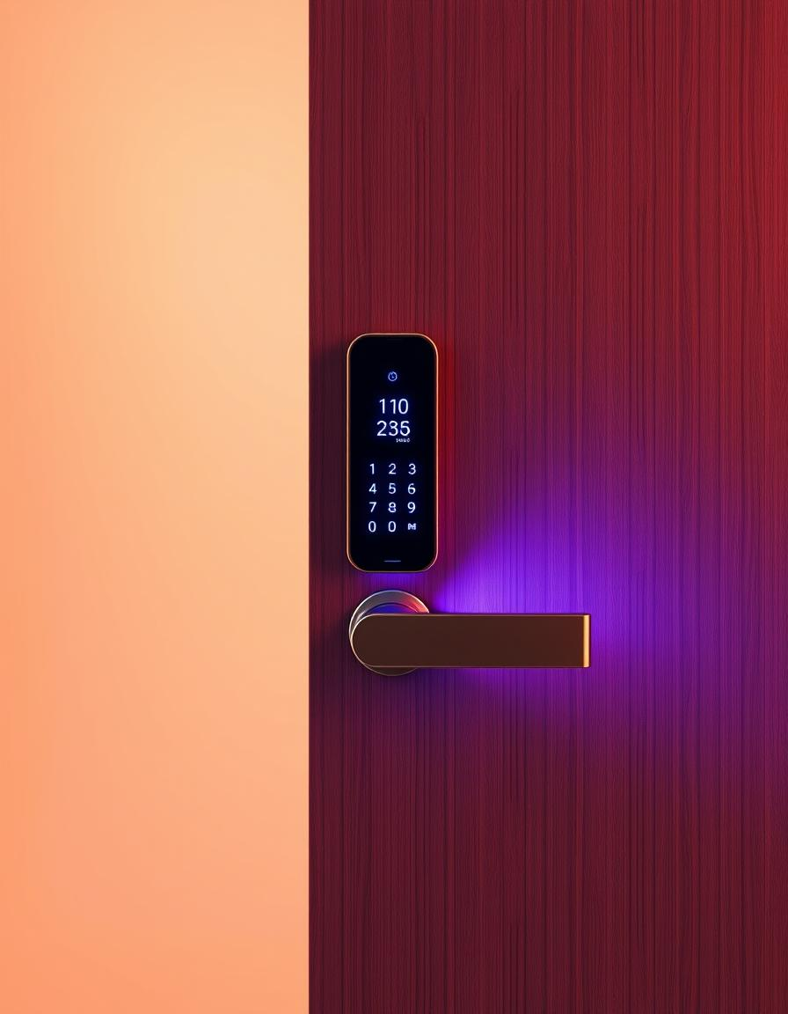
Secure Door Lock System
This presentation details the development of a secure, low-cost, password-protected smart door lock system utilizing Arduino.
We will explore the system's design, components, working principles, and potential enhancements, highlighting its practical applications in various settings.
With intuitive design and reliable components, it blends affordability, efficiency, and enhanced security in one solution.

Slide 3
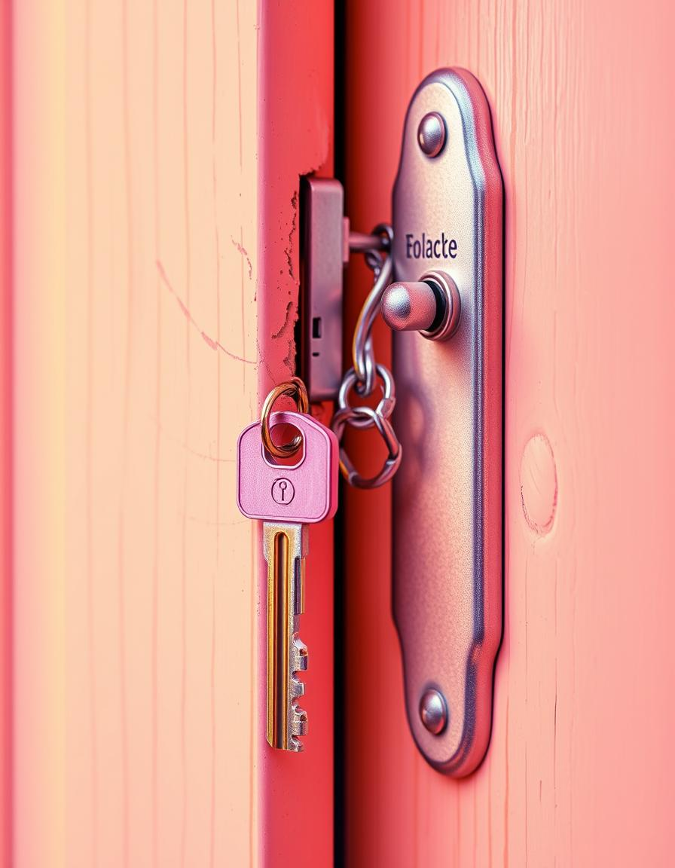
Problem Statement: Enhancing Security
Vulnerability of Traditional Locks
Conventional mechanical locks are susceptible to picking, bumping, and forced entry, posing significant security risks.
Loss or Theft of Keys
Physical keys can be easily lost, stolen, or duplicated, compromising access control and requiring costly lock replacements.
Lack of Access Control
Traditional locks offer limited control over who enters and when, making it difficult to manage access for multiple users or temporary visitors.

Slide 4








Requirements
Arduino Uno
Microcontroller board for processing logic.
4x4 Keypad
For entering the password.
16x2 LCD
For displaying user prompts and status.
Servo Motor
Actuator for locking/unlocking the door.
Buzzer
For audible alerts and feedback
Wires
For electrical connections.
Tinker CAD
For simulating and testing the circuit without physical hardware.
Resistor
to limit current and protect components.

Slide 5
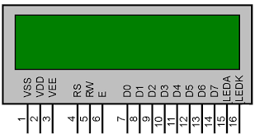

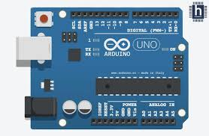
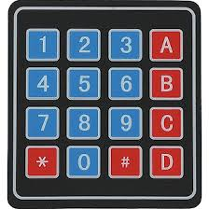
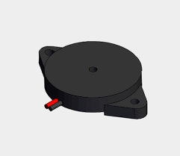
Hardware Components Explanation
Arduino Uno:
A microcontroller board that acts as the brain of the system.
It reads keypad inputs, processes logic, and controls output devices.
All decision-making and timing are handled by the Arduino.
4x4 Keypad:
A matrix-style input device used to enter a numeric password.
Each keypress is detected and sent to Arduino for verification.
Ensures secure and user-controlled access.
LCD (16x2):
A two-line display used for showing system messages.
Displays prompts like “Enter Password” and results like “Access Granted”.
Provides real-time feedback to the user.
Servo Motor (SG90):
A small motor that rotates to lock or unlock the door.
Controlled by Arduino when the correct password is entered.
Moves precisely between 0° and 90° positions.
Buzzer:
Produces audio feedback during system events.
Alerts user when a password is wrong or access is granted.
Enhances system interaction and security awareness.
Wires:
Used to connect all components in the circuit.
Enable communication and power flow between modules and Arduino.
Essential for completing electrical paths.

Slide 6
Flow Chart
Start → Display "Enter Password"
↓
User Enters Password
↓
Check if Password = Master Password
↓ ↓
Yes No
↓ ↓
Unlock Buzzer ON + "Alert"
↓ ↓
Countdown Retry
↓
Lock Again
↓
Back to Start

Slide 7
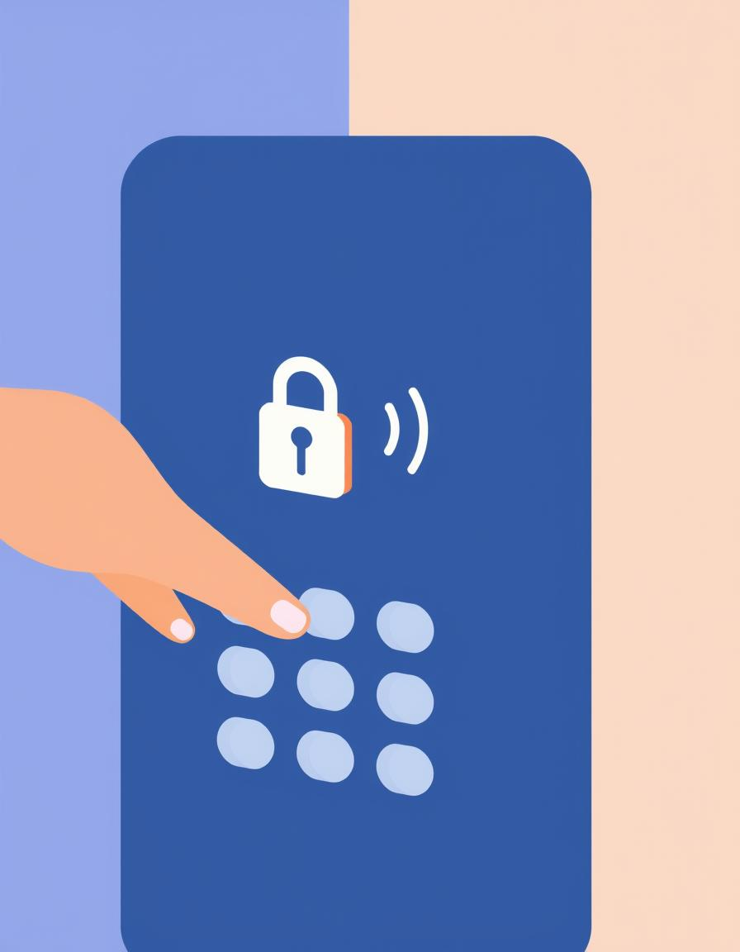



Working Principle
Keypad Input
User enters a password via the 4x4 keypad.
Password Verification
Arduino compares the entered password with the stored password.
Door Control
If correct, the servo motor unlocks the door; otherwise, it remains locked.
Audio Feedback
Buzzer provides distinct tones for successful access or incorrect password.

Slide 8
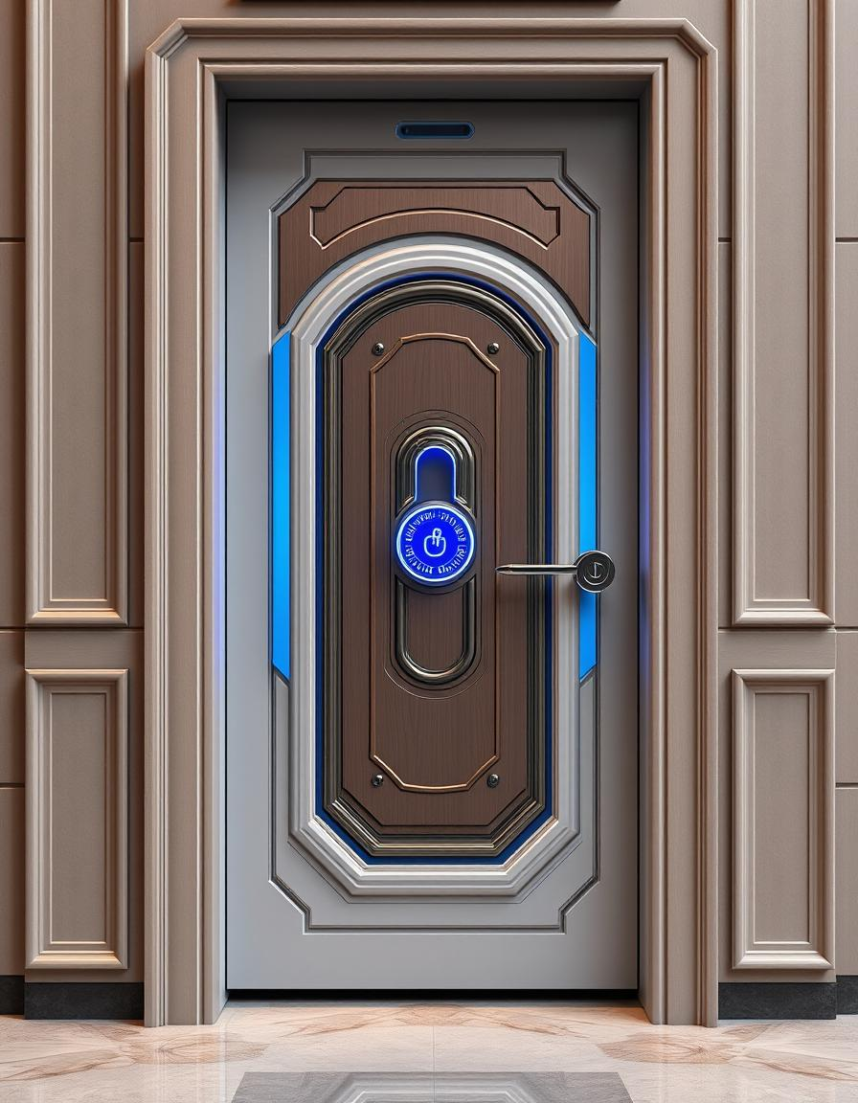
Software Flowchart
Start
Initialize system components.
Input Password
Read characters from keypad.
Verify Password
Compare input with stored password.
Correct?
Decision point: Yes/No.
Open Door / Error
Activate servo or display error and sound buzzer.

Slide 9
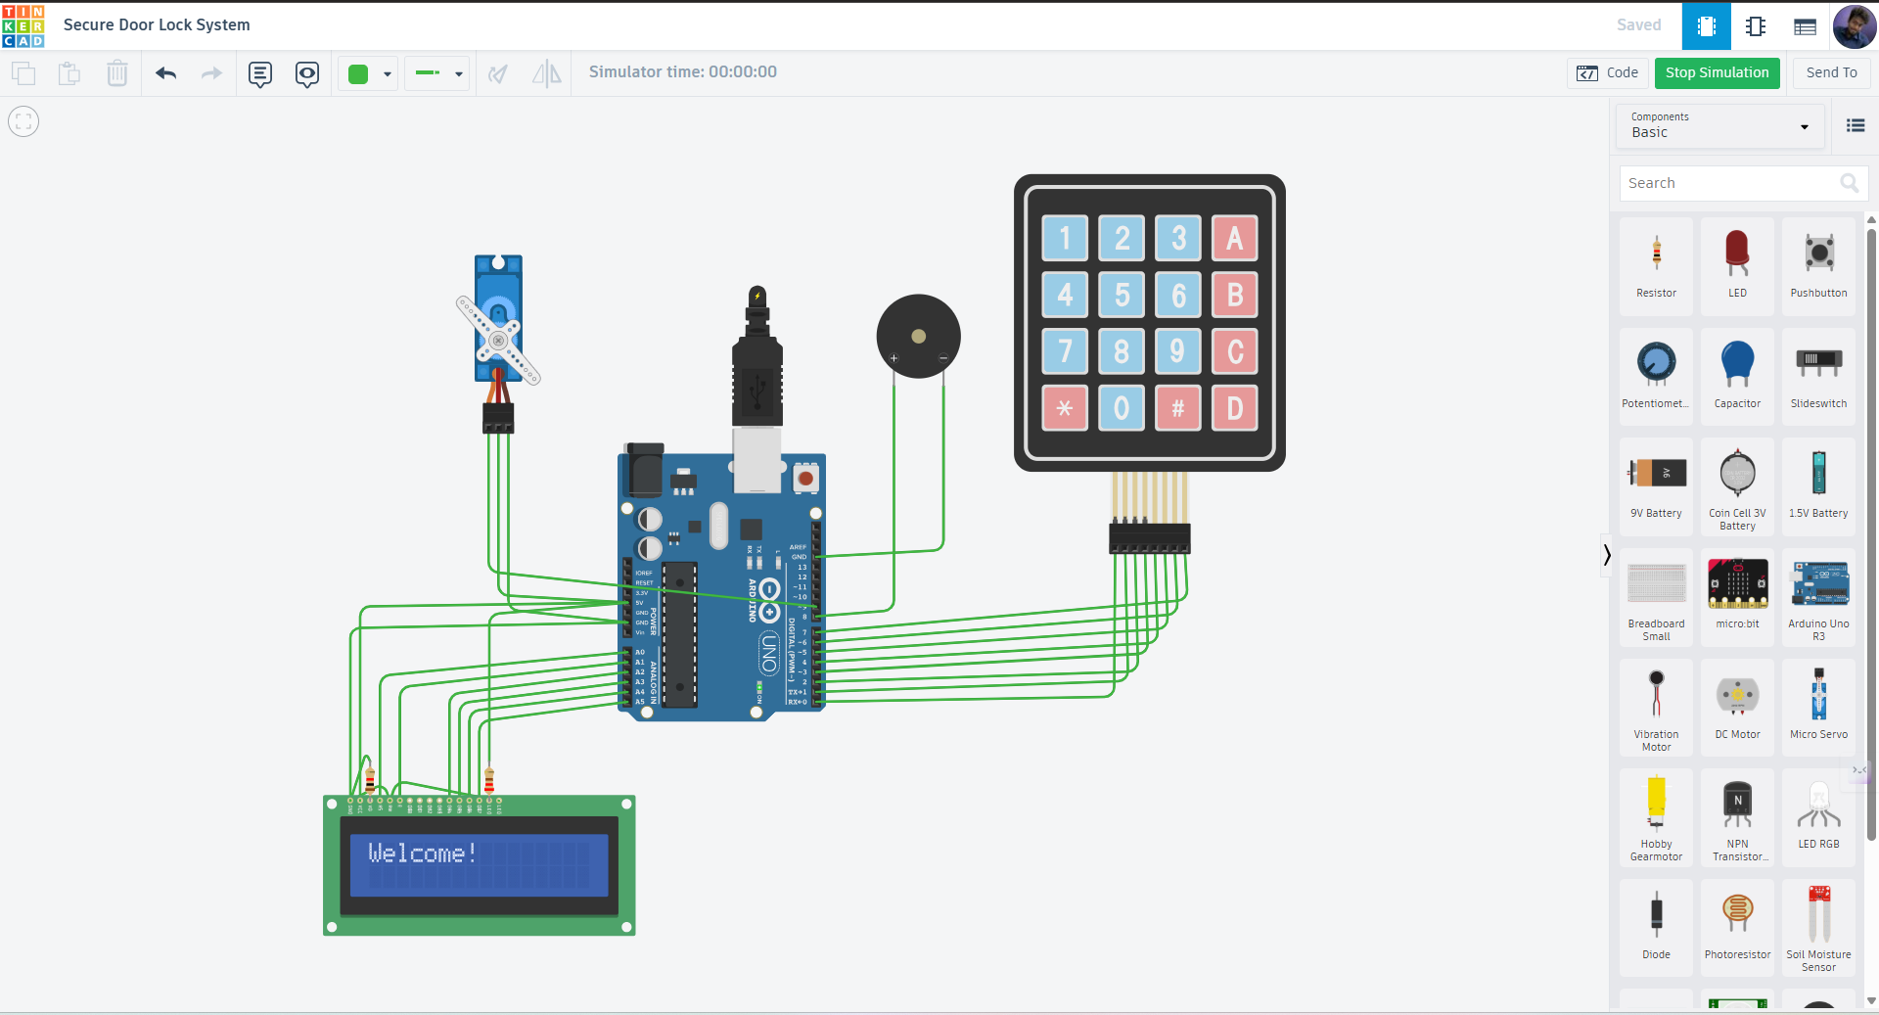

Slide 10
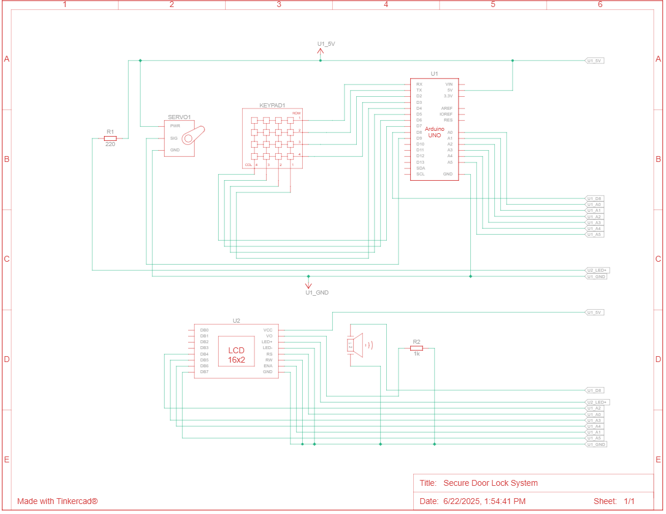
Schematic Diagram

Slide 11
Code Highlights
Password Check Logic
Servo Motor
Buzzer
if(password== correctPassword)
{ //GrantAccess
} else {
// Deny access
}
void ServoOpen() { myservo.write(90);
// Open
}
void ServoClose() { myservo.write(0); // Close }
tone(buzzerPin, 1000); // Success
delay(200); noTone(buzzerPin);
tone(buzzerPin, 500); //Fail
delay(500); noTone(buzzerPin);

Slide 12
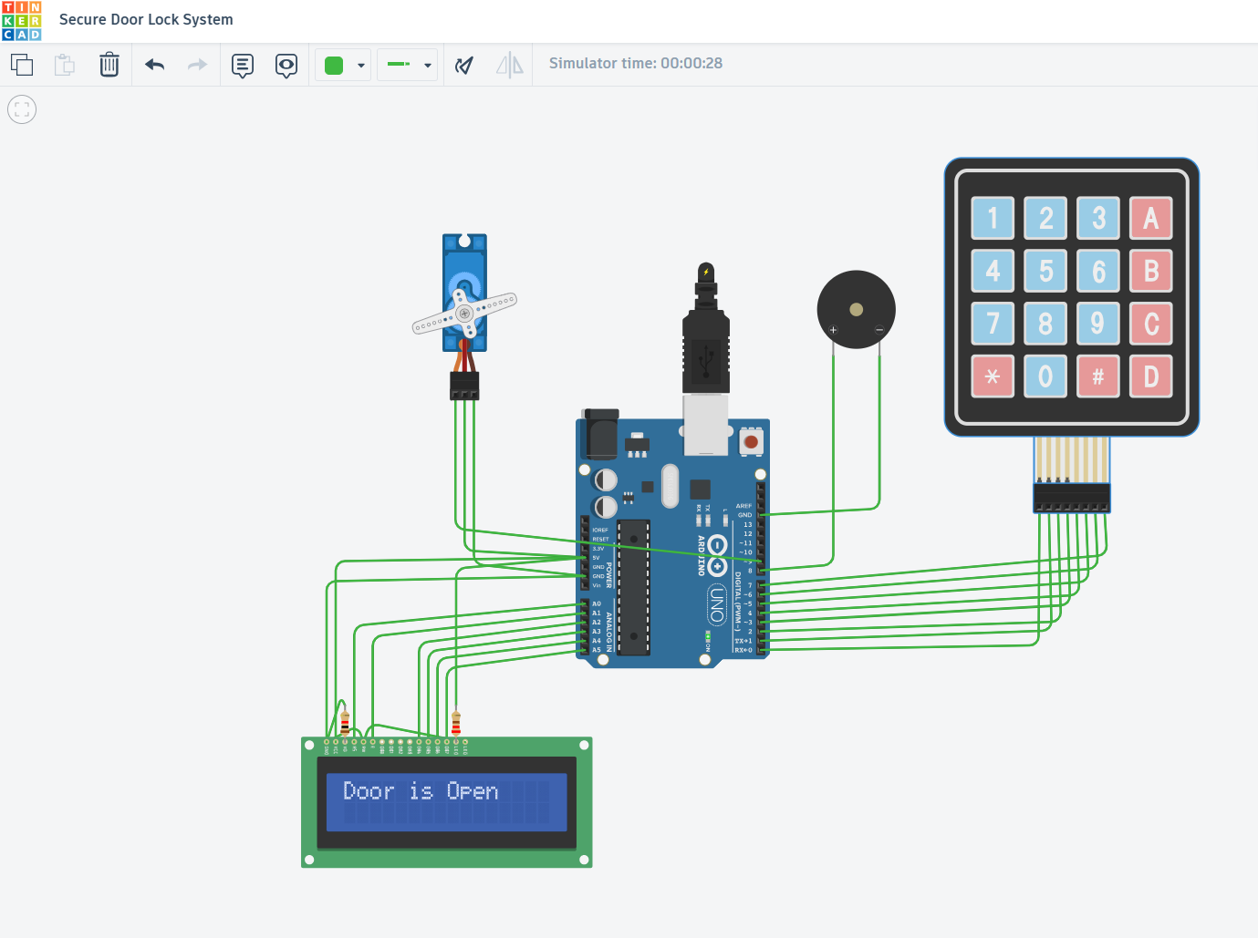
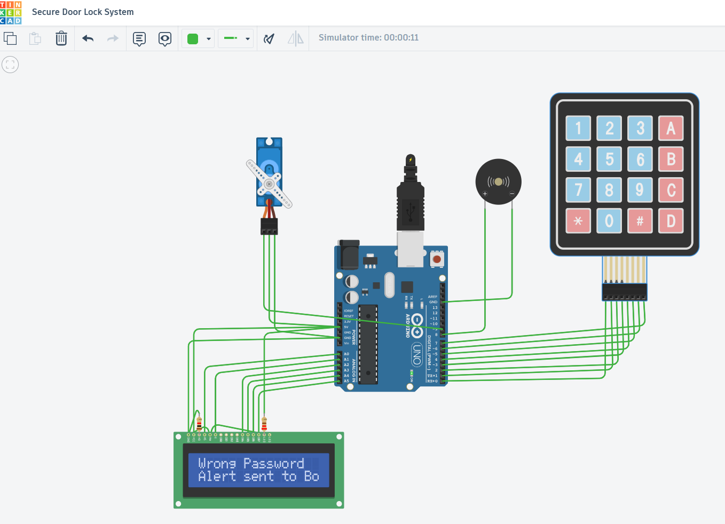
Outputs
Correct Password - Door is Opened
Incorrect Password - Alert Sent & Stay Closed

Slide 13
Advantages
Applications
Enhanced Security
User-Friendly Interface
Low-Cost Implementation
Scalable Design
Low-Power Consumption
Customizable Logic
Smart Homes
Educational Institutions
Server Rooms/Data Centres
Warehouses and Stores

Slide 14
Conclusion
The Secure Door Lock System was successfully developed using Arduino and basic electronic components.
It provides reliable, low-cost access control with password-based authentication.
The system is easy to use, energy-efficient, and scalable for future upgrades.
Both simulation and hardware testing confirmed its effectiveness.
Overall, it serves as a practical and educational solution for smart security.

Slide 15


