Slide 1

MOST POPULAR COMPONENTS IN SYNCFUSION
Presented by SIVA

Slide 2
COMPONENTS
Data Grid
Charts
List View
Scheduler
Diagram
PDF Viewer
Excel Library

Slide 3
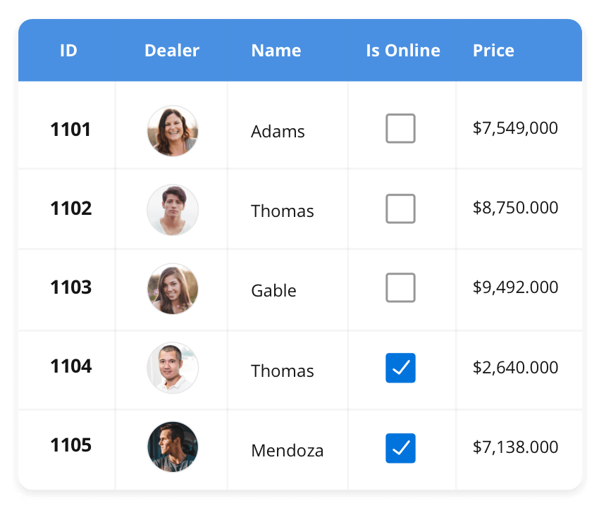



The DataGrid control is a high-performance grid component that helps display and manipulate large amounts of data in a tabular format. Its rich feature set includes functionalities like data binding, sorting, grouping, editing, filtering, swiping, dragging, resizing, loading more items, pull-to-refresh, and exporting to Excel and PDF file formats.
DATAGRID
SUPPORTED PLATFORMS
JavaScript
Angular
React
Vue
Blazor
Flutter
ASP.NETMVC
ASP.NET Core
WinForms
WPF
WinUI
Flutter
Xamarin
UWP
.NET MAUI
Xamarin
Flutter
UWP
JavaScript
.NET MAUI

Slide 4
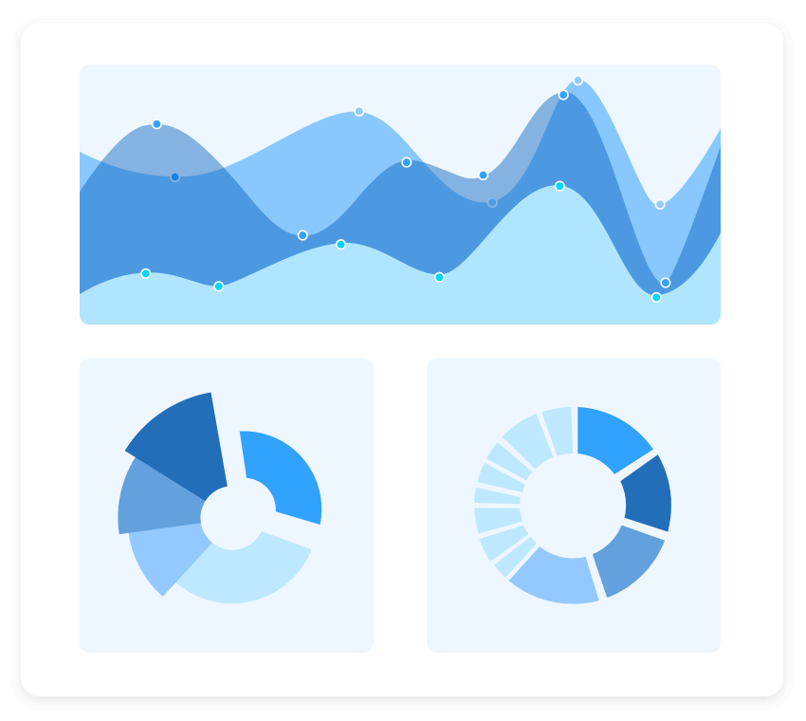
The Charts control can plot a wide range of chart types, ranging from line charts to specialized financial charts. Its rich feature set includes functionalities like data binding, multiple axes, legends, animation, data labels, annotations, trackballs, tooltips, and zooming.
CHARTS
SUPPORTED PLATFORMS
JavaScript
Angular
React
Vue
Blazor
ASP.NETMVC
Flutter
ASP.NET Core
WinForms
WPF
WinUI
Flutter
Xamarin
UWP
.NET MAUI
Xamarin
Flutter
UWP
JavaScript
.NET MAUI

Slide 5
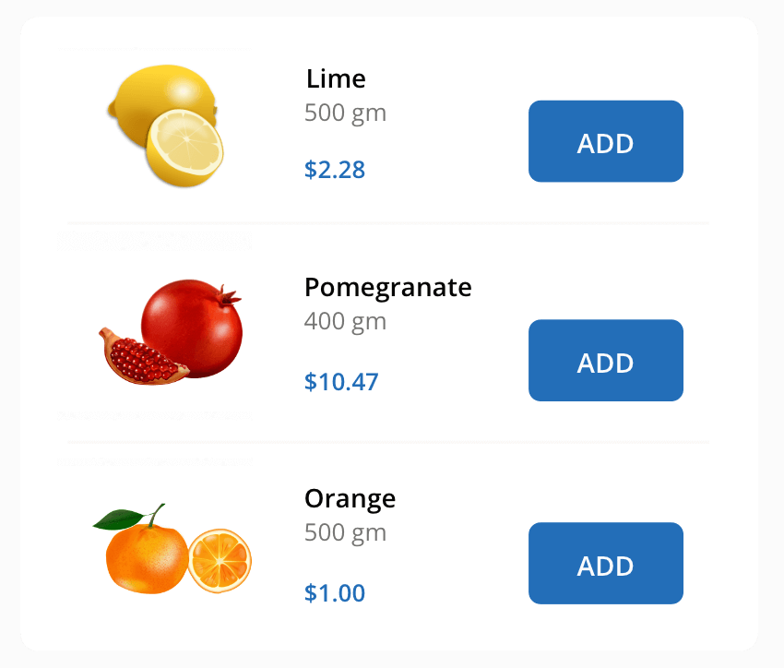
The List View renders a set of data items with UI views or custom templates. It has many features like grouping, sorting, filtering, paging, swiping, multiple selection, drag and drop, and different layout types. The List View control has been optimized to work with large amounts of data.
LIST VIEW
SUPPORTED PLATFORMS
JavaScript
Angular
React
Vue
Blazor
ASP.NETMVC
ASP.NET Core
WinForms
.NET MAUI
Xamarin
.NET MAUI
Xamarin
JavaScript

