Slide 1
Cascading Style Sheet 3
Overview of CSS3

Slide 2
Overview
CSS is used to control the style and layout of Web pages
CSS adds a lot of features to make life easier for web designers and developers
CSS3 is the latest standard which is an extension of version CSS 2.1

Slide 3
Enabling Objectives
After completing this chapter, you will be able to :
Explain and demonstrate the knowledge obtained in enhancing the look and feel of the page using the CSS3.

Slide 4
Key Topics
What is CSS and differences between CSS2 and CSS3
CSS3 syntax and usage.
Pros and Cons of using CSS3

Slide 5
What is CSS?
Cascading Style Sheets (CSS) is a language used change the look and formatting of a HTML web page.
It can also be used for XML, SVG and XUL
The CSS file will have an extension .css (eg. myStyle.css)
The Content-type should be “text/css”
Notes:
Cascading Style Sheets (CSS) is a style sheet language used for describing the presentation semantics (the look and formatting) of a document written in a markup language.
Its most common application is to style web pages written in HTML and XHTML, but the language can also be applied to any kind of XML document, including plain XML, SVG and XUL
File extension is .css
Content-type is “text/css”

Slide 6
CSS2 Vs CSS3
CSS 2 | CSS3
CSS2 was submitted as a single document with all the Cascading Style Sheets information within it. Each of the modules is being worked on individually. We have a much wider range of browser support for CSS3 modules | CSS3 has been split up into different sections, called modules. Each of these modules is making it's way through the W3C in various stages of the recommendation process

Slide 7
What is meant by CSS3?
CSS3 is a latest standard of css.
The older version CSS code written can work in CSS3
CSS3 is collaboration of CSS2 specifications called modules.
Notes:
CSS3 is a latest standard of css.
The older version CSS code written can work in CSS3 (backward compatible)
CSS3 Modules
CSS3 is split up into "modules". The old specification has been split into smaller pieces, and new ones are also added.
Some of the most important CSS3 modules are:
Selectors
Box Model
Backgrounds and Borders
Text Effects
2D/3D Transformations
Animations
Multiple Column Layout
User Interface

Slide 8
Border element and properties

Slide 9
CSS3 Borders
The border properties allow you to specify how the border of the box representing an element should look.
CSS3 Border properties :
border- radius
box-shadow
border-image
For DEMO : Navigate to DEMO folder -> CSS3
Notes:
Link : http://www.css3.info/preview/border-image/
The border properties allow you to specify how the border of the box representing an element should look.
CSS3 Border properties :
border- radius
box-shadow
border-image
CSS3 Rounded Corners
In CSS2 , adding rounded corners in CSS2 was tricky . But in CSS3 , creating rounded corners is easy
border-radius property is used for creating rounded corners
Eg : div
{
border:2px solid;
border-radius:25px;
-moz-border-radius:25px; /* Firefox 3.6 and earlier */
}
For DEMO : Navigate to DEMO folder -> CSS3

Slide 10
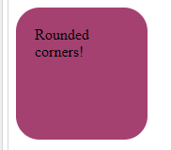
CSS3 Rounded Corners
Adding rounded corners using border-radius.
The example shows how the rounded corner looks like.
Eg : div
{
border:2px solid;
border-radius:25px;
-moz-border-radius:25px; /* Firefox 3.6 and earlier */
}
Notes:
Link : http://www.css3.info/preview/border-image/
CSS3 Rounded Corners
In CSS2 , adding rounded corners in CSS2 was tricky . But in CSS3 , creating rounded corners is easy
border-radius property is used for creating rounded corners
Eg : div
{
border:2px solid;
border-radius:25px;
-moz-border-radius:25px; /* Firefox 3.6 and earlier */
}
For DEMO : Navigate to DEMO folder -> CSS3

Slide 11

CSS3 Box Shadow
It is used to add shadow to boxes.
The example shows how the shadow looks like.
Eg: div
{
box-shadow: 10px 10px 5px #888888;
}

Slide 12

CSS3 Border Image
We can use image to create a border.
The example shows how the image is used as border.
For DEMO : Navigate to DEMO folder -> CSS3
Eg: div { border-image:url(border.png) 30 30 round; -moz-border-image:url(border.png) 30 30 round; /* Firefox */ -webkit-border-image:url(border.png) 30 30 round; /* Safari and Chrome */ -o-border-image:url(border.png) 30 30 round; /* Opera */ }

Slide 13
Gradient Generator

Slide 14
CSS3 Gradient Generator
The CSS3 gradient property is one of the most useful tools available to a web designer.
It allows you to create stunning interfaces using gradients without the need for images
Each browser has their own prefix so the syntax can be quite complex
Notes:
Link : http://css3gen.com/gradient-generator/

Slide 15
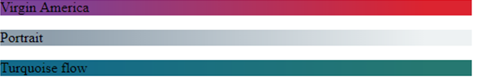
CSS3 Gradient Generator - Example
Eg :
#myDiv {
background: rgb(30, 50, 230);
background: -moz-linear-gradient(30deg, rgb(30, 50, 230) 30%, rgb(90, 140, 250) 70%);
background: -webkit-linear-gradient(30deg, rgb(30, 50, 230) 30%, rgb(90, 140, 250) 70%);
background: -o-linear-gradient(30deg, rgb(30, 50, 230) 30%, rgb(90, 140, 250) 70%);
background: -ms-linear-gradient(30deg, rgb(30, 50, 230) 30%, rgb(90, 140, 250) 70%);
background: linear-gradient(30deg, rgb(30, 50, 230) 30%, rgb(90, 140, 250) 70%);
}
This image is only a representation.
Notes:
Link : http://css3gen.com/gradient-generator/

Slide 16
CSS3 Gradient Generator - Sources
Online CSS3 Generator
http://gradients.glrzad.com/
http://css3gen.com/gradient-generator/
Online Demo : http://www.youtube.com/watch?v=ryaAzv5PxlA

Slide 17
Transform

Slide 18
CSS3 Transforms
With CSS3 transform, we can move, scale, turn, spin, and stretch elements
A transform is an effect that lets an element change shape, size and position.
We can transform your elements using 2D or 3D transformation
For DEMO : Navigate to DEMO folder -> CSS3

Slide 19
CSS3 Transform – 2D
2D transforms are used to re-change the element structure as translate, rotate, scale, and skew
2D Transforms
translate()
rotate()
scale()
skew()
matrix()
For DEMO : Navigate to DEMO folder -> CSS3

Slide 20
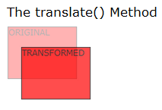
2D Transforms – translate()
The translate() method, moves the element from its current position, depending on the parameters given for the left (X-axis) and the top (Y-axis).
div { transform: translate(50px,100px); -ms-transform: translate(50px,100px); /* IE 9 */ -webkit-transform: translate(50px,100px); /* Safari and Chrome */ -o-transform: translate(50px,100px); /* Opera */ -moz-transform: translate(50px,100px); /* Firefox */ }

Slide 21
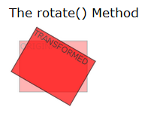
2D Transforms – rotate()
The rotate() method, rotates the element clockwise at a given degree. Negative values are allowed and rotates the element counter-clockwise
div { transform: rotate(30deg); -ms-transform: rotate(30deg); /* IE 9 */ -webkit-transform: rotate(30deg); /* Safari and Chrome */ -o-transform: rotate(30deg); /* Opera */ -moz-transform: rotate(30deg); /* Firefox */ }

Slide 22
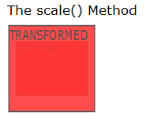
2D Transforms – scale()
The scale() method, increases or decreases the size of the element, depending on the parameters given for the width (X-axis) and the height (Y-axis)
div { transform: scale(2,4); -ms-transform: scale(2,4); /* IE 9 */ -webkit-transform: scale(2,4); /* Safari and Chrome */ -o-transform: scale(2,4); /* Opera */ -moz-transform: scale(2,4); /* Firefox */ }

Slide 23
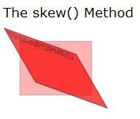
2D Transforms – skew()
The skew() method, makes the element turn in a given angle, depending on the parameters given for the horizontal (X-axis) and the vertical (Y-axis) lines
div { transform: skew(30deg,20deg); -ms-transform: skew(30deg,20deg); /* IE 9 */ -webkit-transform: skew(30deg,20deg); /* Safari and Chrome */ -o-transform: skew(30deg,20deg); /* Opera */ -moz-transform: skew(30deg,20deg); /* Firefox */ }

Slide 24
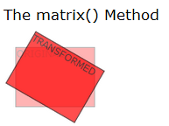
2D Transforms – matrix()
The matrix() method combines all of the 2D transform methods into one.
div { transform:matrix(0.866,0.5,-0.5,0.866,0,0); -ms-transform:matrix(0.866,0.5,-0.5,0.866,0,0); /* IE 9 */ -moz-transform:matrix(0.866,0.5,-0.5,0.866,0,0); /* Firefox */ -webkit-transform:matrix(0.866,0.5,-0.5,0.866,0,0); /* Safari and Chrome */ -o-transform:matrix(0.866,0.5,-0.5,0.866,0,0); /* Opera */ }
For DEMO : Navigate to DEMO folder -> CSS3

Slide 25
CSS3 Transform – 3D
Using with 3d transforms, we can move element to x-axis, y-axis and z-axis.
rotateX()
rotateY()
3D Transforms
For DEMO : Navigate to DEMO folder -> CSS3

Slide 26
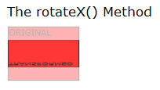
3D Transforms – rorateX()
The rotateX() method, rotates the element around its X-axis at a given degree.
div { transform: rotateX(120deg); -webkit-transform: rotateX(120deg); /* Safari and Chrome */ -moz-transform: rotateX(120deg); /* Firefox */ }
For DEMO : Navigate to DEMO folder -> CSS3

Slide 27
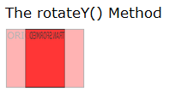
3D Transforms – rotate()
The rotateY() method, rotates the element around its Y-axis at a given degree
div { transform: rotateY(130deg); -webkit-transform: rotateY(130deg); /* Safari and Chrome */ -moz-transform: rotateY(130deg); /* Firefox */ }
For DEMO : Navigate to DEMO folder -> CSS3

Slide 28
Transition

Slide 29
CSS3 Transition
With CSS3, we can add an effect when changing from one style to another, without using Flash animations or JavaScripts
CSS3 transitions are effects that will gradually change the element from one style to another.
To achieve this , we need to do two things:
Specify the CSS property you want to add an effect to
Specify the duration of the effect.
div { transition: width 2s; -moz-transition: width 2s; /* Firefox 4 */ -webkit-transition: width 2s; /* Safari and Chrome */ -o-transition: width 2s; /* Opera */ }
For DEMO : Navigate to DEMO folder -> CSS3

Slide 30
CSS3 Transition Properties
Property | Description
transition | A shorthand property for setting the four transition properties into a single property
transition-property | Specifies the name of the CSS property to which the transition is applied
transition-duration | Defines the length of time that a transition takes. Default 0
transition-timing-function | Describes how the speed during a transition will be calculated. Default "ease"
transition-delay | Defines when the transition will start. Default 0

Slide 31
Fonts

Slide 32
CSS3 Fonts
Earlier CSS, web designers had to use fonts that were already installed on the user's computer.
Currently CSS3, web designers can use whatever font he/she likes
Eg: 1
<style type="text/css"> @font-face { font-family: myFirstFont; src: url('Sansation_Light.ttf'), url('Sansation_Light.eot'); /* IE9+ */ } div { font-family:myFirstFont; } </style>
Eg :2
@font-face { font-family: myFirstFont; src: url('Sansation_Bold.ttf'), url('Sansation_Bold.eot'); /* IE9+ */ font-weight:bold; }
For DEMO : Navigate to DEMO folder -> CSS3

Slide 33
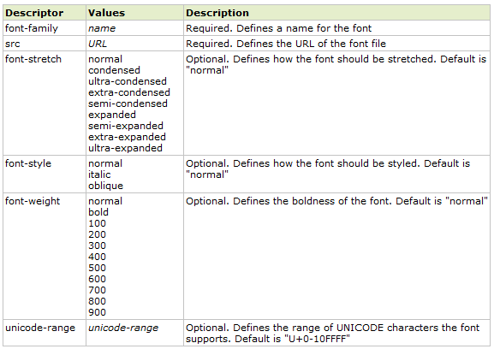
CSS3 Font Descriptors

Slide 34
Multicolumns

Slide 35
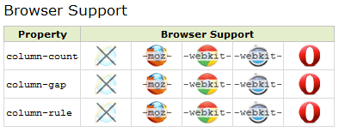
CSS3 Multicolumn Layouts
We can have multiple columns layout like a newspapers.
CSS3 Multiple column properties:
column-count
column-gap
column-rule

Slide 36
CSS3 Multicolumn Layouts
This example shows how to divide the text in a div element into three columns.
div { -moz-column-count:3; /* Firefox */ -webkit-column-count:3; /* Safari and Chrome */ column-count:3; }

Slide 37
CSS3 Multicolumn Layouts
This example shows how to specify 40 pixels spacing between columns
div { -moz-column-gap:40px; /* Firefox */ -webkit-column-gap:40px; /* Safari and Chrome */ column-gap:40px; }

Slide 38
CSS3 Multicolumn Layouts
It is shown in the example on how to specify the width, style and color of the rule between columns:
div { -moz-column-rule:3px outset #ff00ff; /* Firefox */ -webkit-column-rule:3px outset #ff00ff; /* Safari and Chrome */ column-rule:3px outset #ff00ff; }

Slide 39
Advantages of CSS3
Learning Language - CSS3 is a much easier language to learn compared to its predecessor.
Size – Number of lines of code written in CSS3 is less to implement a functionality.
Implementation - CSS3 is written directly into the standard stylesheet and there is no need for extra files.
Accessibility – Provides accessibility to all types of used including differently abled users.
Notes:
Learning Language - CSS3 is a much easier language to learn, especially for all those front end developers out there that have been coding CSS2 for years and simply want to add a few extra aesthetics to their sites
Size - CSS3 is much smaller. The code is tiny in comparison and you can work it straight into your standard stylesheets
Implementation - CSS3 can be written straight into your standard stylesheet and there is no need for extra files. This means you can avoid linking to various libraries and files full of complicated code in the <head> of your html documents
Accessibility - Accessibility is really important on the Web, especially if you are designing sites that are potentially going to be visited by disabled users. As CSS3 will be part of the W3C Web Standards then it will be completely accessible, no matter what technology you are using to browse the Internet.

Slide 40
Disadvantages of CSS3
CSS3’s compatibility with browsers.
Syntaxes are not matured yet.
CSS3 is still evolving.
Notes:
The biggest problem is compatibility with old browsers and even new ones.
This is because CSS3 is still under development, actually there are different modules being developed separately.
Many properties have not even reached a mature syntax yet, this is why you will need to use prefixes like moz and webkit for those ones.

Slide 41
Summary
Cascading Style Sheets (CSS) is language used for enhancing the look and feel for a web page.
The CSS3 gradient property is one of the most useful tools available to a web designer.
A transform is an effect that lets an element change shape, size and position.
Notes:
Cascading Style Sheets (CSS) is a style sheet language used for describing the presentation semantics (the look and formatting) of a document written in a markup language
The CSS3 gradient property is one of the most useful tools available to a web designer. It allows you to create stunning interfaces using gradients without the need for images
A transform is an effect that lets an element change shape, size and position. We can transform your elements using 2D or 3D transformation

Slide 42

Source
Websites:
http://en.wikipedia.org/wiki/Cascading_Style_Sheets
http://webdesign.about.com/od/css3/a/differences-css2-css3.htm
CSS Border : http://www.sitepoint.com/css3-border-images/
http://www.whatcreative.co.uk/blog/tips/the-benefits-of-css3-vs-jquery/
CSS3 -Pros and Cons : http://a-developer-life.blogspot.in/2011/07/pros-and-cons-of-css3.html
Disclaimer: Parts of the content of this course is based on the materials available from the Web sites and books listed above. The materials that can be accessed from linked sites are not maintained by Cognizant Academy and we are not responsible for the contents thereof. All trademarks, service marks, and trade names in this course are the marks of the respective owner(s).

Slide 43

Source
Websites:
http://en.wikipedia.org/wiki/Cascading_Style_Sheets
http://webdesign.about.com/od/css3/a/differences-css2-css3.htm
CSS Border : http://www.sitepoint.com/css3-border-images/
http://www.whatcreative.co.uk/blog/tips/the-benefits-of-css3-vs-jquery/
CSS3 -Pros and Cons : http://a-developer-life.blogspot.in/2011/07/pros-and-cons-of-css3.html
Disclaimer: Parts of the content of this course is based on the materials available from the Web sites and books listed above. The materials that can be accessed from linked sites are not maintained by Cognizant Academy and we are not responsible for the contents thereof. All trademarks, service marks, and trade names in this course are the marks of the respective owner(s).

Slide 44
You have successfully completed -
Overview of CSS3

