Slide 1
ICU Mortality Prediction using Machine Learning
Siva Ram Potluri
UMBC Data Science Capstone
Instructor:
Dr. Chaojie (Jay) Wang

Slide 2
Motivation
ICU patients are at high risk
Early prediction can save lives
Manual assessment is complex
Need a data-driven solution

Slide 3
Problem Statement
Predict hospital mortality
Binary classification problem
Use clinical features
Support medical decision-making

Slide 4
Dataset Overview
ICU clinical dataset
Vitals and lab measurements
Real-world noisy data
Target: hospital_death

Slide 5
Feature Engineering
Selected 16 key features
APACHE (severity indicators)
Non-APACHE (labs and vitals)
Reduced noise and complexity

Slide 6
Exploratory Data Analysis
Distribution analysis
Boxplots for comparison
Correlation heatmap
Reveals data patterns

Slide 7
Key Insights
Class imbalance observed
Some features separate outcomes
Presence of outliers
Moderate correlations

Slide 8
Modeling Approach
Logistic Regression
Random Forest
Gradient Boosting
Compared using ROC-AUC

Slide 9
Results
ROC-AUC comparison
Gradient Boosting performed best
Handles complex patterns
Best predictive performance

Slide 10
Feature Importance
Top features identified
APACHE features most important
Improves interpretability
Supports decision-making

Slide 11
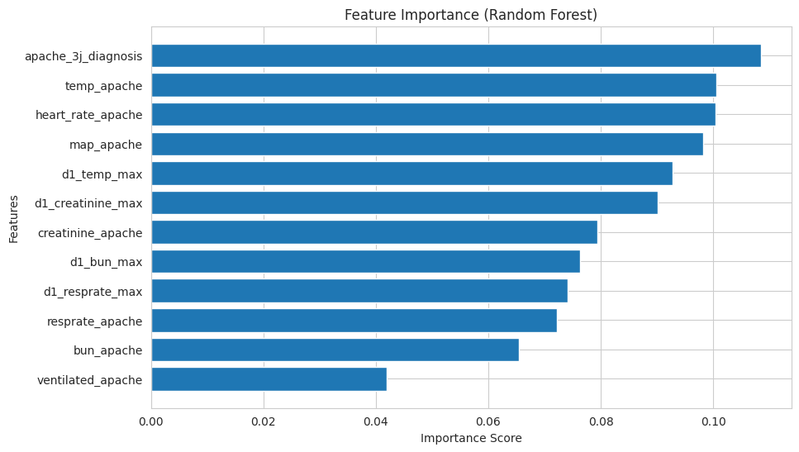

Slide 12
Interactive Dashboard
Built using Streamlit
Real-time predictions
Visual outputs (charts, gauge)
User-friendly interface

Slide 13
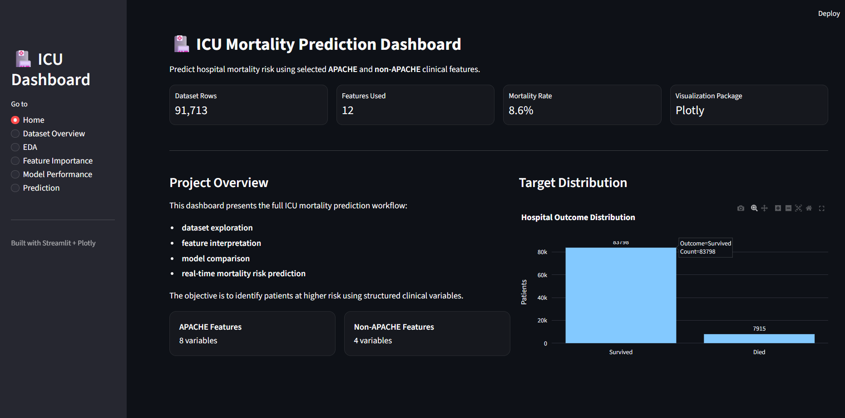

Slide 14
Conclusion
Model predicts ICU mortality effectively
Gradient Boosting is best model
Useful for healthcare support
Provides actionable insights

Slide 15
Future Scope
Use larger datasets
Apply deep learning models
Integrate with hospital systems
Improve feature engineering

Slide 16
Thank you

