Slide 1
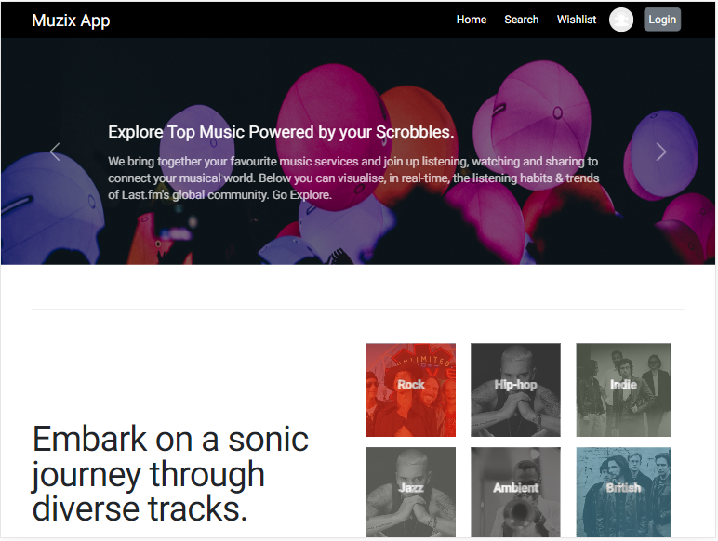
MUZIX App Team - 05
Members
Aparna Ashok Salokhe
Gobinathan Viswanathan
Kiran Andhalkar
Sivasai Kuruva

Slide 2
INDEX
PROBLEM STATEMENT
OBJECTIVE
PROJECT FLOW
PROJECT ARCHITECTURE
TECHNOLOGY AND TOOLS USED
APP DEMO
CONCLUSION

Slide 3
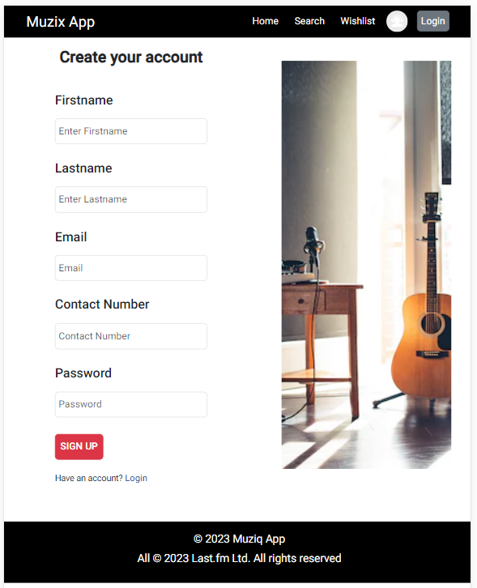
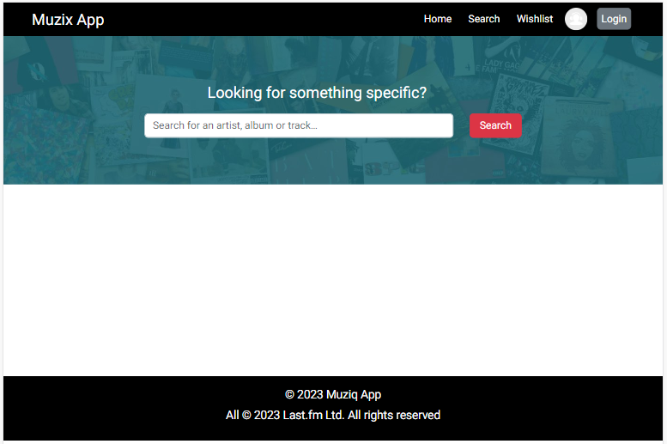
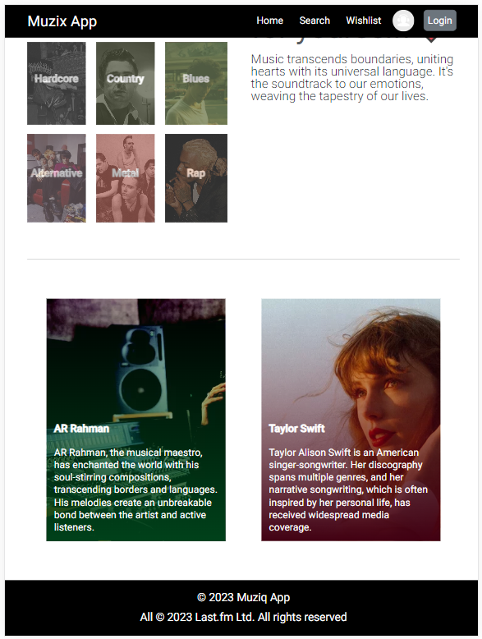
PROBLEM STATEMENT
Build an Application to search for music tracks and add them to a Wishlist / Favorite list .

Slide 4
OBJECTIVE
Muzix application is built with an objective to help users to find their favorite songs from a wide range of geners globally.
Get latest top trending songs as recommendations.
One stop place for wish listing all favorite songs.
Features
Search tracks based on title & artist
Favorites / Wishlist,
Recommendations.

Slide 5


PROJECT FLOW
Get User Profile
Register
User Profile
Update User Profile
registered
Search Tracks
Search
Login
Search Artists
Forgot Password
Password Change
Wishlist
Add to Wishlist
Change Password
Dashboard
Remove from Wishlist
Recommendations
Get Recommendations

Slide 6



PROJECT ARCHITECTURE
Eureka Service Discovery
Userprofile
Authorization - JWT
Spring Gateway
LastFm
Wishlist

Slide 7


MUZIX APP DEMO

Slide 8















TECHNOLOGY AND TOOLS USED

Slide 9
CONCLUSION
With Muzix app registration, users will be able to login into his account with customized dashboard.
Users able to search for worldwide music songs albums based on title/artist search.
Get top most Recommendation tracks from last-fm service.
Muzix app allows users to store their favorites tracks and manage their Favorite playlist with Favorite section.

Slide 10

Q & A

Slide 11


