Slide 1


DEFORMABLE
MIRROR

Slide 2
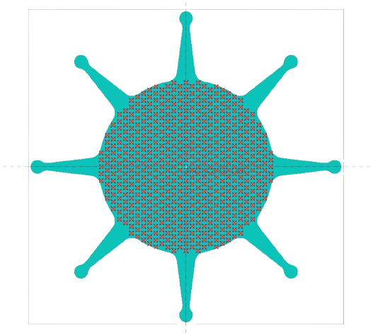


PARAMETERS
Arm Length
DEFORMABLE MIRROR
Arm Angle
Inner Diameter
Thickness
0.201mm =
Actuator Contact diameter (OACD)
Fillet Radius

Slide 3
10.5
37.5
10
ARM LENGTH
ARM ANGLE
40
9
42.5
8
7
1
INNER DIAMETER
55
2
FILLET RADIUS
60
3
4
5
OACD
4
5

Slide 4
PARAMETERS
Arm Length | 42.5 | 40.0 | 37.5 | - | -
Arm Angle | 7 | 8 | 9 | 10 | 10.5
Inner Dia | 55 | 60 | - | - | -
Fillet Radius | 1 | 2 | 3 | 4 | 5
OACD | 4 | 5 | 6 | - | -

Slide 5

INFLUENCE MATRIX
X | Y | O1 | O2 | O3 | O4 | O5
... | ... | ... | ... | ... | ... | ...
O6 | 07 | O8 | Ce | I1 | I2 | I3
... | ... | ... | ... | ... | ... | ...
I4 | I5 | I6 | I7 | I8
... | ... | ... | ... | ...
CODE
MATLAB CODE
CODE

Slide 6
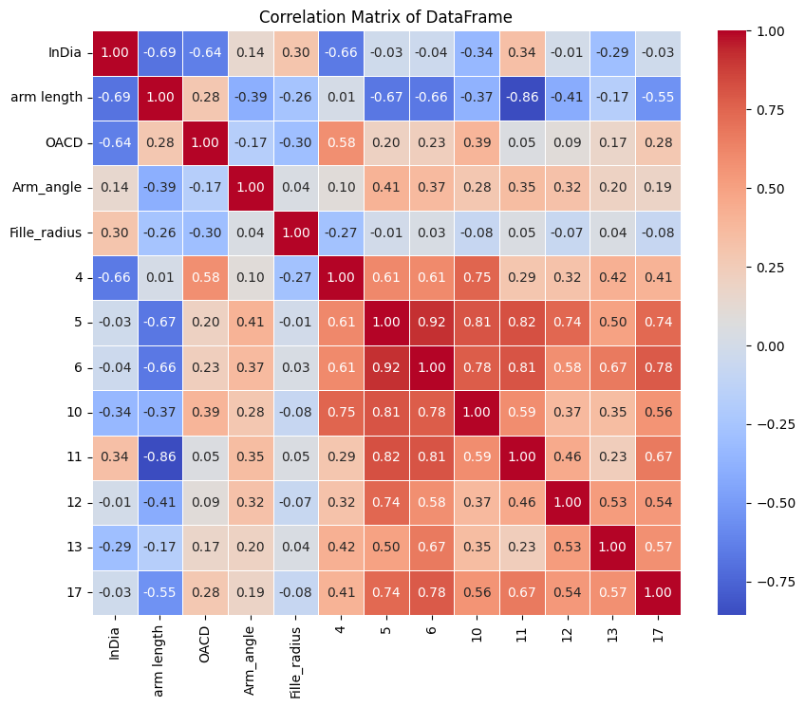
Correlation matrix
  Feature–Output Relations:
  InDia and arm length → strong negative correlation with several outputs.
  OACD and Arm_angle → moderate positive correlation.
  Fille_radius → very weak correlation (low importance).
  Output–Output Relations:
  5, 6, 10, 11 → highly correlated (easy to predict together).
  12 & 13 → weak correlations with inputs and other outputs → harder to predict.
  Takeaway: Strong dependencies among some outputs can be exploited with multi-output models, while weakly correlated outputs may need additional features/engineering.

Slide 7
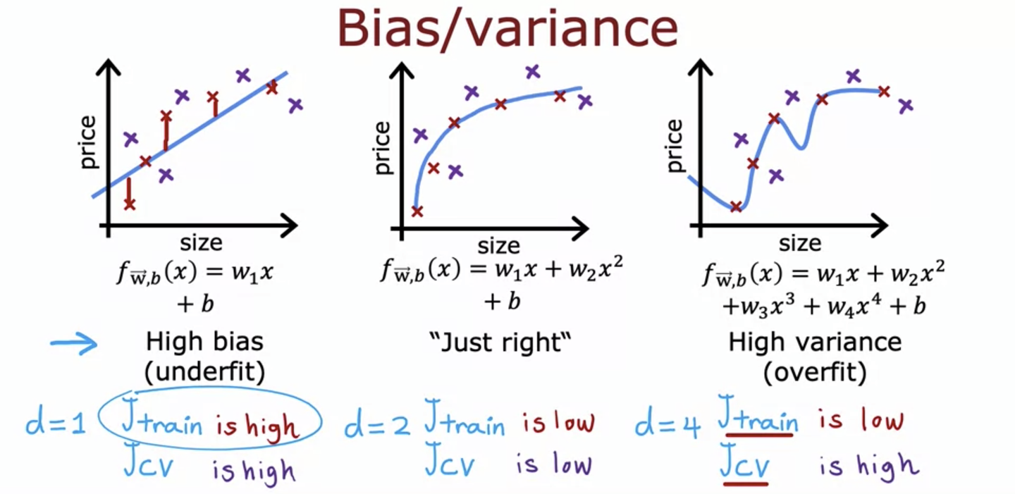
FIRST APPROACH :
RIDGE REGRESSION
Why Ridge Regression?
it minimizes variance by adding penalty to the overfitting.
it minimizes bias +alpha(a) *slope^2
hence, sensitivity of the model reduces which prevents overfitting.

Slide 8
Model | BIAS | VARIANCE | DIFFERENCE
Elastic - net | 41.384066 | 72.628185 | 31.2441
Linear Regression | 57.32751951331115 | 89.2304366 | 31.9029
Ridge Regression | 58.267617821524766 | 91.59428673531225 | 33.3267
Polynomial RR 2 | 26.663680 | 66.126302 | 39.462622
Polynomial RR 3 | 17.174038016666618 | 106.49099166477806 | 89.3170
Random Forest | 8.932265061060601 | 59.60058374819435 | 50.6683

Slide 9
In-Dia Arm len OACD Arm Ang F_r
Elastic -net
60 37.5 6 10 1
Polynomial rr 2
60 37.5 6 10 1
Linear REGRESSION
60 37.5 4 10 5
RIDGE REGRESSION
60 37.5 4 10 5
random forest
55 40.0 5 8 3
Elastic -net
Ridge Regression
Random Forest

Slide 10
Inverse Prediction with Optimization
  Purpose: Find input values (X) that produce a desired target output (Y_target).
  Objective Function: Minimizes error = (Model Prediction – Y_target)².
  Optimization (scipy.minimize):
    Starts from an initial guess.
    Adjusts inputs within set bounds.
    Finds the X combination that best matches Y_target.
  Use Case: Reverse-engineering the model → “What inputs give me this output?”

Slide 11
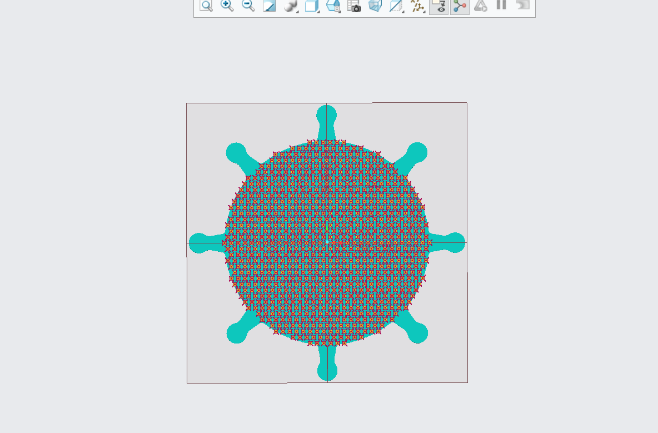

37.5 (Arm Length)
10 (Arm Angle)
30 (Inner Radius)
6 (OACD)
1 (Fillet Radius)
FINAL SHAPE

Slide 12
INITIAL MODEL | ML Parameters
68 72.9 71 65.6 defocus astig45 astig0 z=17 | 82.58 86.3 86.98 90.31 defocus astig45 astig0 z=17
42.5 (Arm Length)
37.5 (Arm Length)
8 (Arm Angle)
10 (Arm Angle)
30 (Inner Radius)
30 (Inner Radius)
4 (OACD)
6 (OACD)
3 (Fillet Radius)
1 (Fillet Radius)
ACCURACIES :
ACCURACIES :

Slide 13
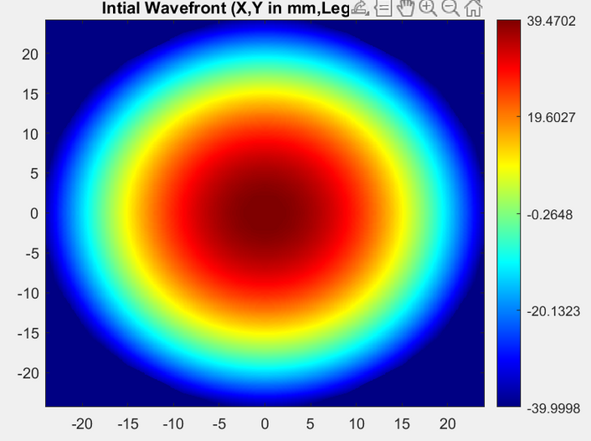
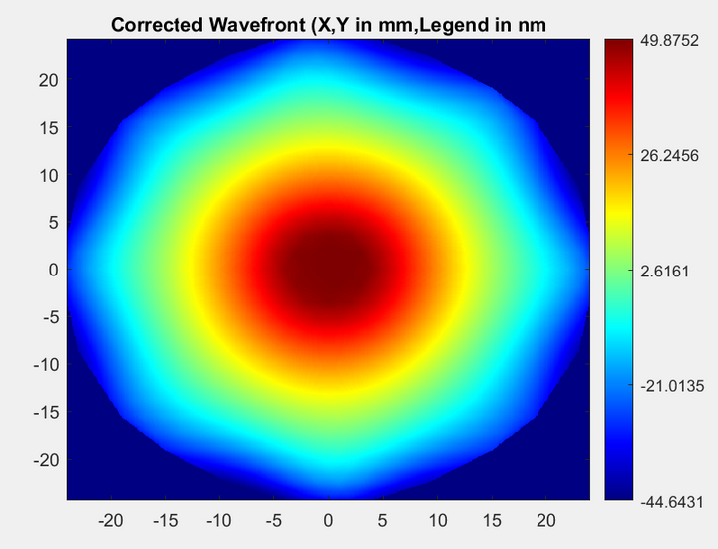
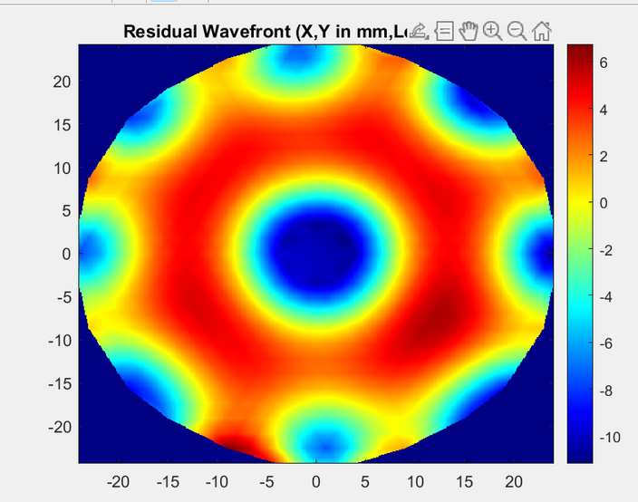
DeFOCUS
82.58

Slide 14
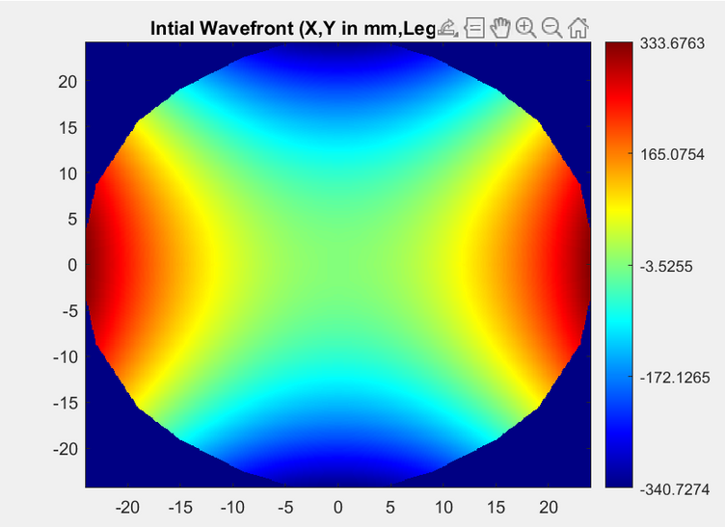
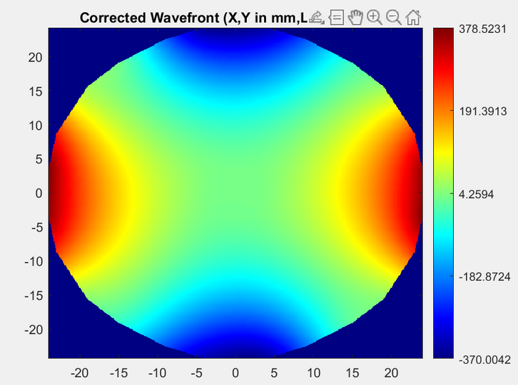
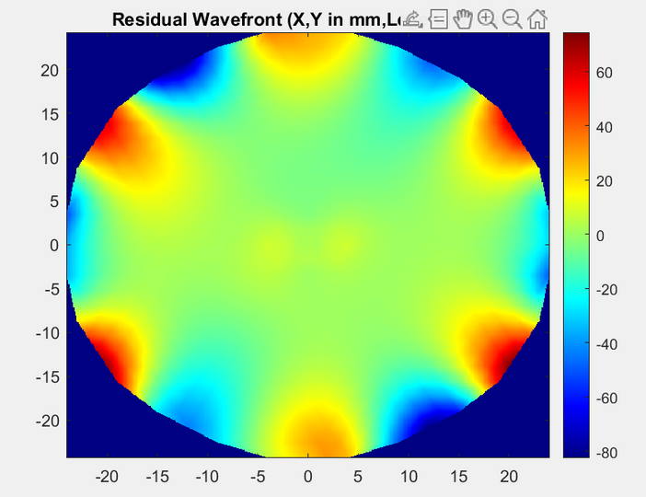
ASTIG 45
86.3

Slide 15
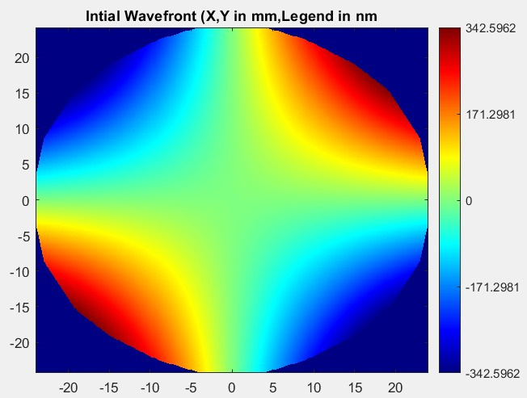
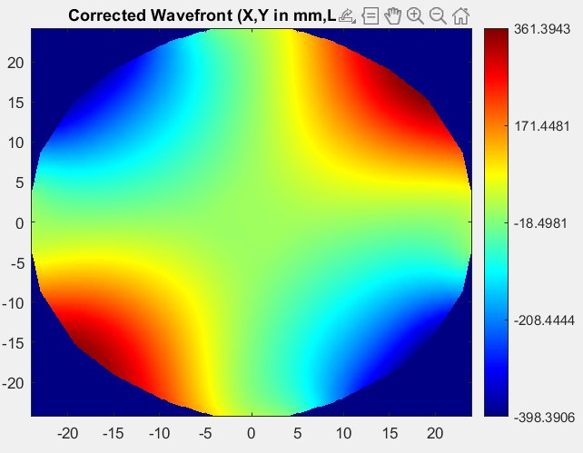
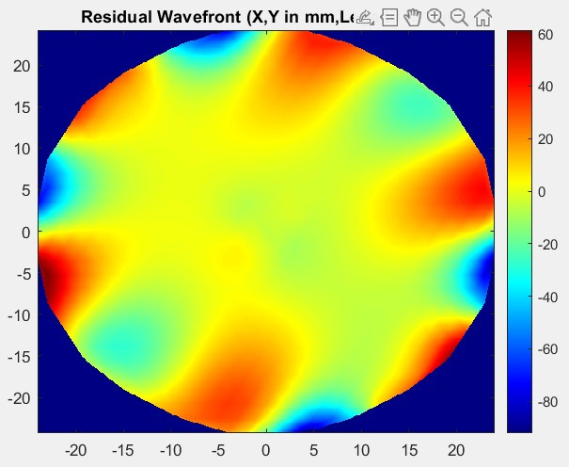
ASTIG 0
86.98

Slide 16
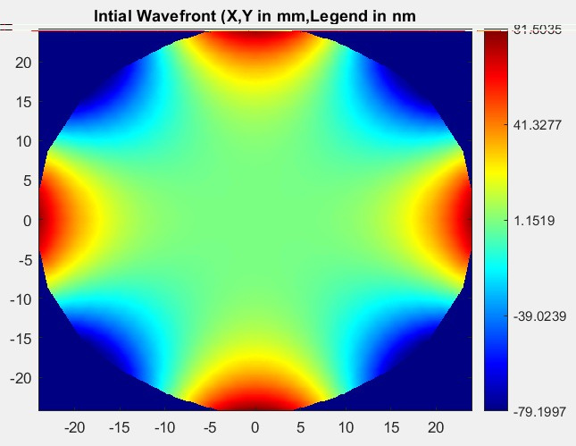
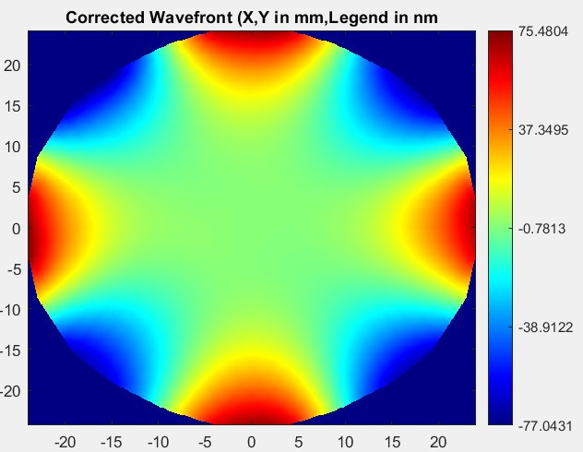
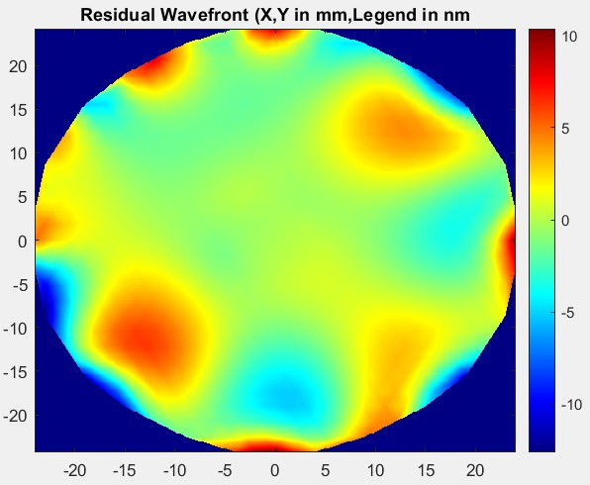
Z = 17
90.31

Slide 17
THANK YOU

