Slide 1
Google Big Query
Handling Really Big Data

Slide 2
Team Members -Group 4
Monishkumar Reddy Chintha
Vineeth Reddy Pandala
Saikrishna Peruka
Anjani Naga Venkata Siva Sai Krishna Rathamsetti
Rakesh Siripuram

Slide 3
What is Big Query
It is a complete serverless and cost-effective enterprise data warehouse that works across cloud.
It can easily scales with our data without any downtime and very cost effective.
It has BI, AI and machine learning built in.

Slide 4
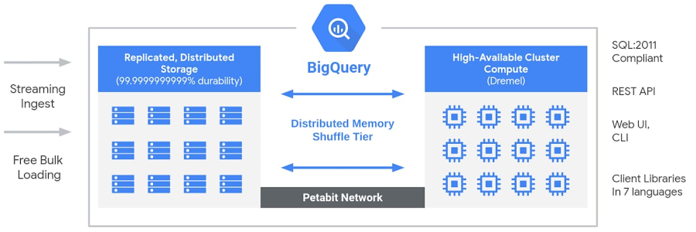
Architechture

Slide 5
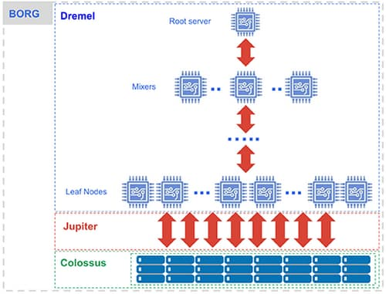
BigQuery: Under the hood Architechture

Slide 6
Under the hood architecture explained
Compute is Dremel, a large multi-tenant cluster that executes SQL queries.
Storage is Colossus, Google’s global storage system.
Compute and storage talk to each other through the petabit Jupiter network.
BigQuery is orchestrated via Borg, Google’s precursor to Kubernetes.

Slide 7
How can we access Big Query?
Using the GCP Console
Using the command line tool bq
Making calls to the BigQuery Rest API
Using various client libraries like python, java, .Net etc

Slide 8
Components of BigQuery
Project: Any Google Cloud resources that you allocate, and use must belong to a project. You can think of a project as the organizing entity for what you're building.
Dataset: A dataset is contained within a specific project. Datasets are top-level containers that are used to organize and control access to your tables and views.
Table: Tables are the lowest level component where actual data are stored.

Slide 9
Components of BigQuery Project
Projects are the top-level containers that store the data
Within the project, you can configure settings, permissions, and other metadata that describe your applications
Each project has a name, ID, and number that you’ll use as identifiers
When billing is enabled, each project is associated with one billing account, but multiple projects can be billed to the same account

Slide 10
Components of BigQuery Datasets
Datasets allow you to organize and control access to your tables
All tables must belong to a dataset. You must create a dataset before loading data into BigQuery
You can configure permissions at the organization, project, and dataset level

Slide 11
Components of BigQuery Tables
Each table has a schema that describes the data contained in the table, including field names, types, and descriptions
BigQuery supports the following table types:
Native tables: tables backed by native BigQuery storage
External tables: tables backed by storage external to BigQuery
Views: virtual tables defined by a SQL query

Slide 12
Common Uses
Transfer Data into BigQuery: BigQuery helps us to make analytics easier by bringing together data from multiple sources into BigQuery. We can Upload the data from multiple sources like local, Google cloud storage, using BigQuery Data Transfer services etc.
Migrate data Warehouse to BigQuery: We can seamlessly our business by moving our data warehouse to big query to provide fast real time like analytics. We can streamline our migration from SnowFlake, Teradata or Redshift using the free and fully managed BigQuery migration service.

Slide 13
Common Uses Contd.
Real Time Analytics: BigQuery responds to business event in real time with event-driven analysis. Built-In streaming capabilities automatically ingests streaming data and make it available.
Predictive Analytics: BigQueryML can help us build recommendation system, predict customers lifetime value etc.
Log Analytics: We can get deeper insights on our log data by analysing it on BigQuery. We can explore and run queries on generated data from servers, sensors simply using GoogleSQL.

Slide 14
Why BigQuery?
Service for interactive analysis of massive datasets (TBs)
Query billions of rows: seconds to write, seconds to return
Uses a SQL-style query syntax
It's a service, can be accessed by a API
Reliable and Secure
Replicated across multiple sites
Secured through Access Control Lists
Scalable
Store hundreds of terabytes
Pay only for what you use
Fast (really)
Run ad hoc queries on multi-terabyte data sets in seconds

Slide 15
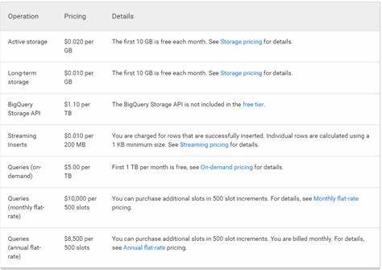
Pricing

Slide 16
Sample Code Run
SELECT
EXTRACT(YEAR FROM creation_date) AS year,
EXTRACT(MONTH FROM creation_date) AS month,
COUNT(creation_date) AS number_posts
FROM
`bigquery-public-data.stackoverflow.stackoverflow_posts`
WHERE
answer_count > 0
GROUP BY year, month
ORDER BY year ASC, month ASC;

Slide 17
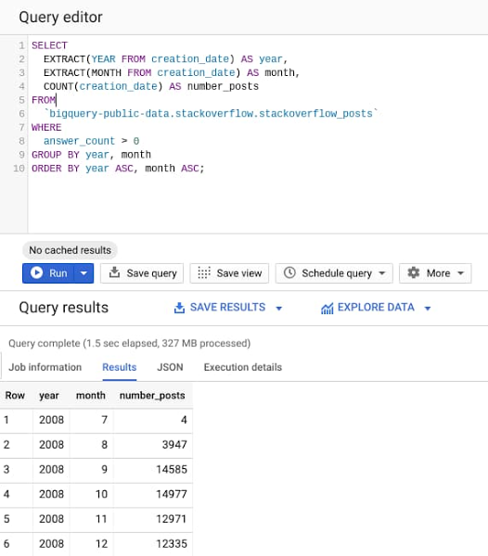
Sample Code Output

