Slide 1



Supply Chain Performance Analysis
Optimizing Supply Chain Efficiency
Presented By
Siva Suriyan M
Feb 2025

Slide 2

Learning Objectives
Evaluate total revenue, cost, and profit margins.
Identify defect rates and their impact on product quality.
Analyze shipping and transportation costs for efficiency.
Assess supplier contributions and performance.
GOAL
Source :
www.freepik.com/

Slide 3
Tools and Technologies Used
Power Query - Data transformations and data cleaning.
Data Modeling - Creating relationships between tables in Power BI.
DAX (Data Analysis Expressions) - Creating measures and calculated columns.
Power BI - Data visualization and dashboard development.

Slide 4
Methodology
Data Preparation: Loaded the CSV file into Power BI and used Power Query to create separate tables (Inventory, Manufacturing, Supplier, Supply Chain).
Data Cleaning: Retained relevant columns and rounded numeric values for consistency.
Data Modeling: Established relationships between key tables for seamless analysis.
Data Visualization: Developed dashboards for Supply Chain, Manufacturing, and Supplier Insights.
Insights & Recommendations: Extracted key insights and provided data-driven recommendations.

Slide 5
Problem Statement
How can we improve supply chain efficiency while maintaining sustainability and cost-effectiveness?

Slide 6
Solution
Optimize transportation costs by selecting efficient carriers.
Reduce defect rates by improving quality control.
Enhance supplier selection to improve profit margins.
Minimize lead times for better supply chain efficiency.
Use data-driven decision-making to optimize logistics and production.

Slide 7
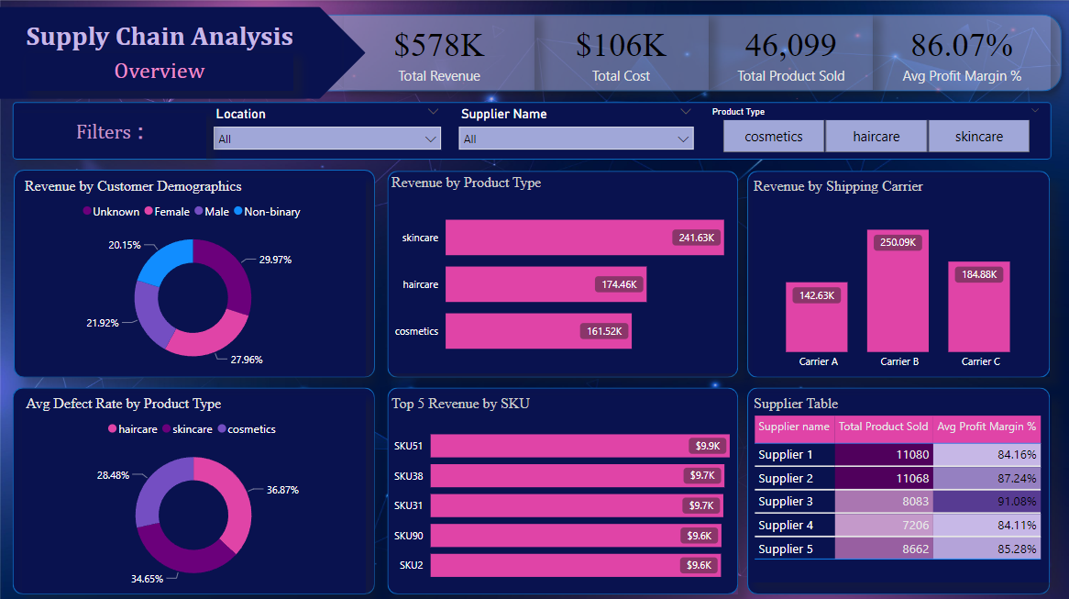
Screenshot of Output

Slide 8
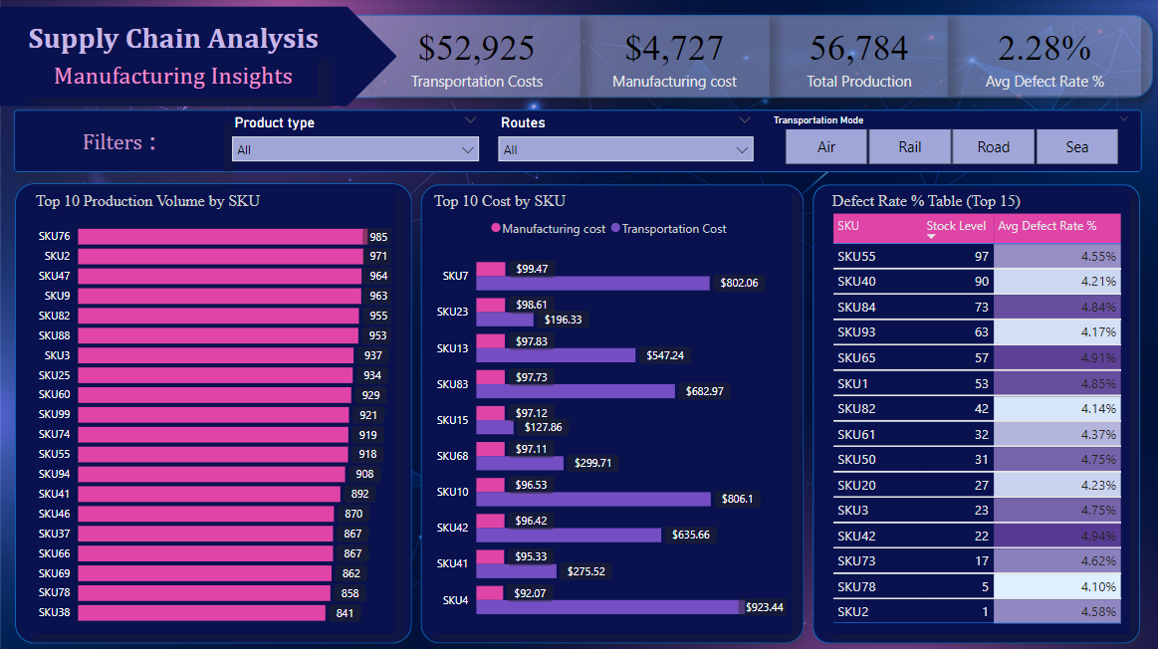
Screenshot of Output

Slide 9
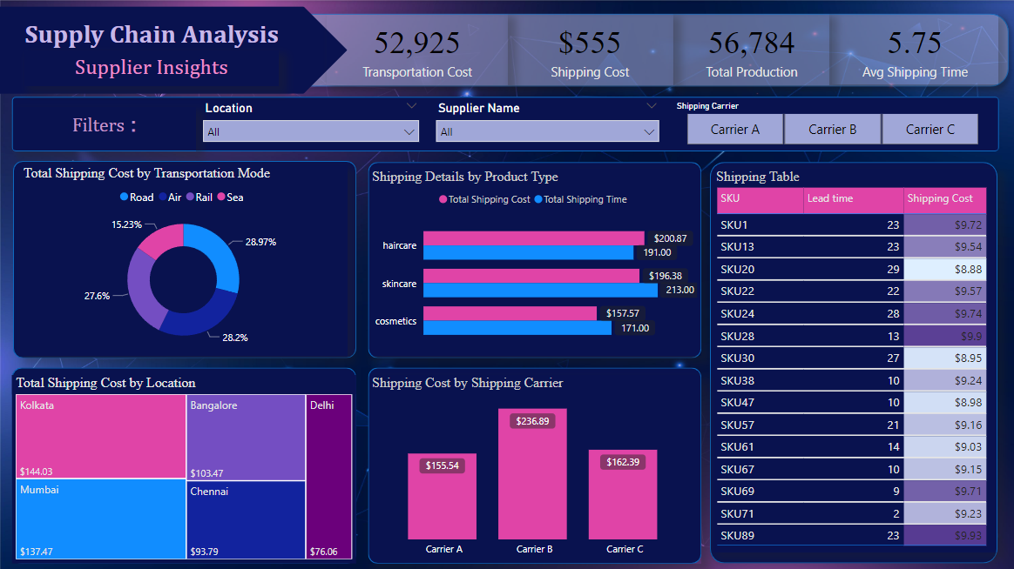
Screenshot of Output

Slide 10
Conclusion:
This analysis provides valuable insights into optimizing supply chain performance by:
Identifying key revenue drivers and cost factors.
Improving product quality and reducing defect rates.
Enhancing supplier and shipping efficiency.
By implementing the recommendations, businesses can enhance profitability and sustainability within their supply chain.

