Slide 1
DATA 5100
Project Assignment
TEAM 6
Siva Sushmitha Meduri
Janani Krishnamurthy
Divyasree Vammigari

Slide 2
CONTENTS:
S.No. | TOPIC | SLIDE NO.
1. | Introduction | 3
2. | Business Purpose | 4
3. | Data Source | 5
4. | Keywords | 6
5. | Approach | 7
6. | Data Collection | 8
7. | Data Preparation | 9
8. | Data Exploration | 10-17
9. | Model Prediction | 18-27
10. | Feature Engineering | 28
11. | Model Selection | 29-31
12. | Model Training | 32,34
13. | Model Evaluation | 33,35
14. | Conclusion | 36

Slide 3
INTRODUCTION:
Reliable power load forecasting is critical in today's linked world, providing as the foundation for educated energy sector decision-making. Energy merchants, grid operators, and policymakers benefit from accurate forecasts because they provide insights to optimize strategies, assure grid stability, and steer sustainable energy policies.
Accurate load estimates enable energy traders to forecast electricity prices, optimize trading methods, and reduce risks. These projections help grid operators with resource allocation, maintenance planning, and outage prevention. Load projections are used by policymakers to define energy policies, steer investments, and promote a sustainable energy future.
The goal of this project is to develop a model for estimating hourly load in New Hampshire for January 2023. Because of the different energy consumption patterns in New Hampshire, which are influenced by weather, economics, and seasonality, accurate forecasting is critical for stakeholders in the region.

Slide 4
Business Purpose :
Cost Savings for Energy Traders: Trading techniques that are optimized based on accurate load projections not only lower risks, but also result in cost savings for energy dealers. Precise estimates enable more strategic energy purchase and sales decisions.
Grid Operators' Operational Efficiency: Grid operators realize operational efficiency benefits by anticipating and responding to load changes, resulting in a smoother grid operation with less impact from unplanned events.
Resilience in the Face of Outages: Precise load estimates enable grid operators to proactively improve grid resilience, addressing vulnerabilities and averting outages to ensure consumers have uninterrupted power supply.
Scheduling Adaptive Maintenance: The ability to properly estimate load patterns assists grid operators in scheduling maintenance during times of low demand. This adaptive maintenance strategy reduces consumer disturbances while optimizing maintenance resource utilization.
Sustainability and the Environment: Reliable data-driven policy decisions based on precise load estimates enable policymakers to prioritize and advocate for sustainable energy practices, lowering the region's environmental impact by promoting renewable energy sources.
Policymakers' Investment Confidence: Reliable load projections enable policymakers to make educated investment decisions, promoting infrastructure development that is aligned with the region's long-term energy demands and aspirations.
Public Awareness and Participation: Accurate load forecasting, in conjunction with sustainable energy legislation, fosters an energy-efficient culture by educating the public on consumption trends and encouraging educated energy usage choices.
Market Competitivity: Accurate load forecasts provide energy traders a competitive advantage by enabling strategic positioning and responsiveness to market trends, fostering dynamism in the competitive energy market.

Slide 5
DATA SOURCE:
The utilized data is from New Hampshire (NH) ranging from 2020 to 2022 for analysis
A model is created for estimating the hourly load in New Hampshire for January 2023.
All pricing information from the three datasets, and data after January 1st, 2023, is not included as asked.

Slide 6
KEY WORDS:
In this all along the project we use
'Hr_End','Dry_Bulb','Dew_Point',’RT_Demand’
Hr_End: The hour of the observation, in hour ending and 24-hour convention
Dry_Bulb: The dry-bulb temperature in °F for the weather station which is not influenced by humidity corresponding to the load zone or Trading Hub .The summer period is June-September, while the winter period is October-May.
Dew_Point: The dewpoint temperature in °F for the weather stationwhich is influenced by humidity corresponding to the load zone or Trading Hub. The summer period is June-September, while the winter period is October-May.
Rt_Demand: Real-Time Demand, in MW, is Non-PTF Demand for wholesale market settlement from revenue quality metering, and is defined as the sum of non-dispatchable load assets, station service load assets, and unmetered load assets. Starting on June 1, 2018, this total also includes the grossed up demand response value.

Slide 7
APPROACH:
Data collection
Data preparation
Data exploration
Model Prediction
Feature Engineering
Model Selection
Model Training
Model Evaluation

Slide 8
DATA COLLECTION:
Once loading all the required libraries, the 3 data sets are loaded from New Hampshire (NH) spanning from 2020 to 2022 .
The three data sets loaded are:
2020 SMD Hourly Data
2021 SMD Hourly Data
2022 SMD Hourly Data
The above excel files are loaded using “pd.read_excel ()” function AND filtering the sheet name to be NH i.e., New Hampshire.

Slide 9
DATA PREPARATION:
Initially the data set consists of multiple variables which is not so required for our analysis.
For accurate forecasting we filter out the required variables out from the all the three datasets.
The required variables are:
1. Date
2. Hr_End
3. Dry_Bulb
4. Dew_Point
5. RT_Demand
Once filtering out the above variables , all the 3 datasets are joined together for efficiency and ease.

Slide 10
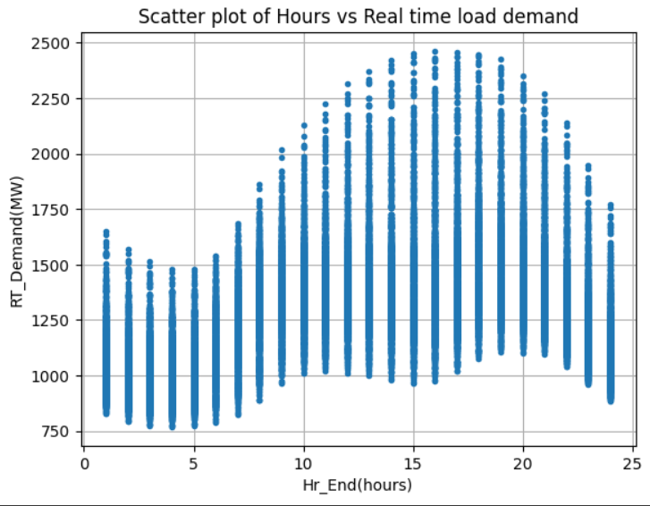
DATA EXPLORATION :
In order to understand the characteristics of data present we have plotted few plots
First we have plotted Hours vs Real time load demand
The scatterplot shows a clear pattern in load, with higher load during the day and lower load during nights. This suggests that Hr_End is a useful predictor of load.

Slide 11
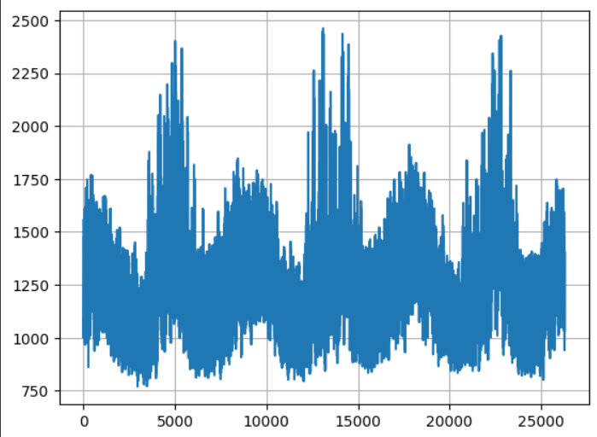
DATA EXPLORATION : (continued..)
Next we have plotted three years seasonality:
The three-year seasonality graph demonstrates that the seasonal pattern of RT demand is very stable year after year. However, there are some year-to-year fluctuations in demand. This is most likely due to a mix of factors such as seasonal trends, holidays and special events, and weather conditions.

Slide 12
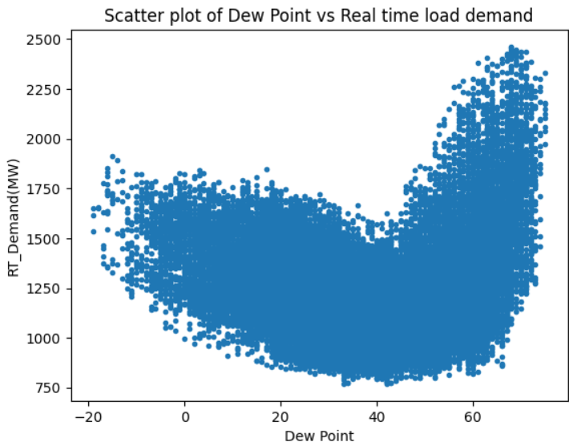
DATA EXPLORATION : (continued..)
The next plot is between Dew point and Real time load demand.
The scatterplot reveals a positive association between Dew Point and load; as the temperature rises, so does the load. To figure out the non-linear relationship, we can use additional terms such as quadratic or cubic terms when forecasting load using Dew Point.

Slide 13
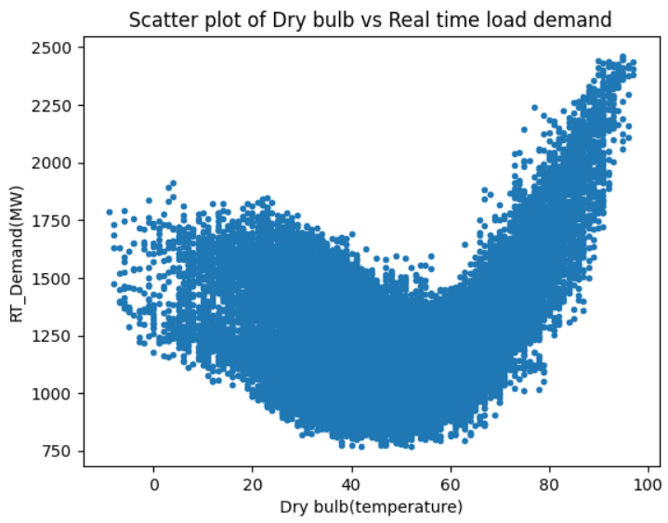
DATA EXPLORATION : (continued..)
The scatter plot of Dry bulb vs Real time load demand.
The scatterplot shows a positive correlation between Dry bulb and load, because the temperature increases, there is an increase in load. To forecast load using Dry bulb, we can introduce additional terms like quadratic term or cubic term to find out the non-linear relationship.

Slide 14
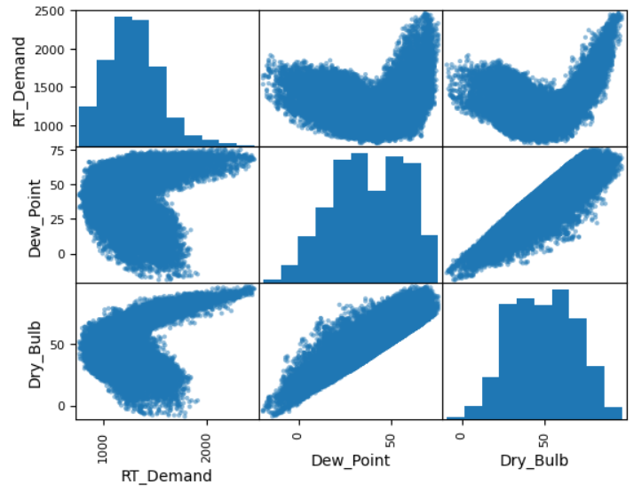
DATA EXPLORATION : (continued..)
The pair plot shows the relationship between three variables: dew point, dry bulb temperature, and RT demand.
The pair plot demonstrates that the relationship between dew point, dry bulb temperature, and RT demand is complex. The association between dew point and dry bulb temperature is strong and positive, whereas the relationship between dew point and RT demand is modest and either negative or positive.

Slide 15
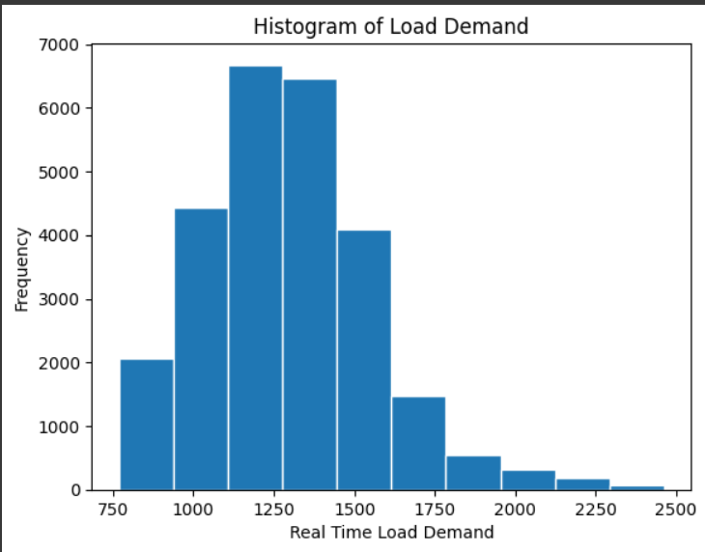
DATA EXPLORATION : (continued..)
Plotted histogram for Rt_demand.
As we examine the histogram, the load is right-skewed with long tail towards right

Slide 16
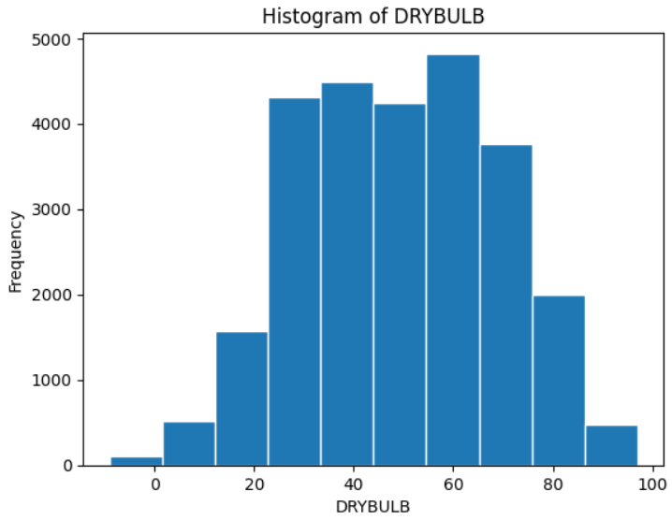
DATA EXPLORATION : (continued..)
Plotted histogram for Drybulb.
As we examine the histogram, the distribution is approximately normal distribution.

Slide 17
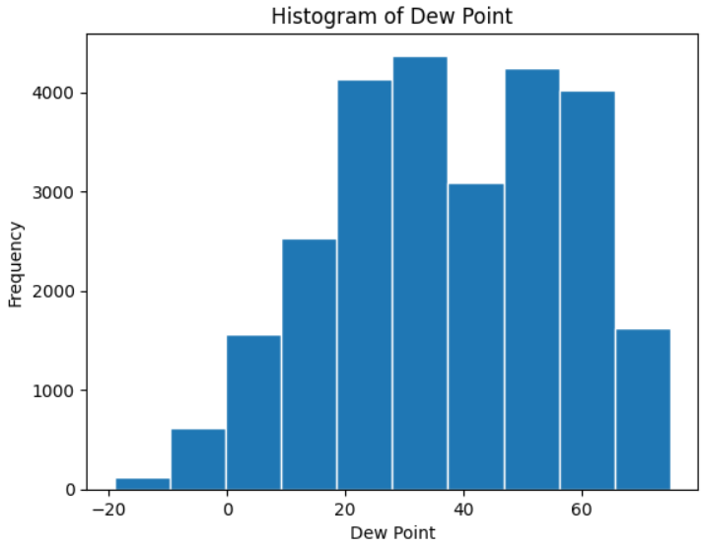
DATA EXPLORATION : (continued..)
Plotted histogram for Dew Point.
As we examine the histogram, the distribution is left-Skewed

Slide 18
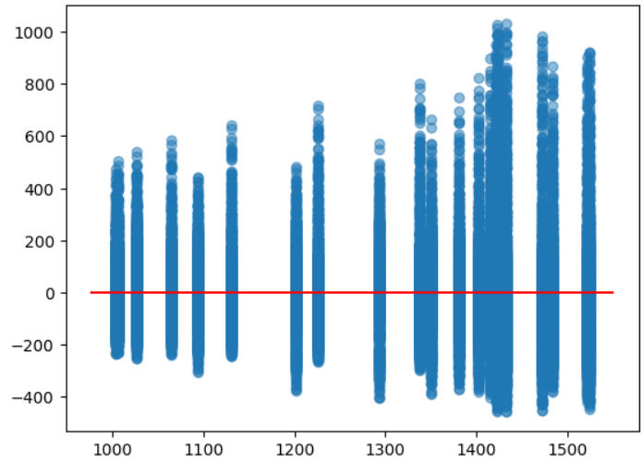
MODEL PREDICTION:
To predict right models , we have predicted total 9 regression models and there residual plots.
Model 1:
The dependent variable RT_Demand and the categorical variable Hr_End are used in a linear regression analysis.
The formula here is formula='RT_Demand ~ C(Hr_End) '
It outputs a summary of the regression findings with R-squared and modified R-squared values as follows:
1. R-squared: 0.4461998744343396
2. Adjusted R-squared: 0.44571519395914905
The plot is between fitted values and residual values.
The model is overly linear. In other words, the model
assumes that the connection between the independent
and dependent variables is exactly linear, although it
may be more non-linear in reality.

Slide 19
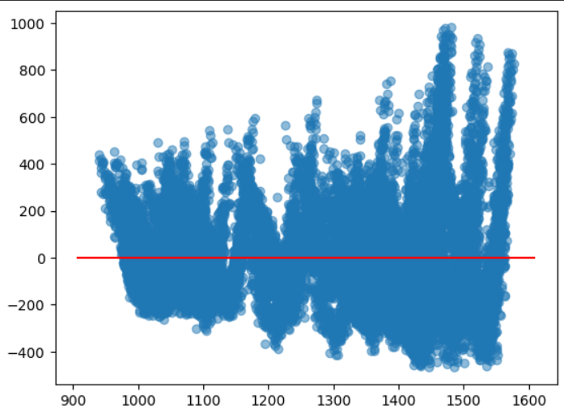
MODEL PREDICTION: (continued..)
Model 2:
The RT_Demand is the dependent variable, and the two independent variables are the categorical variable Hr_End and the continuous variable Dry_Bulb.
It generates a residual plot and publishes a summary of the regression findings for diagnostic purposes. The inclusion of Dry_Bulb indicates that the link between RT_Demand, categorical time periods (Hr_End), and temperature (Dry_Bulb) be investigated.
The formula is formula='RT_Demand ~ C(Hr_End)+ Dry_Bulb'
It outputs a summary of the regression findings with R-squared and modified R-squared values as follows:
1. R-squared: 0.455
2. Adjusted R-squared: 0.455
Residual plot clearly indicates a linear relationship
between the fitted residual values and the residual values.
This shows that at higher fitted values, the model is
underestimating the actual values.

Slide 20
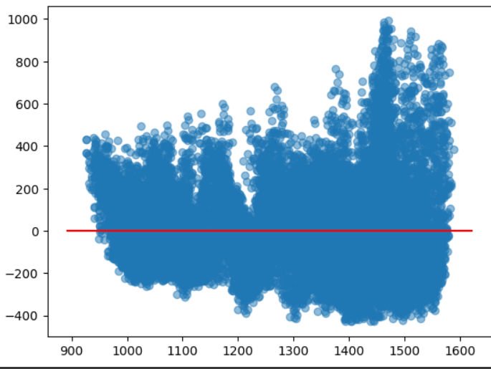
MODEL PREDICTION: (continued..)
Model 3:
This code runs a linear regression analysis on the dependent variable RT_Demand and three independent factors: Hr_End, a categorical variable, and the continuous variables Dry_Bulb and Dew_Point.
The formula is formula='RT_Demand ~ C(Hr_End)+ Dry_Bulb+Dew_Point'
It outputs a summary of the regression findings with R-squared and modified R-squared values as follows:
1. R-squared: 0.459
2. Adjusted R-squared: 0.459
The model is overly linear. In other words, the model assumes
that the connection between the independent and dependent
variables is exactly linear, although it may be more non-linear
in reality.

Slide 21
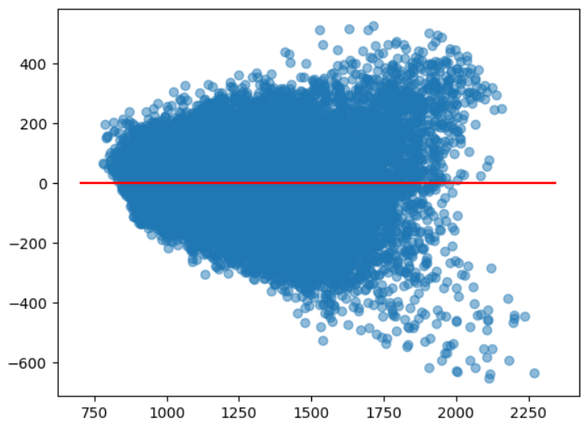
MODEL PREDICTION: (continued..)
Model 4:
A linear regression analysis on the dependent variable RT_Demand and four independent variables: the categorical variable Hr_End, as well as the continuous variables Dry_Bulb, Dew_Point, and the squared term of Dry_Bulb.
The formula is formula='RT_Demand ~ C(Hr_End) + Dry_Bulb + Dew_Point + I(Dry_Bulb**2)’
It outputs a summary of the regression findings with R-squared and modified R-squared values as follows:
1. R-squared: 0.775
2. Adjusted R-squared: 0.775
The residual plot clearly indicates a linear relationship
between the fitted residual values and the residual values.
This shows that with higher fitted residuals, the model is
underestimating the real residuals.

Slide 22
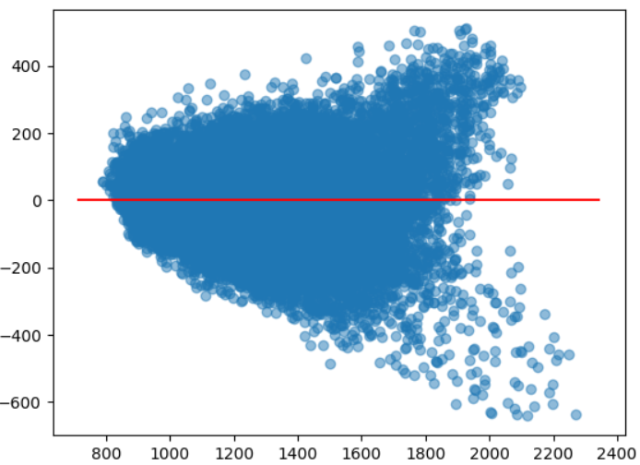
MODEL PREDICTION: (continued..)
Model 5:
By introducing quadratic terms in the linear regression model for both Dry_Bulb and Dew_Point. The quadratic terms enable the model to account for hypothetical nonlinear interactions between RT_Demand and temperature variables.
The formula is (formula='RT_Demand ~ C(Hr_End) + Dry_Bulb + Dew_Point + I(Dry_Bulb**2) + I(Dew_Point**2)’
It outputs a summary of the regression findings with R-squared and modified R-squared values as follows:
1. R-squared: 0.784
2. Adjusted R-squared: 0.783
The residual plot clearly indicates a linear relationship
between the fitted residual values and the residual values.
This shows that with higher fitted residuals, the model
is underestimating the real residuals.

Slide 23
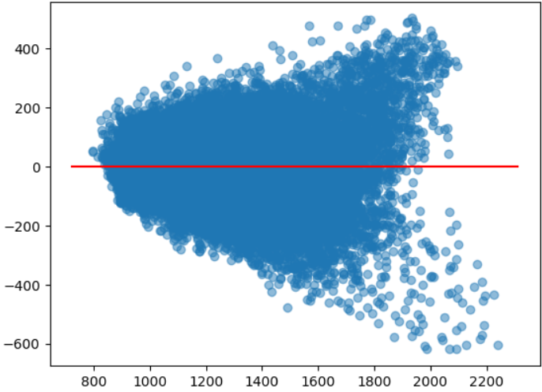
MODEL PREDICTION: (continued..)
Model 6:
A linear regression analysis with the dependent variable RT_Demand that contains categorical variables (C(Hr_End)), continuous variables (Dry_Bulb and Dew_Point), their squared terms, and an interaction term.
The formula is (formula='RT_Demand ~ C(Hr_End) + Dry_Bulb + Dew_Point + I(Dry_Bulb**2) + I(Dew_Point**2) + Dry_Bulb:Dew_Point’
It outputs a summary of the regression findings with R-squared and modified R-squared values as follows:
1. R-squared: 0.789
2. Adjusted R-squared: 0.789
The residual plot clearly indicates a linear relationship
between the fitted residual values and the residual values.
This shows that with higher fitted residuals, the model
is underestimating the real residuals.

Slide 24
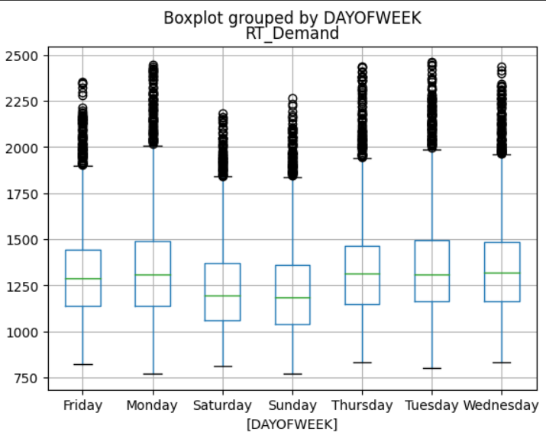
MODEL PREDICTION: (continued..)
Since we have tried all variations of models we have created a day of week column for accuracy and finding best model using datetime function.
For exploring the data we have plotted a boxplot :
We can observe from the plot that Saturday and Sunday’s have low Rt_demand since the all the offices and work places are closed on the days.Whereas on the weekdays the Rt_demand is high .

Slide 25
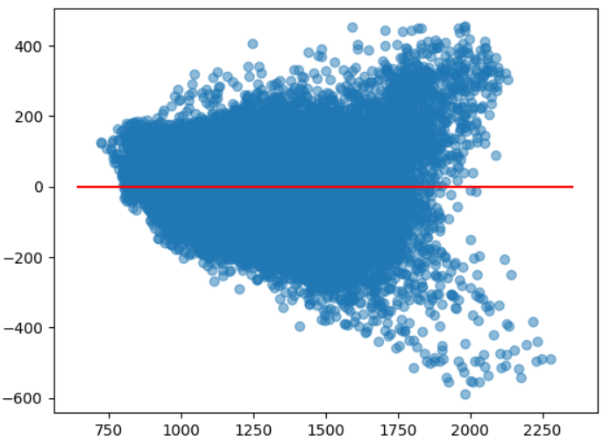
MODEL PREDICTION: (continued..)
Model 7:
RT_Demand is the dependent variable, Hr_End and DAYOFWEEK are categorical variables (C(Hr_End) and C(DAYOFWEEK), and there are continuous variables (Dry_Bulb and Dew_Point), their squared terms, and an interaction term (Dry_Bulb:Dew_Point).
The formula is formula='RT_Demand ~ C(Hr_End) + Dry_Bulb + Dew_Point + I(Dry_Bulb**2) + I(Dew_Point**2) + Dry_Bulb:Dew_Point + C(DAYOFWEEK)’
It outputs a summary of the regression findings with R-squared and modified R-squared values as follows:
1. R-squared: 0.827
2. Adjusted R-squared: 0.827
The residual plot demonstrates that the model does not
match the data well.
The evident pattern in the residual plot indicates that the
model has a problem, misspecification.
This issue must be addressed in order to increase the model’s
accuracy.

Slide 26
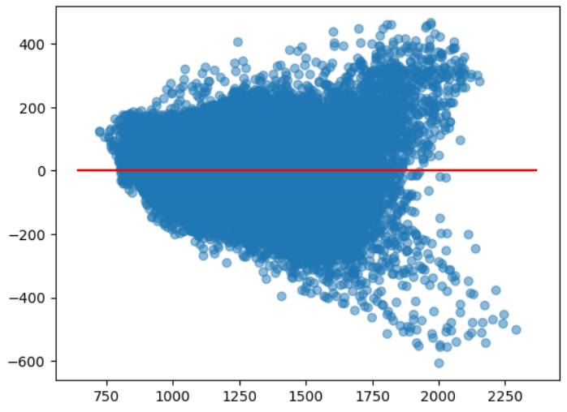
MODEL PREDICTION: (continued..)
Model 8:
A linear regression analysis with the dependent variable RT_Demand and multiple independent variables such as categorical variables (C(Hr_End), C(DAYOFWEEK), continuous variables (Dry_Bulb and Dew_Point), squared terms, and interaction terms (Dry_Bulb:Dew_Point, Dry_Bulb:C(DAYOFWEEK))
The formula is formula='RT_Demand ~ C(Hr_End) + Dry_Bulb + Dew_Point + I(Dry_Bulb**2) + I(Dew_Point**2) + Dry_Bulb:Dew_Point + C(DAYOFWEEK) + Dry_Bulb:C(DAYOFWEEK)’
It outputs a summary of the regression findings with R-squared and modified R-squared values as follows:
1. R-squared: 0.827
2. Adjusted R-squared: 0.827
Your residual plot clearly indicates a linear
relationship between the fitted residual values
and the residual values.

Slide 27
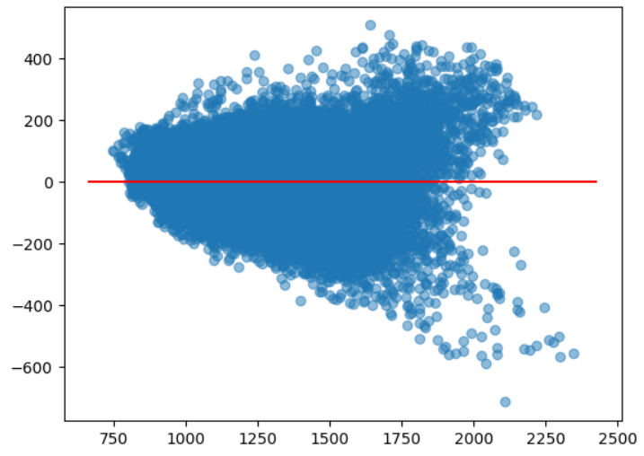
MODEL PREDICTION: (continued..)
Model 9:
A linear regression analysis with the dependent variable RT_Demand and several independent factors, including categorical variables (C(Hr_End), C(DAYOFWEEK), continuous variables (Dry_Bulb and Dew_Point), squared terms, and different interaction terms. The interaction terms with DAYOFWEEK imply an investigation of the relationship between RT_Demand, temperature variables, and their interactions with various days of the week.
The formula is formula='RT_Demand ~ C(Hr_End) + Dry_Bulb + Dew_Point + I(Dry_Bulb**2) + I(Dew_Point**2) + Dry_Bulb:Dew_Point + C(DAYOFWEEK) + Dry_Bulb:DAYOFWEEK + I(Dry_Bulb**2):DAYOFWEEK’
It outputs a summary of the regression findings with R-squared and modified R-squared values as follows:
1. R-squared: 0.83
2. Adjusted R-squared: 0.83
The plot is non linear which shows a good fit to the model.

Slide 28
FEATURE ENGINEERING:
The hourly Dry bulb squared , Dew point squared and interactive terms are added to the data set.
Dummies are created for Hour_end and day of week suing get dummies function.
To know how many features are present we used info() function
There are 34 columns(covariates) in data frame , so k=34 considered .
Since the covariates are greater than 30, exhaustive search cannot be used due to huge computing workload.
So we will be using Step wise model selection.

Slide 29
MODEL SELECTION
In our project we used step wise model selection.
Initially a function is created to provide a convenient way to evaluate the performance of a linear regression model by calculating key metrics such as RSS and R squared values.
To ensure that the first selection is always an improvement, the starting RSS and R-squared values are set to infinity.The loop employs forward selection, beginning with an empty set of features and adding them one at a time depending on the feature with the lowest RSS.
Overall, the method use a forward selection algorithm to create a subset of features for a linear regression model iteratively, picking features that minimize the RSS. It provides insights into the model's incremental progress as new features are introduced.
The selected features, RSS, and R-squared are concatenated into a DataFrame (df1).

Slide 30
MODEL SELECTION: (continued…)
Few variables are initialized for storing length of Y , the predictors p=34 and hat_sigma_squared which is estimate of the error variance.
Then followed by Information Criteria Calculation we used 4 types:
Mallows' C_p is a prediction error estimate derived as (1/m) * (RSS + 2 * numb_features * hat_sigma_squared).
AIC is calculated as (1/(m * hat_sigma_squared)) * (RSS + 2 * numb_features * hat_sigma_squared).
BIC = 1/(m * hat_sigma_squared) * (RSS + np.log(m) * numb_features * hat_sigma_squared).
R_squared_adj: Adjusted R-squared, a modified R-squared that penalizes for predictor number.
Columns for selected features, RSS, R-squared, the number of features, C_p, AIC, BIC, and modified R-squared are included in the final DataFrame df1.
From the result we observed that the model with all the features is having high RSS and R squared values.

Slide 31
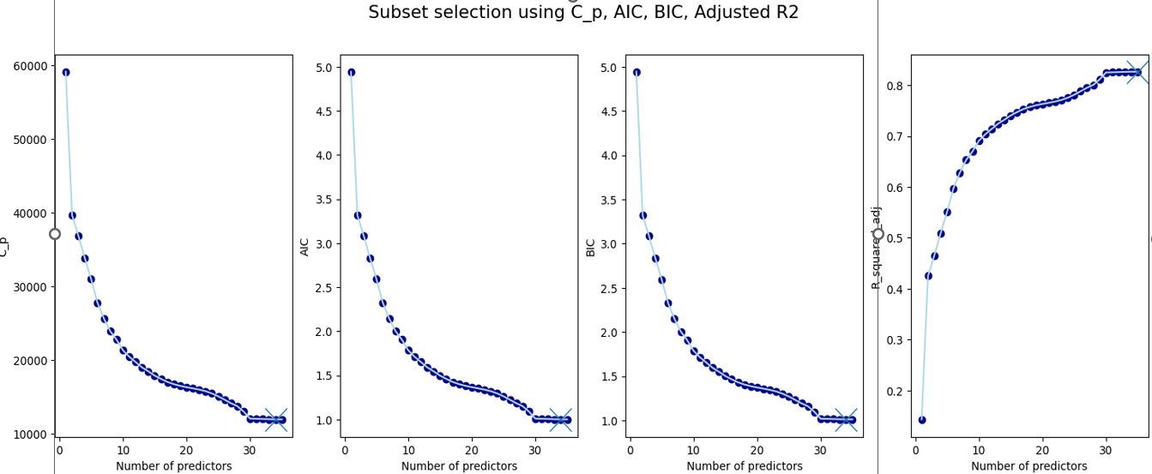
MODEL SELECTION: (continued…)
We have plotted a subplot of line graphs and scatter plots to display the performance of various information criteria (C_p, AIC, BIC, and Adjusted R-squared) in the context of subset selection for better understanding.
A graphical illustration of how various information requirements behave as the number of predictors in the model grows. The plots aid in selecting optimal subsets of predictors for each criterion. On each plot, the 'x' marker denotes the subset with the highest criterion value. This visualization assists in making educated model selection selections based on many criteria.
This shows that 'Dry_Bulb_squared','Dry_Bulb','Hr_End_4','Hr_End_3','Hr_End_5','Hr_End_2','Hr_End_6','Hr_End_24','Hr_End_7','Hr_End_23','Hr_End_19','Hr_End_18''Hr_End_20','Hr_End_17','Hr_End_21','Hr_End_16','Hr_End_14','Hr_End_15','Hr_End_13','Hr_End_12','Hr_End_11','Hr_End_10','Hr_End_9','Hr_End_22','Hr_End_8''DAYOFWEEK_Sunday','DAYOFWEEK_Saturday','DAYOFWEEK_Wednesday','DAYOFWEEK_Tuesday','DAYOFWEEK_Thursday','DAYOFWEEK_Monday''Interactive_Term','Dew_Point','Dew_Point_squared' - with all these 34 features are considered as best model for the data.

Slide 32
MODEL TRAINING:
Based on the date, the dataset is divided into training and testing sets. Data prior to '2022-12-1' is utilized for training (training_data), whereas data after '2022-12-1' is used for testing (testing_data).
Creating Feature Matrix and Target Variable:
The feature matrices (X_train and X_test) for both the training and testing sets are defined using specified columns from the DataFrame. These are the characteristics that will be utilized to predict the target variable.For each set, the goal variables (y_train and y_test) are defined as the 'RT_Demand’ column.
Machine learning models can be trained and tested using these datasets. The feature matrices are represented by X_train and X_test, while the target variables are represented by y_train and y_test.
A fundamental linear regression method in which a model is created, trained with existing data, and used to make predictions on fresh, unknown data. Linear regression presupposes that the independent variables (features) and the dependent variable (target) have a linear relationship. The trained model can then be assessed further and used for analysis or prediction.

Slide 33
MODEL EVALUATION: (Continued…)
These are the values for Linear Regression models:
The MSE and RMSE values are calculated:
Mean Squared Error(MSE) = 11663.605360351292
Root Mean Squared Error = 107.99817294913508
The r2 score value is calculated:
r2 score= 0.654714560140025

Slide 34
MODEL TRAINING: (Continued…)
Random Forest Classifier:The code creates and trains a Random Forest Regressor model with 100 trees based on the characteristics (X_train) and target variable (y_train) supplied.
Random Forest models are a collection of decision trees, with each tree trained on a distinct sample of the data and making its own predictions. The final forecast is frequently an average of all the trees or a vote process.
The random_state parameter is set to allow others to duplicate the exact same model if they use the same random seed.
The rf_model instance holds information on the ensemble of decision trees after training, and this trained model can be used to make predictions on new data (X_test), evaluate performance, or examine feature importance.
After training the Random Forest Regressor model, the predict technique is used to generate predictions using new, previously unseen data (in this case, the test set).The projected values for the target variable are stored in rf_predictions, which is a NumPy array or array-like object based on the characteristics in X_test.

Slide 35
MODEL EVALUATION: (Continued…)
To evaluate the model's performance, these predictions can be further assessed and compared to the actual target values (y_test). Mean Squared Error (MSE), Root Mean Squared Error (RMSE), and R-squared are all common measurements.
The MSE and RMSE values are calculated:
Mean Squared Error(MSE) = 6426.511885828212
Root Mean Squared Error = 80.1655280393525

Slide 36
Conclusion
Based on this MSE and RMSE values Random Forest Classifier is the best model.

Slide 37
Future Scope
We can add interactive variable between Hr_end and Day of week to improve the model.
We can add interactive variable between Dry bulb and DAYOFWEEK to improve the model.
We can add interactive variable between Dry_bulb_square and Dayofweek to improve the model.
We can extend the cross validation to the second level by training data sets till October 2022 and test it with November 2022.
We can consider public holidays and normal days to improve the model .

Slide 38
THANK YOU
TEAM 6

