Slide 1
Agenda
1. Ansible Introduction
2. Why Ansible?
3. Ansible Architecture / How Ansible Works?
4. Ansible Components/Concepts
5. Ansible – Playbooks
6. Ansible – Role
7. Ansible Tower

Slide 2
What is Vagrant?
http://www.vagrantup.com/
Written by Mitchell Hashimoto
Command line tool
Automates VM creation with
Virtual Box
VMWare
Hyper-V
Integrates well with Shell
Ansible
Chef
Puppet
Runs on Linux, Windows, MacOS
Why use Vagrant?
Create new VMs quickly and easily
Only one command! vagrant up
Keep the number of VMs under control
Reproducibility
Identical environment in development and production
Portability
No more 4GB .ova files
git clone and vagrant up

Slide 3
• What if setting up and configuring your cloud / private
infrastructure were even simpler than writing a shell script?
• Based on the concept of Infrastructure as Data
– simplicity as key design requirement
– powerful
– easy to learn for Dev and Ops people alike
• Created by Michael De Haan of Cobbler fame
– Open Source @ https://github.com/ansible/ansible/
– now supported by http://www.ansibleworks.com/
• Well documented,Growing, active and supportive community

Slide 4
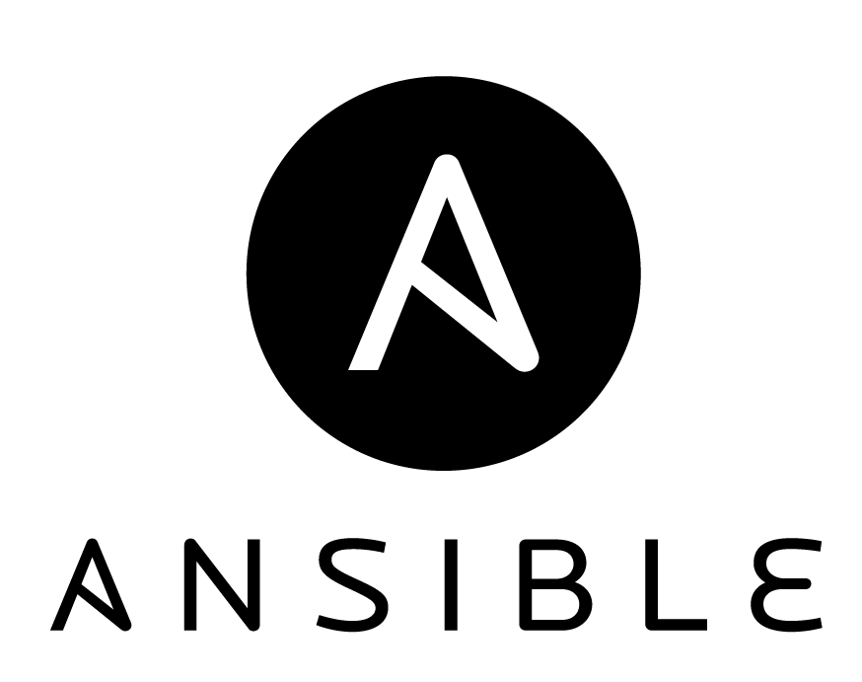
What is Ansible?
Simple, agentless and powerful open source
IT automation tool
Provisioning
Configuration Management
Application Deployment
Continuous Delivery
Security & Compliance
Orchestration

Slide 5
Why Ansible?
Agent-less architecture (no agent is required, everything is done by using SSH, ssh for communication)
It is very simple and powerful
No centralized server, no client-side agents
SSH based secured connection
Configuration as data, not code (YAML files)
Full conf. management, deployment and orchestration
Custom modules can be written in any programming language.
Idempotent : Ensure no changes, unless things change
JSON input/output is sufficient to integrate a module into Ansible.

Slide 6
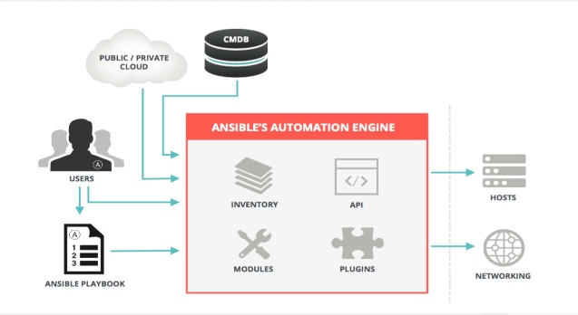
How Ansible Works?
Ansible works by connecting to your nodes and pushing out small programs, called “Ansible Modules” to them. Ansible then executes these modules (over SSH by default) and removes then when finished.

Slide 7
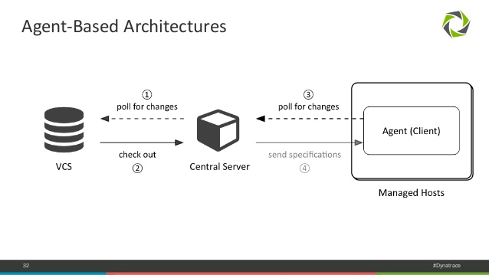
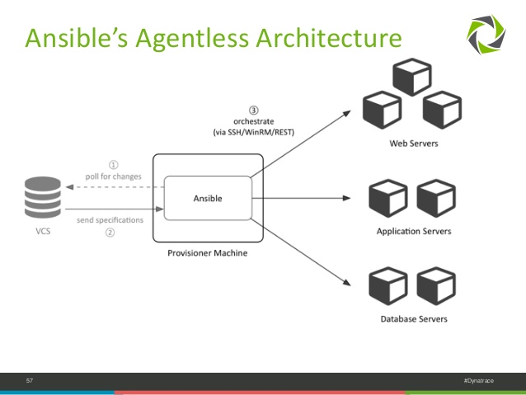

Slide 8
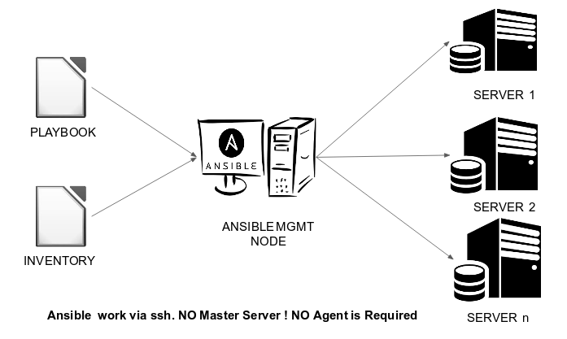
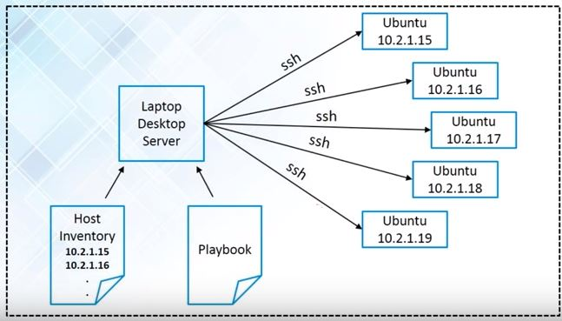

Slide 9
Installation - control machine – Apt
○ Latest release Via Apt
● $ sudo apt-get install software-properties-common
● $ sudo apt-add-repository ppa:ansible/ansible
● $ sudo apt-get update
● $ sudo apt-get install ansible

Slide 10
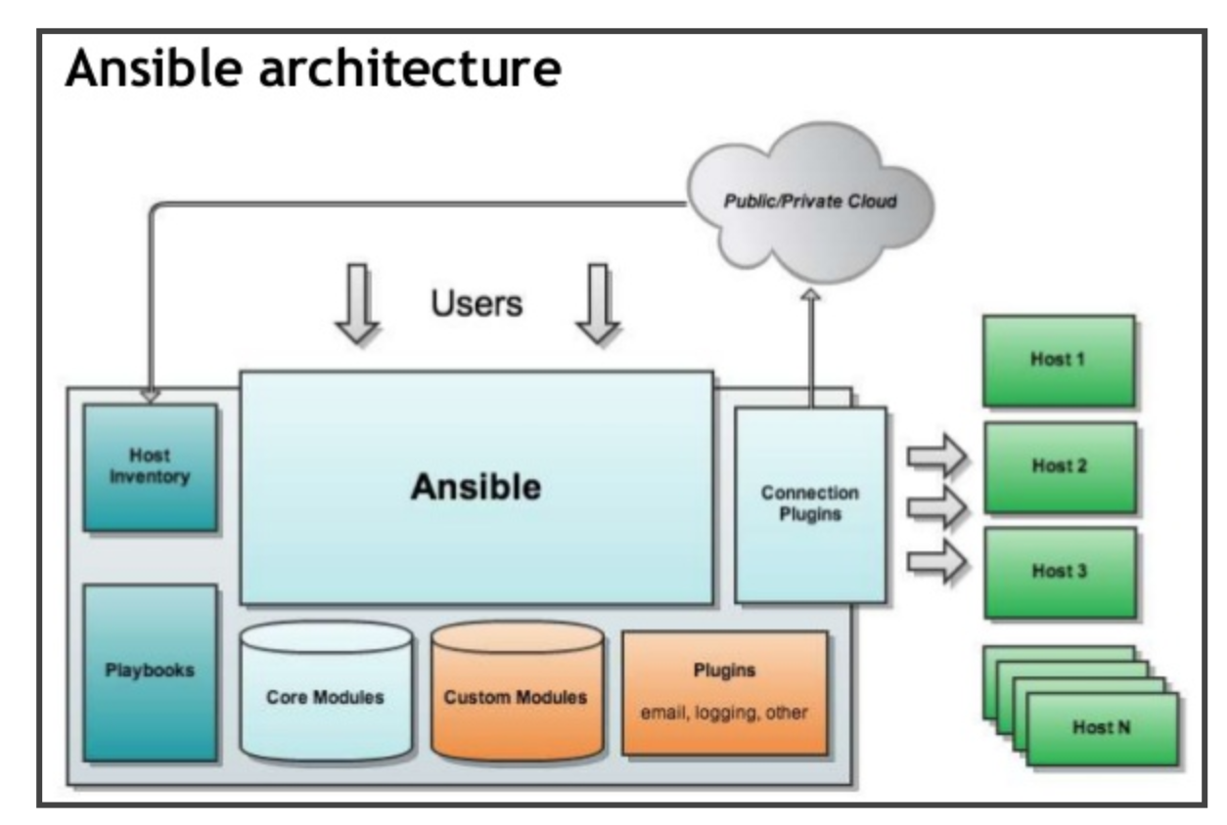

Slide 11
Ansible Terms:
Controller Machine: The machine where Ansible is installed, responsible for running the provisioning on the servers you are managing.
Inventory: An initialization file that contains information about the servers you are managing.
Playbook: The entry point for Ansible provisioning, where the automation is defined through tasks using YAML format.
Task: A block that defines a single procedure to be executed, e.g. Install a package.
Module: A module typically abstracts a system task, like dealing with packages or creating and changing files. Ansible has a multitude of built-in modules, but you can also create custom ones.
Role: A pre-defined way for organizing playbooks and other files in order to facilitate sharing and reusing portions of a provisioning.
Play: A provisioning executed from start to finish is called a play. In simple words, execution of a playbook is called a play.
Facts: Global variables containing information about the system, like network interfaces or operating system.
Handlers: Used to trigger service status changes, like restarting or stopping a service.

Slide 12
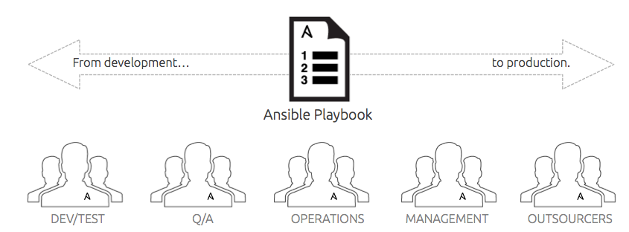
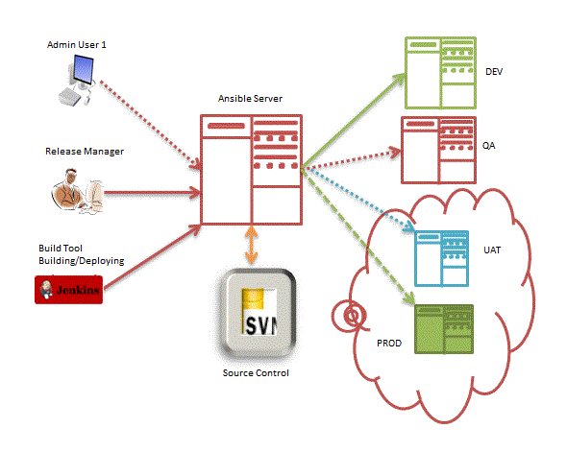

Slide 13
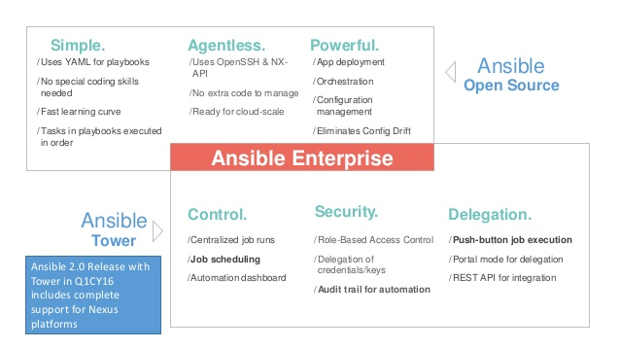
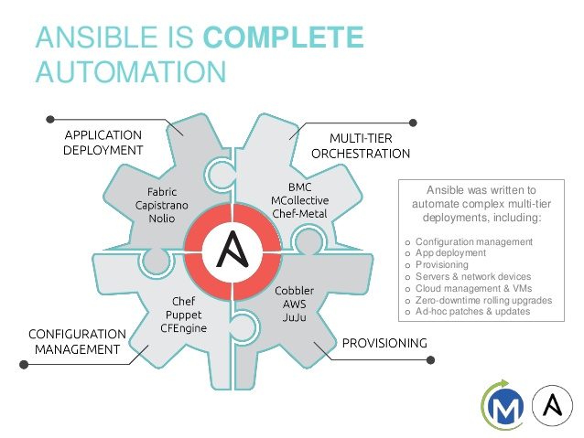

Slide 15
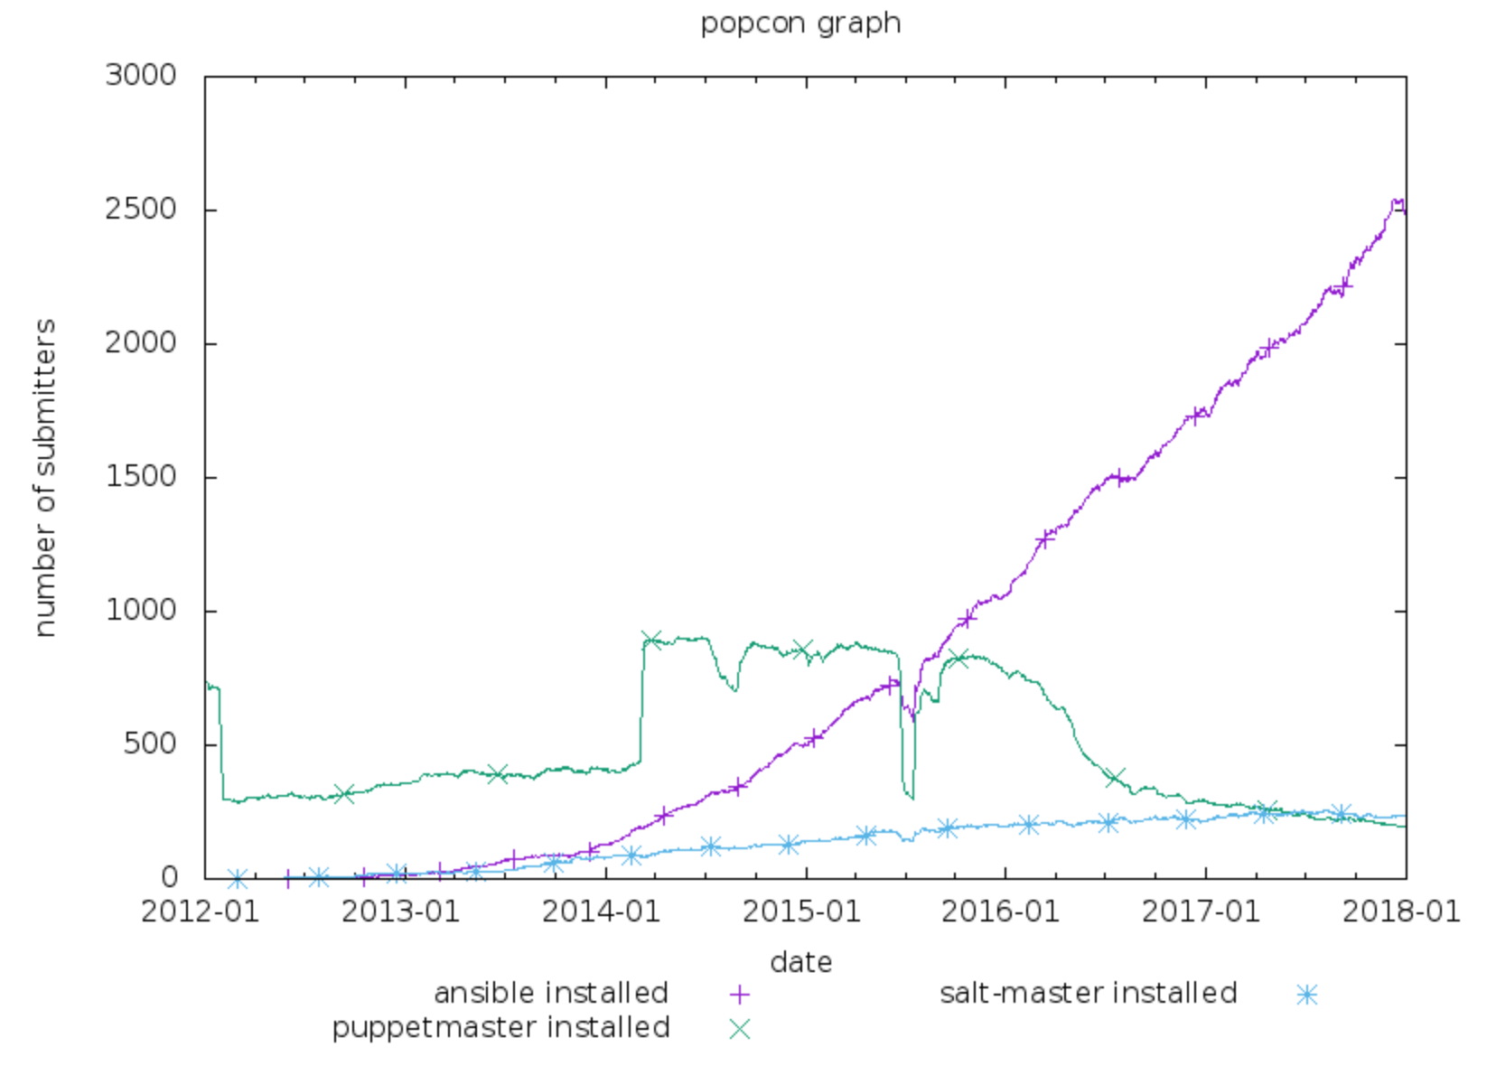
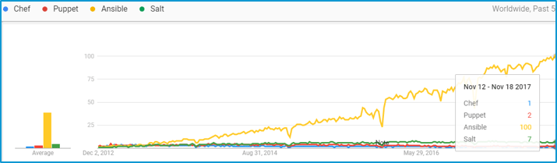

Slide 16
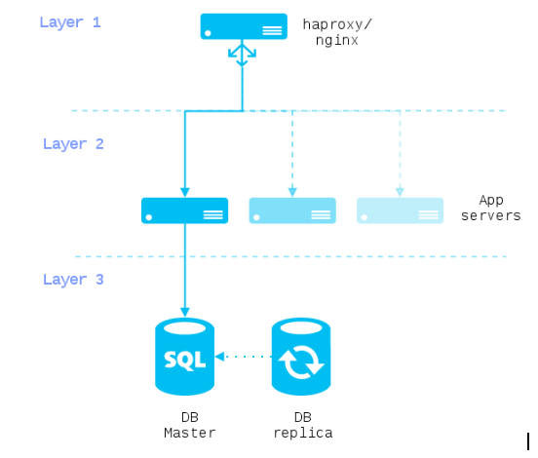
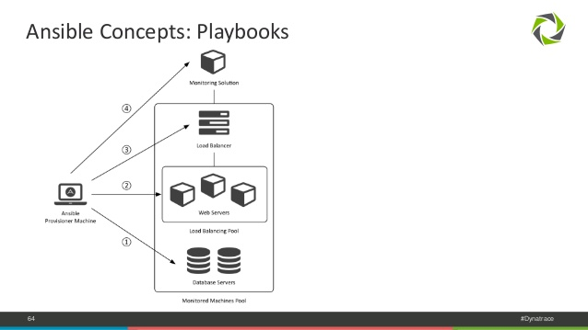

Slide 17
Use Ansible
• Get more sleep
• Require less coffee

Slide 21
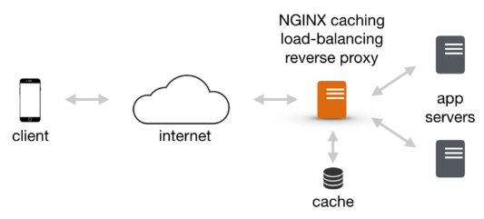

Slide 29
Same operation? Same result, again &
again.
• Ensure no changes unless things change.
• No uncertainty: describe desired state.
• System life cycle as transaction log,
accounts for all changes done on purpose.

