Slide 1
Job portal
PROJECT BY - V SIVA
EMP ID- 154949

Slide 2
Project SUMMARY
Project Title | Online Job Portal System
Abstract : | The System developed for Admin , Job Seeker (User) and Employer. The system provide intermediate space for job seeker and Admin.
Project Type : | Website
Technology : | ASP .NET CORE MVC , C# , API, Test Project HTML, CSS, JS
Libraries | Bootstrap, JQuery
DataBase : | Sql Server
Tools | Visual Studio 2022, Sql Server Management Studio

Slide 3
Introduction
The online job portal system is a platform between job seeker(student) and job provider(company). The Student or Job seeker can easily find and apply for job by login into system. The Employer or company can easily get expert employee from our job portal site by posting a job. The job portal website is a common place between job seeker and company.
When job seeker can login in his account then he can get notification of company lists which match with his profile or education detail. So job seeker can easily apply to this Job and he can also send message to company for other inquiry.
When company login in account, company or employer can get alert of job seeker lists which match with all criteria for posted job.

Slide 4
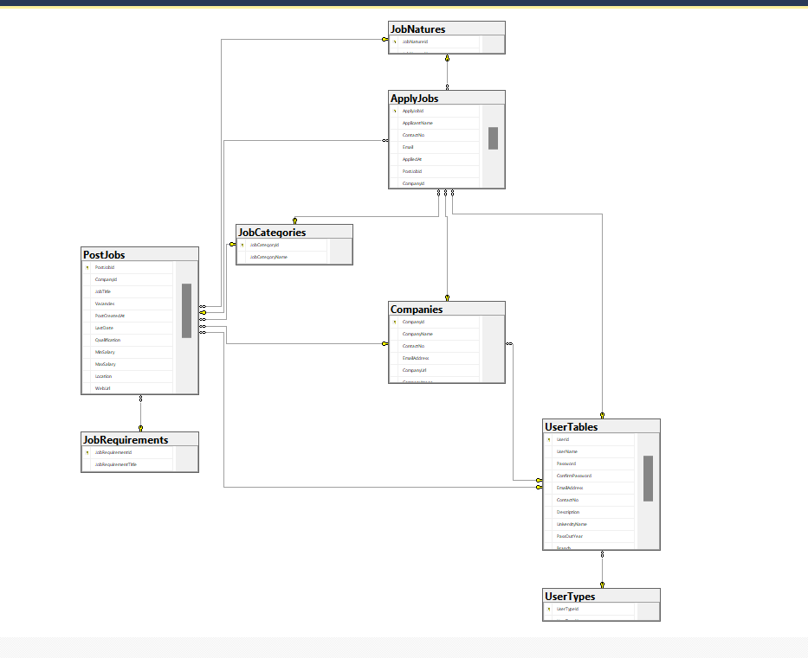
DATABASE DIAGRAM

Slide 5
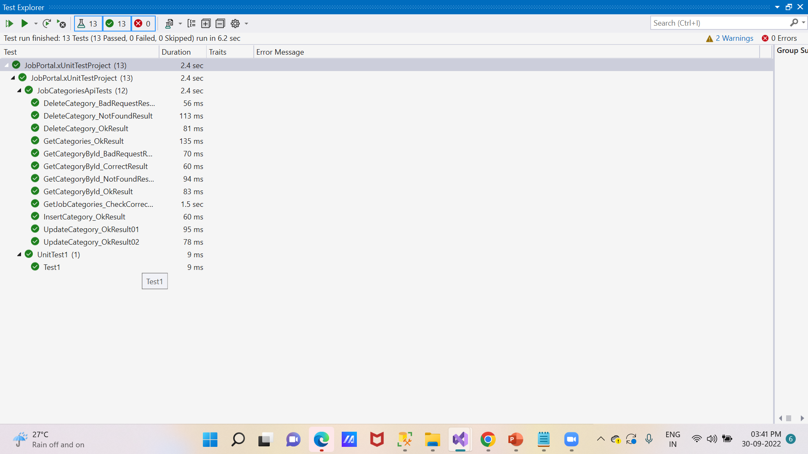

Slide 6

ThaNk YOU

