Slide 1

Mutual Fund Analytics
Bluestock Fintech Capstone Project
Submitted by
Siva Kumar Bandaru

Slide 2


Project Overview
Objective
Develop a complete Mutual Fund Analytics solution that transforms raw financial datasets into actionable business insights using data engineering, analytics, visualization, and reporting.
Project Goals
Build an automated ETL pipeline
Clean and validate financial datasets
Design a relational SQLite database
Perform Exploratory Data Analysis (EDA)
Compute mutual fund performance metrics
Develop interactive Power BI dashboards
Generate investment recommendations using analytics

Slide 3
Data Sources
Data Sources
The project integrates multiple datasets covering different aspects of the mutual fund industry.
Datasets Used
Fund Master
NAV History
AUM by Fund House
Monthly SIP Inflows
Category Inflows
Industry Folio Count
Investor Transactions
Scheme Performance
Portfolio Holdings
Benchmark Indices

Slide 4
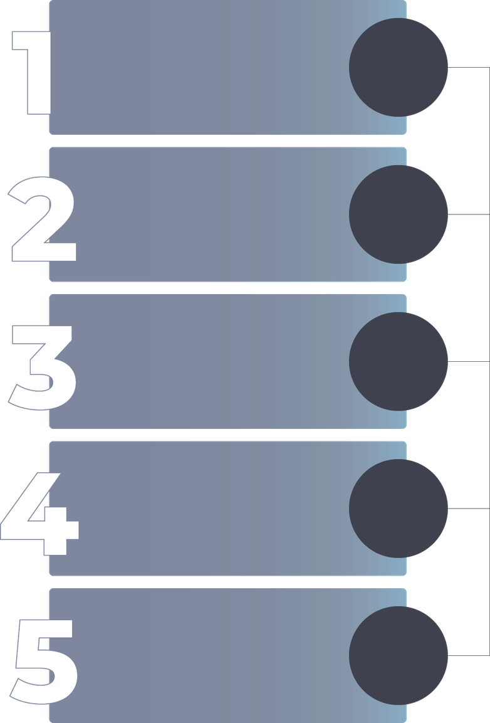
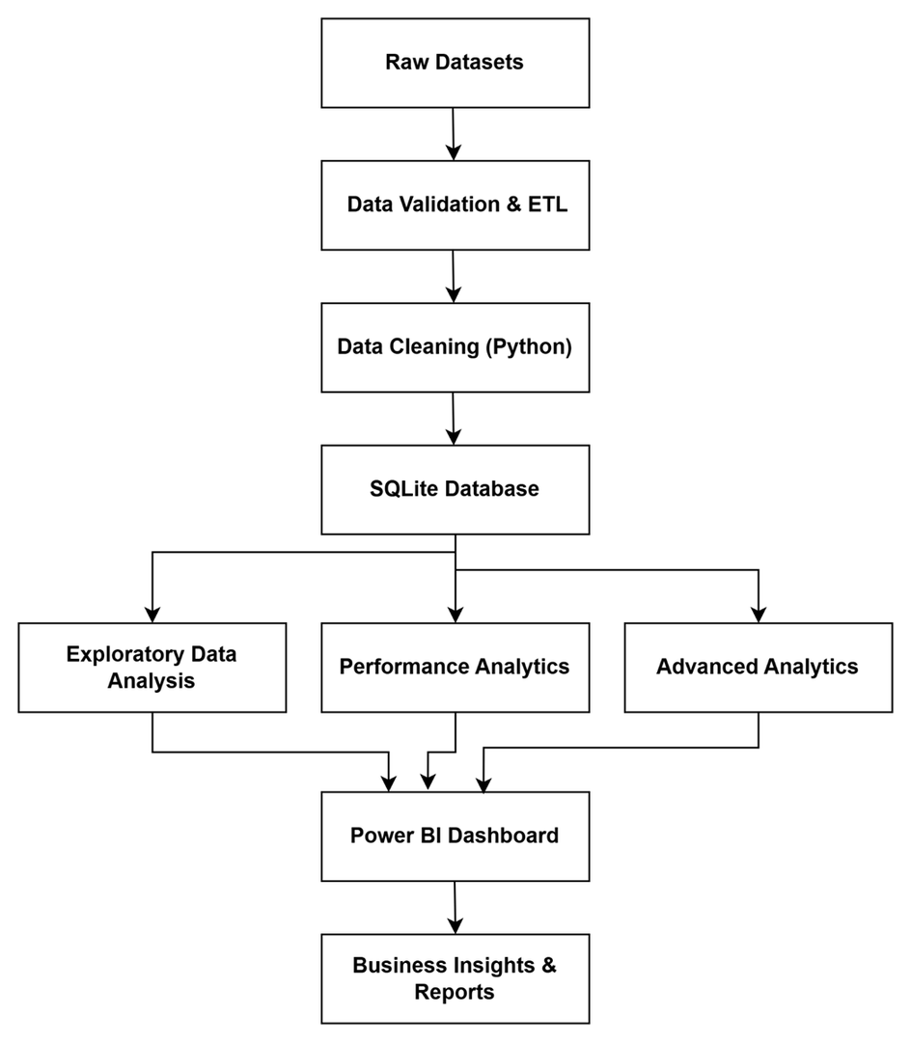
Tools Used
1
Python
2
Pandas
3
SQLite
4
Plotly
5
Power BI

Slide 5
Exploratory Data Analysis
Exploratory Data Analysis
Key analyses performed include:
NAV Trend Analysis
AUM Growth Analysis
SIP Growth Analysis
Investor Demographics
Sector Allocation
State-wise Investments
Category-wise Inflows
Correlation Analysis

Slide 6
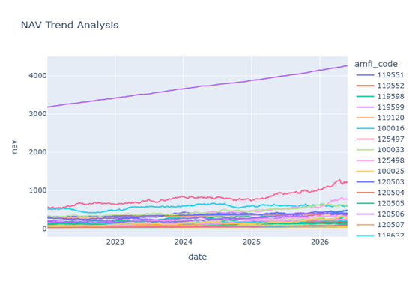
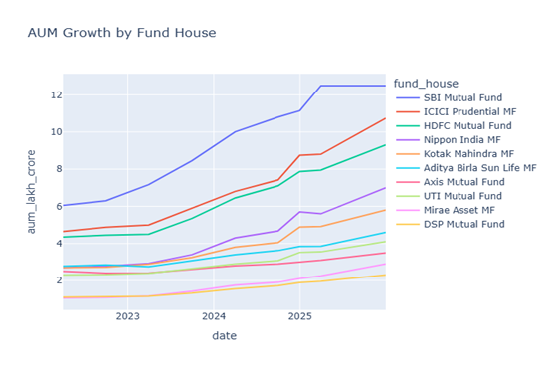
Key Insight
The mutual fund industry showed consistent growth in assets under management and investor participation during the study period.

Slide 7
Performance Analytics
Fund Performance Analytics
Performance metrics were calculated using historical NAV data.
Metrics
Annual Return
CAGR
Sharpe Ratio
Sortino Ratio
Alpha
Beta
Maximum Drawdown

Slide 8
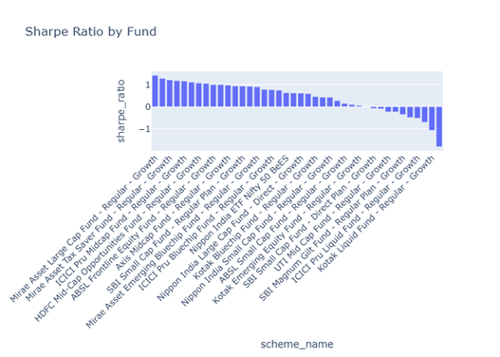
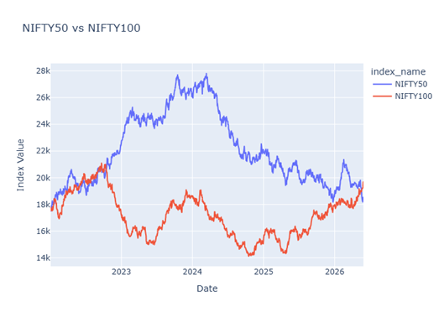
Outcome
A comprehensive fund scorecard was developed to rank schemes based on risk-adjusted performance.

Slide 9
Advanced Analytics
Advanced Analytics
Implemented advanced financial analytics including:
Historical Value at Risk (VaR)
Conditional Value at Risk (CVaR)
Rolling Sharpe Ratio
Investor Cohort Analysis
Sector Concentration (HHI)
Rule-based Fund Recommendation System

Slide 10
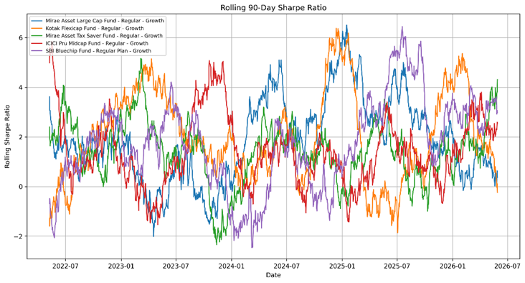
Outcome
Generated data-driven investment recommendations based on investor risk profiles.

Slide 11
Power BI Dashboard
Interactive Dashboard
Developed a four-page interactive dashboard.
Dashboard Pages
Features
Industry Overview
Fund Performance
Investor Analytics
SIP & Market Trends
KPI Cards
Interactive Filters
Dynamic Charts
Drill-down Analysis

Slide 12
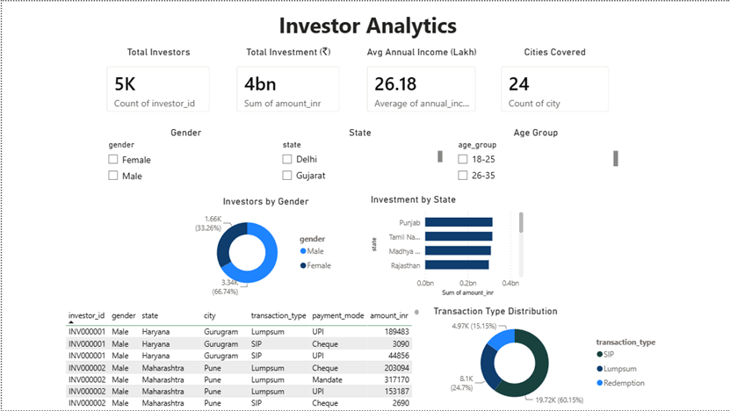

Slide 13
Key Insights
Key Findings
Mutual fund AUM increased significantly during the analysis period.
SIP contributions showed steady year-on-year growth.
Equity funds delivered stronger long-term risk-adjusted returns.
Sharpe Ratio effectively differentiated consistent performers.
Investor participation was highest among the 26–35 age group.
Diversified portfolios demonstrated lower concentration risk.
Interactive dashboards simplified complex financial analysis.

Slide 14
Technologies Used
Technology Stack
Programming
Database
Python
SQL
SQLite
Visualization
Libraries
Power BI
Development Tools
Pandas
NumPy
Matplotlib
Plotly
SciPy
SQLAlchemy
VS Code
Jupyter Notebook
Git
GitHub

Slide 15
Project Deliverables
Deliverables
Skills Demonstrated
ETL Pipeline
SQLite Database
Data Cleaning Scripts
SQL Schema & Queries
EDA Notebook
Performance Analytics Notebook
Advanced Analytics Notebook
Power BI Dashboard
Final Report
GitHub Repository
Data Engineering
Financial Analytics
Data Visualization
Dashboard Development
Business Intelligence

Slide 16
Conclusion
Conclusion
This project demonstrates an end-to-end analytics pipeline for the mutual fund industry, combining data engineering, financial analysis, business intelligence, and interactive visualization to support informed investment decisions.

Slide 17
Thank
You

