Slide 1

BATCH - 11
DEPARTMENT OF ARTIFICIAL INTELLIGENCE
20AM6203 - DESIGN PROJECT - II
MULTILINGUAL VOICE MESSAGE TRANSLATION
TEAM MEMBERS:
MOHAMMED HISHAAM S 811722001032
MUHAMMAD FAATIN S 811722001034
SIVA DHARSHAN M 811722001048
GUIDED BY:
Mrs.P.JASMINE JOSE
Assistant Professor,AI

Slide 2
OBJECTIVE
To develop a multilingual voice translation system that allows users to upload an audio message in any supported language (e.g., Tamil, Hindi, Malayalam, Kannada, French, Arabic, English), automatically transcribe the spoken content, translate it into a selected target language, and output the translated message as a natural-sounding male voice audio, thereby enabling real-time cross-language communication in an intuitive and accessible way.

Slide 3
EXISTING SYSTEM
Provide real-time speech-to-speech translation across many languages.
Require internet connection and do not support pre-recorded voice uploads.
Lack flexibility in voice customization and natural-sounding output.
Cloud solutions offer advanced tools but demand coding skills and are expensive.
Developer-made tools are limited to text or robotic speech.
Most existing systems are either too technical, costly, or not offline-friendly.

Slide 4
PROPOSED SYSTEM
Allows users to upload voice recordings in multiple languages (Tamil, Hindi, Malayalam, etc.)
Uses Whisper model to transcribe speech automatically.
Translates transcribed text into selected target language via Google Translator API.
Built with Gradio for a simple, user-friendly interface.
Supports customizable, natural-sounding voice output.
Accepts pre-recorded voice messages and works partially offline.
Designed for accessibility, education, and multilingual communication.

Slide 5
LITERATURE SURVEY
S.NO | Paper Title | Author(s) | Publication/ Year | Techniques | Demerits
1 | KIT's Multilingual Speech Translation System for IWSLT. | Danni Liu, Thai Binh Nguyen, Sai Koneru. | 2023 | Image Processing, Deep Learning. | End-to-end systems processing, may require more data.
2 | Textless Speech-to-Speech Translation on Real Data. | Ann Lee, Hongyu Gong | 2022 | Self-supervised learning. | Complicate error analysis and system interpretability.
3 | End-to-End Simultaneous Speech Translation. | Xingshan Zeng, Pengfei Li, Liangyou Li | 2022 | Pretraining and knowledge distillation, incorporating automatic speech recognition. | Necessitate substantial computational resources and access to large-scale datasets.
4 | Towards a Deep Understanding of Multilingual End-to-End Speech Translation | Haoran Sun, Xiaohu Zhao | 2022 | SVCCA to analyze how multilingual speech translation models. | Large computational power.
5 | Multilingual Speech-to-Speech Translation into Multiple Target Languages | Hongyu Gong, Ning Dong | 2022 | S2MU model with masking and a multilingual vocoder. | High-quality data for each language.

Slide 6
DATAFLOW DIAGRAM
Text Translation
(Machine Translation)
User Voice
(Audio Input)
Speech to Text conversion
Audio Output
(Response)
Language Selection
Text to Speech

Slide 7
SYSTEM DESCRIPTION
HARDWARE SPECIFICATIONS
Component | Minimum Requirement
Processor | Intel i5 / AMD Ryzen 5 or higher
RAM | 8 GB or more
Storage | At least 5 GB free disk space
Microphone | (Optional) For live voice input
Speakers / Headphones | Required for listening to output

Slide 8
SOFTWARE SPECIFICATIONS
Software | Version / Details
Operating System | Windows 10/11, macOS, or Linux
Python | Version 3.8 or higher
Gradio | For the web interface (pip install gradio)
OpenAI Whisper | For speech-to-text (pip install -U openai-whisper)
Edge TTS | For natural voice generation (pip install edge-tts)
Deep Translator | For language translation (pip install deep-translator)
FFmpeg | Required by Whisper for audio processing
Web Browser | Chrome, Firefox, or Edge (to view Gradio app)

Slide 9
MODULES
Voice Input Module
Transcription Module
Translation Module
Text-to-Speech (TTS) Module
User Interface Module

Slide 10
Voice Input Module:
Enable the system to accept audio input in real-time or from an uploaded file.
Supported Languages: Tamil, Hindi, Malayalam, Kannada, Arabic, French, English.
How it Works:
The input audio is passed to OpenAI’s Whisper model.
Whisper automatically detects the spoken language.
It then transcribes the voice message into accurate text.

Slide 11
Technology Used: Gradio Audio() component for seamless browser-based audio input.
Significance: Provides the starting point of the entire translation pipeline by accepting natural language from users.

Slide 12
2.Transcription Module
Convert the spoken words in the uploaded voice into text.
Tool Used: OpenAI’s Whisper Model.
Key Features:
Supports automatic language detection.
High accuracy even in noisy environments or with accents.

Slide 13
Process:
Preprocesses the audio for noise and duration.
Runs model inference to generate textual output.
Benefits: Lays the groundwork for accurate translation by ensuring a clean and correctly interpreted transcription.

Slide 14
3. Translation Module
Translate the transcribed text into the desired output language selected
by the user.
Tool Used: Deep Translator library (Google Translate API).
Process:
Detects source language automatically (in case Whisper’s language detection fails).
Uses neural network-based translation models for fluency and contextual understanding.

Slide 15
Supported Language Combinations: Translates between all major
world languages.
Real-World Benefit: Breaks language barriers by allowing users to
communicate across cultures seamlessly.

Slide 16
4. Text-to-Speech (TTS) Module
To convert the translated text into a realistic male voice in the target language.
How it Works:
Translated text is sent to the TTS engine.
Voice is generated using selected neural voice
(e.g., en-US-GuyNeural, ta-IN-ValluvarNeural).
Output is saved as a .mp3 audio file for playback or download.

Slide 17
Technology Used: Microsoft Edge TTS (Neural voices via edge-tts library).
Advantage: Natural, expressive voice output with male voice preference.

Slide 18
5. User Interface (UI) Module
Act as the interactive front-end for users to control and use the system.
Tool Used: Gradio (Python UI Framework)
Features:
Upload audio or record directly.
Choose source and target languages from dropdowns.
View transcribed and translated text.
Play and download translated audio.

Slide 19
Advantages:
No technical knowledge required.
Runs in any browser with no extra installations.
Integrates all backend modules for seamless flow.
Outcome:
Delivers a full end-to-end multilingual voice message translation experience.

Slide 20
ADVANTAGES
Enables real-time voice translation for cross-language communication
Supports regional and international languages like Tamil, Hindi, Arabic, and French
Provides an easy web interface for audio upload or recording
Delivers natural-sounding male voice outputs using neural text-to-speech
Ideal for use in tourism, education, customer support, and emergency services

Slide 21
APPLICATIONS
Tourist voice message translation
Multilingual classroom content delivery
Call center language support
Doctor-patient language communication

Slide 22
CONCLUSION
The Multilingual Voice Message Translation System enables seamless
communication across different languages,combining speech-to-text, translation, and text-to-speech technologies. It has practical applications in tourism, education, customer service, and healthcare, providing an accessible and user-friendly solution to break language barriers.

Slide 23
REFERENCES
Bhowmik, M. D., & Das, S. “Speech Translation Systems: A Comprehensive Review.
Journal of Artificial Intelligence Research”, 2024.
Kumar, R., & Gupta, A. “Voice-based Translation Systems: Challenges and Solutions.
International Journal of Linguistic Technology”,2023.
Patel, A., & Sharma, R. “Enhancing Multilingual Voice Recognition Using Deep
Learning. Proceedings of the International Conference on Speech Processing”, 2023.
Zhang, L., & Li, J. “Neural Networks for Text-to-Speech Systems in Multilingual
Environments. Journal of Machine Learning”, 41(6), 2023.

Slide 24
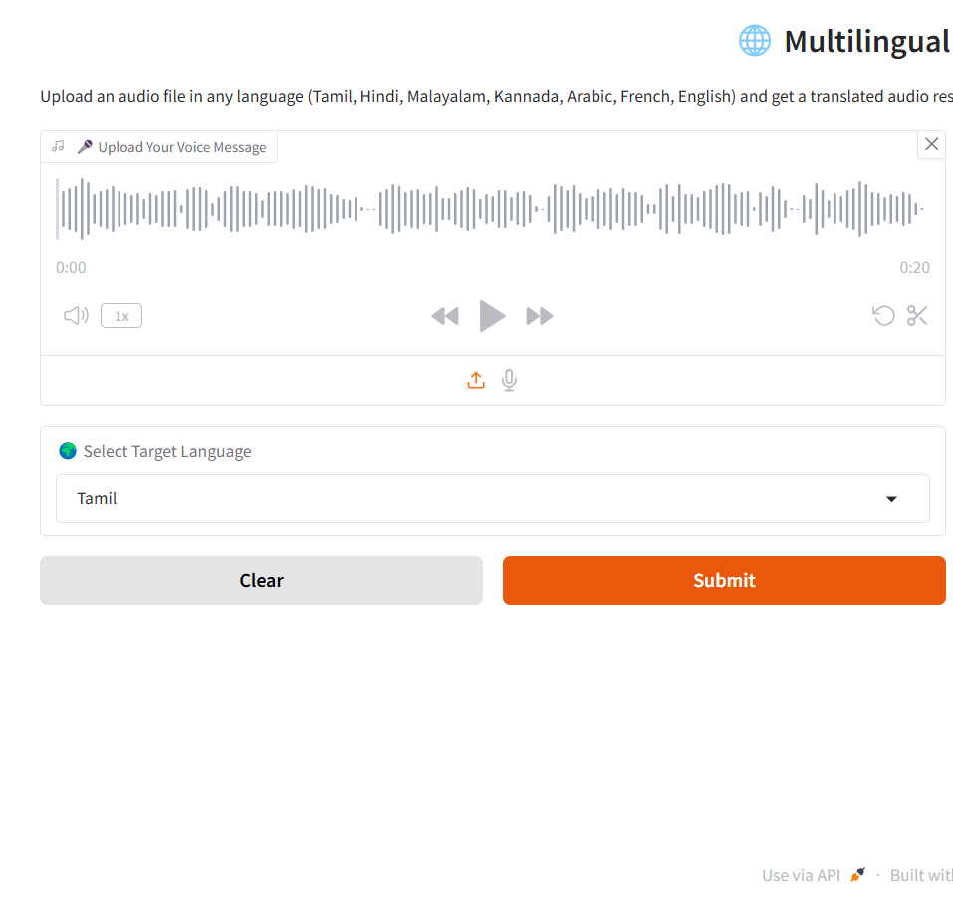
SCREENSHOTS
INPUT

Slide 25
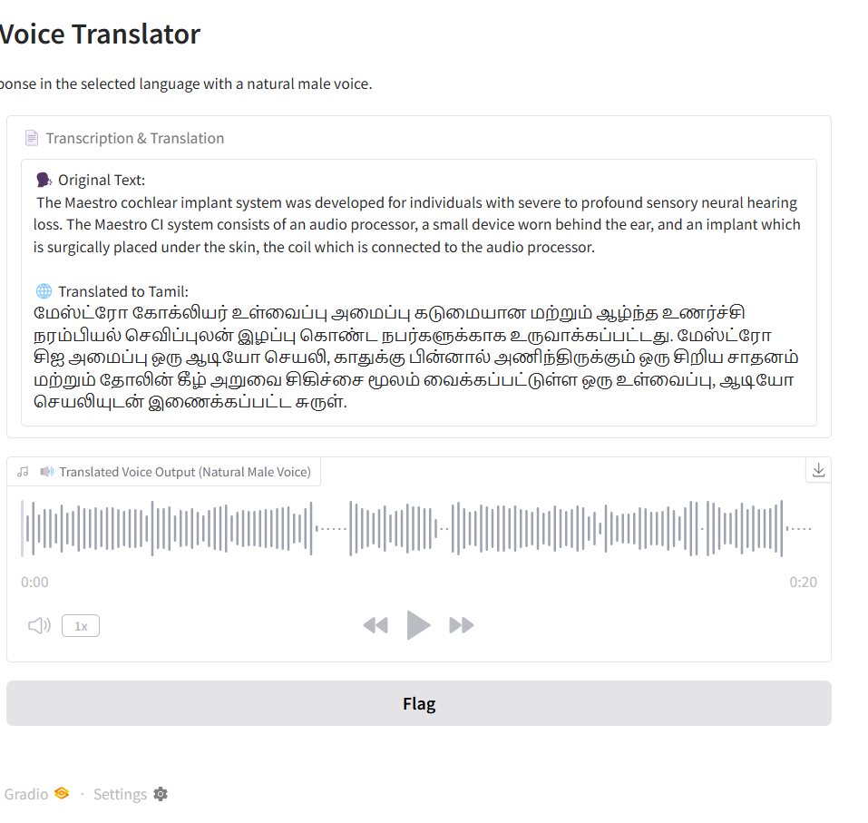
OUTPUT

