Slide 1
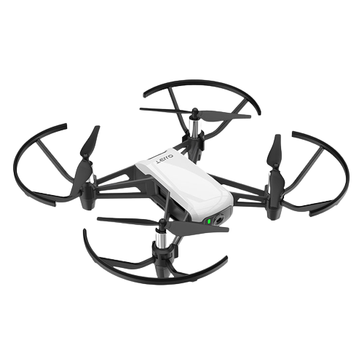

Gesture controlled Quadcopter
With a detailed study and simulation of 3D Estimation
Robotics Project
Sivadinesh Ponrajan

Slide 2
Agenda
Problem Definition
Initial development approach
Challenges Faced
Solution for the challenges
Architecture
Demonstration

Slide 3
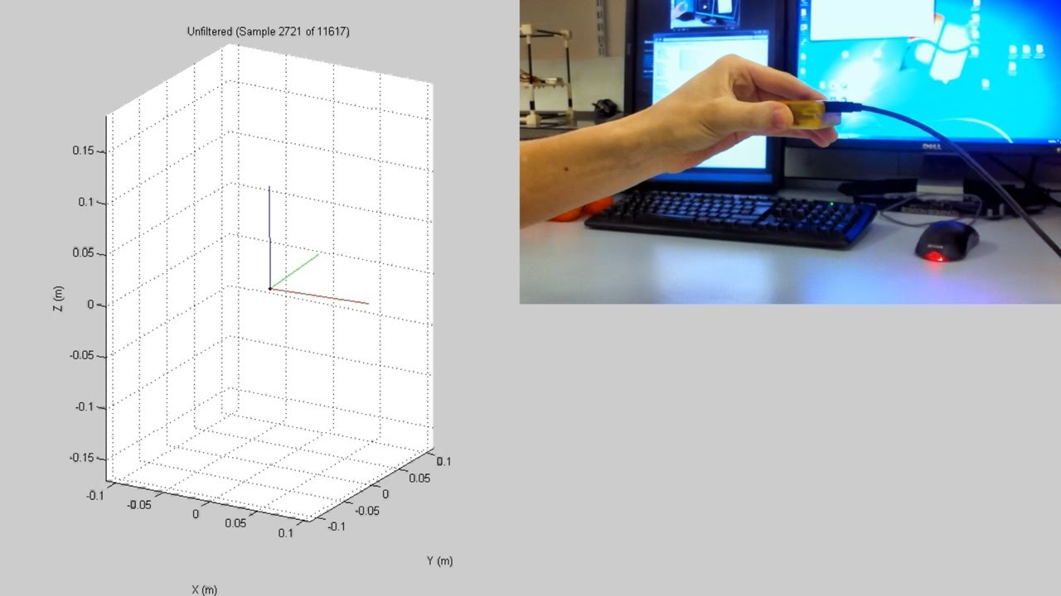
Problem Definition
Initially development plan was to estimate the 3D orientation of the mobile phone by building a simulator.

Slide 4

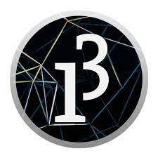
Initial development approach
Software used for the development:
Android studio Processing.org
Android App – Get and stream IMU values to PC
Processing – To process the data and to simulate.
(Processing.org is a software that helps to create visual arts and visual literacy through code)

Slide 5
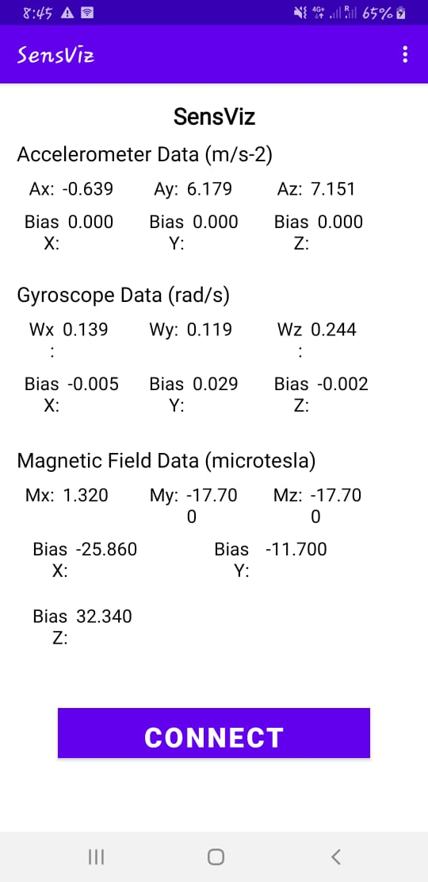
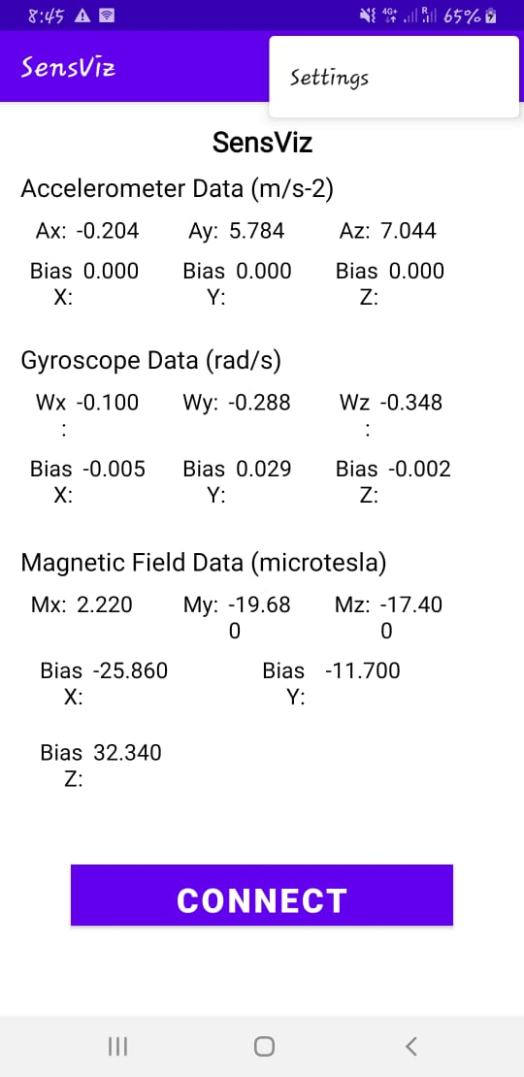
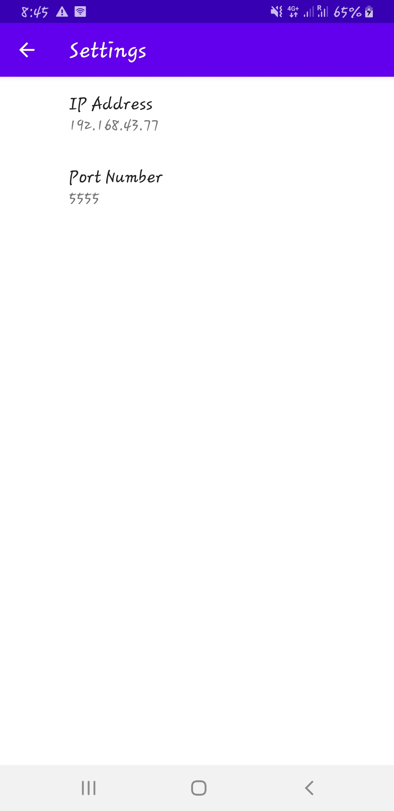
User Interface

Slide 6
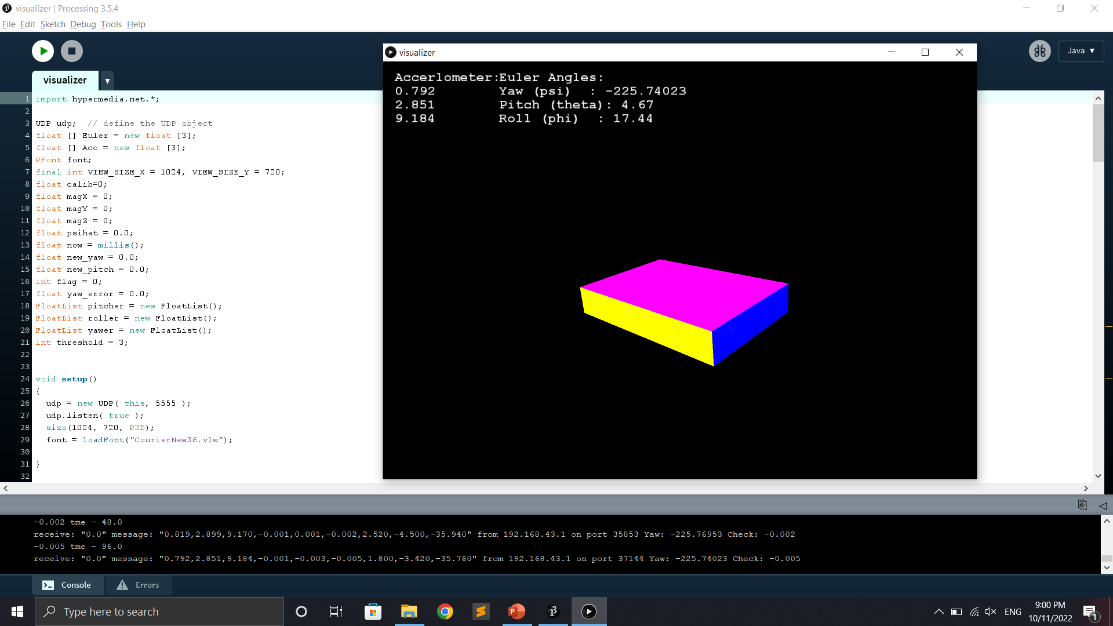
User Interface

Slide 7
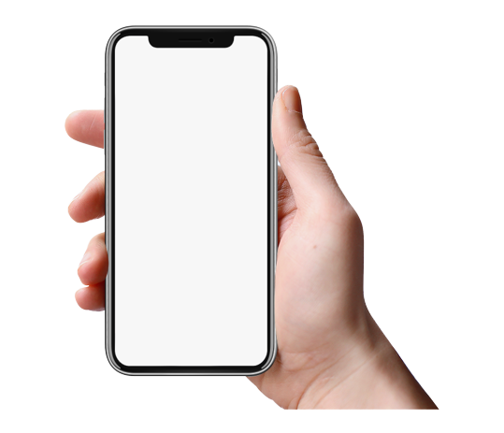
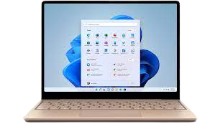
Working
UDP
Sockets
Why not TCP and why UDP? TCP has no acknowledgement back and the data packets may get lost. But in UDP, there won’t be data loss.

Slide 8
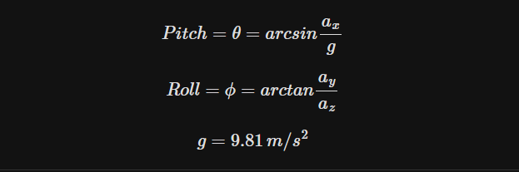
3D Estimation
Calculated the Euler angles.
Accelerometer
Gyrometer
Integrated angular velocity over time gives the angle. (More weightage)
Fused it with magnetometer’s reading as well.

Slide 9
Challenges
Challenges faced:
The roll and pitch values were quite accurate but bit noisy.
Initially TCP was used and some data was missing.
Yaw calculated from accelerometer was inaccurate.
So calculated the yaw from the Gyroscope but there was a drift.

Slide 10
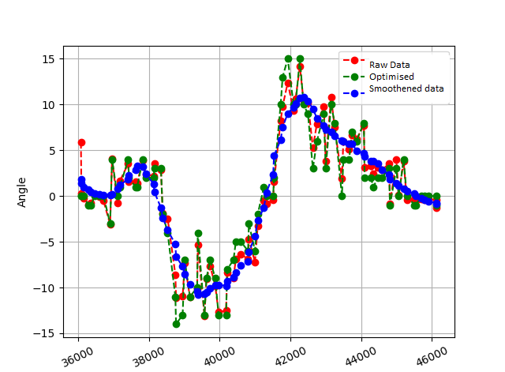
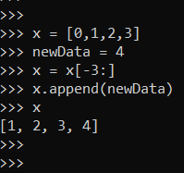
Data Smoothening

Slide 11
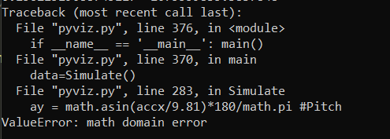
Challenges faced
Main Challenge faced:
Gimbal Lock if pitch θ = +π/2 or - π/2
Solution used: Replaced θ with 0 if it achieves the gimbal lock and rotates the environment accordingly.
And eventually the project expanded with each solution.

Slide 12
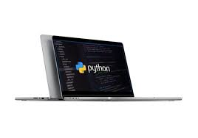
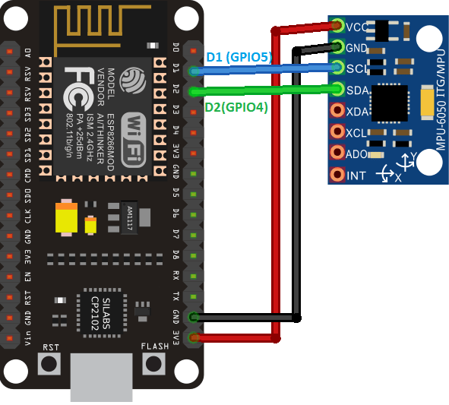
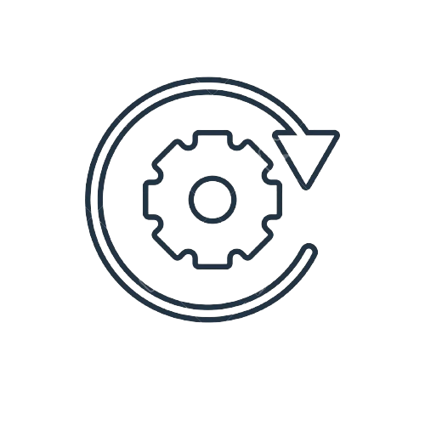
Architecture
Serial Data
Socket

Slide 13
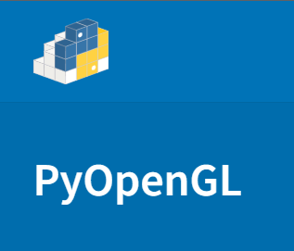

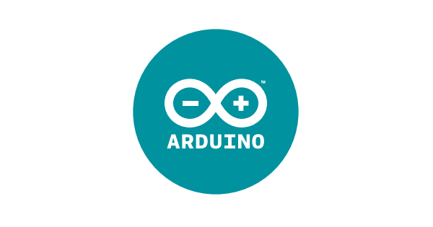
Tech Stacks
Simulator
Electronics
Language - Python
Protocol - UDP Socket
Data Transfer - Sockets
Language - Embedded C
Protocol - I2C Communication
Data Transfer - Serial Write

Slide 14
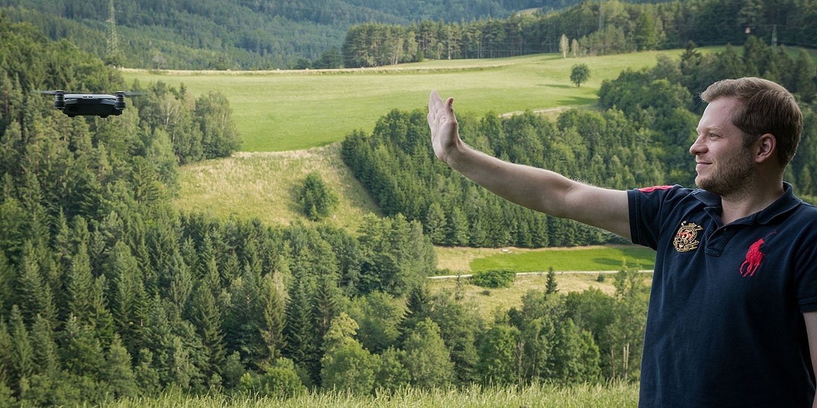
Demonstration

Slide 15
Conclusion
Future Improvements:
Implementation of quaternions to avoid gimbal lock.
Integration of GPS and fusion of IMU with GPS.
Direct control of the quadcopter from the mobile to reduce the mediation devices.

