Slide 1
Recipe Recommender EDA Case Study

Slide 2
Objectives :
Step into the shoes of an ML engineer working at food.com. Our job is to design a recommender system to recommend recipes to users based on their choice and the current recipe they are looking at.
The recommendation engine is a way to increase the website's user engagement. If a user is shown relevant recipes, they are more likely to spend more time on your site reading about recipes. Higher user engagement will likely result in more business opportunities like collaborations, promotions, etc.
The performance of a recommendation engine will significantly impact the revenue the recipe site can generate.
By exploring the data we need to create features that will be used to build the recommender.

Slide 3
We need to work on AWS tool to execute the problem statement. For that :
Creating and Launching an EMR Cluster on AWS (AMAZON WEB SERVICES).
Creating and Launching an EMR Studio and Workspace to work with a jupyter notebook .
Performing the tasks given in the task list.
Steps before starting the Coding :

Slide 4
Tasks Given
Task 1 : Read the data
Task 2 : Extract individual features from the nutrition column.
Task 3 : Standardize the nutrition values.
Task 4 : Convert the tags column from a string to an array of strings.
Task 5 : Read the second data file
Task 6 : Create time-based features.
Task 7 : Processing Numerical Columns (Optional)

Slide 5
Task 1 : Reading the data Raw_Recipes_Data from S3 bucket
raw_recipes_df = spark.read.csv("s3://sdemo2024/data1/RAW_recipes_cleaned.csv",inferSchema=True,header=True)
Note : We need to read the recipe data and ensure that each column has the correct data type.

Slide 6
Task 2 : Extracting individual features from the nutrition column
Based on the spark compiler, the nutrition column is a string column where it should be an array of float(decimal values). Each row in the nutrition column contains seven values which represents nutrition information. our task is to separate the array into seven individual columns.
We need to write a code that takes in the nutrition column from Raw_Recipes_Data dataframe, and extracts individual values into seven different columns named calories, total_fats, sugars, sodiums, proteins, saturated_fats, and carbohydrates.
Task 3 : Standardize the nutrition values
The different Nutrition values of a recipe might have different quantity and different measurements of ingredients, so though the number is same its quantity might differ.
so we need to convert the nutritions from absolute values to per 100 calorie values

Slide 7
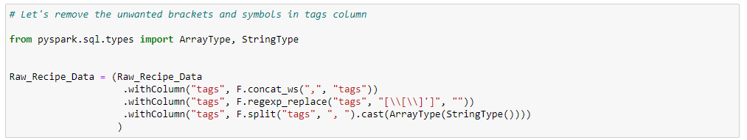
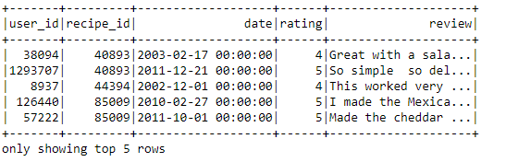
Task 4 : Convert the ‘tags’ column from a string to an array of strings.
The ‘tags’ column a string column which should be an array of strings. We need to convert the tags column into array of strings.
Task 5 : Read the second data file
interaction_level_df = raw_ratings_df.join(raw_recipes_df,raw_ratings_df.recipe_id==raw_recipes_df.id,"inner"

Slide 8
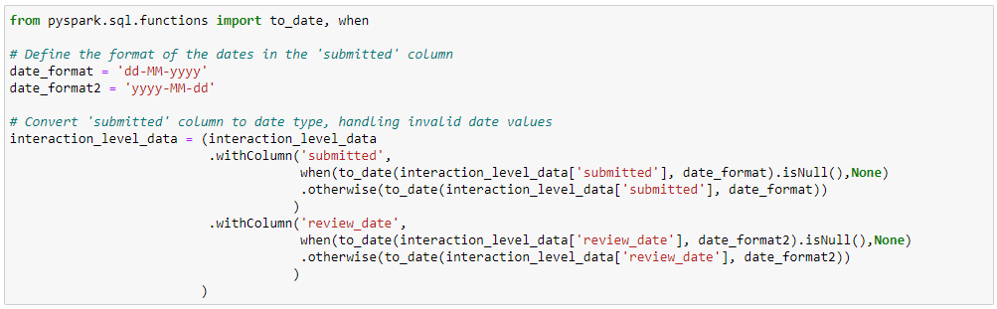
Task 6 : Create time-based features.
Currently, the date columns, the submitted date, and the review date are in string forms. We need to convert the submitted and review_date to DateType(). So, we can use review date and submission date to derive new features:
days_since_submission_on_review_date Number of days between the recipe submission and the current review.
months_since_submission_on_review_date Number of months between the recipe submission and the current review.
years_since_submission_on_review_dateNumber of years between the recipe submission and the current review.

Slide 9
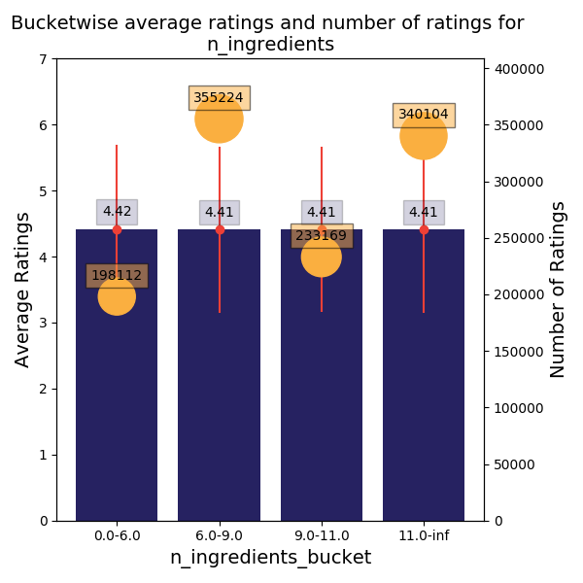
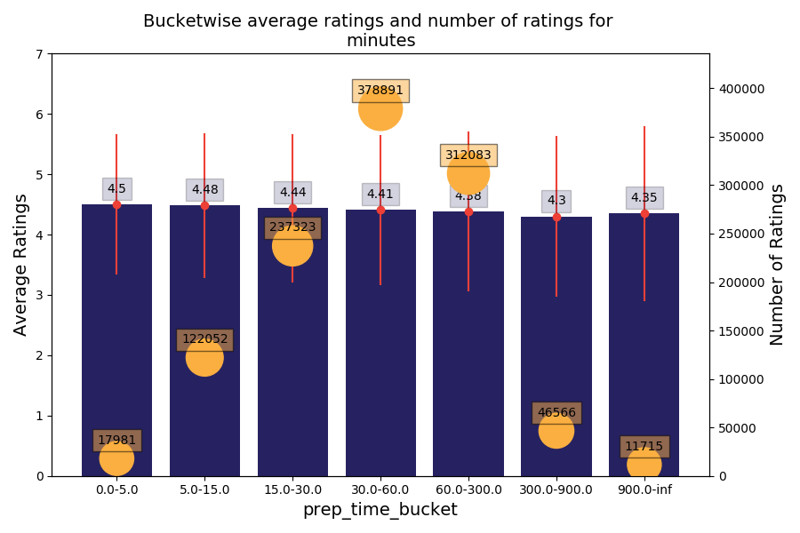
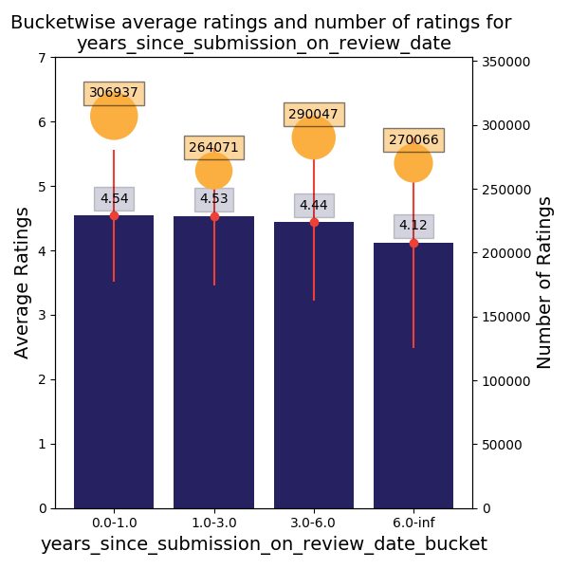
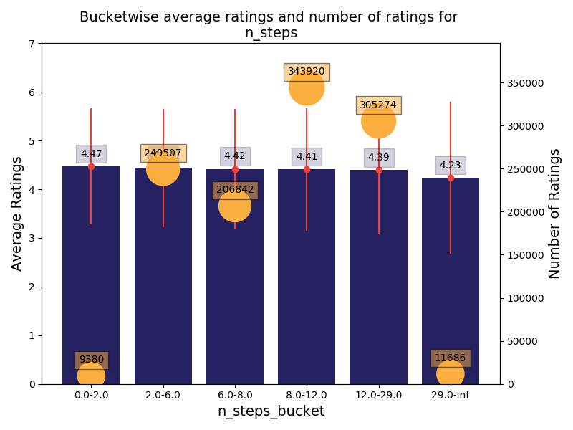
Task 7 : Processing Numerical Columns (Optional)

Slide 10
Tag Processing Priority: Give high priority to processing the 'tags' field, as it contains valuable information on user preferences and recipe characteristics, which are crucial for the recommender system.
Description Column Analysis: Evaluate the potential value of processing the 'description' column while considering the overlap of information with the 'tags' field. Prioritize based on the uniqueness and value of information it adds.
Strategic Documentation: Use a structured document to track and organize the EDA and feature extraction process. Document each field, intended processing, and the features to be extracted, along with their prioritization.
Template Utilization: Leverage template notebooks for EDA and feature extraction, which contain prewritten code and guidelines. Customize or create your features as needed, ensuring the data passes assert checks for consistency and accuracy.
Summary

