Slide 1
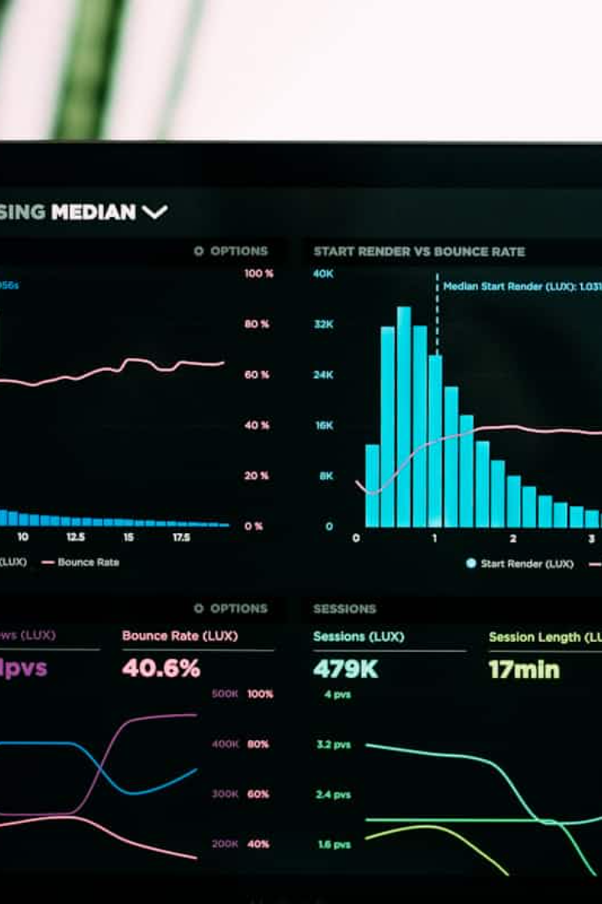
Undersampling Using Leader Algorithm
This presentation explores the implementation of the Leader Algorithm for undersampling the majority class in an imbalanced dataset. The goal is to create a balanced dataset and improve the accuracy of classification.
B.SIVAGOWTHAM
22AUCS043
III – B.Sc COMPUTER SCIENCE

Slide 2
Problem Description
Imbalanced Datasets
Leader Algorithm
Imbalanced datasets contain a significant disparity in the number of instances between the majority and minority classes. This imbalance can negatively impact the performance of classification algorithms, leading to biased predictions.
The Leader Algorithm is a technique used for undersampling the majority class. It aims to reduce the number of instances in the majority class, creating a more balanced dataset for improved classification accuracy.

Slide 3
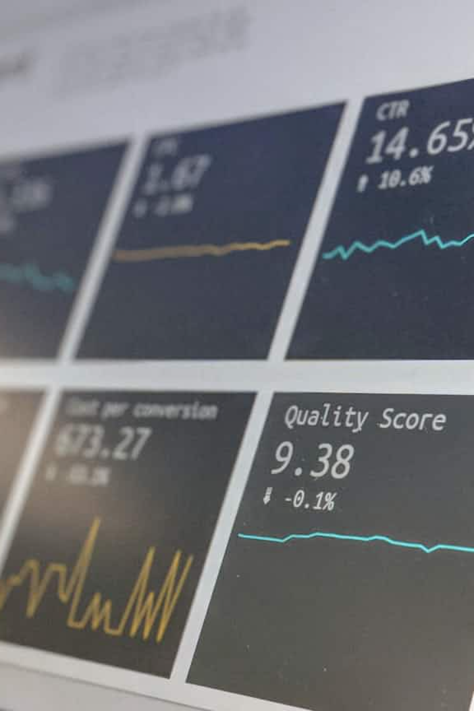
Procedure: Data Preprocessing
1
Load Dataset
2
Handle Missing Values
The first step involves loading the ecoli dataset, which is an imbalanced dataset used for this project.
Missing values in the dataset are handled appropriately to ensure data integrity and prevent errors during algorithm implementation.
3
Encode Boolean Values
Boolean values, such as "yes or no" or "positive or negative," are encoded as 0s or 1s for better utilization by the Leader Algorithm.

Slide 4
Procedure: Leader Algorithm Implementation
Balancing Dataset
Cluster Formation
After clustering, the undersampled majority class instances are combined with the minority class instances, creating a balanced dataset saved as a new CSV file.
Pattern Sum Calculation
Each pattern sum is considered a cluster representative or leader. Data rows are compared to these leaders based on a threshold value. If the difference exceeds the threshold, a new cluster is formed with the data row as the leader.
Separate Majority Class
The Leader Algorithm is applied to the majority class instances, which are then separated and saved into a separate CSV file.
For each row in the majority class, the pattern sum is calculated by adding all features except the "class" feature. These sums are then sorted in ascending order.

Slide 5
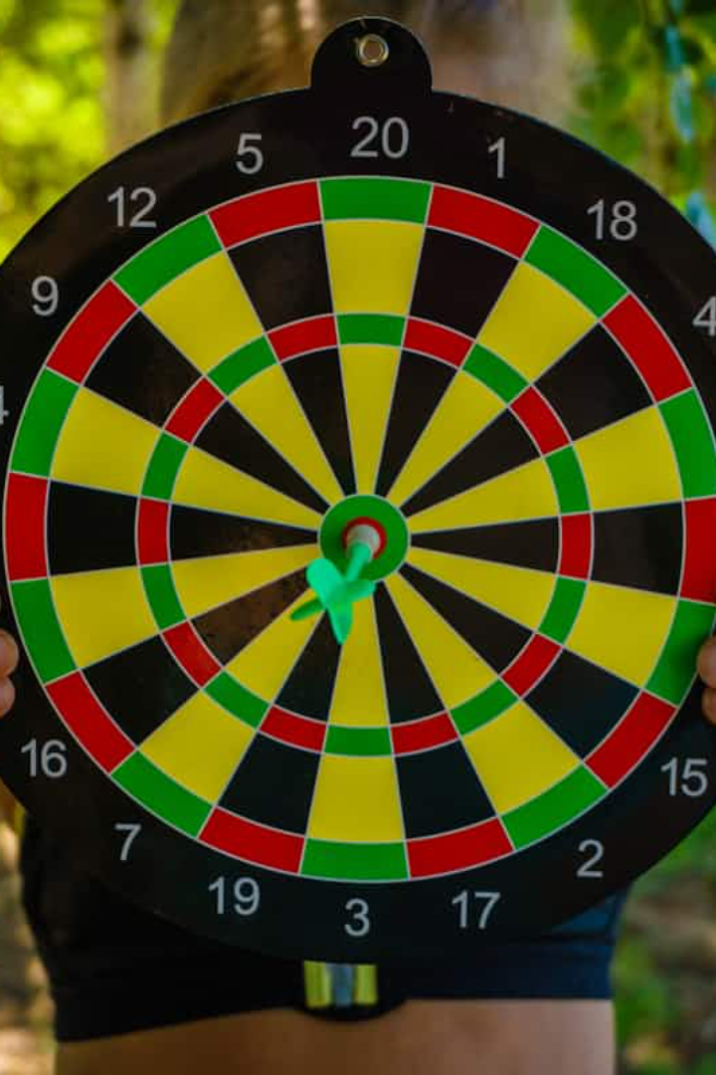



Procedure: Accuracy Check
KNN Classifier
Data Splitting
Accuracy Comparison
The balanced and imbalanced datasets are classified using the KNN classifier, a common algorithm for classification tasks.
Both datasets are split into 80% for training and 20% for testing to evaluate the performance of the KNN classifier.
The accuracy of the KNN classifier is compared for both the balanced and imbalanced datasets to assess the effectiveness of the undersampling process.

Slide 6
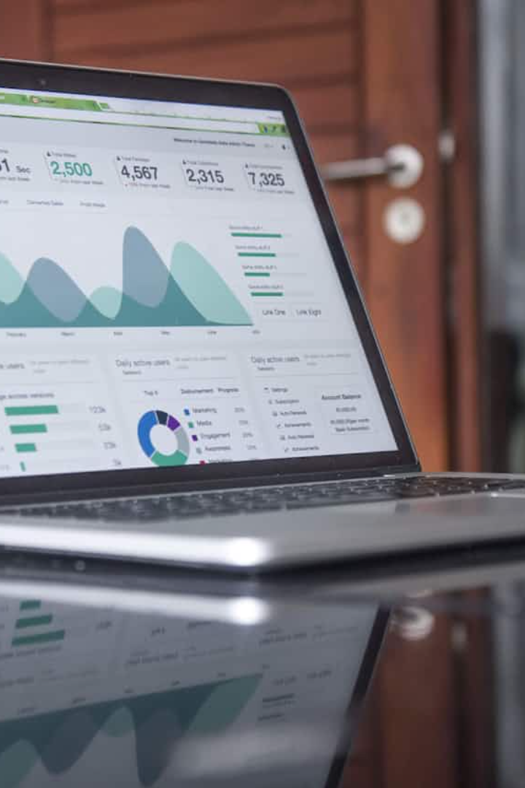
Conclusion
The Leader Algorithm successfully undersampled the majority class in the imbalanced dataset, resulting in a balanced dataset. This balanced dataset achieved a higher accuracy in classification compared to the imbalanced dataset, demonstrating the effectiveness of the undersampling technique in improving classification performance.

Slide 7


