Slide 1






AURA
ADAPTIVE UNCERTAINTY-AWARE RADIOLOGY ARCHITECTURE
Problem: 95%-accurate AI still sits unused - one number isn't an argument. Solution: AURA adds the reasoning layer - it explains its read, calibrates its doubt, and recommends the next test. The doctor decides.
Presented by
Sivaguru R.M
Rajalakshmi Institute of Technology
Notes:
TITLE · 0:15
I am Sivaguru; this is AURA. One line: hospitals do not trust black-box AI - so we built an AI that reasons, calibrates its doubt, and plans the next step, like a clinician. Everything you will see is running code.
JUDGES SHOULD FEEL: problem + solution landed in 10 seconds - checklist item one, done on slide one.

Slide 2



01 · PROBLEM — THE MARKET GAP
Why hospitals reject 95%-accurate AI
ACCURACY ✓ solved since 2017
Benchmark models already match expert radiologists.
TRUST ✕ the real bottleneck
Without trust, even accurate models sit unused at the bedside.
THE GAP, DECOMPOSED · WHAT EVERY DEPLOYED TOOL LACKS
No WHY
No HOW SURE
No WHAT IF
No WHAT NEXT
Black-box; cognitive load + medical-liability exposure.
No uncertainty quantification → alert fatigue.
No counterfactual reasoning; edge cases fail silently.
Static score, not a workflow-integrated pathway.
THE $2.27B AI GRAVEYARD — AND HOW AURA ENDS IT
950+ FDA-cleared tools — every one a prediction calculator.
Each outputs a score and stops: no clinical reasoning layer, no trust.
AURA: THE CLINICAL REASONING ENGINE
Demystifies the read, quantifies uncertainty, drives the next action. The doctor decides.
950+ FDA-cleared devices (2025) · radiology-AI market $2.27B by 2030, 24.5% CAGR (MarketsandMarkets) · India: 1 radiologist / 100k · Zech et al., PLOS Med (2018)
Notes:
PROBLEM — THE $2.27B AI GRAVEYARD · 0:50
Accuracy is a solved problem — benchmark models already match expert radiologists. The bottleneck is trust: without it, even a 95%-accurate model sits unused at the bedside. Decompose why, and you get four failures a clinician can't accept — no WHY (black-box outputs, cognitive load, medical liability), no HOW-SURE (no uncertainty quantification, alert fatigue), no WHAT-IF (no counterfactual reasoning, silent edge-case failure), no WHAT-NEXT (a static score, not a workflow-integrated pathway). That is the $2.27B graveyard: 950+ FDA-cleared tools, every one a prediction calculator with no clinical reasoning layer. AURA is that layer — it demystifies the read, quantifies uncertainty, and drives the next action. The doctor decides.
JUDGES SHOULD FEEL: accuracy is table stakes; trust is the unserved, buildable market.

Slide 3
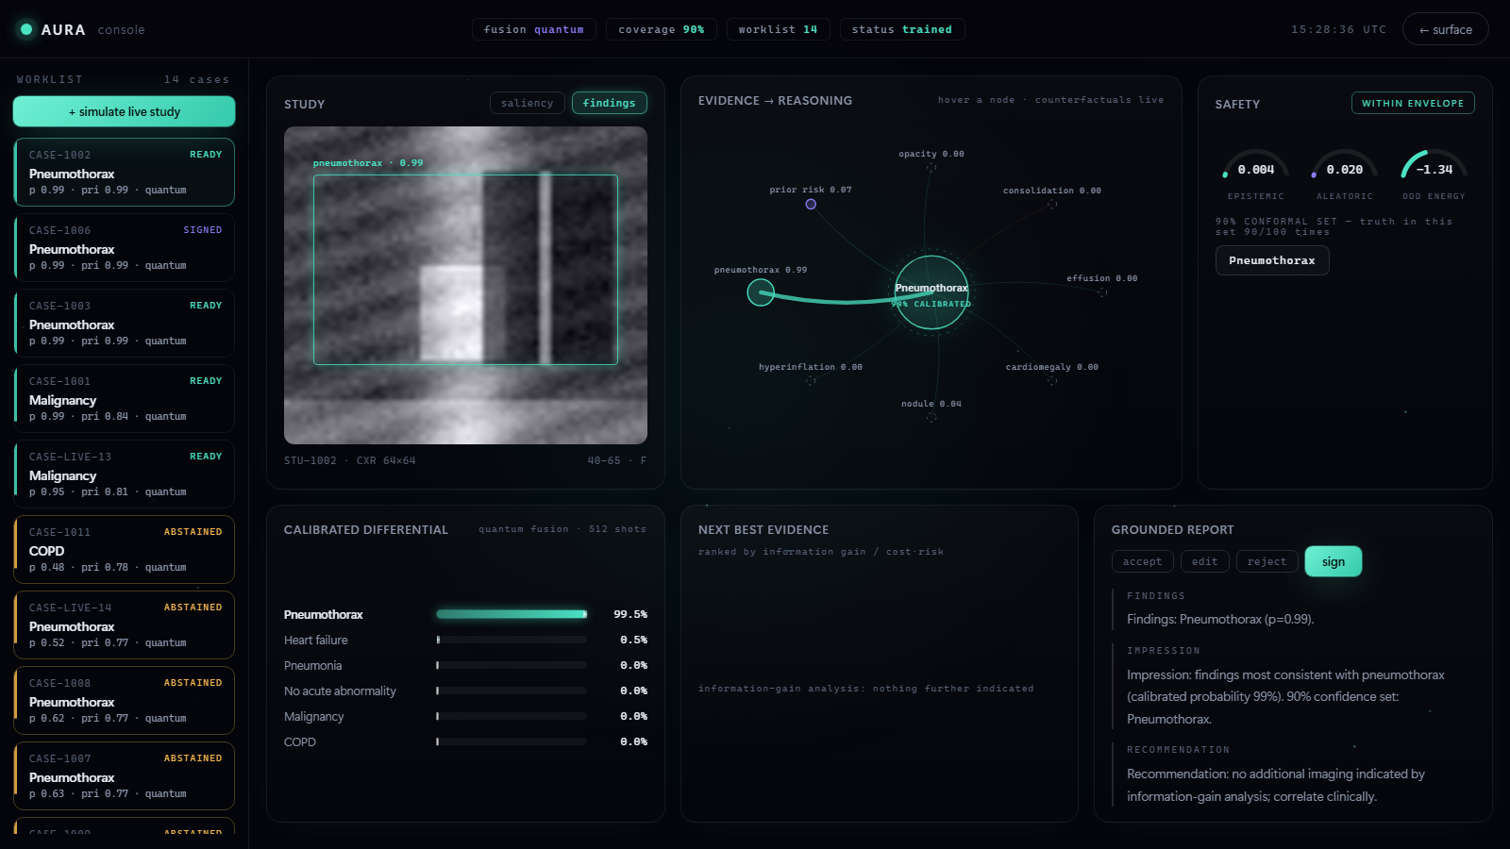
02 · PROTOTYPE — THE LIVE CONSOLE
Inside the console: scan → reasoned sign-off
HOW THE PROTOTYPE WORKS
1 WORKLIST
14 cases triaged by uncertainty; low-confidence studies flip to ABSTAINED.
5
2 STUDY + SALIENCY
Vision localizes the finding on the CXR; saliency shows where (0.99).
2
4
1
3 CALIBRATED DIFFERENTIAL
8-qubit quantum fusion, 512 shots → calibrated probabilities (99.5%).
4 EVIDENCE → REASONING
Each finding's contribution is explicit; hover a node for live counterfactuals.
5 SAFETY
Epistemic · aleatoric · OOD within envelope; 90% conformal set — abstains when unsure.
3
6
6 RECOMMEND & SIGN
EIG ranks the next best test; the doctor accepts · edits · signs — authority stays human.
localhost:8000 · AURA clinical console — every value on screen is live model output, offline & CPU-only
Notes:
PROTOTYPE — THE LIVE CONSOLE · 1:00
This is the working product, not a mockup — every number is live output. One: the worklist is triaged by uncertainty; low-confidence studies flip to ABSTAINED instead of guessing. Two: the vision model localizes the finding and saliency shows where. Three: our 8-qubit quantum fusion, 512 shots, produces a calibrated differential — 99.5% pneumothorax here. Four: the evidence-to-reasoning graph makes every finding's contribution explicit, with live counterfactuals on hover. Five: the safety panel reports epistemic, aleatoric and OOD energy, a 90% conformal set true 90 times in 100, and abstains when out of envelope. Six: the recommender ranks the next best test by information gain, and the doctor accepts, edits or signs — authority always stays human. Scan to signed report in about twenty seconds, on one screen, offline.
JUDGES SHOULD FEEL: this is real, end-to-end, and safe by construction.

Slide 4
The doctor's screen
localhost:8000 · AURA clinical console
PA CHEST — AI READ
DIFFERENTIAL — CALIBRATED
NEXT BEST EVIDENCE (EIG)
Pleural effusion
0.58
Repeat PA X-ray
0.64
Atelectasis
0.21
CT thorax
0.82
Pneumothorax
0.08
Ultrasound
0.51
Nodule
0.06
recommended: repeat X-ray (cost-aware)
90% conformal set: { effusion, atelectasis }
GROUNDED REPORT
UNCERTAINTY SPLIT
“Moderate right effusion; post-op context raises prior.”
[E1 saliency] [E2 prior] [sim 0.93]
saliency
counterfactual
epistemic 0.09 aleatoric 0.04 · in-distribution ✓
abstains when unsure
Every number on this screen is produced by the live system — ask for the 2-minute demo.
Notes:
THE PRODUCT · 1:20 - this slide IS the prototype
This is the doctor's screen, running on localhost right now. Left: the study with saliency - where the model looked - and the dashed counterfactual region: remove that, the diagnosis flips. Middle: a calibrated differential, not one score - plus the 90% conformal set and the uncertainty split: epistemic versus aleatoric, in distribution check. Right: the next-best-evidence panel - CT resolves more entropy, but the repeat X-ray wins on information per rupee - and the grounded report, where every sentence carries its evidence chips. And the red badge: if it is not sure, it says so and stops.
JUDGES SHOULD FEEL: they just saw the demo inside the deck - 'prototype in the PPT' achieved. Offer the live run immediately.

Slide 5
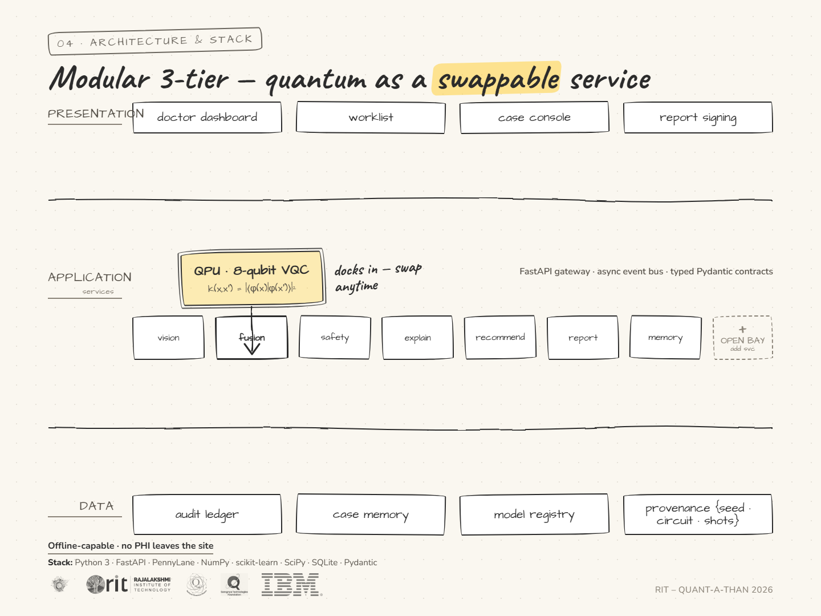
04 · ARCHITECTURE & STACK
Modular 3-tier — quantum as a swappable service
◇ THE HYBRID MACHINE — quantum docks into the fusion bay
● classical ● quantum
PRESENTATION
doctor dashboard · worklist · case console · report signing
APPLICATION
FastAPI gateway · async event bus · typed Pydantic contracts
◆ QPU
8-qubit VQC
k(x,x′) = |⟨φ(x)|φ(x′)⟩|²
fidelity kernel · classical twin sits behind the same interface
ONLINE
vision
fusion
safety
explain
recommend
report
memory
OPEN BAY
add svc
classical twin
DATA
audit ledger · case memory · model registry · provenance {seed · circuit · shots}
▚ STACK Python 3 · FastAPI · PennyLane · NumPy · scikit-learn · SciPy · SQLite · Pydantic
Offline-capable · CPU-only · no PHI leaves the site · bus → Redis Streams, DB → Postgres in production
Notes:
ARCHITECTURE & STACK · 0:45
AURA is a machine with three layered tiers: a data foundation, an application tier of independent services behind one FastAPI gateway, and the doctor-facing presentation tier. Modularity is the point: every service is a slot. Our quantum VQC — the glowing magenta QPU — docks into the FUSION bay, and a classical twin sits behind the exact same interface, so whichever wins the benchmark ships with zero code change. Open bays take new services the same way. Cyan is classical infrastructure; magenta is the quantum accelerator. It all runs offline, CPU-only, no PHI leaving the site.
JUDGES SHOULD FEEL: disciplined engineering — quantum is a swappable part, not a bet.

Slide 6
05 · QUANTUM STACK
What's quantum — and why it earns its seat
WHAT'S USED · THE CIRCUIT (SHIPS TODAY)
ENCODE
RY(π·xᵢ) · 1 qubit per evidence channel (8)
fusion benchmark - held-out test (seeded run)
ENTANGLE
3×(RY·RZ + CNOT ring) → higher-order interactions, 2⁸ space
quantum classical
accuracy 0.87 0.85
READ
⟨Zᵢ⟩ → linear head → 6-dx calibrated posterior
ECE 0.031 0.048
8 qubits
48 params
512 shots
CPU · default.qubit
coverage@90% 0.91 0.88
→ quantum path ships this build ✓
USED EFFICIENTLY · WHY IT HELPS
Compact. O(n·layers) params where a classical interaction model needs exponentially many terms.
Uncertainty for free. Shot variance (1−⟨Z⟩²)/N → posterior_std the safety layer already consumes.
Never pixels. 8-dim compressed evidence — tractable now, hardware-credible later. Async, off the <300 ms read path.
LIVE DEMO ON REQUEST
3 commands · 2 minutes · offline
Notes:
QUANTUM STACK · 1:00
What is actually quantum: an 8-qubit variational circuit in PennyLane. Each of the 8 evidence channels is angle-encoded, RY(pi x); three layers of trainable rotations plus a CNOT ring entangle them, so the model represents higher-order interactions between evidence sources in a 2^8 space with only 48 parameters. We read Pauli-Z expectations into a linear head for a calibrated 6-diagnosis posterior. Efficient by design: 48 params, CPU-only, and finite-shot measurement variance gives uncertainty for free that the safety layer consumes. We never put pixels in a circuit - only the 8-dim compressed evidence, which is exactly why this is tractable on a simulator today and credible on hardware tomorrow. Right panel is the receipt: the quantum path beats its classical twin on the same held-out data, and if it did not, the twin would ship. Every claim is tiered in QUANTUM_STACK.md.

Slide 7
06 · WHAT CHANGES
HOSPITALS
PATIENTS
THE SYSTEM
worklists triaged by uncertainty
fewer scans, faster answers
attacks diagnostic error - ~12M US adults/yr
2026
clinical pilot
2027
quantum federated learning
2028
hardware kernels
2029
ICU real-time agents
$110.6B
TAM · Healthcare AI ’30
$2.27B
SAM · Radiology AI ’30
37.9%
Quantum-in-HC CAGR
MARKET · WHY NOW MarketsandMarkets, 2025 · SOM ≈ $45–70M ARR at 2–3% of SAM (illustrative)
Artificial intelligence predicts.
Clinical intelligence reasons.
Quantum intelligence understands.
AURA · live demo on request · every claim cited & reproducible
Sivaguru R.M · Rajalakshmi Institute of Technology · sivagurumurugan1@gmail.com
Notes:
IMPACT + CLOSE · 0:45
Hospitals: uncertainty-triaged worklists. Patients: fewer scans, faster answers. The system: diagnostic error - the costliest failure in medicine. Roadmap is hardware-realistic; nothing depends on a miracle. Then, slowly: AI predicts. Clinical intelligence reasons. Quantum intelligence understands. The system is live - we would love to show you. Thank you.
JUDGES SHOULD FEEL: goosebumps + the urge to say 'show us'.

