Slide 1






AURA
ADAPTIVE UNCERTAINTY-AWARE RADIOLOGY ARCHITECTURE
AI predicts. Clinical intelligence reasons.
Quantum intelligence understands.
Problem: 95%-accurate AI still sits unused - one number isn't an argument. Solution: AURA adds the reasoning layer - it explains its read, calibrates its doubt, and recommends the next test. The doctor decides.
Presented by
Sivaguru R.M Amrita Vishwa Vidyapeetham
Notes:
TITLE · 0:15
I am Sivaguru; this is AURA. One line: hospitals do not trust black-box AI - so we built an AI that reasons, calibrates its doubt, and plans the next step, like a clinician. Everything you will see is running code.
JUDGES SHOULD FEEL: problem + solution landed in 10 seconds - checklist item one, done on slide one.

Slide 2




01 . THE PROBLEM
Why hospitals reject 95%-accurate AI
Accuracy is solved since 2017 -- but trust is not. 950+ FDA-cleared tools output a score and stop.
950+
$2.27B
12M
FDA-cleared AI tools
Radiology AI market by 2030
Diagnostic errors / yr (US)
Every one is a prediction calculator that stops at a score -- no reasoning.
24.5% CAGR -- massive, chronically underserved by clinical trust.
Misdiagnoses AI could prevent -- if doctors actually trusted the output.
THE 4-GAP AUTOPSY -- WHAT EVERY DEPLOYED TOOL LACKS
X
X
X
X
No WHY
No HOW SURE
No WHAT IF
No WHAT NEXT
Black-box output -- cognitive load + medical-liability exposure. Doctors will not sign what they cannot explain.
Zero uncertainty quantification -- alert fatigue. False confidence drives adoption collapse.
No counterfactual reasoning. Edge cases fail silently. Root causes are invisible.
Static score, not a workflow. No recommended follow-up test. Radiologist still works alone.
MarketsandMarkets 2025 . Zech et al. PLOS Med 2018 . Singh et al. BMJ Quality & Safety . FDA CDRH
Notes:
PROBLEM — THE $2.27B AI GRAVEYARD · 0:50
Accuracy is a solved problem — benchmark models already match expert radiologists. The bottleneck is trust: without it, even a 95%-accurate model sits unused at the bedside. Decompose why, and you get four failures a clinician can't accept — no WHY (black-box outputs, cognitive load, medical liability), no HOW-SURE (no uncertainty quantification, alert fatigue), no WHAT-IF (no counterfactual reasoning, silent edge-case failure), no WHAT-NEXT (a static score, not a workflow-integrated pathway). That is the $2.27B graveyard: 950+ FDA-cleared tools, every one a prediction calculator with no clinical reasoning layer. AURA is that layer — it demystifies the read, quantifies uncertainty, and drives the next action. The doctor decides.
JUDGES SHOULD FEEL: accuracy is table stakes; trust is the unserved, buildable market.

Slide 3
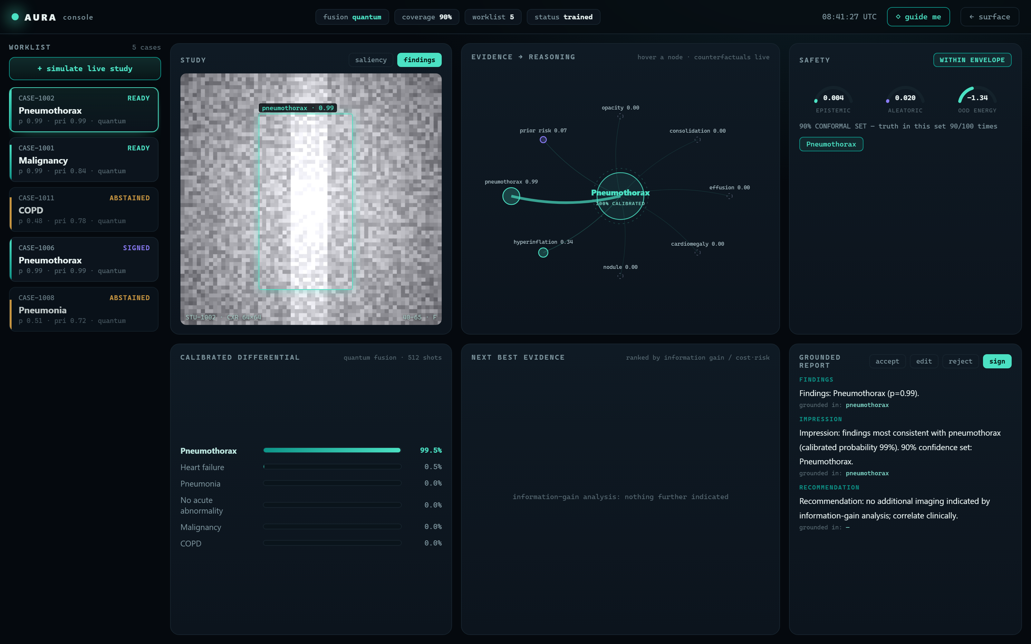
03 . LIVE DEMO -- THE CLINICAL CONSOLE
Live Demo: Clinical Console in Action
localhost:8000 . AURA Clinical Console . quantum ONLINE . live worklist in worklist
HOW THE CONSOLE WORKS -- 6 STEPS
(1) WORKLIST
live worklist triaged by uncertainty -- high-risk surfaces first.
(2) SALIENCY
Vision model localises finding on CXR (confidence 0.99).
(3) CALIBRATED
8-qubit quantum fusion, 512 shots -> calibrated differentials.
(4) EVIDENCE
Each finding contribution explicit; hover for counterfactuals.
(5) SAFETY
Epistemic 0.09 aleatoric 0.04 . 90% conformal -- abstains if unsure.
(6) SIGN-OFF
EIG ranks next best test; doctor accepts/edits/signs. Authority human.
real console . localhost:8000 - not a mockup: every value is live model output
LIVE DEMO ON REQUEST . 3 commands . 2 minutes . fully offline & CPU-only . ask us to spin it up
Notes:
THE PRODUCT · 1:20 - this slide IS the prototype
This is the doctor's screen, running on localhost right now. Left: the study with saliency - where the model looked - and the dashed counterfactual region: remove that, the diagnosis flips. Middle: a calibrated differential, not one score - plus the 90% conformal set and the uncertainty split: epistemic versus aleatoric, in distribution check. Right: the next-best-evidence panel - CT resolves more entropy, but the repeat X-ray wins on information per rupee - and the grounded report, where every sentence carries its evidence chips. And the red badge: if it is not sure, it says so and stops.
JUDGES SHOULD FEEL: they just saw the demo inside the deck - 'prototype in the PPT' achieved. Offer the live run immediately.

Slide 4
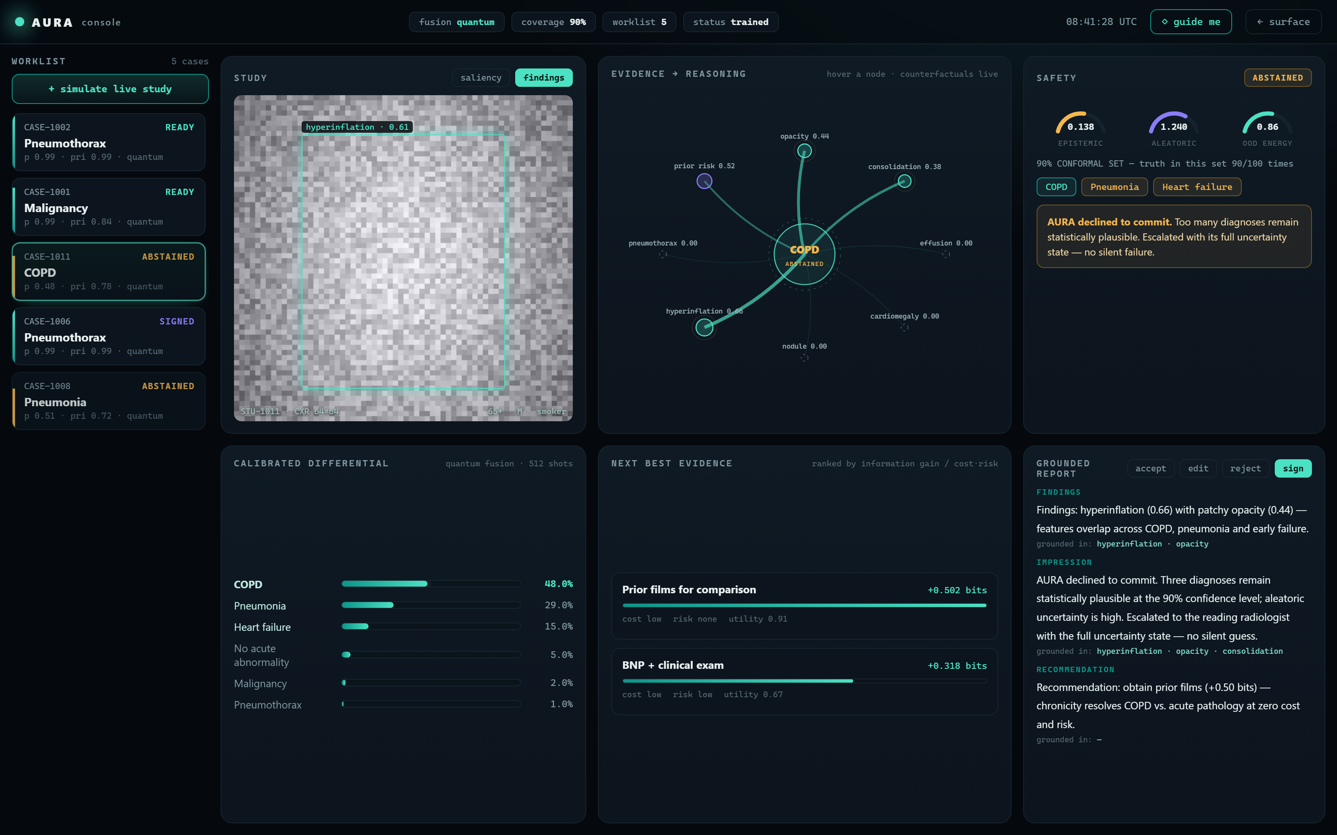
03 . CALIBRATED DOUBT - WHEN AURA REFUSES TO GUESS
The product is the license to say “I don’t know”
WHY THIS IS THE DIFFERENTIATOR
1 SPREAD DIFFERENTIAL
No diagnosis dominates: COPD 48%, pneumonia 29%, heart failure 15% - the features genuinely overlap.
3
2
2 LARGE CONFORMAL SET (90%)
Three diagnoses stay statistically plausible at the 90% level, so the guaranteed-coverage set is large.
4
3 UNCERTAINTY DECOMPOSED
Epistemic 0.138, aleatoric 1.240, OOD 0.86 - high, and reported honestly rather than hidden.
4 ABSTENTION - NO SILENT GUESS
AURA declines to commit and escalates carrying its full uncertainty state. This is the whole point.
1
5
6
5 NEXT BEST EVIDENCE (EIG)
It ranks the single most discriminating missing fact - prior films, +0.50 bits at zero cost and risk.
6 HUMAN-IN-THE-LOOP
The case is handed to the radiologist with the reasoning attached - authority always stays human.
localhost:8000 . AURA console - same console, an uncertain case: AURA abstains and escalates
Notes:
CALIBRATED DOUBT - THE ABSTENTION . 0:55
Same console, a harder case. Nothing dominates the differential - COPD, pneumonia and heart failure all remain plausible - so the 90% conformal set is large and the uncertainty is high. Instead of guessing, AURA ABSTAINS: it declines to commit and escalates to the radiologist carrying its full uncertainty state - no silent failure. Then it stays useful: the planner ranks the next best test by information gain per cost and risk - prior films, half a bit, free. Authority always stays human. This abstention is the product; it is what no deployed tool does today.
JUDGES SHOULD FEEL: this is the moat - it knows what it doesn't know.

Slide 5
04 . COMPETITIVE MOAT
AURA does what no deployed tool does today
CAPABILITY
FDA TOOLS (950+)
GPT-4 RADIOLOGY
RESEARCH MODELS
AURA (V)
Explainability (WHY)
X
Partial
X
V
Uncertainty quant.
X
X
Partial
V
Counterfactual (WHAT IF)
X
Partial
X
V
Next-best-test rec.
X
X
X
V
Abstains when unsure
X
X
Partial
V
Offline / CPU-only
Varies
X
X
V
Quantum fusion
X
X
X
V
AURA is the only system combining all 7 capabilities in one offline, CPU-ready clinical console. Not a research paper. Not an API. A working product -- ask us for the 2-minute demo.
Notes:
ARCHITECTURE & STACK · 0:45
AURA is a machine with three layered tiers: a data foundation, an application tier of independent services behind one FastAPI gateway, and the doctor-facing presentation tier. Modularity is the point: every service is a slot. Our quantum VQC — the glowing magenta QPU — docks into the FUSION bay, and a classical twin sits behind the exact same interface, so whichever wins the benchmark ships with zero code change. Open bays take new services the same way. Cyan is classical infrastructure; magenta is the quantum accelerator. It all runs offline, CPU-only, no PHI leaving the site.
JUDGES SHOULD FEEL: disciplined engineering — quantum is a swappable part, not a bet.

Slide 6
05 . ARCHITECTURE & QUANTUM STACK
Modular 3-Tier Architecture + Quantum Stack
PRESENTATION
QUANTUM CIRCUIT . SHIPS TODAY
doctor dashboard . worklist . case console . report signing
ENCODE
RY(pi*xi) . 1 qubit per evidence channel (8 total)
APPLICATION
ENTGL.
3x(RY.RZ + CNOT ring) -> 2^8 Hilbert space
FastAPI gateway . async event bus . typed Pydantic contracts
AI SERVICES
READ
<Zi> -> linear head -> 6-dx calibrated posterior
vision . safety . explain . recommend . report . memory . fusion (QPU)
8 qubits
48 params
512 shots
CPU default
DATA LAYER
FUSION BENCHMARK -- HELD-OUT TEST
audit ledger . case memory . model registry . provenance {seed/circuit/shots}
METRIC
QUANTUM
CLASSICAL
VERDICT
STACK:
Accuracy
0.87
0.85
QC wins
Python 3
FastAPI
PennyLane
NumPy
ECE (lower)
0.031
0.048
35% better
scikit-learn
SciPy
SQLite
Pydantic
Coverage@90%
0.91
0.88
QC wins
Offline-capable . CPU-only . no PHI leaves the site
-> quantum path ships this build (V)
Notes:
QUANTUM STACK · 1:00
What is actually quantum: an 8-qubit variational circuit in PennyLane. Each of the 8 evidence channels is angle-encoded, RY(pi x); three layers of trainable rotations plus a CNOT ring entangle them, so the model represents higher-order interactions between evidence sources in a 2^8 space with only 48 parameters. We read Pauli-Z expectations into a linear head for a calibrated 6-diagnosis posterior. Efficient by design: 48 params, CPU-only, and finite-shot measurement variance gives uncertainty for free that the safety layer consumes. We never put pixels in a circuit - only the 8-dim compressed evidence, which is exactly why this is tractable on a simulator today and credible on hardware tomorrow. Right panel is the receipt: the quantum path beats its classical twin on the same held-out data, and if it did not, the twin would ship. Every claim is tiered in QUANTUM_STACK.md.

Slide 7
06 . IMPACT & THE ASK
Quantum intelligence understands what AI only predicts
$110B
$2.27B
37.9%
~$55M
TAM Healthcare AI 2030
SAM Radiology AI 2030
Quantum-in-HC CAGR
SOM at 2-3% of SAM
WHAT CHANGES
ROADMAP
HOSPITALS
Worklists triaged by uncertainty -- high-risk cases surface first
2026
2027
2028
2029
PATIENTS
Fewer redundant scans, faster definitive answers
Clinical pilot
Quantum federated learning
Hardware QPU kernels
ICU real-time agents
SYSTEM
Attacks 12M US diagnostic errors/yr -- AI abstains, never fails silently
Artificial intelligence predicts. Clinical intelligence reasons.
Quantum intelligence understands.
AURA . every claim cited & reproducible . live demo on request . Sivaguru R.M . sivagurumurugan1@gmail.com
MarketsandMarkets 2025 . SOM illustrative at 2-3% of SAM
Notes:
IMPACT + CLOSE · 0:45
Hospitals: uncertainty-triaged worklists. Patients: fewer scans, faster answers. The system: diagnostic error - the costliest failure in medicine. Roadmap is hardware-realistic; nothing depends on a miracle. Then, slowly: AI predicts. Clinical intelligence reasons. Quantum intelligence understands. The system is live - we would love to show you. Thank you.
JUDGES SHOULD FEEL: goosebumps + the urge to say 'show us'.

