Slide 1
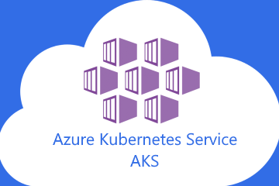
Deploy AKS Cluster and Customize while they scale
Sivaiah Yakkanti

Slide 2

Agenda
Overview of AKS
Overview of Autoscaling
Overview of Node Customization
Deployments
Quick Demo

Slide 3
Overview of AKS
Azure Kubernetes Service (AKS) is a managed Kubernetes service that you can use to deploy and manage containerized applications
AKS reduces the complexity and operational overhead of managing Kubernetes by shifting that responsibility to Azure
It can run in on-premises, public cloud and hybrid infra-architecture
Benefits
Management etc...
Scalability – auto scale nodes, pods
High Availability – distribute app in multiple nodes
Resource Isolation – resource limits, quotas and namespaces
Load Balancing – traffic distribute evenly across nodes

Slide 4
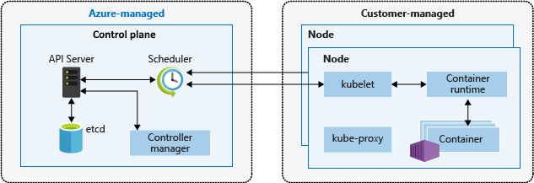
Azure Kubernetes Services Architecture
Control Plane (Master Node ) Components
API Server
Scheduler
Controller Manager
Etcd
Date Plane (Worker Node ) Components
Kubelet
Kube-Proxy
Container runtime
such as Docker, containerd, or CRI-O.

Slide 5
Overview of Autoscaling
Manual Scaling:
Manually scale the number of nodes in aks cluster using the azure cli or azure PowerShell, This method allows you to define a specific number of nodes to maintain a fixed cost and resource allocation
Horizontal Pod Autoscaler (HPA):
HPA automatically scales the number of pods based on observed cpu utilization or other select metrics. it adjusts the number of replicas to meet the demand, ensuring efficient resource usage
Cluster Autoscaler:
The cluster autoscaler adjusts the number of nodes in your AKS cluster based on the resource requests of your pods. It scales out when there are unscheduled pods due to insufficient resources and scales in when nodes are underutilized
Kubernetes Event-driven Autoscaling (KEDA):
KEDA scales workloads based on the number of events, making it suitable for applications with bursty traffic or high data volumes. It extends Kubernetes with custom resource definitions to handle event-driven scaling
Burst to Azure Container Instances (ACI):
For rapid scaling, you can integrate AKS with ACI. This allows you to deploy container instances quickly without additional infrastructure overhead. ACI acts as a virtual node in your AKS cluster, enabling seamless scaling
Custom Node Pools:
You can create custom node pools with different VM sizes and configurations to handle specific workloads. This allows you to optimize resource allocation and performance based on the needs of different applications

Slide 6
Customization scenarios
Diverse Workloads:
When your applications have different resource requirements, such as CPU-intensive or memory-intensive tasks, you can create custom node pools with varying VM sizes and configurations to handle these specific workloads
GPU Requirements:
For applications that require GPU resources, such as machine learning or high-performance computing tasks, you can add node pools with GPU-enabled VMs
Burst Workloads:
In cases where you experience sudden spikes in traffic or demand, integrating AKS with Azure Container Instances (ACI) allows for rapid scaling without the need for additional infrastructure
Cost Optimization:
Using Spot VMs for non-critical, interruptible workloads can significantly reduce costs. Customizing node pools to include Spot VMs helps manage expenses while maintaining performance
Availability Zones:
To enhance fault tolerance and availability, you can distribute node pools across multiple availability zones. This setup ensures that your applications remain resilient to zone-specific failures
Compliance and Security:
For workloads with specific compliance or security requirements, you might need to customize node pools to use specific VM types or configurations that meet these standards
Scaling to Zero:
For development or testing environments, you can scale node pools to zero when not in use, saving costs. This is particularly useful for user node pools that do not need to be always active

Slide 7
Customization examples
1. Memory Configuration
You can adjust memory settings to optimize performance for memory-intensive applications.
For example:
Transparent Huge Pages (THP): Enable or configure THP to improve memory management. { "transparentHugePageEnabled": "madvise", "transparentHugePageDefrag": "defer+madvise" }
Swap File Size: Configure the swap file size to manage memory more effectively. { "swapFileSizeMB": 1500 }

Slide 8
2. CPU Configuration
Customizing CPU settings can help manage CPU-intensive workloads:
CPU Manager Policy: Set the CPU manager policy to "static" for better CPU allocation.
{ "cpuManagerPolicy": "static" }
CPU CFS Quota: Enable or disable CPU CFS quota enforcement.
{ "cpuCfsQuota": true, "cpuCfsQuotaPeriod": "200ms" }
3. I/O Configuration
Adjusting I/O settings can enhance performance for I/O-bound applications:
Maximum Connections: Configure the maximum number of connections.
{ "sysctls": { "net.core.somaxconn": 16384 }

Slide 9
TCP Settings: Optimize TCP settings for better network performance.
{ "sysctls": { "net.ipv4.tcp_tw_reuse": true, "net.ipv4.ip_local_port_range": "32000 60000" }
4. Kubelet Configuration
Customizing kubelet settings can help manage pod resources more effectively:
Image Garbage Collection: Configure thresholds for image garbage collection. { "imageGcHighThreshold": 90, "imageGcLowThreshold": 70 }
Container Log Settings: Set limits for container log sizes and file counts. { "containerLogMaxSizeMB": 20, "containerLogMaxFiles": 6 }
5. Node Pool Configuration
You can create custom node pools with specific VM sizes and configurations to handle different workloads:
Node Pool with Specific VM Sizes: Use different VM sizes for different node pools to optimize resource allocation.
az aks nodepool add --resource-group myResourceGroup --cluster-name myAKSCluster --name mynodepool1 --node-vm-size Standard_D4s_v3

Slide 10
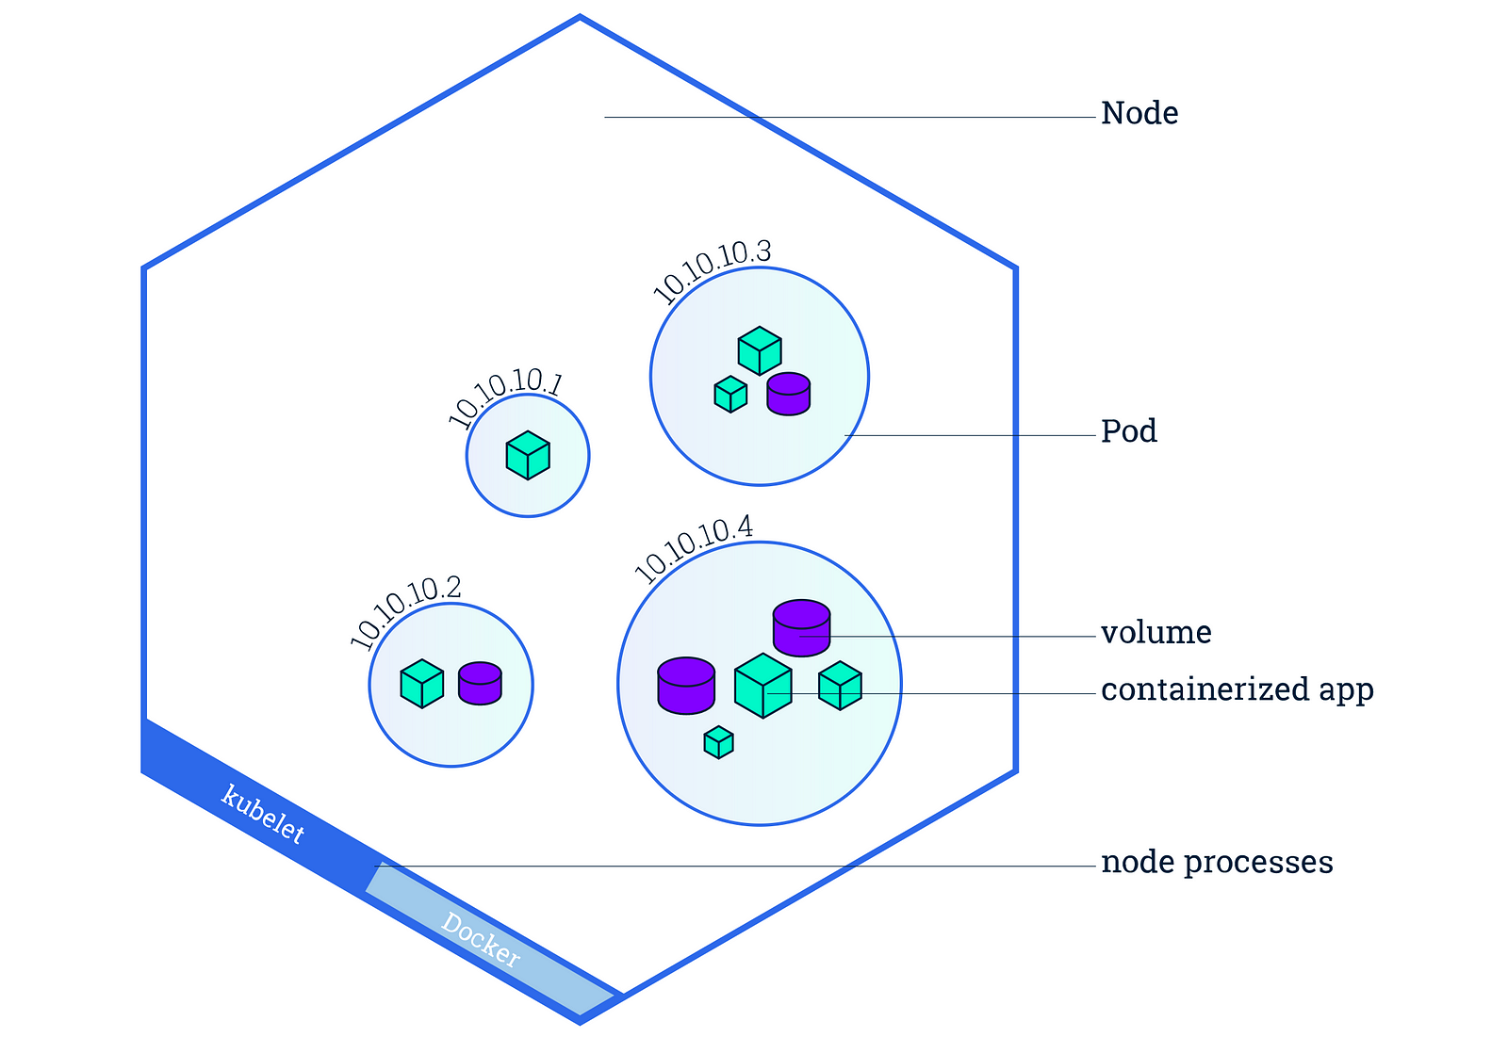
Deployments
Kubernetes provides a distributed platform for containerized applications. You build and deploy your own applications and services into a Kubernetes cluster and let the cluster manage the availability and connectivity.
Update a Kubernetes manifest file.
Deploy an application in Kubernetes.
Test the application.

Slide 11
Quick Demo

Slide 12
Q & A
12

Slide 13

Thank you
Sivaiah Yakkanti
Siva Yakkanti-K8SUG_35th_Meetup_Dec2024

