Slide 1

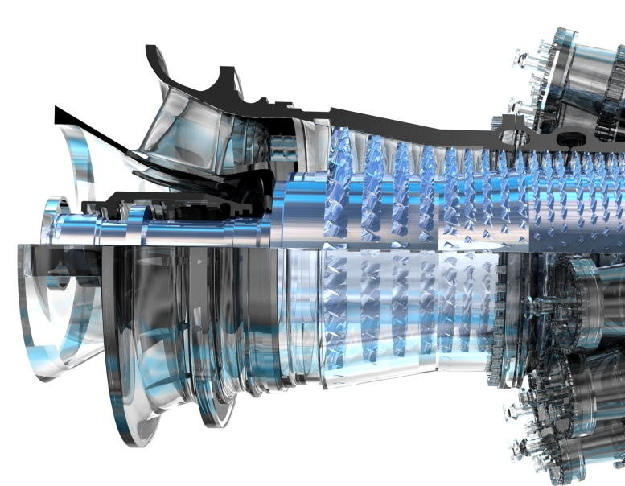
Projects with SIL Quick HOWTO
Jean-Marc Ingremeau
GT Controls
2021 | Belfort, France
Notes:
Sources des dessins dans r:\OTR\_Consignes\Work\graphes_génériques.xlsx

Slide 2
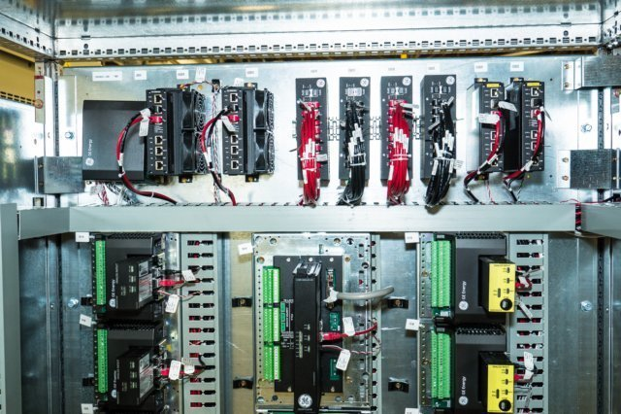
Context
Safety controller added for compliance to IEC61511 (MkVIeS)
Contains only protections dedicated to the safety of personal
MkVIe
MkVIeS

Slide 3
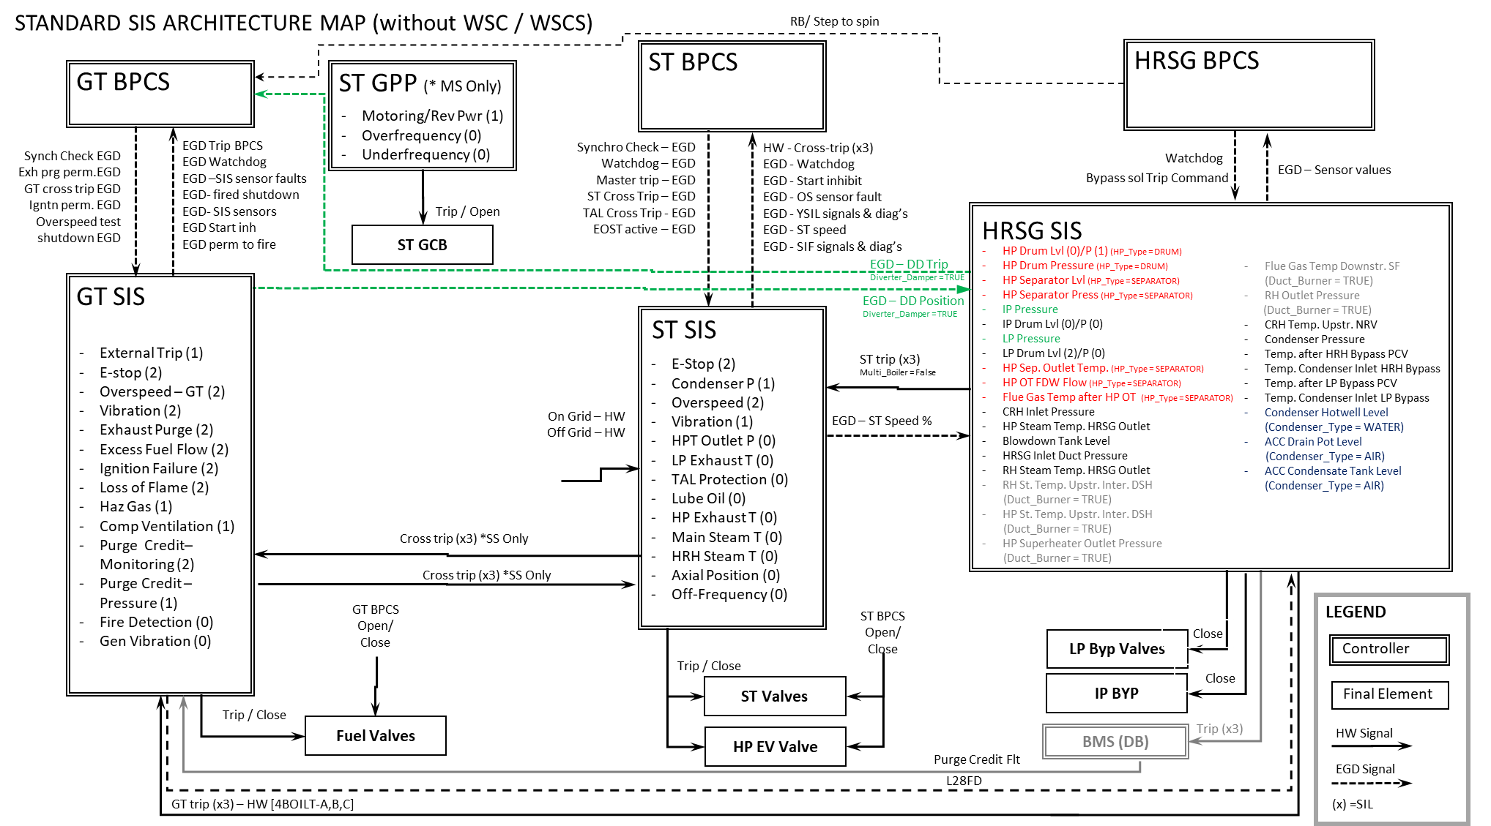
SIS Architecture

Slide 4
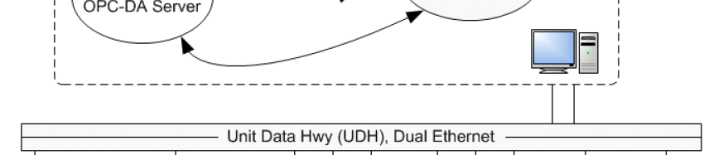
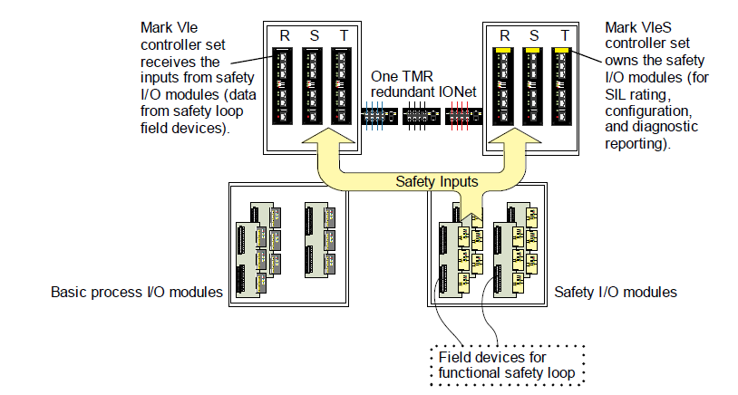
HMI Screen
EGD
Trip
Shutdown
Start Inh
Exhaustive list in A312
Safety sensor
(eg. Flame detector)
Control sensor
(eg. Compressor
Temperature CTD)
Control actuator
(eg. IGV)
Safety Actuator (eg. GCV)
Powered by both controllers

Slide 5

Process
DoR Controls:
Controls Requisition Engineering
Device (G1S/GS1) – Ios, constants, etc.
Interface with site / client (inc. customer SWAT)
Project-specific documents
Screens/Simulations
SIL Standard Team
Maintain up-to-date standard software on-time for all projects
Maintain up-to-date standard documentation
Develop project-specific software in libraries, own the CIAs.
Run SIL SWAT and interface with 3rd party
Audits
Confluence links to the detailed process:
ST: https://engineeringconfluence.pw.ge.com/pages/releaseview.action?pageId=302448816
GT: https://engineeringconfluence.pw.ge.com/display/public/GPD/13.+SIL+Controller+-+GT
Plant: https://engineeringconfluence.pw.ge.com/pages/releaseview.action?pageId=320176535

Slide 6
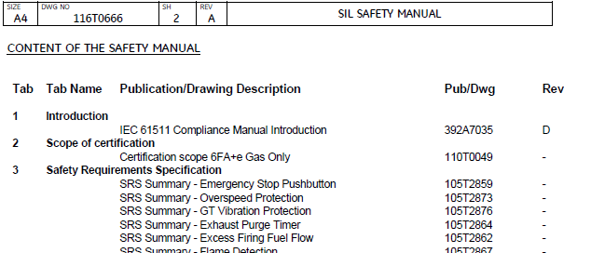
Process
DoR outside Controls:
SIL Compliance Leader (Compliance Team)
Gathers documentation for Safety Manual
Project management for the SIL compliance
Safety – reliability documentation
Interface with 3rd party certification company (Exida or Ineris)
Customer Engineer
Interface with customer
Interface with the rest of GE (SDA, …)
Site TA
Realizes the SAT

Slide 7
Process - Software
Management of Change shared with 3rd party certification company
Strong management of change in standard or on project with CIA process (Change Impact Analysis)
CIA process: e-DRB EPE-3581
CIA Template: https://ge.ent.box.com/file/513527184161
Standard main branch
Initial version
V01.00.00C
Evolution 1
V02.00.00C
Evolution 2
V03.00.00C
Customization for project 745972
V01.00.00Cx745972
Evolution V02.00.00C applied to project 745972
V02.00.00Cx745972
Customized branches

Slide 8
Process - Milestones
Confluence links to the detailed process:
ST: https://engineeringconfluence.pw.ge.com/pages/releaseview.action?pageId=302448816
GT: https://engineeringconfluence.pw.ge.com/display/public/GPD/13.+SIL+Controller+-+GT
Plant: https://engineeringconfluence.pw.ge.com/pages/releaseview.action?pageId=320176535

Slide 9
SIL Team
ALL
J-M Ingremeau
P-A Foinet
C Bach (Scrum Master)
GT:
M Faivre
ST:
M Pouret
A Staller
HRSG:
B Martin
S Burcez

Slide 10

SIL Coding Practices

Slide 11

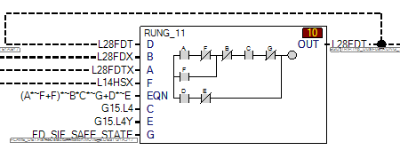
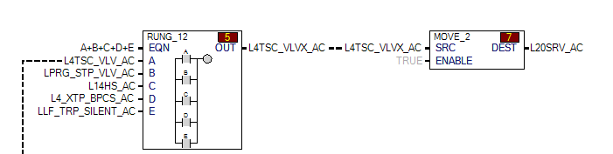
IEC61511 – Independence of the safety controller
11.7.3 Communication interface requirements
11.7.3.1 The design of the SIS communication interface shall ensure that any failure of the communication interface shall not adversely affect the ability of the SIS to bring the process to a safe state.
11.7.3.2 The SIS shall be able to communicate with the BPCS and peripherals with no impact on the SIF.
It means:
- BPCS can read MkVIeS variables through EGD since it does not interfere with SIF
- MkVIeS can read (the least possible) MkVIe variables through EGD as long as the SIF can not lead to a situation with a SIF deactivated or negatively affected.
Example: BPCS cross-trip that can only trip the safety controller
Example: loop deactivated by an BPCS signal
OK

Slide 12
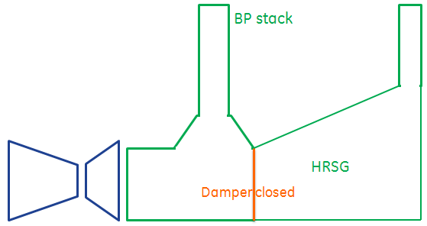
Exhaust Purge with Damper
Position limit switches wired to MkVIeS (2x3)
Additional protection: Both paths have to be purged prior firing (except exceptions)

Slide 13
Exhaust purge with damper
Starting sequence with damper.
Start order
speed
Damper Position
Closed
Opened
3 min
T*>5 min
MarkVIeS
BP Purge timer
HRSG Purge timer
Excess firing fuel flow active
Spark plugs inhibited / P2=0
Firing permitted
* For projects with IEC61511 compliance, NFPA085 is to be applied. Consider 5 times the exhaust volume up to temperature 100 F lower than autoignition temperature to be purged at purge speed.

Slide 14
Process

Slide 15
Change Impact Analysis
When is a CIA required? (extract from e-DRB EPE-3581)
CIA needed for any change in the algorithm/logic or hardware modification used by a safety loop.
CIA not needed if no impact on the software algorithm/safety loop, example:
Add point to EGD
Change Alarm class
Modify comment…

Slide 16
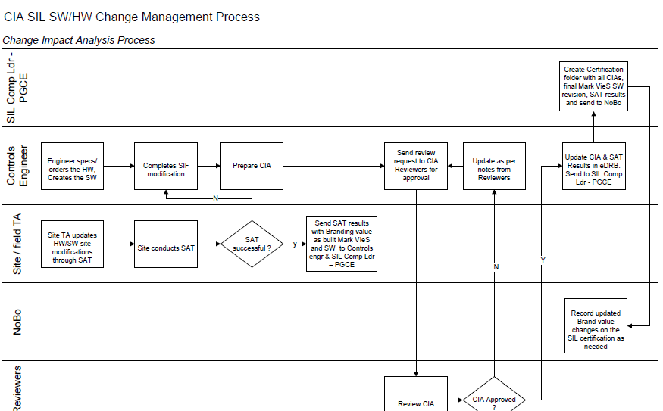
Change Impact Analysis

Slide 17
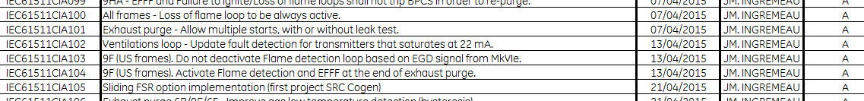
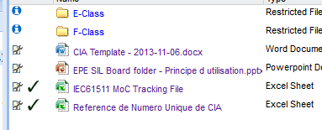
Change Impact Analysis
CIA is identified by a unique number and e-DRB reference (in CSE-12 or EPE-frame type -SIL folder)
Example: CIA103_CSE-61985
CIA can be customer-specific or applied to standard.
Add together with SIL compliance leader the CIA number to the CIA list table.
Template and unique numbers on the dedicated folder:
http://libraries.ge.com/foldersIndex.do?entity_id=38189161101&sid=101&SF=1#38189161101

Slide 18
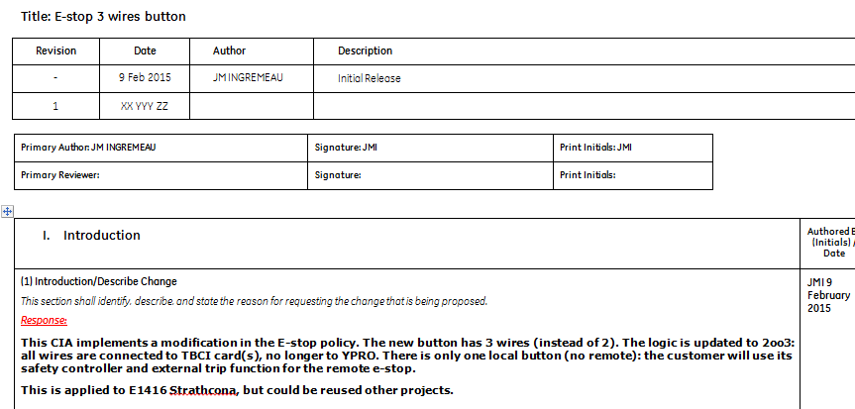
Change Impact Analysis
Example: CIA075_EPE-3539
Exxon required a 3 contact e-stop button (instead of 2 for standard)

Slide 19
Change Impact Analysis
Example: CIA075_EPE-3539
Exxon required a 3 contact e-stop button (instead of 2 for standard)
Main parts:
Introduction, reason of the modification
Impacts on documentation (Filled by Safety and Controls team)
Impacts on software/hardware/sensors/actuators
Technical description of the change
Simulation / test plan to be done
First validation before implementation
Result (software, documents, simulations)
Final validation in e-DRB

Slide 20
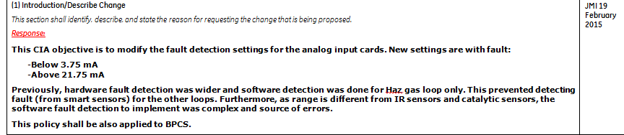
Change Impact Analysis
Example: CIA078_EPE-3542
Apply NAMUR standards for YAIC cards

Slide 21
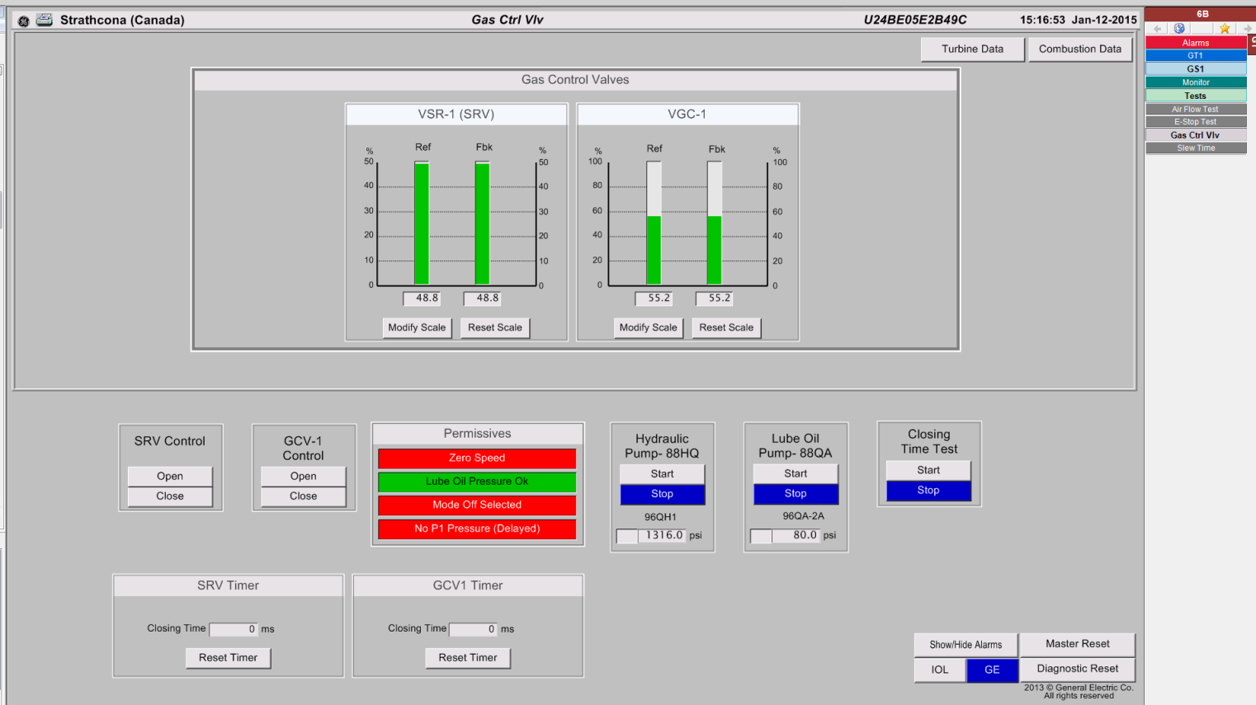
Regular proof test – Closing Times
SRV/GCV closing time are measured with the help of software/HMI (in BPCS)
Customer is required to test them regularly

Slide 22
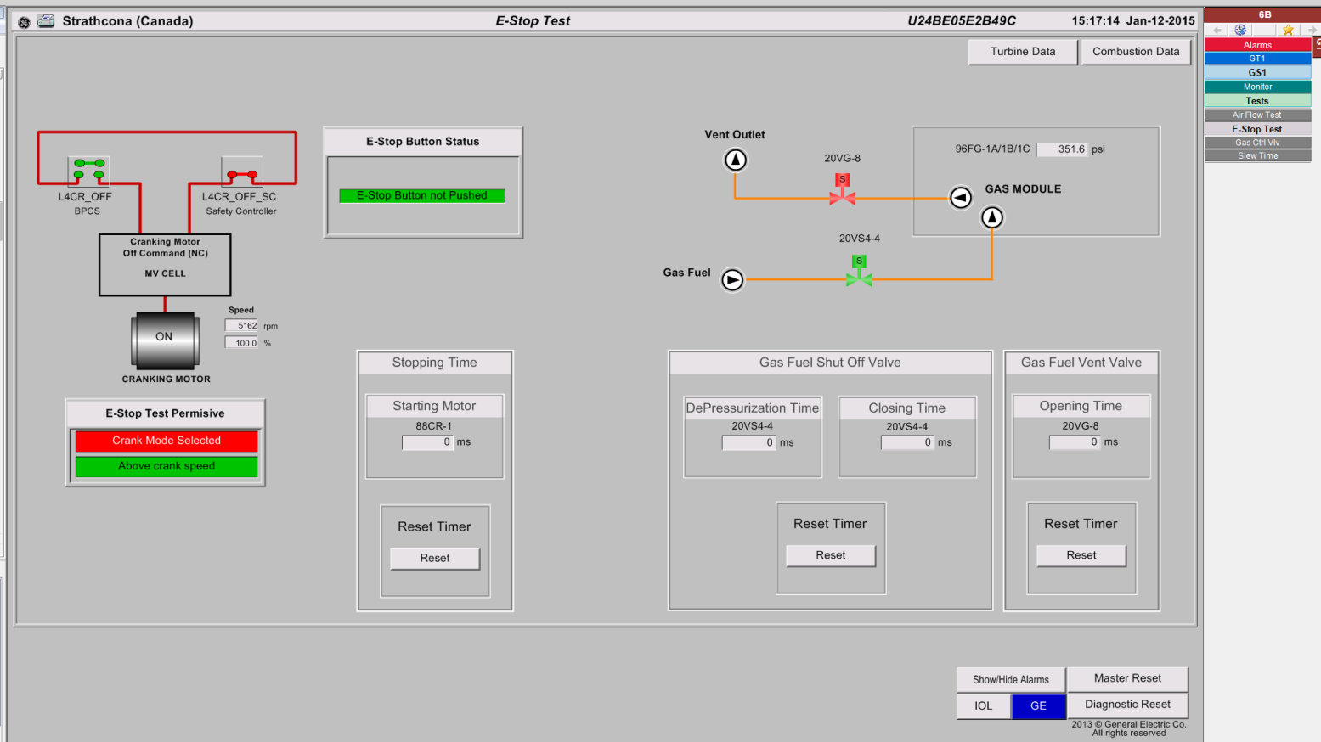
Regular proof test – P1 depressurization
E-stop test is done during crank.
It validates:
E-stop wiring
P1 depressurization time
Starting motor stopping time

Slide 23
Documentation

Slide 24
Documentation
In addition to:
GEH- 6723 Safety control functional safety instruction guide
GEH-6722 Safety control system guide
Control specification for MarkVIeS (A312 -GT, HAUS –ST)
List of process MarkVIeS alarms with potential causes, consequences and debug support
GEK
List of periodic tests (description, acceptance criteria)

Slide 25
SAT and site interface

Slide 26
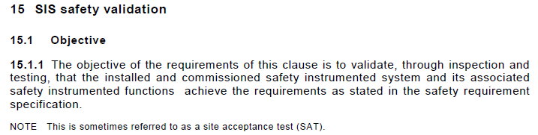
Site acceptance test -SAT
Done by control TA during commissioning
Validated by SIL compliance engineer and CST req. engineer
Part of the certification folder
Results stored and forwarded to NoBo (if necessary) by SIL compliance engineer
SAT specification developed by controls and SCL.
Warning: to check and include if different from standard (additional SIFs, etc. modifications identified by CIA

Slide 27
Process

