Slide 1
TIFFIN ADVENTURE
KANA: Tamil Nadu Idly Kadai
KANA: Tamil Nadu Idly Kadai
Run the kadai · Feed the crowd
CREATED BY SIVAKARTHI A
Notes:
Welcome everyone to KANA: Tamil Nadu Idly Kadai, an anime-inspired cooking and serving game created by Sivakarthi A. Set the stage for the morning breakfast rush.

Slide 2

Welcome to the breakfast rush
Run a South Indian tiffin shop and bring breakfast hospitality to life.
THE MISSION
Serve hot tiffin quickly, keep customers happy, and build the town's most loved idly kadai.
Game created by Sivakarthi A.
Notes:
Introduce the atmosphere of the tiffin shop. The player's goal is to keep the breakfast rush moving smoothly while delighting every hungry patron.

Slide 3

Meet the kitchen team
The Master Chef — You control the chef at the stoves: manage cooking stations, pour batter, watch timers and plate fresh food on banana leaves.
Waiter Shinchan — The energetic, mischievous runner carries tickets from tables to the kitchen counter and serves hot dishes to customers.
Notes:
Highlight the two-person dynamic: the player controls the chef managing stoves and timing, while Shinchan handles the dining room flow.

Slide 4
From order to happy customer
PHASE 01
PHASE 02
PHASE 03
Take the ticket
Cook the dish
Serve & delight
Customers order and Shinchan brings tickets to the kitchen.
Cook the food and take it to the serving counter.
Shinchan delivers the orders to the tables.
Notes:
Walk through the three-step gameplay loop: ticket pickup, cooking execution, and speedy table delivery.

Slide 5


Time each dish just right
Collect food in the sweet spot for maximum quality bonuses. Too early it is raw; too late it burns.
Movement: WASD / Arrow Keys
Navigate between steamer, griddle, and counter.
Action: E / Space Key
Interact with stoves, pick up plates, and place food for pickup.
Notes:
Explain the timing risk/reward system. Perfect pulls yield higher scores, while keyboard controls make precision quick and accessible.

Slide 6
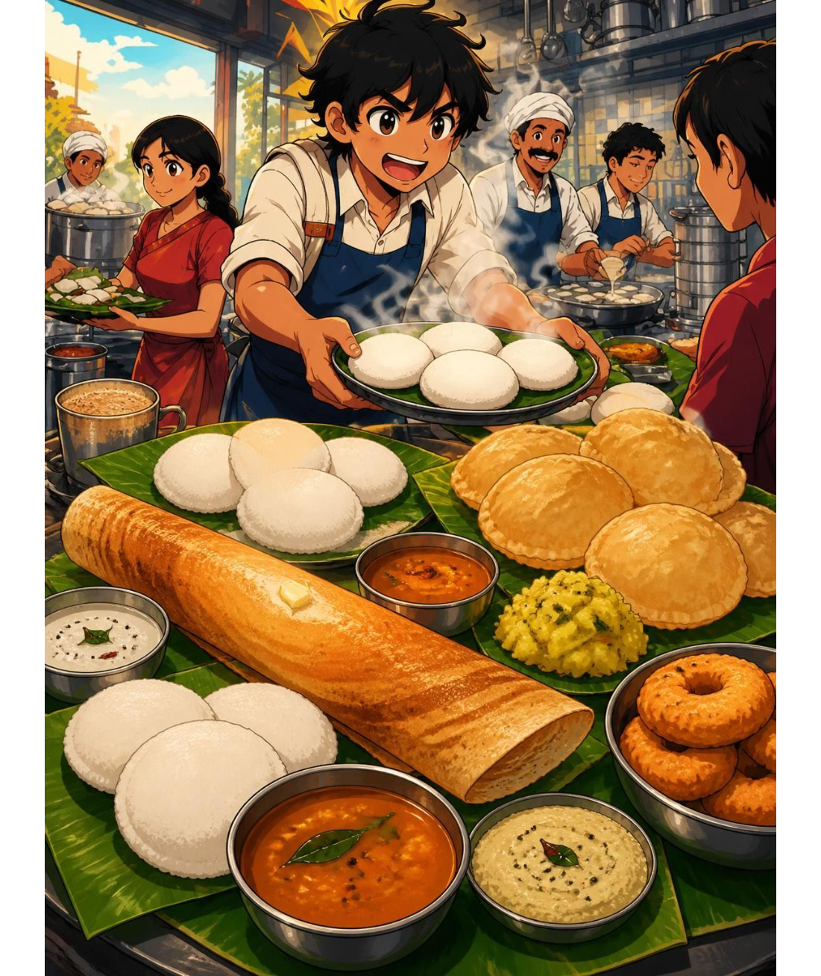
A menu full of South Indian favorites
Idly — pillowy fermented rice cakes with chutney and sambar.
Dosa & Egg Dosa — golden, lacy crepes, with spiced egg variants.
Poori Masala — puffed golden pooris with potato and onion masala.
Ven Pongal & Chapati — ghee-tempered pepper rice and soft whole-wheat flatbreads.
Notes:
Introduce the six authentic menu offerings: idly, dosa, poori masala, ven pongal, chapati, and egg dosa, each requiring different kitchen timing.

Slide 7

Turn good service into upgrades
4X · FOUR REVENUE STREAMS
Sales · Speed · Quality · Tips
Reinvest savings in upgraded equipment and faster stoves: advanced steamers, faster tawa griddles and kitchen improvements.
KADAI+ — expand capacity and speed up your workflow.
Notes:
Explain how revenue is earned from sales, speed, dish quality, and customer tips, and how it can be spent on shop equipment upgrades.

Slide 8
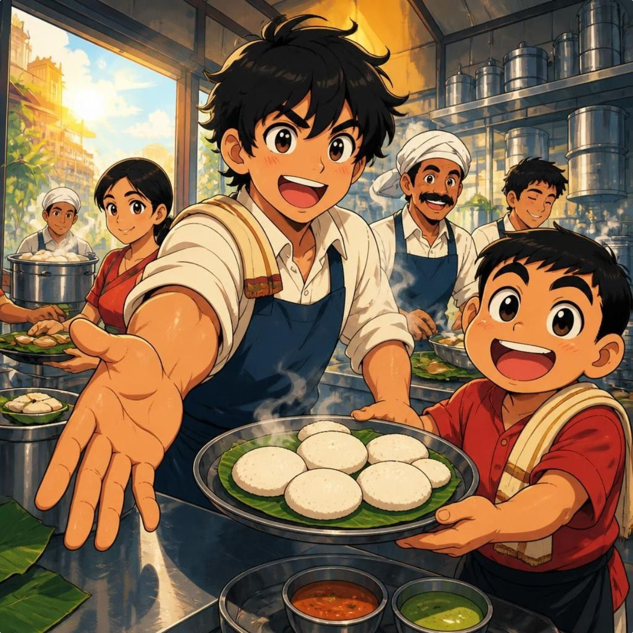
Ready to run the kadai?
Fire up the tawa and join Shinchan in the breakfast rush!
PLAY IN YOUR BROWSER
kanaidlykadaigame-five.vercel.app
Free to play · No install required · Created by Sivakarthi A
Notes:
Direct players to the game link and invite them to experience the morning tiffin rush firsthand.

