Slide 1
SIVAKARTHIKEYAN
BTECH CHEMICAL ENGG
112721203010
SWIGGY DATA ANALYSIS
3/21/2024 Annual Review

Slide 2
PROJECT TITLE
A Comprehensive Analysis of swiggy Restaurant Data

Slide 3


AGENDA
Introduction & Objectives
Data Collection & Preparation
Exploratory Data Analysis
Restaurant Insights
Consumer Behaviour Analysis
Regional & Cuisine Trends
Geospatial Analysis
Business Recommendation
Conclusion & Discussion
3/21/2024 Annual Review

Slide 4

PROBLEM STATEMENT
Swiggy, one of the leading food delivery platforms, has witnessed significant growth in recent years. As the market becomes increasingly competitive and dynamic, it is crucial for Swiggy to gain deep insights into customer behavior and market trends to maintain its competitive edge. The problem statement revolves around conducting an exploratory analysis of Swiggy's operations, focusing on understanding customer preferences, identifying key market trends, and uncovering opportunities for improvement

Slide 5

PROJECT OVERVIEW
Project swiggy The project uses data from Swiggy 's food delivery platform to analyze key metrics such as order volume, delivery time, customer ratings, and restaurantratings. The analysis is performed using Python programming language and various data analysis libraries such as Pandas, NumPy, and Matplotlib, Seaborn.

Slide 6

WHO ARE THE END USERS?
End users of the analysis include:
Restaurant owners/managers
Chain restaurant executives
Independent restaurateurs
Swiggy and food service platforms
investors and analysts
Food industry consultants

Slide 7

YOUR SOLUTION AND ITS VALUE PROPOSITION
Solutions and Proportions:
Menu Optimization & Pricing: 30%
Marketing Enhancement: 20%
Operational Efficiency: 15%
Customer Experience Improvement: 20%
Platform Optimization (swiggy): 10%
Strategic Planning & Investment: 5%

Slide 8

THE WOW IN YOUR SOLUTION
The "wow" factor in the solutions derived from the swiggy restaurant data. analysis lies in their ability to provide actionable insights that drive tangible improvements across various aspects of the restaurant industry. Here's where the "wow" factor lies in each solution:
1.Menu Optimization & Pricing:
2. Marketing Enhancement:
3.Operational Efficiency:
4.Customer Experience Improvement:
5.Strategic Planning & Investment:
3/21/2024 Annual Review
8

Slide 9
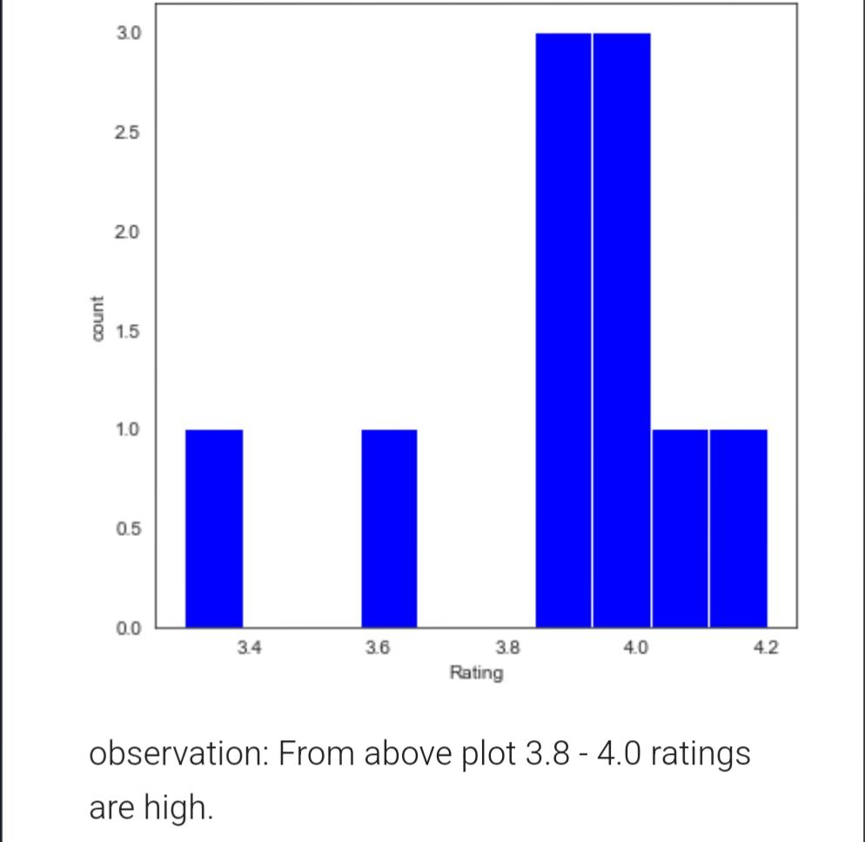
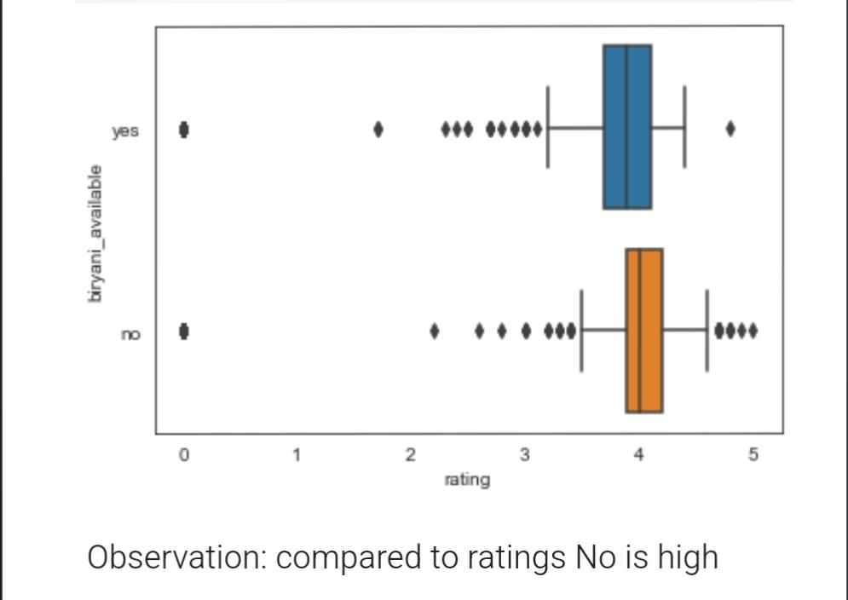
RESULTS
9

