Slide 1

Exploratory Data Analysis
Siva Kashyap Ch
IN1240589

Slide 2



About me
I am Siva Kashyap Ch , a BTech student at IIITDM Kancheepuram, majoring in Computer Science and Engineering. My primary goal is to excel in Data Science and Machine Learning. Despite lacking prior experience, I have undertaken significant projects in the realm of Data Science. Committed to advancing my expertise, I aim to leverage my academic background to delve into the intricacies of these fields. My focus is on acquiring practical skills and knowledge to become proficient in Data Science and Machine Learning. I am enthusiastic about applying theoretical concepts to real-world scenarios and am dedicated to continuous learning and improvement.

Slide 3
Objective of the Project
The primary objective of analyzing the Aspiring Mind Employment Outcome 2015 (AMEO) dataset is to perform a comprehensive Exploratory Data Analysis (EDA) with a particular focus on understanding the employment outcomes of engineering graduates. The target variable for analysis is the "Salary," and the aim is to explore the relationships between this variable and various independent features such as cognitive skills, technical skills, personality traits, academic performance, and demographic information. The analysis seeks to uncover patterns, trends, and factors influencing salary offers, providing valuable insights for stakeholders, employers, and policymakers.

Slide 4
Purpose of the Dataset
The dataset aims to provide a comprehensive understanding of the employment outcomes of engineering graduates, considering a wide range of factors. It allows for the exploration of relationships between academic performance, skills assessment, personality traits, and employment-related variables. The unique identifier for each candidate facilitates individual tracking, and the dataset's size ensures a substantial sample for analysis.

Slide 5
Description of the Data Set
The dataset was released by Aspiring Minds from the Aspiring Mind Employment Outcome 2015 (AMEO). The study is primarily limited only to students with engineering disciplines. The dataset contains the employment outcomes of engineering graduates as dependent variables (Salary, Job Titles, and Job Locations) along with the standardized scores from three different areas – cognitive skills, technical skills and personality skills. The dataset also contains demographic features. The dataset contains around 40 independent variables and 4000 data points. The independent variables are both continuous and categorical in nature. The dataset contains a unique identifier for each candidate. Below mentioned table contains the details for the original dataset.

Slide 6
Overview of the dataset:
- Dataset Size: Approximately 40 Independent Variables and 4000 Data Points
- Variables:
- Dependent Variables: Salary, Job Titles, Job Locations
- Independent Variables: Cognitive Skills, Technical Skills, Personality Skills and Demographic Features
- Data Types:
- Continuous: Salary, Exam Scores, GPA, etc.
- Categorical: Designation, Job City, Gender, Board, College Tier, Degree, Specialization, etc.
- Dates: DOJ, DOL, DOB, Graduation Year
- Unique Identifiers: ID (UID), College ID, College City ID

Slide 7
Key Features:
- Unique Identifier (ID/UID) for each candidate
- Information about academic performance in grade 10 and 12
- Details about the college attended, including tier and location
- Scores in various sections of AMCAT (Aspiring Minds Computer Adaptive Test)
- Personality test scores (conscientiousness, agreeableness, extraversion, neuroticism, openness to experience)

Slide 8
Data Variables - Types
•Continuous:
•Salary
•10percentage
•Domain Scores (e.g., Conscientiousness, Neuroticism)
•Categorical:
•Designation
•Gender
•CollegeTier
•Specialization
•Degree
•JobCity
•12board
•CollegeCityTier

Slide 9
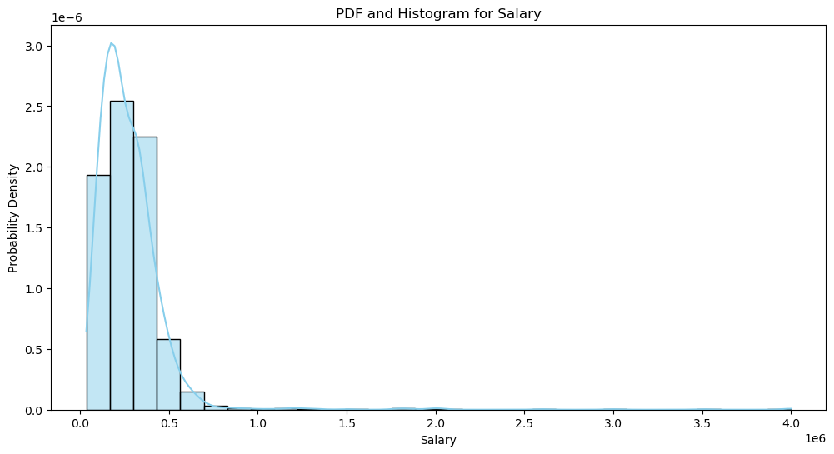
Numerical Data

Slide 10
Insights from the Histogram:
-The salary distribution is left-skewed, meaning that there are more employees who earn lower salaries than there are employees who earn higher salaries.
-The median salary is around 100,000.
-There is a small number of employees who earn very high salaries, as evidenced by the tail on the right side of the distribution.
-It is possible that the two professions being compared in the graph have different salary distributions. For example, the profession with the higher median salary may also have a wider range of salaries, while the profession with the lower median salary may have a narrower range of salaries.

Slide 11
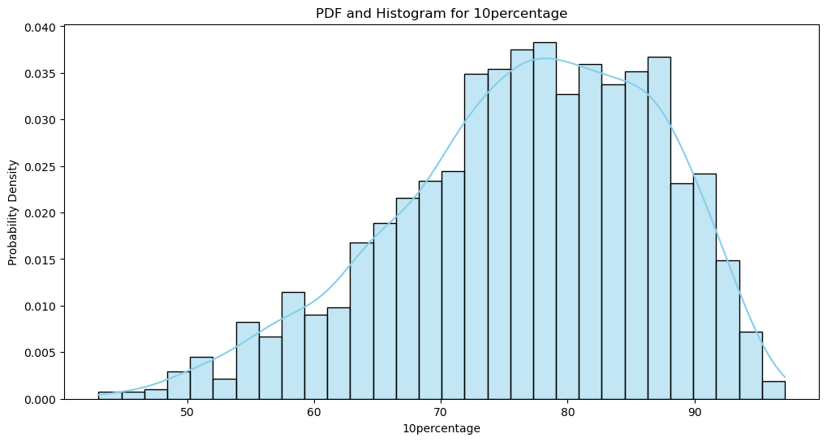

Slide 12
Insights from the Histogram of 10th Percentage:
Most students scored between 50% and 70%: The highest point of the probability density curve is around 60%, indicating that this is the most common score. The curve slopes down gradually on either side, showing that fewer students scored very high or very low percentages.
The distribution is slightly left-skewed: There are more students who scored lower than 60% than students who scored higher than 60%. This is because the left tail of the curve extends further than the right tail.
There is a small number of students who scored very high: The curve extends slightly above 90%, indicating that a small number of students scored very high percentages.

Slide 13
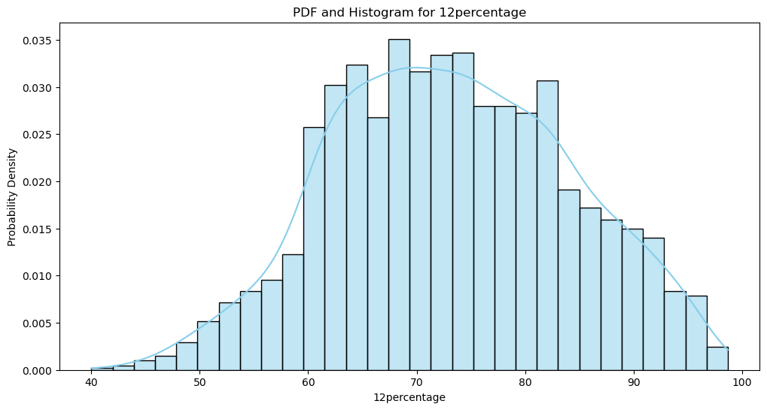

Slide 14
Insights from the 12th Percentage Histogram:
The average percentage is 59.3%: This is indicated by the peak of the curve, which is around 59.3%.
The standard deviation is 12.9%: This is determined by the width of the curve. A wider curve indicates a larger standard deviation, meaning more students scored farther away from the average.
68% of students scored between 46.4% and 72.2%: This is the area under the curve between one standard deviation below and one standard deviation above the mean (59.3% ± 12.9%).
95% of students scored between 33.5% and 85.1%: This is the area under the curve between two standard deviations below and two standard deviations above the mean.
The distribution is slightly left-skewed: The left tail of the curve extends slightly further than the right tail, indicating that there are slightly more students who scored lower than the average than students who scored higher than the average.

Slide 15
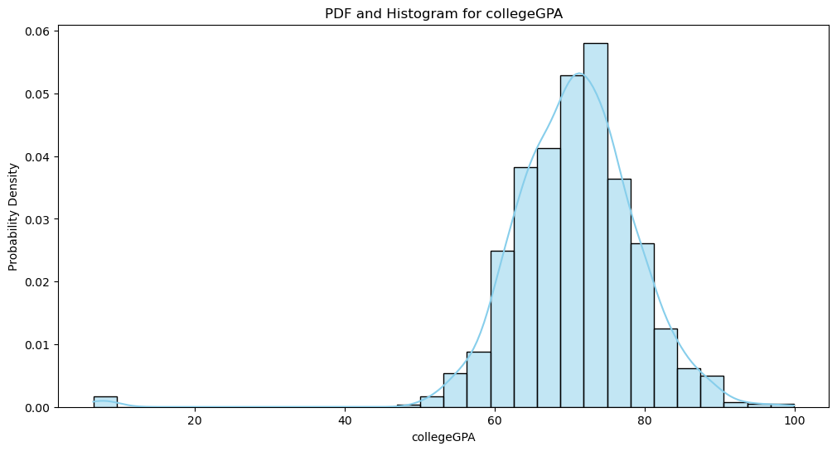

Slide 16
Insights from the College GPA:
The distribution is left-skewed, meaning more students scored lower than the average than scored higher.
The average percentage is 59.3%.
The standard deviation is 12.9%.
68% of students scored between 46.4% and 72.2%.
95% of students scored between 33.5% and 85.1%.

Slide 17
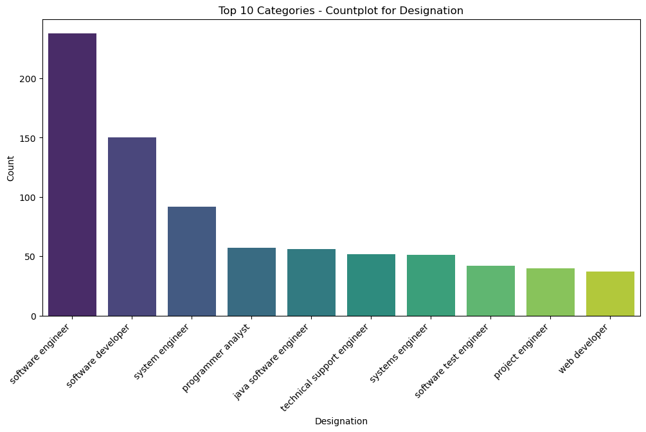
Categorical Data

Slide 18
Insights from the designation histogram:
The most common designation is "Software Engineer," with over 200 people having completed the program with this designation.
Other common designations include "Software Developer," "System Engineer," and "Programmer Analyst."
There are a smaller number of people who have completed the program with less common designations, such as "Technical Support Engineer," "Systems Engineer," and "Software Test Engineer."
It is possible that the people who have completed the dedication program are IT professionals who are looking to advance their careers.
The program may be offered by a company or organization that is looking to develop the skills of its employees.

Slide 19
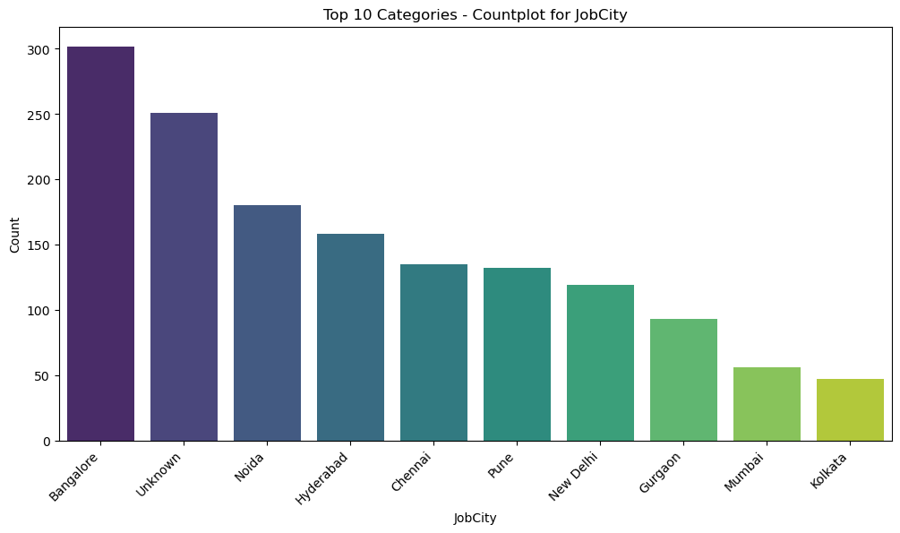

Slide 20
Insights from the histogram of the cities:
The distribution of people across cities is skewed to the right. This means that there are more people living in a smaller number of larger cities, and fewer people living in many smaller cities.
The five most populous cities are Bangalore, Chennai, Pune, New Delhi, and Gurgaon. These cities have significantly more people working in them compared to the other cities listed.
There is a large gap between the number of people working in the most populous cities and the other cities. This suggests that there is a significant concentration of people in a few major metropolitan areas.
The unknown column in the graph is the number of no mentions in the data.

Slide 21
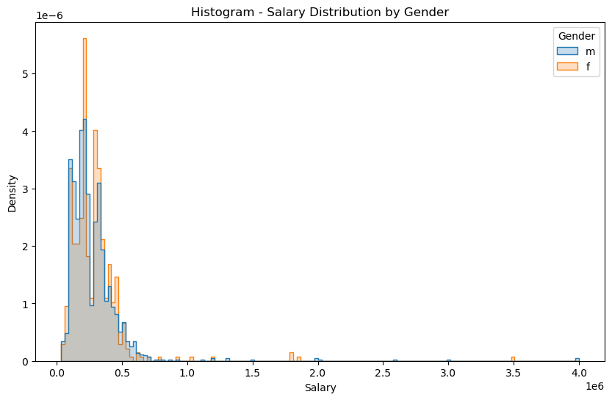
BI VARIATE ANALYSIS

Slide 22
Insights from the Histogram on the Gender vs Salary:
The distribution of salaries for both men and women is skewed to the right, meaning that there are more people who earn lower salaries than there are people who earn higher salaries.
The distribution of salaries for men is wider than the distribution of salaries for women, meaning that there is more variability in the salaries that men earn.
The median salary for men is higher than the median salary for women.

Slide 23
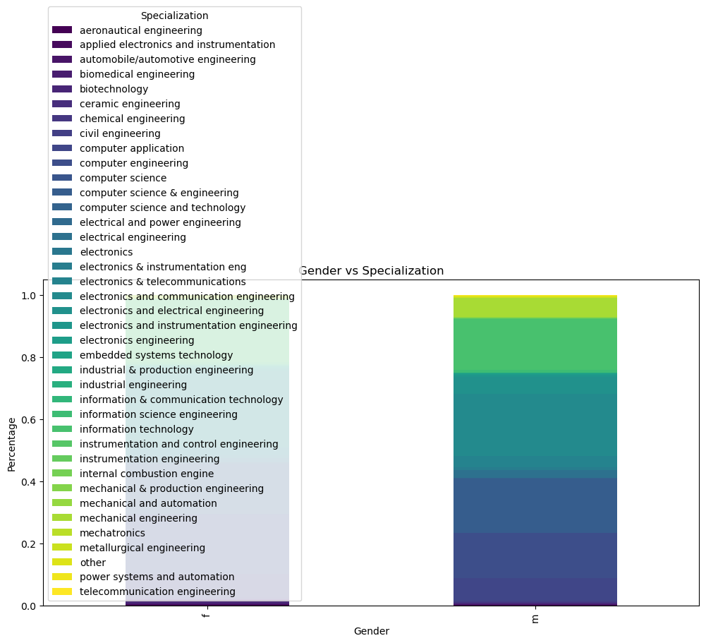
Gender vs Specialization

Slide 24
Insights from the Gender vs Specializations:
Electrical engineering is the most popular specialization, with 10% of engineers specializing in it. This is followed by computer science and mechanical engineering, both at 8%.
Specializations within electrical engineering are quite diverse. There are 13 different specializations listed, each with at least 0.6% of engineers specializing in it. The most popular specializations within electrical engineering are electronics engineering (2.8%) and electrical and power engineering (2.4%).
There is a gender gap in some specializations. For example, 3.2% of engineers who specialize in electronics engineering are women, while 8.4% of engineers who specialize in computer science are women.

Slide 25
Conclusion
The exploratory data analysis (EDA) on the Aspiring Mind Employment Outcome 2015 (AMEO) dataset unveiled key insights. Univariate analysis revealed outliers in numerical columns and offered nuanced perspectives on the distribution of variables, notably influencing salary outcomes for engineering graduates. Examination of categorical variables highlighted diverse preferences in specialization and college tiers among candidates, prompting further investigation.
Bivariate analysis delved deeper into relationships between variables. Scatter plots and pair plots suggested potential correlations among numerical features, pinpointing areas for focused scrutiny. The exploration of gender and specialization uncovered no clear association, challenging assumptions about gender-related preferences in engineering disciplines. The evaluation of a salary claim from a Times of India article indicated the need for more rigorous statistical testing to draw conclusive insights. Overall, the EDA process not only presented a snapshot of dataset characteristics but also uncovered intriguing patterns, guiding subsequent targeted analyses and decision-making in further stages of data exploration and modeling.

Slide 26

THANK YOU

