Slide 1
VisCommerce Notes
Jan, 2021

Slide 2
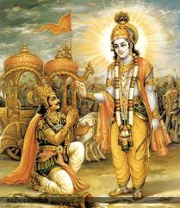
Bhagwadh Geetha

Slide 3
migenius
Unity Client
https://github.com/migenius/rs-unity
Downloads
http://download.migenius.com/releases/RealityServer/realityserver-60-3000.539.tgz
http://download.migenius.com/releases/RealityServer/iview2-327300.9514.zip
License Key
0780-8103-7450-7287

