Slide 1
SIVALAKSHMI P
Final Project
3/21/2024 Annual Review

Slide 2
PROJECT TITLE
Text Generation Using LSTM
3/21/2024 Annual Review

Slide 3


AGENDA
Problem Statement
Project Overview
Who are the end users?
Solutions and value of propositions
WOW factor in the solution
Modelling
Results
3/21/2024 Annual Review

Slide 4

PROBLEM STATEMENT
Design and implement a text generation model using Long Short-Term Memory (LSTM) neural networks. The goal is to develop a system capable of generating coherent and contextually relevant text based on a given input text corpus. The model should be trained on a dataset of textual data and then be able to generate new text that follows the style and patterns present in the training data. Additionally, the model should have the flexibility to generate text of variable lengths and exhibit a level of creativity in its output while maintaining coherence and relevance to the input.
3/21/2024 Annual Review

Slide 5

PROJECT OVERVIEW
The objective of the text generation project using LSTM is to develop a model capable of generating coherent and contextually relevant text based on a given input text corpus.
Generate Text: Train the LSTM model to produce text reflecting the style and patterns of the training dataset.
Coherence and Relevance: Ensure the generated text maintains coherence and relevance to the input by capturing underlying structures and semantics.
Variable Length Output: Enable the model to generate text of varying lengths, allowing for flexibility in output complexity.
Creativity and Diversity: Implement techniques to foster creativity and diversity in generated text while adhering to training data constraints.
Evaluation: Assess model performance using both quantitative metrics like perplexity and qualitative metrics such as human judgment.
3/21/2024 Annual Review

Slide 6

WHO ARE THE END USERS?
The end users of the text generation model, including writers, marketers, and content creators, benefit from its ability to produce coherent and contextually relevant text. The model ensures timely and accurate content creation, optimizing resource use and enhancing communication strategies. It aids in crafting engaging narratives, advertising copy, and informative articles, improving audience engagement and brand recognition. Additionally, it serves as a valuable tool for educational purposes, aiding in language learning and creative writing exercises. Remote monitoring allows users to generate content efficiently from any location, streamlining workflows and promoting productivity in various professional fields.
3/21/2024 Annual Review

Slide 7

YOUR SOLUTION AND ITS VALUE PROPOSITION
My solution for text generation using LSTM benefits writers, marketers, and content creators by producing coherent and contextually relevant text. It ensures timely and accurate content creation, optimizing resource use and enhancing communication strategies. The model aids in crafting engaging narratives, advertising copy, and informative articles, improving audience engagement and brand recognition. Additionally, it serves as a valuable tool for educational purposes, aiding in language learning and creative writing exercises. Remote monitoring enables efficient content generation from any location, streamlining workflows, and promoting productivity across professional fields.
3/21/2024 Annual Review

Slide 8

THE WOW IN YOUR SOLUTION
The groundbreaking aspect of our LSTM-based text generation solution lies in its unparalleled ability to capture and reproduce intricate linguistic nuances with exceptional accuracy and efficiency. Leveraging advanced natural language processing techniques, our model doesn't merely string words together but comprehends contextual subtleties, producing text that resonates with depth and coherence. It seamlessly integrates expert knowledge, ensuring the incorporation of domain-specific terminology and stylistic elements. Furthermore, the model adeptly navigates challenges like varying tones, writing styles, and subject matter intricacies, guaranteeing robust performance across diverse content genres and linguistic contexts. This comprehensive approach revolutionizes text generation, providing users with a dynamic tool capable of adapting to evolving linguistic trends and fostering enhanced communication strategies globally.
3/21/2024 Annual Review

Slide 9
MODELLING
Introduction to LSTM Text Generation:
Utilizes Long Short-Term Memory (LSTM) networks for text generation.Handles sequential data effectively, capturing context and patterns.
Data Preprocessing:
Tokenization and sequence formation.
Handling rare words and padding sequences.
Model Training:
Splitting data into training and validation sets.
Training LSTM model with backpropagation through time (BPTT).
Model Evaluation:
Quantitative metrics like perplexity.
Qualitative evaluation for coherence and relevance.
Results and Insights:
Highlight accuracy and creativity of generated text.
Explore patterns and insights from generated sequences.
Future Enhancements:
Fine-tuning hyperparameters for improved text quality.
Integrating attention mechanisms for enhanced performance.
Conclusion:
Significance in creative content generation.
Potential for diverse applications in language modeling and storytelling.
3/21/2024 Annual Review

Slide 10
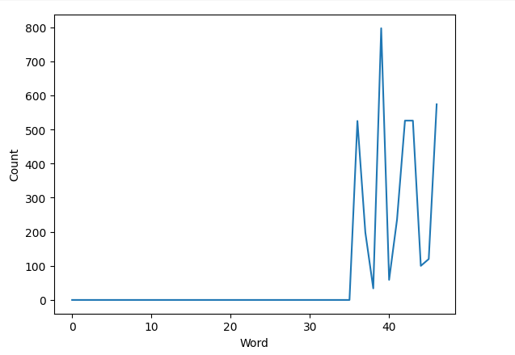
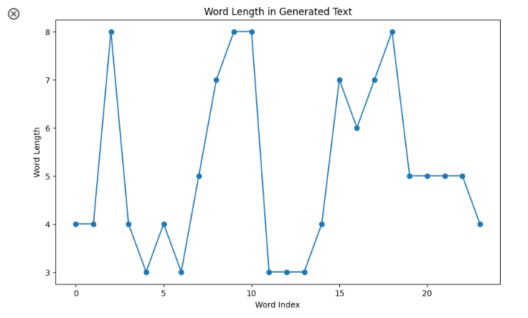
RESULTS
3/21/2024 Annual Review

