Slide 1
DeepEthogram

Slide 2
Introduction
Unlike other approaches in the field of Neuroscience and animal behavior, the current approach is end2end and does not need two steps (pose estimation + classifier)
Supervised approach, annotations for behavior supervised deep-learning model that, with minimal user-based training data, takes a video with T frames and a user-defined set of K behaviors and generates a binary [T, K] matrix
convolutional neural networks (CNNs) were used, specifically Hidden Two-Stream Networks (Zhu et al., 2017) and Temporal Gaussian Mixture (TGM) networks (Piergiovanni and Ryoo, 2018), to detect actions in videos, and we pretrained the networks on large open-source datasets (Kinetics700 video dataset)
Authors admit that this model is not SOTA for action detection in CS, rather, for specific biomedical animal research. Moreover, authors states that the architecture is not SOTA and does not use transformers and GNN.
Notes:
https://paperswithcode.com/dataset/kinetics-700

Slide 3
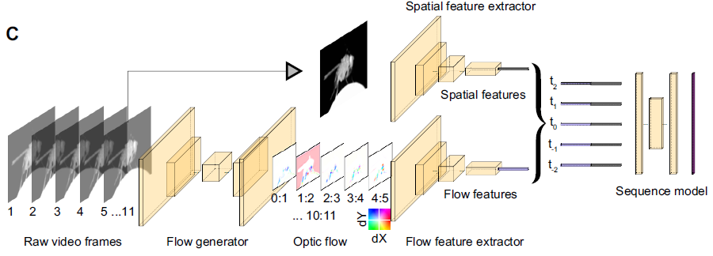
Architecture
The overall architecture of our solution includes (1) estimating motion (optic flow) from a small snippet of video frames, (2) compressing a snippet of optic flow and individual still images into a lower dimensional set of features, and (3) using a sequence of the compressed features to estimate the probability of each behavior at each frame in a video
Flow generator: CNN is used to generate optic flow from a set of images. We incorporate optic flow because some behaviors are only obvious by looking at the animal’s movements between frames, such as distinguishing standing still and walking. Input includes set of 11 frames.
Optic flow: compress the large number of optic flow snippets across all the pixels into a small set of features called flow features. MotionNet (Zhu et al., 2017) architecture to generate 10 optic flow frames from 11 images.
Spatial features CNN: takes single video frames as input, to compress the large number of raw pixels into a small set of spatial features, which contain information about the values of pixels relative to one another spatially but lack temporal information. ResNet family of models TGM.
Final stage: fuse the outputs of the two feature extractors by averaging, To produce the final probabilities that each behavior was present on a given frame – a step called inference – we use a sequence model, which has a large temporal receptive field and thus utilizes long timescale information
The final output of DeepEthogram is a [T, K] matrix, in which each element is the probability of behavior k occurring at time t
Augmentations of the input for the training included random pertubations of: brightness, contrast, 10deg rotation, horizontal flip and vertical flip for some of the data.

Slide 4
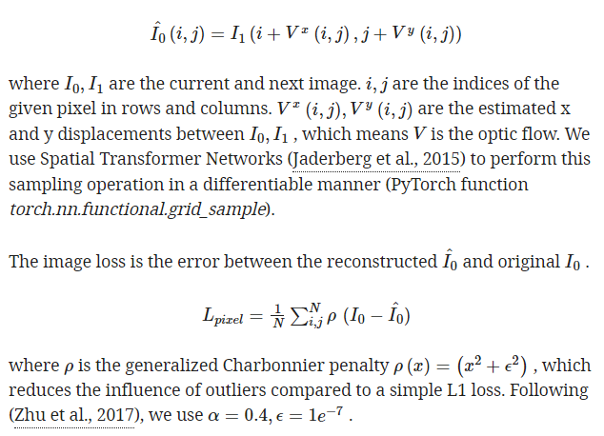
Loss functions
Flow generator, minimization of reconstruction error and high-frequency components

Slide 5
Results
Tested on varied datasets from different animals and settings (i.e., fly, mouse..)
Compared with 3 human experts labeling, most of the classifications were not significantly different from the human annotations. Moreover, lowest performance tended to be the behaviors for which humans had less agreement
In order to deal well with rare classes the following were conducted: 1) cost function had weighed errors such that rare classes were more heavily represented. 2) regularization specigic to transfer leartning to reduce overfitting. 3) tuned threshold for converting the models probability of a given class into a classification of whether that behavior was present.

Slide 6
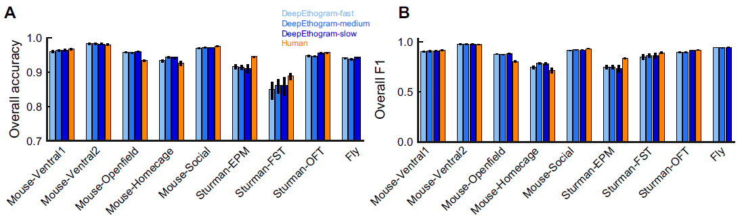
Results

Slide 7
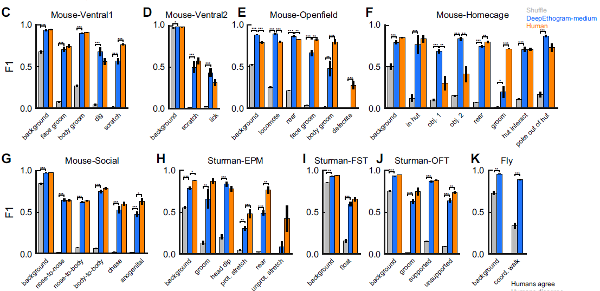
Results

Slide 8
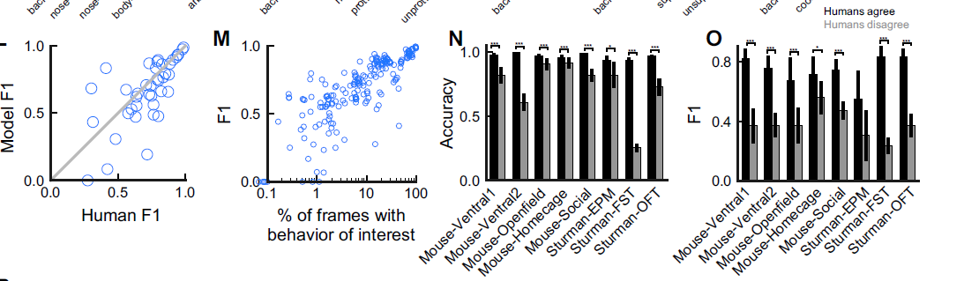
Results

Slide 9
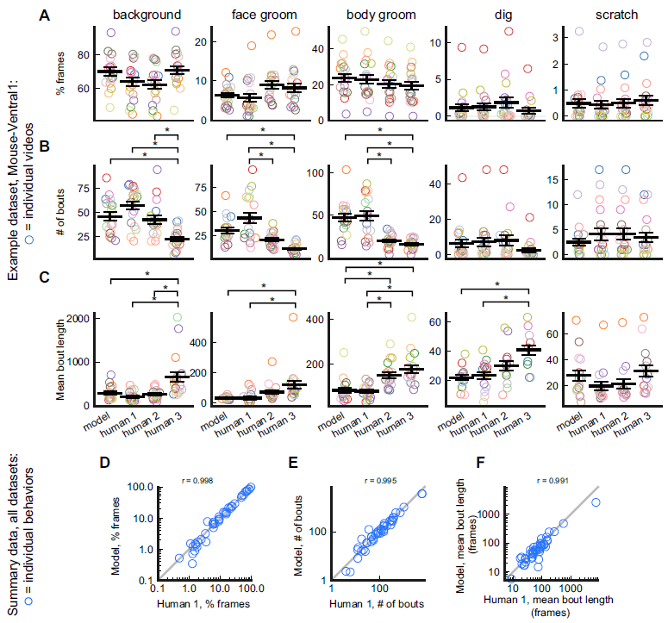
Results

Slide 10
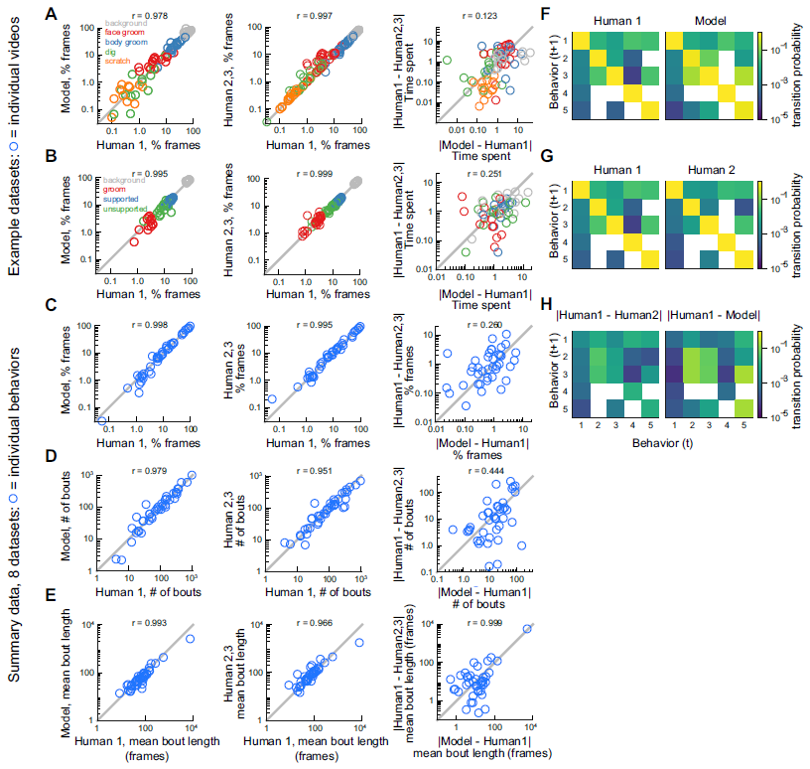
Results

