Slide 1

Data Analytics Task - Digital Biomarker Scientific Question
/ 03
01
02
RESEARCH QUESTION
§ 1.0
Can a consumer smartphone's built-in accelerometer reliably detect the characteristic 4–6 Hz resting tremor associated with Parkinson's disease?
FIG. 1 — TREMOR FREQUENCY TAXONOMY
The diagnostic band is narrow and well separated from voluntary motion.
4–6 Hz · Parkinson
0 Hz
Voluntary
Resting tremor
Essential
12 Hz
H₀ — WORKING HYPOTHESIS
The acceleration magnitude spectrum exhibits a dominant peak inside the 4–6 Hz band when, and only when, parkinsonian tremor is present.
Medical Software Development · Exercise 10
FHNW · School of Life Sciences

Slide 2
01
Data Analytics Task - Digital Biomarker Scientific Question
/ 03
02
03
INSTRUMENTATION
DEVICE UNDER TEST
ID DUT-01 REV 1.0 2025
A single MEMS accelerometer, three axes, no add-ons.
Samsung Galaxy S24 Ultra
SM-S928B · Android 14
SENSOR
STMicroelectronics LSM6DSV
6-axis IMU (accelerometer + gyroscope), non-wake-up mode
WHY AN ACCELEROMETER?
i
Prevalence . Already present in every modern smartphone, no extra hardware, no compliance burden.
SAMPLING RATE
≈ 116 Hz
Nyquist 58 Hz — well above the 4–6 Hz band of interest
ii
Sensitivity. MEMS resolution easily resolves the sub-centimetre displacements of resting tremor.
QUANTITY
Linear acceleration in m/s²
Three orthogonal body-fixed axes (X, Y, Z); gravity included, removed in pre-processing
iii
Validated. Prior literature establishes pocket-mounted accelerometry as viable for tremor monitoring.
X · LATERAL
Y · LONGITUDINAL
Z · NORMAL
Side-to-side acceleration of the device chassis.
Along the phone's long edge — gravity-aligned in portrait.
Perpendicular to the screen — pocket-facing axis.
Medical Software Development · Exercise 10
FHNW · School of Life Sciences

Slide 3
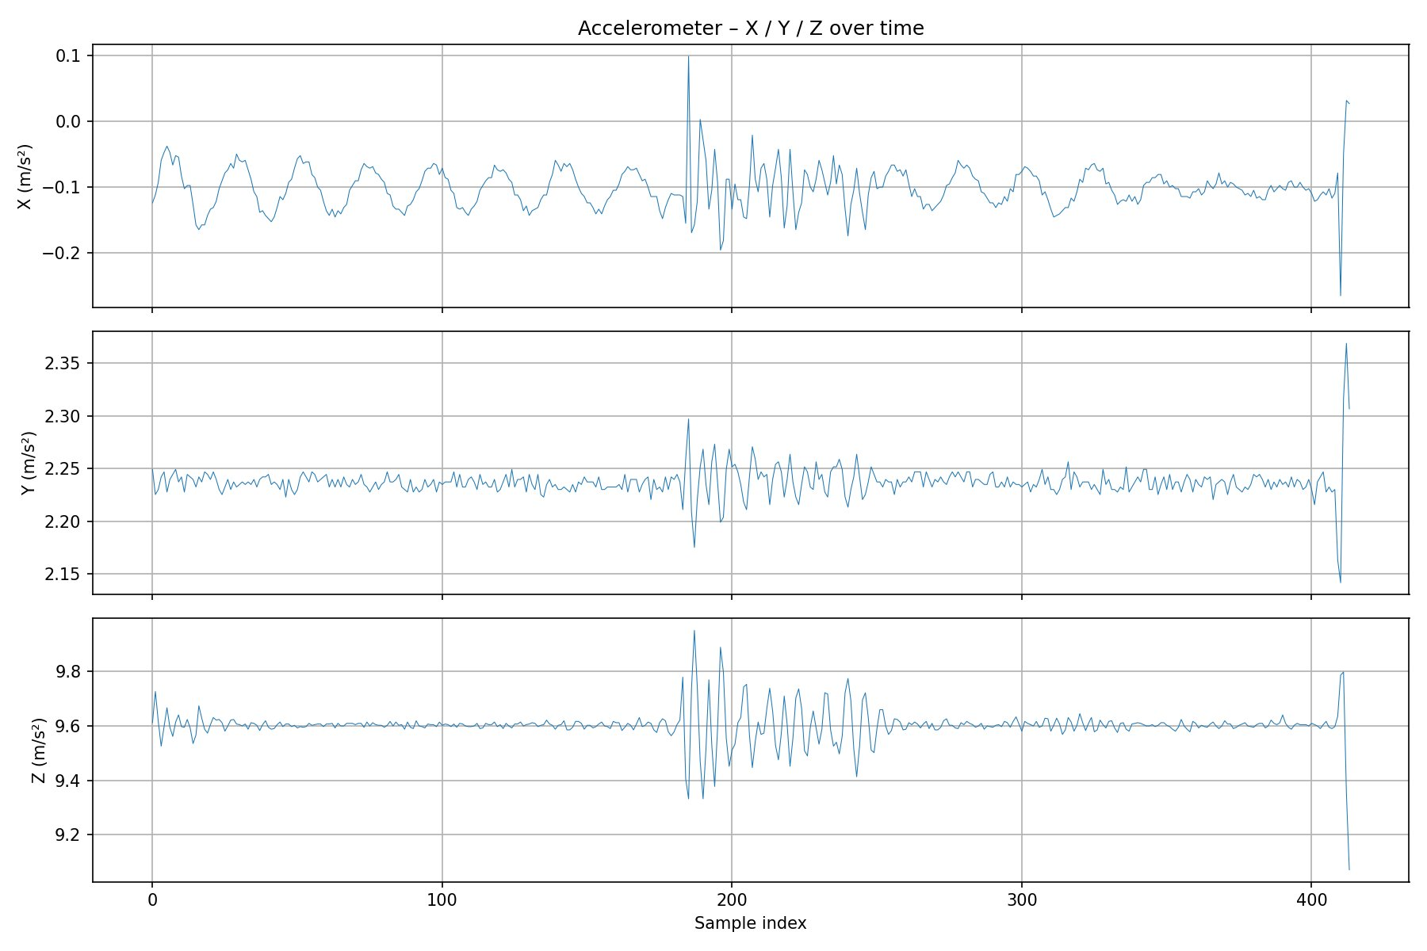
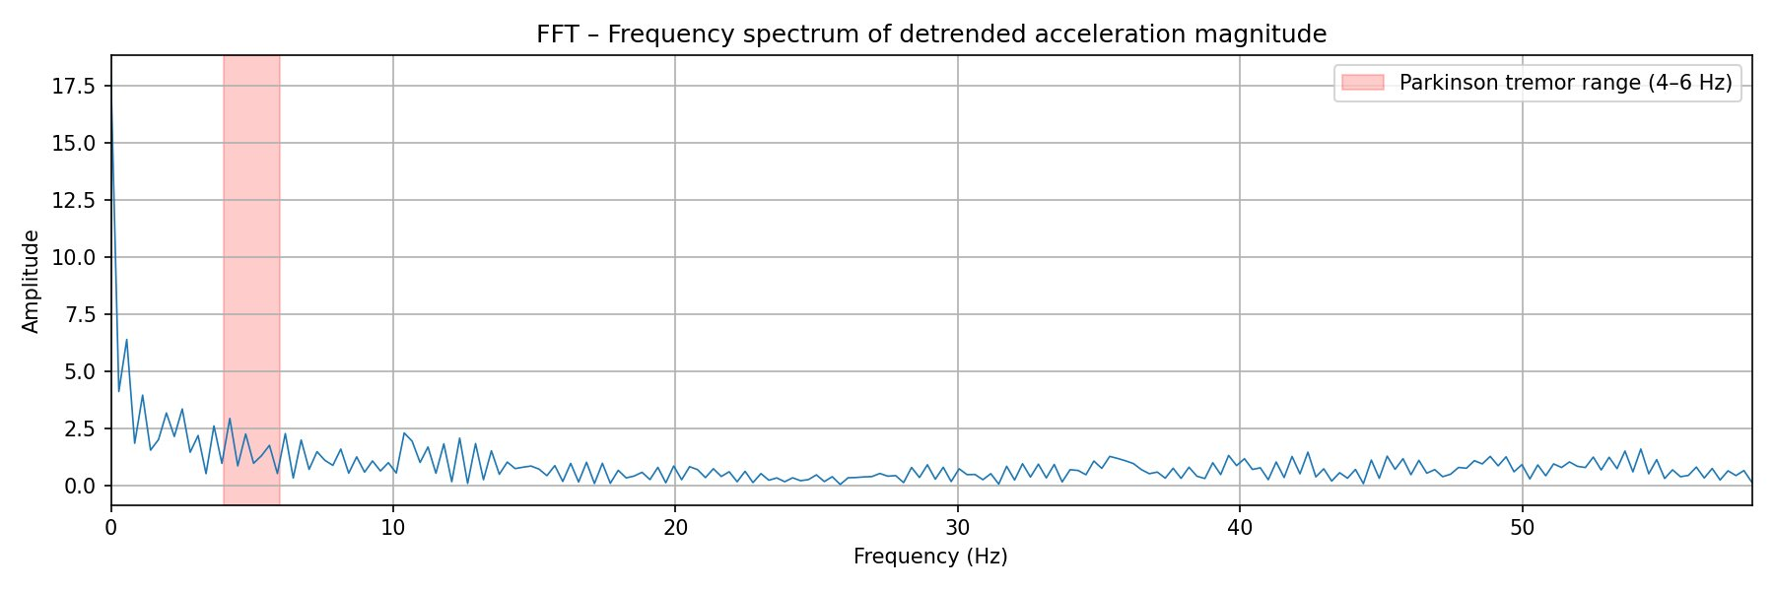
03
Data Analytics Task - Digital Biomarker Scientific Question
/ 03
ANALYTICS & RESULT
Fig. 2 — Raw 3-axis acceleration over time
TIME DOMAIN
From time series to a frequency verdict.
01
Acquire X / Y / Z
3-axis recording at ~116 Hz, ≈ 420 samples (3.6 s).
02
Magnitude & detrend
‖a‖ = √(x² + y² + z²); subtract running mean.
03
FFT spectrum
DFT of detrended magnitude; inspect 4–6 Hz band.
Fig. 3 — FFT spectrum, Parkinson band highlighted
FREQUENCY · RESULT
FINDING · HEALTHY SUBJECT
No tremor detected
No significant peak in 4–6 Hz. Energy concentrates below 2 Hz , consistent with brief voluntary movement rather than parkinsonian oscillation.
Medical Software Development · Exercise 10
FHNW · School of Life Sciences

