Slide 1

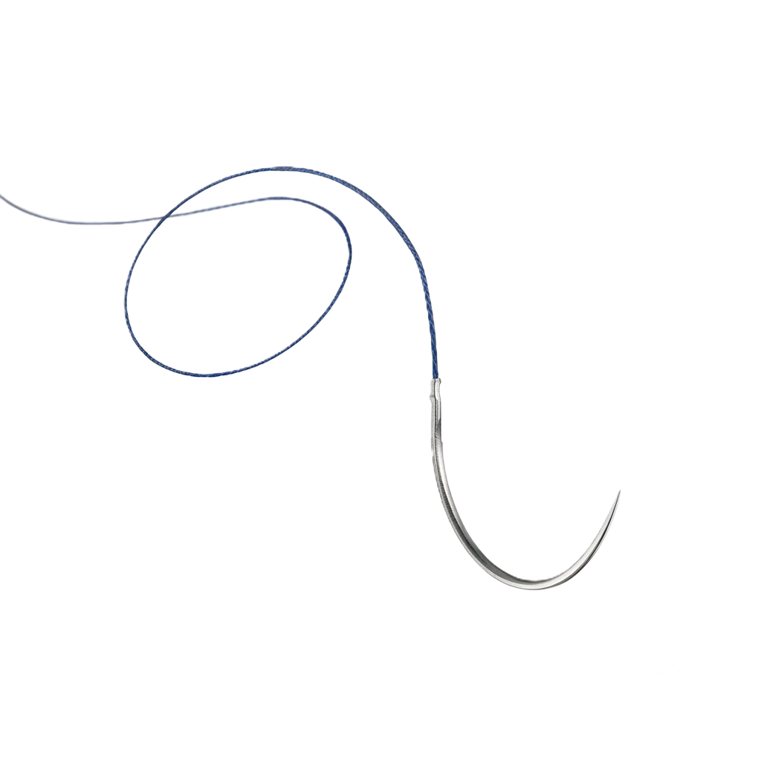
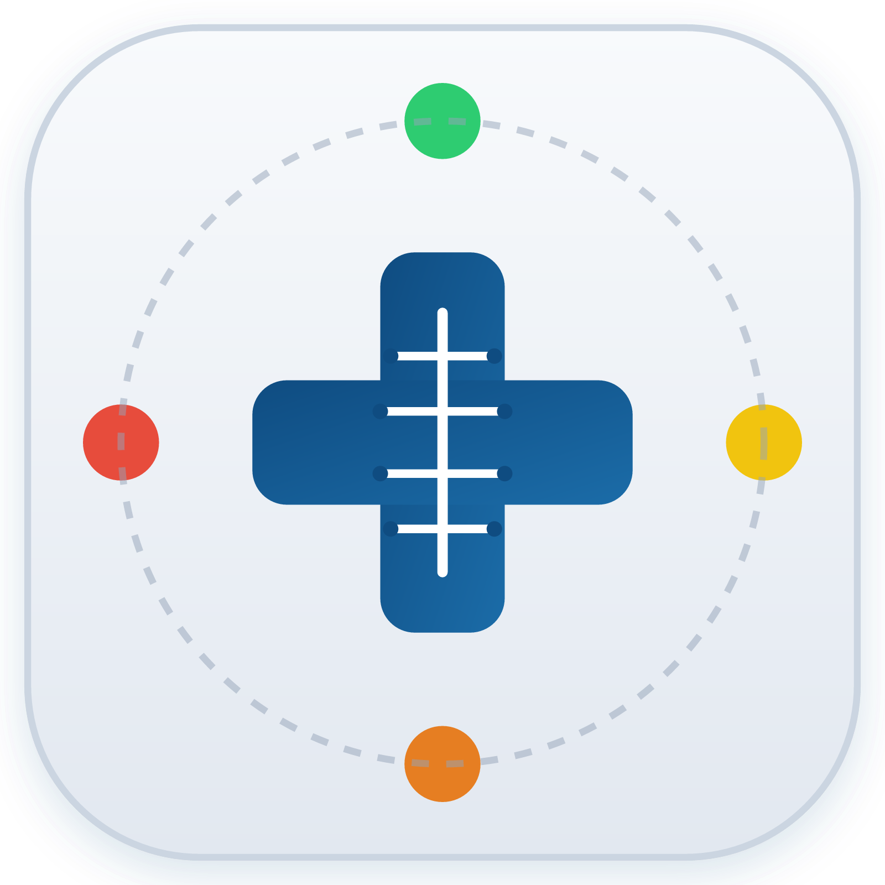
WundCheck
A mini CDSS that puts the daily wound check in the hands of the patient
Feline Weger, B.Sc. Biomedical Engineering
Sivanajani Sivakumar, B.Sc. Medical Informatics
FHNW · MSc Medical Informatics · Clinical Decision Support Systems 2026
Notes:
For most patients, the most difficult part of surgery begins after they leave the hospital. Picture this scenario: You have returned home after surgery. Your wound looks different today. Is it normal… or should you call your doctor?"
This is where WundCheck steps in: WundCheck is a wound guideline for health professionals -> translated into an instrument for people without a medical background.
We are Feline
Najani
And Our CDSS promotes patient empowerment by helping patients decide whether they should seek medical attention at a doctor.

Slide 2
HEALTH SYSTEM NEED
Surgical site infections appear after discharge
when nobody is looking
60.1 %
Too late
Too early
of surgical site infections occur after discharge — systematic review of 1.4 million operations. The CDC surveillance window runs 30 days, 90 for implants.
Warning signs are read as normal. The infection progresses; treatment starts days later than it could.
Normal healing signs — a scab, day-2 redness — trigger calls that bind practice staff and worry patients.
SSI incidence in Europe 0.5–10.1 % depending on procedure (ECDC 2017: 10,149 SSIs in 648,512 operations) · 9.5 % after colon surgery, 1.0 % after hip replacement (WHO) · Switzerland: > 170 hospitals in the Swissnoso surveillance programme
Why a knowledge-based CDSS — and not the alternatives
Scope
Information leaflet
already exists everywhere; no feedback on the actual finding
Adults · elective surgery · wounds with primary closure · any body region.
Telephone follow-up
not deliverable daily; “the wound looks odd” is not usable data
Photo-based ML
light, angle and skin tone vary; decisions not explainable
Not covered
Chronic wounds · burns · secondary healing · children · contaminated emergencies
Rule-based CDSS
traceable to a guideline, reviewable, maintainable by clinicians
Woelber et al., Surg Infect 2016;17(5):510–19 · ECDC Annual Epidemiological Report 2017 · WHO Global Guidelines for the Prevention of SSI · CDC/NHSN SSI Event
FHNW · MSc Medical Informatics · Clinical Decision Support Systems 2026
Notes:
Najani
Thank you feline. So the number on the left is the whole problem. Sixty per cent of surgical site infections occur after discharge, that is a systematic review of 1.4 million operations. The CDC surveillance window is thirty days, ninety for implants. Almost all of that time the patient is at home.
And the observation gap cuts both ways.
Either it is Too late: a warning sign gets read as normal healing, and treatment starts days later than it could. Or Too early: a scab or day-two redness triggers a call that costs practice time and frightens the patient.
We looked at the alternatives. A leaflet already exists everywhere and gives us no feedback. In a patient-facing safety context, explainability beats predictive accuracy, so: a rule-based CDSS, traceable to a guideline, maintainable by clinicians (Kli-nischens).

Slide 3
PERSONAS & SCENARIOS
Three users on three levels
only one of them operates the app
1
Peter Brunner, 58
2
Sandra Meier, 34
3
Dr Anna Keller, 45
Patient · primary user
Practice assistant · secondary
Surgeon · tertiary
Knee replacement 4 days ago. Little medical knowledge, reading glasses, uses everyday apps.
Triages calls and messages all day. High workload, no time for guessing games.
Operates and runs follow-ups. Wants the trajectory, not a retrospective recollection.
“I want to know it is fine — without calling anyone.”
“I need to see in 10 seconds whether this needs an appointment today.”
“I want the full trend without opening every single answer.”
SCENARIO A
Day 6 — the scab
36.9 °C, pain 2/10 and better than yesterday — but a brown scab has formed, and Peter's brother once had a wound infection. WundCheck returns GREEN with “a scab is a normal sign of healing — do not pick it off”. Peter does not call the clinic. The entry still goes into the record, so Dr Keller sees an unbroken trajectory at the suture removal appointment.
The call that is avoided is worth as much as the one that is triggered.
FHNW · MSc Medical Informatics · Clinical Decision Support Systems 2026
Notes:
Our scenario includes three users, but only one interacts directly with the app.
Peter is the patient, Sandra is the triage assistant, and Dr Keller is the treating physician. Each persona represents different user needs that shaped our design.
For Peter, we use image-based wound assessment and plain language instead of medical terminology.
For Sandra, cases are automatically assigned a triage level, and she only receives alerts for orange and red cases.
For Dr Keller, every assessment is automatically written to the electronic health record, providing a complete wound trajectory.
For example: On day six after his knee-surgery, Peter notices a scab and worries about an infection. WundCheck classifies the wound as green and explains that a scab is a normal part of healing. Peter avoids an unnecessary phone call, while the assessment is still documented for Dr Keller's follow-up.

Slide 4
GUIDELINES & EVIDENCE
L1
›
L2
›
L3
›
L4
Four sources, three roles
and one we deliberately discarded
CDC / NHSN
Normative — definition
Superficial vs. deep incisional SSI, 30/90-day window, the five clinical signs
Surveillance definition
NICE NG125
Normative — management
Post-operative wound care; §1.1.3 requires patients be taught to recognise an SSI
Evidence-based guideline
Southampton score
Instrument
Visual grading 0–V — the anchor for our image selection
Validated instrument
Campwala et al. 2019
Evidence
Compares CDC, ASEPSIS and Southampton
Retrospective, n = 22
How good is our evidence?
Why we discarded ASEPSIS — the best performer
Campwala et al.: n = 22, retrospective, single-centre study in implant-based breast reconstruction. ASEPSIS showed better predictive performance than Southampton for implant failure.
→ Southampton as a standardized assessment and communication framework rather than a predictive model.
ASEPSIS needs more data:
antibiotic administration, drainage, debridement, inpatient days and culture results.
→ Not obtainable by a patient at home.
FHNW · MSc Medical Informatics · Clinical Decision Support Systems 2026
Notes:
We based our CDSS on four complementary sources, each serving a different purpose.
-The CDC provides the clinical definition of a surgical site infection.
-The NICE guideline defines what patients should know and when they should seek medical advice.
-The Southampton Wound Scale provides a standardized visual classification of postoperative wounds.
Our main reference was a study on implant failure and wound assessment. Rather than using the Southampton Scale as a prognostic score like in the paper, we used it as a standardized framework for wound assessment and patient triage.
The ASEPSIS Score showed better predictive performance, but it relies on clinical data that patients at home cannot provide. For a patient-facing CDSS, the Southampton Wound Scale was therefore the more appropriate choice.

Slide 5
L1 → L2 · SOUTHAMPTON MAPPING
L1
›
L2
›
L3
›
L4
Our image selection based on a published grading —
not arbitrary UI design
0
Normal healing
→ Calm & dry
What this buys us
a citable source for our core interaction
a non-trivial derived element
an honest, evidenced limitation
I
Mild bruising and/or erythema
→ Slightly reddened
II
Erythema plus other signs of inflammation
→ Markedly reddened & swollen
III
Clear / serous / bloody discharge
→ Clear or bloody discharge
The adaptation problem
IV
Pus
→ Cloudy / purulent discharge
Southampton grades “> 2 cm along the wound”. Patients do not measure. We ask “one small spot or the whole wound?” — closer to usable, further from precise.
V
Deep infection ± tissue breakdown
→ Open / pus
Examples:
FHNW · MSc Medical Informatics · Clinical Decision Support Systems 2026
Notes:
The main interaction in our CDSS is the patient selecting the example-picture that best matches their wound. For the example pictures we use illustrated graphics, so that we don‘t shock the patient. These graphics are derived from the descriptions of the published Southampton Wound Assessment Scale.
The mapping is not always perfect. For example, Southampton describes „redness“ as „extending more than two centimetres along the wound.“
Patients are unlikely to measure this accurately. Instead, we translate this into questions such as: "Is it just a small area, or does it involve most of the wound?„
This makes the system easier to use, while sacrificing some precision. We consider this an explicit design trade-off, and it would be the first aspect we would validate in a future clinical study.

Slide 6
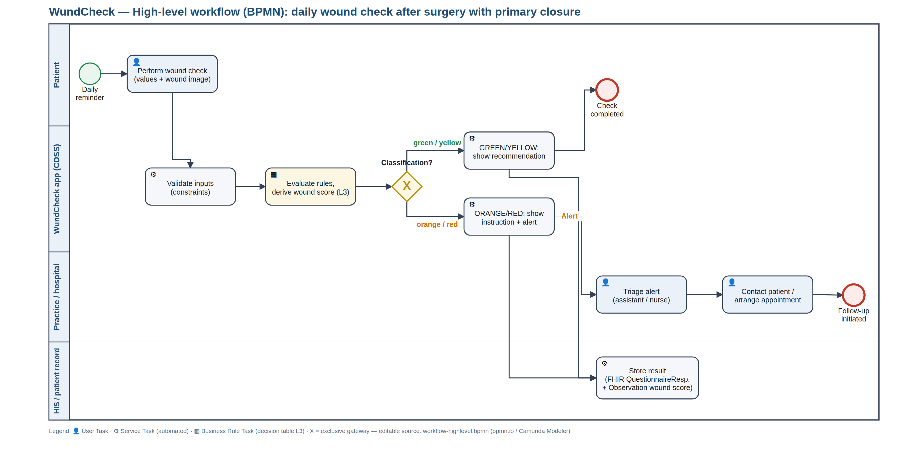
L2 · HIGH-LEVEL WORKFLOW (BPMN)
L1
›
L2
›
L3
›
L4
Clinical decision logic is separated
from the user interface
FHNW · MSc Medical Informatics · Clinical Decision Support Systems 2026
Notes:
Feline:
This is our process model, which separates responsibilities across four lanes: the patient, the CDSS, the healthcare provider, and the health information system.
The key element is the Business Rule Task. The application itself does not make any clinical decisions. Instead, it executes the L3 decision table, keeping the decision logic independent from the user interface.
That's why we'll focus on the decision table in the next few slides.

Slide 7
L2 · DATA DICTIONARY
L1
›
L2
›
L3
›
L4
49 data elements —
everything traceable to a guideline
49
10
38
48
data elements
derived
terminology-bound
FHIR-mapped
ID
ELEMENT
TYPE
TERMINOLOGY
FHIR
L1 SOURCE
DE-020
Body temperature
decimal
LOINC 8310-5
Observation.valueQuantity
CDC — fever > 38 °C
DE-030
Wound appearance
select_one
SNOMED 225552003
Observation.valueCodeable
Southampton 0–V
DE-032
Red streak
select_one
SNOMED 46117009
Observation.valueCodeable
NICE NG125 §1.4.9
DE-035
Discharge
select_one
SNOMED 449736006
Observation.valueCodeable
CDC — purulent drainage
DE-045
Southampton grade
calculated
SNOMED 225552003
Observation.valueCodeable
Southampton
FHNW · MSc Medical Informatics · Clinical Decision Support Systems 2026
Notes:
Our data dictionary contains 49 data elements, most of them linked to standard terminologies and FHIR.
The key point, is the last column: every data element is linked back to its L1 source, making every decision traceable to a guideline or evidence source.
To preserve this traceability, each element keeps the same identifier throughout the entire system—from the data dictionary to the L3 decision table, the test cases, and the FHIR export.

Slide 8
L2 · DECISION LOGIC
L1
›
L2
›
L3
›
L4
“Worst-first”: a reassuring finding can never overwrite a warning
RED · emergency
Systemic signs · lymphangitis · dehiscence or pus
Why worst-first
R1 R2 R3
A false alarm costs a phone call. False reassurance can delay an infection by days. We accept a higher false-alarm rate on purpose.
▼
ORANGE · suspected
Feeling unwell · purulent discharge · fever · persistence
R9 R4 R5 R11 R12
▼
YELLOW · abnormal
Inflammation · wound gap · bleeding on anticoagulants
Two-pass evaluation (Same day)
R6b R6a R7 R10
Some rules depend on previous results (e.g. two consecutive yellow days). Therefore, the decision table is evaluated twice. The second pass can only escalate the urgency level.
▼
GREEN · all clear
Catch-all — never “everything is fine” without a contact hint
R8
All thresholds are named constants in the L3 with their source — a guideline change is one line, not a release.
FHNW · MSc Medical Informatics · Clinical Decision Support Systems 2026
Notes:
Our decision logic consists on eighteein rules.
The classification rules are evaluated from the most severe to the least severe.
One interesting challenge only became apparent once we executed the decision table: Some rules depend on previous assessments
To support these temporal rules, we evaluate the decision table twice. The first pass determines the initial classification. The second pass applies rules that depend on previous classifications. It can only increase the urgency level—it never downgrades a patient.

Slide 9
L1 → L2 · TRANSLATION CHALLENGES
L1
›
L2
›
L3
›
L4
Nine places where the guideline left us on our own
C-01
C-02
C-03
Professional instrument → layperson instrument
Sub-grades without centimetres
When does redness stop being normal?
C-04
C-05
C-06
Scab: warning or reassurance?
CDC criteria assume a clinical examination
Southampton as triage, not prognosis
C-07
C-08
C-09
Two fever thresholds instead of one
No trajectory on the first day
Severity scale ≠ urgency of action
The two highest-risk decisions sit in the same place
C-01 Southampton was built for trained staff. We turned it into an image selection for patients without medical knowledge. That is our core idea — and it is unvalidated.
C-03 No source defines the day on which redness stops being physiological. We set day 3. Too early means false alarms; too late means delayed detection.
All nine would need clinical sign-off. We do not have it — and we list that as a limitation.
FHNW · MSc Medical Informatics · Clinical Decision Support Systems 2026
Notes:
We identified nine translation challenges
Two were classified as high risk.
The first is our core concept: translating the Southampton Scale into an image-based assessment for patients, which is an unvalidated procedure
The second concerns postoperative redness. No guideline defines when normal redness becomes abnormal,
so we introduced day three as a pragmatic threshold.
All nine decisions require clinical validation before real-world use, and we explicitly report them as project limitations.

Slide 10
L3 · ARCHITECTURE DECISION
L1
›
L2
›
L3
›
L4
Author in readable JSON, speak standards at the interface
XLSForm / ODK
Established, executable by existing engines
Standard widgets cannot carry our image cards — the L4 would dictate the UX
FHIR Questionnaire + CQL
Full standard, WHO SMART compliant
“FHIR resources are not human readable” — not reviewable by our clinical lead in six days
Hardcoding in the app
Fastest to a prototype
Every rule change needs a developer and a rebuild
Custom JSON + FHIR at the edge
Reads like the L2; full control of the UX; standards where they count
No existing engine runs it directly; expression language is not CQL
✓
And we can prove it: a check scans the app source for every element id, threshold, code system and endpoint. Any clinical content in the L4 fails the build.
FHNW · MSc Medical Informatics · Clinical Decision Support Systems 2026
Notes:
Najani
Which brings us to where all of that knowledge actually lives, because it is deliberately not in the app.
We compared four ways to make the L2 machine-readable.
XLSForm is executable by existing engines, but its standard widgets cannot carry our image cards — the tooling would have dictated our UX, and the images are the whole idea. FHIR Questionnaire plus CQL is the full standard, but the lecture's own point stands: FHIR resources are not human-readable, and we had to review this in six days. Hardcoding is fastest and needs a developer for every rule change.
So: we author in a custom JSON that reads like the L2, and we speak standards at the interface. We do not achieve full software neutrality. That is a stated trade-off, not an oversight.
And the claim at the bottom is not a promise, it is a check that fails the build. It scans the app source for every element ID, every rule ID, every threshold, every code system and the endpoint. It found two real leaks the first time we ran it.

Slide 11
DEMO
Short Demo
Scan for the Demo
Study prototype — not for clinical use.
FHNW · MSc Medical Informatics · Clinical Decision Support Systems 2026
Notes:
Let’s start with a little demo: So every patients get access code, for this we did two ready. And then the usually things are already in there, then the…

Slide 12
QUALITY ASSURANCE
Two defects were invisible until the rules actually ran
B-01
Marked inflammation on day 1–2 classified GREEN
L2
19/19
decision-logic tests
B-02
“I feel really unwell” triggered nothing at all
L2
20/20
FHIR conformance checks
B-03
Emergency rule unreachable behind conditional logic
L2/L3
B-04
Fever threshold duplicated in two places
L3
6
hazards ranked
B-05
Anticoagulant status collected but never used
L2
B-06
Southampton IV mapped RED in one doc, ORANGE in another
L2
Residual risk
B-07
Trend rule could never fire — circular dependency
L3/L4
We never tested the one thing our whole approach rests on: whether laypeople assign the images correctly. That is monitored after deployment — GREEN cases that still present to a physician within 72 h.
B-08
That same rule was unreachable even after the fix
L2
Risk-based testing per Day 5: identify hazards → rank by risk → test critical paths first → document residual risk.
FHNW · MSc Medical Informatics · Clinical Decision Support Systems 2026
Notes:
Najani
For testing we used the risk-based approach from the module: work out what could go wrong, rank it by severity, test the dangerous paths first, and write down what stays untested.
Six ranked hazards, nineteen tests on the decision logic, twenty conformance checks on the FHIR output — all passing. The interesting part is the eight defects we found on the way, because three of them were invisible on paper.
Two of those came from the same rule. It needed a classification as its input, but it also produced one — so it could never fire. We fixed that, and then it still could not be reached, because the worst-first cascade caught every case before it got there. You do not find that by reading the decision table. You find it by running it.
The third was a contradiction between two of our own documents: Southampton grade four was red in one and orange in the other.
And then the honest one. Our whole approach rests on patients picking the right picture of their wound — and we cannot test that without patients. So we do not claim it works. We watch it after go-live instead: green results that still end up at a doctor within three days.

Slide 13
IMPLEMENTATION, MONITORING & EVALUATION
How it reaches users, how it is maintained &
how we would know it works
0 · Preparation
1 · Pilot
2 · Evaluation
3 · Expansion
4 · Scaling
clinical sign-off
1 hospital, 30 patients
rule revision, UX rework
HIS integration live
further sites, languages
4 wk
3 mo
2 mo
6 mo
open
Implementation
Monitoring
Evaluation
Provision
Functionality
Pilot
QR code on the discharge sheet — no app store, no account, no install
> 99 % error-free runs
SUS + patient-vs-clinician agreement (κ)
Training
Stability
Demonstration
Patient 5 min at discharge (first check done together) · practice 30 min · onboarding module for new staff
zero data loss on network drop
chart review — time to medical contact
Maintenance
Fidelity
Scale-up
Clinical department owns the content; four-eyes sign-off; guideline update to live in ≤ 4 weeks
> 70 % of days checked
stepped-wedge; SSI rate, readmissions
Integration
Data quality
Adverse effects
FHIR R4 to the HIS / Swiss EPD; endpoint is L3 configuration
< 5 % incomplete entries
false alarms, alert overrides, equity
Interoperability reached: structural yes · semantic partly · organisational no. · Most important safety indicator: GREEN cases that still present to a physician within 72 h.
FHNW · MSc Medical Informatics · Clinical Decision Support Systems 2026
Notes:
Najani Getting it to people is deliberately boring: a QR code on the discharge sheet. No app store, no account, nothing to install. Five minutes at discharge, and the first check is done together with the patient.
Then we hand it over. The clinical department owns the content, not us — every change signed off by two people, and our target is four weeks from a guideline update to it being live.
We monitor four things: does it run, does it survive a lost connection, do patients actually use it daily, and is the data complete. Each one has a number attached to it.
What we would measure depends on how far along we are. In a pilot, usability — and whether the patient and the clinician see the same wound. Later, in a chart review, how long it takes someone to reach a doctor; that is our primary outcome. Infection rates only at scale.

Slide 14
EXPECTED IMPACT & REGULATION
False reassurance weighs more than a false alarm
Benefits
Risks
Earlier treatment when an infection develops
Fewer contacts without clinical consequence
Complete trajectory for the follow-up appointment
Structured, standardised follow-up data
Automation bias — the patient stops observing
Alert fatigue in the practice
Scaling our own errors consistently, at volume
Digital divide — the gap may widen
Is WundCheck a medical device? Yes — SaMD, IMDRF Category II
Inform
Drive
Treat/dx
State of the healthcare situation = serious: an untreated SSI is not self-limiting and can lead to sepsis or revision surgery. Significance of information = drive clinical management: we neither diagnose nor treat, but we determine whether and when clinical action is taken.
Standards that would apply: ISO 14971 · IEC 62304 · IEC 62366 · ISO 13485. The EU AI Act does not — the system is rule-based, a deliberate consequence of avoiding image analysis.
Critical
IV
III
II
Serious
III
II
I
Non-serious
II
I
I
IMDRF risk categorisation
FHNW · MSc Medical Informatics · Clinical Decision Support Systems 2026
Notes:
Najani
The benefits are on the slide, so let me pick one out: a complete trajectory. Today a surgeon at the follow-up appointment gets the patient's recollection. With this, they get eight days of structured data.
The risks matter more to us. Automation bias — the patient stops watching their own wound, because an app is doing it for them. And this one: if our rules are wrong, they are wrong for everyone, every day, at scale.
Now Is it a medical device? Yes. Software as a medical device, IMDRF category two. The condition is serious — an untreated infection does not resolve on its own — and the information drives clinical management. We do not diagnose and we do not treat, but we do decide whether and when someone seeks care.

Slide 15
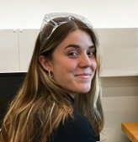

Individual contributions
L1 source research and evidence appraisal — CDC, NICE NG125, Southampton, Campwala et al.
Health system need, scope decision, three personas and the scenarios
Southampton → image-card mapping; the nine documented L1 → L2 translation decisions
BPMN high-level and detail process · data dictionary (49 elements) · decision table (18 rules)
Feline Weger
BSc Biomedical Engineer · clinical lead & L2
L3 schema and authoring — thresholds, terminology bindings, FHIR mappings, versioning
L4 application, expression engine, bilingual rendering, FHIR R4 transaction interface
Hazard analysis, 19 decision-logic tests, 20 FHIR checks, the no-hardcoding check, bug log
Implementation and M&E strategy · expected impact · SaMD classification
Sivanajani Sivakumar
BSc Medical Informatics · technical lead & QA
FHNW · MSc Medical Informatics · Clinical Decision Support Systems 2026
Notes:
Feline owned the clinical layers: the sources, the evidence appraisal, the personas, and the whole L2.
Najani owned the L3, the application, the FHIR interface and the quality assurance, plus implementation and regulation. We cross-assigned the testing on purpose: neither of us signed off our own layer.

Slide 16

Everything is in the repository
Documents, BPMN sources, the L3, the running L4, the test and conformance scripts — all of it, reproducible.
Scan for the full project
github.com/Sivanajani/smart-wound-guideline-app
Study prototype — not for clinical use.
docs/ 01–14
every assignment item as its own document
l3/wundcheck-l3.json
the machine-readable CDSS — 49 elements, 18 rules
l4/wundcheck-app.html
one file, opens offline in any browser
tools/
19 logic tests · 20 FHIR checks · the no-hardcoding check
Thank you — questions?
Scan for the Demo
Study prototype — not for clinical use.
Notes:
You can find everything in the repository, just scan the QR-code and you’ll be able to test WundCheck yourself:
Our approach to take the weight off the patients and the clinical staff. Thank you for your interest. We are happy to take your questions.

Slide 17
BACKUP · REFERENCES
Sources
Woelber E et al.
Proportion of Surgical Site Infections Occurring after Hospital Discharge: A Systematic Review. Surg Infect 2016;17(5):510–19.
60.1 % post-discharge
ECDC
Healthcare-associated infections: surgical site infections — Annual Epidemiological Report 2017.
0.5–10.1 % by procedure
CDC / NHSN
Surgical Site Infection Event (SSI). Patient Safety Component Manual.
30 / 90-day window
NICE
Surgical site infections: prevention and treatment. NG125, 11 Apr 2019, upd. 19 Aug 2020.
nice.org.uk/guidance/ng125
Bailey IS et al.
Southampton Wound Scoring System.
grades 0–V
Campwala I, Unsell K, Gupta S
A Comparative Analysis of Surgical Wound Infection Methods: CDC, ASEPSIS and Southampton in breast reconstruction SSI. Plastic Surgery, 2019.
PMID 31106164
WHO
Monitoring and Evaluating Digital Health Interventions: a practical guide. 2016.
maturity stages
WHO
SMART Guidelines — the L1–L5 knowledge layers.
who.int
IMDRF
Software as a Medical Device: possible framework for risk categorisation.
categories I–IV
HL7
FHIR R4 — QuestionnaireResponse, Observation, Communication.
hl7.org/fhir/R4
FHNW · MSc Medical Informatics · Clinical Decision Support Systems 2026

Slide 18
BACKUP · L2
Decision table — all 18 rules
R1
temp ≥ 39 OR chills = 1
CDC · sepsis red flags
R2
red_streak = 1 OR redness_extent = 4
NICE NG125 §1.4.9
R3
wound_open = 2 OR bleeding = 2 OR wound_state = 4
CDC deep incisional
R9
wellbeing = 2 OR nausea_vomiting = 2
systemic signs
R4
secretion = 3 OR secretion_smell = 1
CDC superficial incisional
R5
fever OR (pain ≥ 7 AND worsening AND day ≥ 3)
CDC · NICE
R11
secretion ≥ 1 AND discharge ≥ 3 days
Southampton IIId
R12
classification = yellow AND yesterday = yellow
persistence
R6b
Southampton II OR swelling = 3 (from day 1)
Southampton II
R6a
Southampton I AND day ≥ 3
wound healing phases
R7
wound_open = 1 OR numbness OR mobility change
follow-up standards
R10
bleeding ≥ 1 AND anticoagulants
bleeding assessment
R8
catch-all
—
I1–I5
risk factors · medication · smoking · scab · high-risk procedure
non-exclusive
FHNW · MSc Medical Informatics · Clinical Decision Support Systems 2026
Notes:
Here is the complete table. Thirteen exclusive rules in priority order, five information rules that fire alongside. Each row carries the condition AND the source it came from — CDC for the discharge and dehiscence rules, NICE one-point-four-point-nine for the red streak, Southampton for the grading rules. R8 at the bottom is the catch-all: it always matches, so no input can ever fall through without an answer — and even R8 never says "everything is fine" without a hint about when to make contact.

Slide 19
BACKUP · QA
Test protocol — 19 decision-logic cases, all passing
T1
R1 fever · temp 39.2
RED (R1)
✓
T11
B-02 fixed · feeling unwell
ORANGE (R9)
✓
T2
R1 boundary · temp 39.0
RED — inclusive
✓
T12
B-03 fixed · red streak
RED (R2)
✓
T3
R3 safety · image “open/pus” alone
RED (R3)
✓
T13
B-01 fixed · grade II on day 2
YELLOW (R6b)
✓
T4
R5 before R6
ORANGE (R5)
✓
T14
B-01 counter-check
GREEN
✓
T5
mild signs on day 2
GREEN
✓
T15
Southampton derivation
grade IV → ORANGE
✓
T6
conditional logic
3 follow-ups hidden
✓
T16
B-05 fixed · bleeding + anticoag
YELLOW (R10)
✓
T7
constraint · temp 45
input rejected
✓
T17
persistence rule
ORANGE (R12)
✓
T8
info rules non-exclusive
GREEN + I1 + I2 + I3
✓
T18
discharge ≥ 3 days
ORANGE (R11)
✓
T9
scab reassures
GREEN + I4
✓
T19
threshold change without rebuild
GREEN → ORANGE
✓
T10
worst-first vs reassurance
ORANGE (R4) + I4
✓
Reproduce: node tools/run-tests.mjs · node tools/check-fhir.mjs · node tools/check-hardcoding.mjs
FHNW · MSc Medical Informatics · Clinical Decision Support Systems 2026
Notes:
Nineteen cases, and they are not arbitrary — they are chosen against the hazard ranking. T1 to T3 are the red paths. T5 and T14 are the counter-checks: cases that MUST NOT escalate, because over-triage is a real failure mode too. T13, T11, T12 and T16 are the retests for the defects we fixed. T15, T17 and T19 are the three that failed on first run and produced defects B-06, B-07 and B-08. T19 is the threshold change you saw in the demo, as an automated test.

Slide 20
BACKUP · QA
Hazard analysis and risk matrix
H-01
An infection is classified GREEN
sev 5 · lik 3
15
5
5
H-02
H-01
20
25
H-02
An emergency is classified ORANGE
sev 5 · lik 2
4
4
H-06
12
16
20
10
Severity
H-03
The patient abandons the check
sev 3 · lik 3
3
3
H-05
H-03
12
15
9
H-04
False alarm during normal healing
sev 2 · lik 4
2
2
4
6
H-04
10
8
1
1
2
3
4
5
H-06
The practice overlooks an alert
sev 4 · lik 2
8
1
2
3
4
5
H-05
An implausible input is processed
sev 3 · lik 2
6
Likelihood
Score ≥ 10 → full test coverage. Score 6–9 → sample-based coverage.
FHNW · MSc Medical Informatics · Clinical Decision Support Systems 2026
Notes:
Six hazards, scored severity times likelihood. The two in the red zone are H-01, a missed infection classified green, and H-03, an emergency rule that is unreachable. Both drove the test order — we tested the red paths before we tested anything cosmetic. The matrix is also our argument for worst-first: it moves risk from the severe corner into the tolerable one, at the cost of more false alarms.

Slide 21
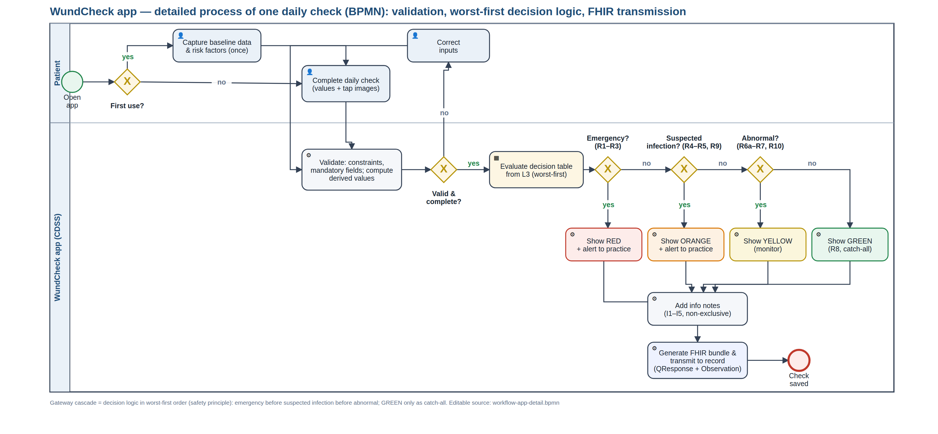
BACKUP · L2 · VALIDATION LOOP AND WORST-FIRST CASCADE
Detailed process inside the app
FHNW · MSc Medical Informatics · Clinical Decision Support Systems 2026
Notes:
This is the process one level down: input validation, the two-pass evaluation, the worst-first cascade as explicit gateways, and the write-back. The gateway chain is the decision table one to one — the same rule IDs. That is deliberate: the diagram and the executable file cannot drift apart, because they are generated from the same rule set.

Slide 22
BACKUP · L3 / L4
The FHIR interface — a real transaction bundle, not a download
QuestionnaireResponse
every answer, typed and terminology-coded; canonical carries the L3 version
every run
Observation
traffic light, Southampton grade, triggering rule, L3 version, days post-op
every run
Communication
structured alert, priority urgent (ORANGE) or stat (RED)
ORANGE / RED only
The endpoint is configuration, not code
"fhir": { "endpoint": "https://…/baseR4", "patient_reference": "Patient/example",
"alert_recipient": "Organization/practice", "send_mode": "transaction" }
Redirecting to a hospital FHIR server or the Swiss EPD gateway is one line of JSON. If the endpoint is unreachable the bundle queues — the patient still gets the recommendation.
FHNW · MSc Medical Informatics · Clinical Decision Support Systems 2026
Notes:
One check produces three resources in a single transaction bundle. The QuestionnaireResponse holds the raw answers against a versioned canonical Questionnaire. The Observation carries the classification, coded in SNOMED, with the Southampton grade and the fired rule as components. And the Communication is the alert to the practice, created only from orange upwards — that is Sandra's persona turned into a technical rule. The endpoint, the patient reference and the alert recipient are all L3 configuration.

Slide 23
BACKUP · METHOD
Traceability — one finding, all the way through
L1
CDC/NHSN — “purulent drainage from the superficial incision”
▼
L2
DE-035 discharge · SNOMED 449736006 · rule R4 → ORANGE
▼
L3
"when": "secretion = 3 or secretion_smell = 1"
▼
L4
image selection “cloudy / purulent” → SUSPECTED INFECTION
▼
QA
T10, T15 — passed · challenge C-09 documents the severity/urgency split
▼
FHIR
QuestionnaireResponse.item[secretion] + Observation.component
Every element, rule, challenge, hazard, test and defect carries an ID that is identical in all artefacts.
FHNW · MSc Medical Informatics · Clinical Decision Support Systems 2026
Notes:
This is one finding traced end to end: the CDC criterion "purulent drainage" becomes data element DE-035 with a SNOMED code, which is used by rule R4 at orange priority, which produces an Observation component in the FHIR bundle, and which is verified by test case T15. Five artefacts, one identifier. If you change the element, everything downstream of it is findable in seconds.

Slide 24
BACKUP · L3 · WUNDCHECK-L3.JSON V0.3.7
The L3 in one screen — this file is the CDSS
{ "meta": {
Bilingual by construction
"version": "0.3.3", "languages": ["en","de"], "default_language": "en",
Every user-facing string is a language-keyed object. A further language is a content change, not a code change.
"l1_sources": [ CDC/NHSN · NICE NG125 · Southampton · Campwala 2019 ],
"thresholds": { "fever_orange": 38.0, // CDC — deep incisional SSI
"fever_red": 39.0, // group decision — challenge C-07
"normal_healing_days": 3 }, // group decision — C-03
"fhir": { "endpoint": "…/baseR4", "send_mode": "transaction" } },
Thresholds carry their source
"elements": [ {
Each constant names where it comes from — a guideline value or a documented group decision.
"id": "secretion", "de_id": "DE-035", "type": "select_one",
"label": { "en": "Is fluid coming out of the wound?",
"de": "Kommt Flüssigkeit aus der Wunde?" },
"options": [ 0 = none · 1 = clear · 2 = bloody · 3 = purulent, each with an image ],
Rules carry their reference
"terminology": { "snomed": "449736006" },
Every rule states its L1 source and an annotation, so a clinician can review it without reading code.
"fhir": "Observation.valueCodeableConcept",
"l1_source": "CDC/NHSN — purulent drainage · Southampton III–IV" } ],
"decision_rules": [ {
"id": "R4", "priority": "orange", "exclusive": true,
The endpoint is configuration
"when": "secretion = 3 or secretion_smell = 1",
"output": { "en": "SUSPECTED INFECTION — contact your practice today…" },
Redirecting to a hospital FHIR server is one line — no code change, no rebuild.
"annotation": "Purulent drainage is a primary criterion of superficial SSI.",
"reference": "CDC/NHSN superficial incisional SSI · Southampton IV" } ] }
49 elements · 18 rules · 74 KB · read by the L4 at runtime — swap this file and the app becomes a different CDSS.
FHNW · MSc Medical Informatics · Clinical Decision Support Systems 2026
Notes:
This file IS the CDSS. Metadata with the thresholds and their sources, the elements with their labels in two languages and their terminology bindings, and the decision rules with their conditions and outputs. The app that renders it contains none of this. Hand this file to a different renderer and you have the same clinical system — that is the property we were actually trying to buy.

Slide 25
BACKUP · L2 · EXCERPT OF 49 ELEMENTS
Data dictionary — the four required columns
ID
LABEL
TYPE
RESPONSE OPTIONS
CONDITIONAL LOGIC
CONSTRAINT
TERMINOLOGY
DE-020
Body temperature today
decimal
free numeric input, °C
—
34–43 °C
LOINC 8310-5
DE-023
Pain 0–10
integer
NRS 0–10
—
0–10
LOINC 72514-3
DE-026
How do you feel overall?
select_one
0 = well · 1 = tired · 2 = really unwell
—
—
SNOMED 386661006
DE-030
Which picture matches your wound?
select_one
1 = calm & dry · 2 = slightly red · 3 = markedly red & swollen · 4 = open / pus
—
—
SNOMED 225552003
DE-032
Does a red streak run away?
select_one
1 = yes · 0 = no
none — deliberately ungated (B-03)
—
SNOMED 46117009
DE-035
Is fluid coming out?
select_one
0 = none · 1 = clear · 2 = bloody · 3 = cloudy / purulent
—
—
SNOMED 449736006
DE-036
Does the discharge smell?
select_one
1 = yes · 0 = no
secretion ≥ 1
—
SNOMED 288227007
DE-037
One spot or the whole wound?
select_one
1 = small spot · 2 = along the wound
secretion ≥ 1
—
—
DE-038
For how many days?
integer
free numeric input, days
secretion ≥ 1
0–60
—
DE-025
Did pain disturb your sleep?
select_one
1 = yes · 0 = no
pain ≥ 4
—
SNOMED 301345002
DE-045
Southampton grade
calculated
0 · I · II · III · IV · V
derived from 5 elements
—
SNOMED 225552003
49 elements in total · 10 derived · 4 with conditional logic · 8 with constraints · 38 with a terminology binding · 48 with a FHIR mapping. Full table: docs/05.
FHNW · MSc Medical Informatics · Clinical Decision Support Systems 2026
Notes:
The full dictionary has forty-eight rows; this is an excerpt showing the four columns the assignment asks for — the element, its type and permitted values, its terminology binding, and its FHIR mapping — plus a fifth we added, the L1 source. Nine elements are calculated rather than asked, eight carry plausibility constraints, and four are conditional on an earlier answer.

Slide 26
BACKUP · DOCUMENTATION
Depth that did not fit into ten minutes
Testing types applied (Day 5 vocabulary)
The L3 implementation package (Day 3)
L2 verification — decision table ↔ BPMN cascade ↔ L3 rules reconciled
Functional testing — individual rules, exclusions, severity order, boundary values
Integration testing — derived elements → rules → output; conditional logic → rule reachability
Usability testing — image assignment by lay people: NOT carried out, our largest residual risk
Documentation — health need, personas, BPMN
Content / workflow — sections, relevant, decision rules
Terminology — SNOMED CT / LOINC / ICD-10 bindings
Validation — 19 test cases, test data, conformance checks
Interfaces — FHIR export · UI/UX — image options, traffic light
Stakeholders and where it could fail
What we would do with three more months
The critical group is the practice, not the patient
If Sandra experiences the alerts as a burden, the rollout fails — however good the classification is
Hence: alerts only from ORANGE upwards, structured instead of free text, alert load measured explicitly
1 · Clinical sign-off on every threshold and rule — it settles all nine L1→L2 decisions at once
2 · Usability study on the image assignment — validates the central design idea
3 · Graphics for several skin tones and body regions
4 · Convert the L3 to a FHIR Questionnaire — the software neutrality we consciously gave up
FHNW · MSc Medical Informatics · Clinical Decision Support Systems 2026
Notes:
A pointer slide. It lists the testing types we applied, the versioning and update path for the L3, the multilingualism approach, the interoperability level we reach — structural yes, semantic partly, organisational no — and what we would do differently with more time. The honest answer to that last one is: validate the image assignment. Everything else is second.

