Slide 1
WundCheck
A mini CDSS that puts the daily wound check in the hands of the patient
We translated a guideline written for health professionals into an instrument for laypersons —
and learned where that translation becomes dangerous.
48
18
9
8
data elements
decision rules
L1→L2 challenges
defects fixed
FHNW · MSc Medical Informatics · Clinical Decision Support Systems 2026
Notes:
Opening line: postoperative wound infections mostly appear AFTER discharge — exactly when nobody is looking at the wound. Our thread for the next ten minutes is the translation problem.

Slide 2
HEALTH SYSTEM NEED
Surgical site infections appear after discharge — when nobody is looking
60.1 %
Too late
Too early
of surgical site infections occur after discharge — systematic review of 1.4 million operations. The CDC surveillance window runs 30 days, 90 for implants.
Warning signs are read as normal. The infection progresses; treatment starts days later than it could.
Normal healing signs — a scab, day-2 redness — trigger calls that bind practice staff and worry patients.
SSI incidence in Europe 0.5–10.1 % depending on procedure (ECDC 2017: 10,149 SSIs in 648,512 operations) · 9.5 % after colon surgery, 1.0 % after hip replacement (WHO) · Switzerland: > 170 hospitals in the Swissnoso surveillance programme
Why a knowledge-based CDSS — and not the alternatives
Scope
Information leaflet
already exists everywhere; no feedback on the actual finding
Adults · elective surgery · wounds with primary closure · any body region.
Telephone follow-up
not deliverable daily; “the wound looks odd” is not usable data
Photo-based ML
light, angle and skin tone vary; decisions not explainable
Not covered
Chronic wounds · burns · secondary healing · children · contaminated emergencies
Rule-based CDSS
traceable to a guideline, reviewable, maintainable by clinicians
Woelber et al., Surg Infect 2016;17(5):510–19 · ECDC Annual Epidemiological Report 2017 · WHO Global Guidelines for the Prevention of SSI · CDC/NHSN SSI Event
Notes:
The gap is not a knowledge gap in professionals — it is an observation gap at home, plus laypeople being unable to tell normal from abnormal. Explainability beats predictive accuracy in a patient-facing safety context.

Slide 3
PERSONAS & SCENARIOS
Three users on three levels — only one of them operates the app
1
Peter Brunner, 58
2
Sandra Meier, 34
3
Dr Anna Keller, 45
Patient · primary user
Practice assistant · secondary
Surgeon · tertiary
Knee replacement 4 days ago. Little medical knowledge, reading glasses, uses everyday apps.
Triages calls and messages all day. High workload, no time for guessing games.
Operates and runs follow-ups. Wants the trajectory, not a retrospective recollection.
“I want to know it is fine — without calling anyone.”
“I need to see in 10 seconds whether this needs an appointment today.”
“I want the full trend without opening every single answer.”
SCENARIO A
Day 6 — the scab
36.9 °C, pain 2/10 and better than yesterday — but a brown scab has formed, and Peter's brother once had a wound infection. WundCheck returns GREEN with “a scab is a normal sign of healing — do not pick it off”. Peter does not call the clinic. The entry still goes into the record, so Dr Keller sees an unbroken trajectory at the suture removal appointment.
The call that is avoided is worth as much as the one that is triggered.
Notes:
Personas drive design decisions: images instead of terminology because of Peter; alerts only from ORANGE upwards because of Sandra; classification as a separate FHIR Observation because of Dr Keller.

Slide 4
GUIDELINES & EVIDENCE
L1
›
L2
›
L3
›
L4
Four sources, three roles — and one we deliberately discarded
CDC / NHSN
Normative — definition
Superficial vs. deep incisional SSI, 30/90-day window, the five clinical signs
Surveillance definition
NICE NG125
Normative — management
Post-operative wound care; §1.1.3 requires patients be taught to recognise an SSI
Evidence-based guideline
Southampton score
Instrument
Visual grading 0–V — the anchor for our image selection
Validated instrument
Campwala et al. 2019
Evidence
Compares CDC, ASEPSIS and Southampton
Retrospective, n = 22
Why we discarded ASEPSIS — the best performer
How good is our evidence? Not very — and that shapes the use
It needs antibiotic administration, drainage, debridement, inpatient days and culture results. None of that is obtainable by a patient at home. We chose the usable instrument over the statistically better one — and we say so.
Campwala et al.: n = 22, retrospective, single-centre, implant-based breast reconstruction — a population far from ours, and the endpoint is implant failure, not detection of infection. Southampton showed only limited predictive value there.
So we use it as a communication and triage grid, not as a prognostic instrument.
Notes:
Three roles, deliberately separated: CDC defines WHAT an SSI is, NICE says WHEN to act, Southampton says HOW to describe the wound visually. NICE 1.1.3 is the legitimation of the whole use case — it already requires that patients be taught to recognise an SSI; we operationalise a recommendation that usually ends up as a leaflet. And we grade our own evidence rather than citing it uncritically.

Slide 5
L1 → L2 · SOUTHAMPTON MAPPING
L1
›
L2
›
L3
›
L4
Our image selection is a published grading, not a UI whim
0
Normal healing
→ Calm & dry
What this buys us
a citable source for our core interaction
a non-trivial derived element
an honest, evidenced limitation
I
Mild bruising and/or erythema
→ Slightly reddened
II
Erythema plus other signs of inflammation
→ Markedly reddened & swollen
III
Clear / serous / bloody discharge
→ Clear or bloody discharge
The adaptation problem
IV
Pus
→ Cloudy / purulent discharge
Southampton grades “> 2 cm along the wound”. Patients do not measure. We ask “one small spot or the whole wound?” — closer to usable, further from precise.
V
Deep infection ± tissue breakdown
→ Open / pus
Notes:
This slide is the hinge of the whole talk: the image selection is the answer to the translation problem, and it is anchored in a published instrument rather than invented by us.

Slide 6
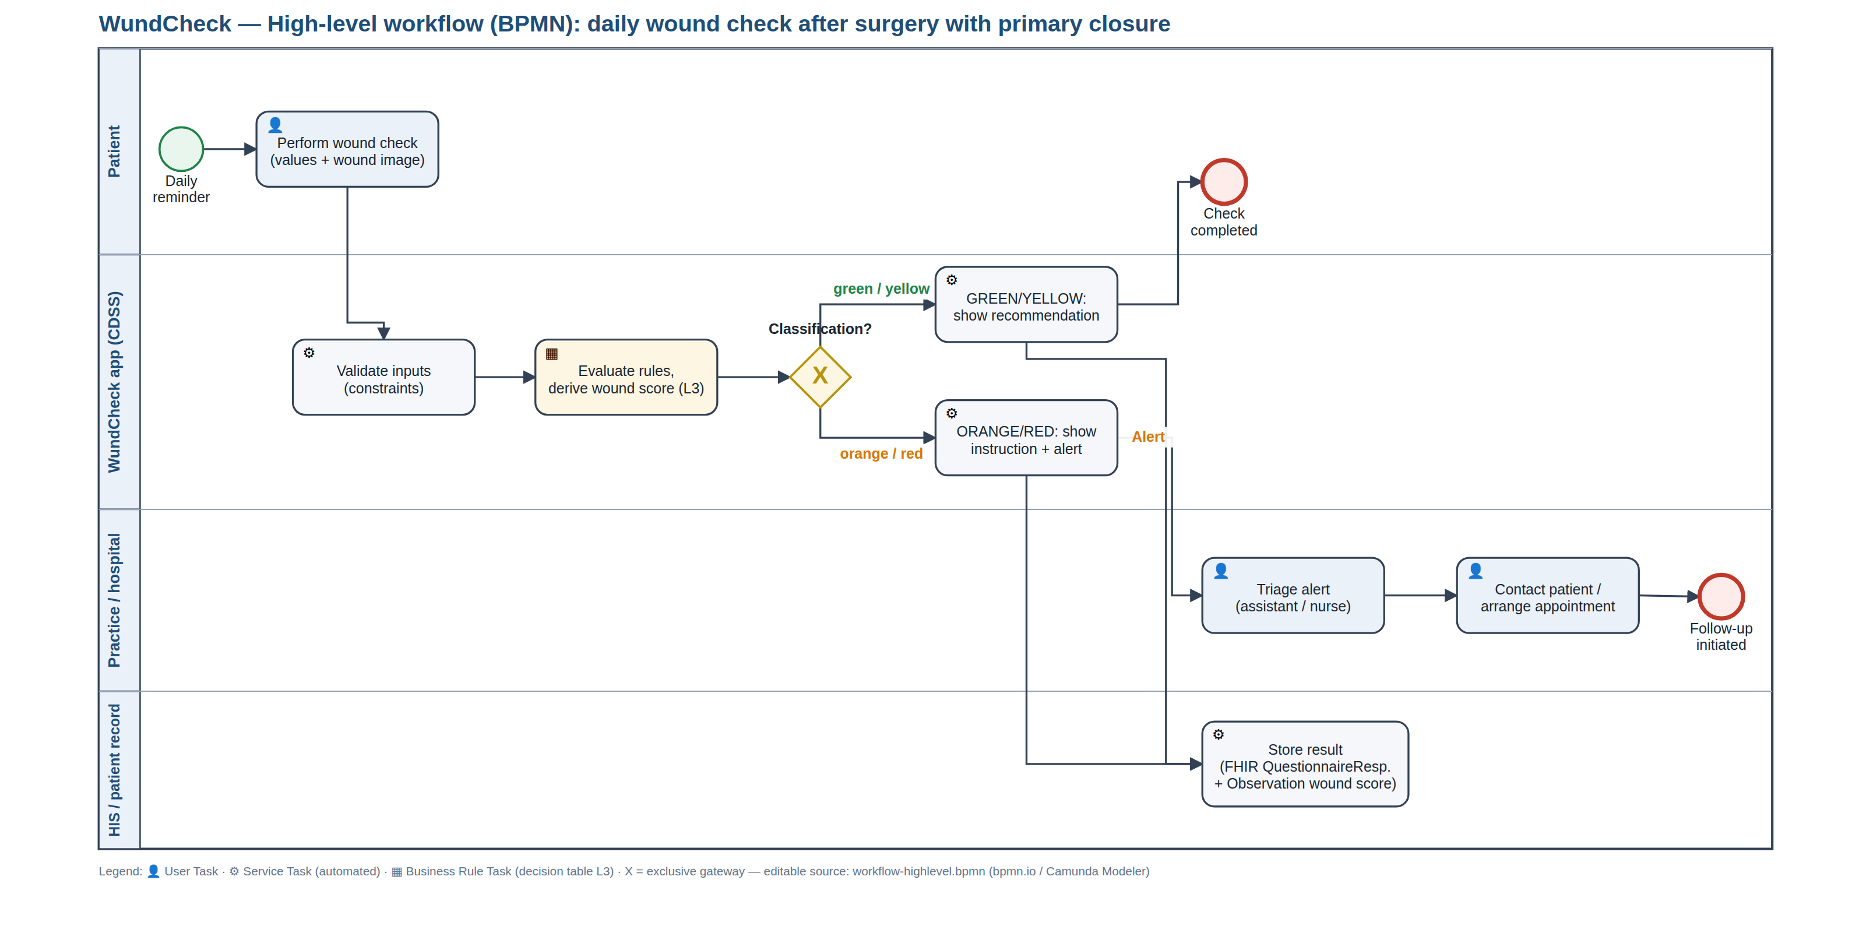
L2 · HIGH-LEVEL WORKFLOW (BPMN)
L1
›
L2
›
L3
›
L4
The logic sits in a business rule task — not in the app
Notes:
Say out loud: four lanes, so responsibility is explicit. One business rule task — the app decides nothing itself, it executes the L3 decision table. Every completed check is written to the record, INCLUDING green: without that baseline the surgeon has no trajectory at the follow-up appointment. Two end events: check completed, or case handed to the practice. Real BPMN 2.0, editable in bpmn.io — not a flowchart with diamonds.

Slide 7
L2 · DATA DICTIONARY
L1
›
L2
›
L3
›
L4
48 data elements — every one traceable to a guideline
48
9
38
47
data elements
derived
terminology-bound
FHIR-mapped
ID
ELEMENT
TYPE
TERMINOLOGY
FHIR
L1 SOURCE
DE-020
Body temperature
decimal
LOINC 8310-5
Observation.valueQuantity
CDC — fever > 38 °C
DE-030
Wound appearance
select_one
SNOMED 225552003
Observation.valueCodeable
Southampton 0–V
DE-032
Red streak
select_one
SNOMED 46117009
Observation.valueCodeable
NICE NG125 §1.4.9
DE-035
Discharge
select_one
SNOMED 449736006
Observation.valueCodeable
CDC — purulent drainage
DE-045
Southampton grade
calculated
SNOMED 225552003
Observation.valueCodeable
Southampton
Sequence follows the patient, not the guideline: baseline data once, then “how do I feel”, then the wound — because inspecting it means opening the dressing.
Notes:
Every element carries a DE-ID that is identical in the data dictionary, the L3, the test protocol and the FHIR export. That is what makes traceability demonstrable rather than claimed.

Slide 8
L2 · DECISION LOGIC
L1
›
L2
›
L3
›
L4
Worst-first: a reassuring finding can never overwrite a warning
RED · emergency
Systemic signs · lymphangitis · dehiscence or pus
Why worst-first
R1 R2 R3
A false alarm costs a phone call. False reassurance can delay an infection by days. We accept a higher false-alarm rate on purpose.
▼
ORANGE · suspected
Feeling unwell · purulent discharge · fever · persistence
R9 R4 R5 R11 R12
▼
YELLOW · abnormal
Inflammation · wound gap · bleeding on anticoagulants
Two-pass evaluation
R6b R6a R7 R10
One rule needs the classification as its own input. The rules run twice — the worse result wins, so a second pass can escalate but never de-escalate.
▼
GREEN · all clear
Catch-all — never “everything is fine” without a contact hint
R8
All thresholds are named constants in the L3 with their source — a guideline change is one line, not a release.
Notes:
Priority order is explicit and tested. Information rules I1–I5 are non-exclusive and fire alongside the classification — a scab note appears next to a warning, never instead of it.

Slide 9
L1 → L2 · TRANSLATION CHALLENGES
L1
›
L2
›
L3
›
L4
Nine places where the guideline left us on our own
C-01
C-02
C-03
Professional instrument → layperson instrument
Sub-grades without centimetres
When does redness stop being normal?
C-04
C-05
C-06
Scab: warning or reassurance?
CDC criteria assume a clinical examination
Southampton as triage, not prognosis
C-07
C-08
C-09
Two fever thresholds instead of one
No trajectory on the first day
Severity scale ≠ urgency of action
The two highest-risk decisions sit in the same place
C-01 Southampton was built for trained staff. We turned it into an image selection for laypersons. That is our core idea — and it is unvalidated.
C-03 No source defines the day on which redness stops being physiological. We set day 3. Too early means false alarms; too late means delayed detection.
All nine would need clinical sign-off. We do not have it — and we list that as a limitation.
Notes:
This is the slide that shows critical thinking. Each challenge has a type, a decision, a rationale, an implication and a risk level in the documentation.

Slide 10
L3 · ARCHITECTURE DECISION
L1
›
L2
›
L3
›
L4
Author in readable JSON, speak standards at the interface
XLSForm / ODK
Established, executable by existing engines
Standard widgets cannot carry our image cards — the L4 would dictate the UX
FHIR Questionnaire + CQL
Full standard, WHO SMART compliant
“FHIR resources are not human readable” — not reviewable by our clinical lead in six days
Hardcoding in the app
Fastest to a prototype
Every rule change needs a developer and a rebuild
Custom JSON + FHIR at the edge
Reads like the L2; full control of the UX; standards where they count
No existing engine runs it directly; expression language is not CQL
✓
And we can prove it: a check scans the app source for every element id, threshold, code system and endpoint. Any clinical content in the L4 fails the build.
Notes:
The lecture explicitly permits authoring in a tailored format and translating at the boundary. We disclose that we do not achieve full software neutrality — a deliberate trade-off for maintainability and available skills.

Slide 11
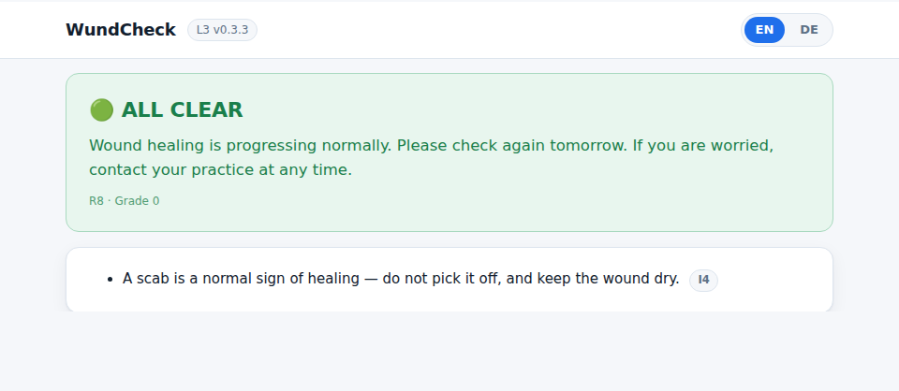
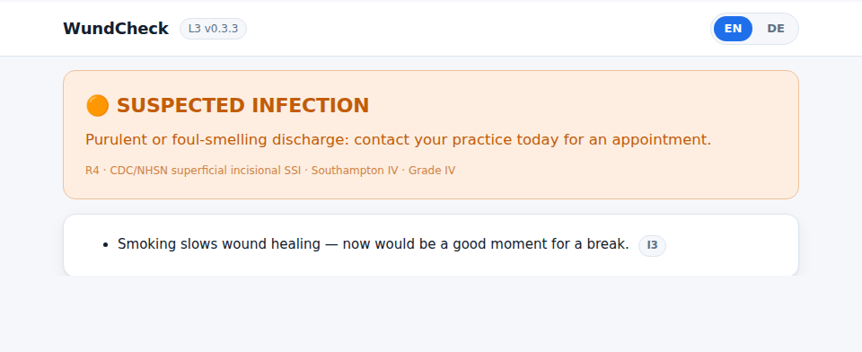
DEMO
One patient, two days — and a threshold change with no rebuild
1
Day 6 — GREEN · Scenario A
A scab worries the patient. The system reassures and names the reason. No call to the clinic.
2
Day 7 — ORANGE · Scenario B
Purulent discharge, 38.3 °C. R4 fires, the patient is told to contact the practice today, a FHIR Communication goes out.
3
Threshold change
fever_orange 38.0 → 37.5 in the L3 inspector. Same case, different result. No rebuild, no developer, not a line of code.
Why the interface looks like this
Images, not clinical terms — crosses language and literacy barriers
The result names its reason, not just a colour — against automation bias
Reassurance is a first-class output, not a leftover
Baseline data once only — a daily check has to stay under 3 minutes
▶ Demo video: submission/WundCheck_L4_Demo.mp4 · 1:46 · Single HTML file · offline · no installation · EN / DE
Notes:
PLAY THE VIDEO HERE — submission/WundCheck_L4_Demo.mp4, 1 min 46 s, 1920×1080, screen recording of the running app. Start it, then stay silent until the threshold change; only narrate over the last part. The screenshots on this slide are the fallback if the video does not start. Step 3 is the important one — it is the live proof that the layer separation is real.

Slide 12
QUALITY ASSURANCE
Two defects were invisible until the rules actually ran
B-01
Marked inflammation on day 1–2 classified GREEN
L2
19/19
decision-logic tests
B-02
“I feel really unwell” triggered nothing at all
L2
20/20
FHIR conformance checks
B-03
Emergency rule unreachable behind conditional logic
L2/L3
B-04
Fever threshold duplicated in two places
L3
6
hazards ranked
B-05
Anticoagulant status collected but never used
L2
B-06
Southampton IV mapped RED in one doc, ORANGE in another
L2
Residual risk
B-07
Trend rule could never fire — circular dependency
L3/L4
We never tested the one thing our whole approach rests on: whether laypeople assign the images correctly. That is monitored after deployment — GREEN cases that still present to a physician within 72 h.
B-08
That same rule was unreachable even after the fix
L2
Risk-based testing per Day 5: identify hazards → rank by risk → test critical paths first → document residual risk.
Notes:
B-07 and B-08 could not have been found by reading the decision table — only by executing it. That is exactly what the assignment means by L2–L4 translation issues.

Slide 13
IMPLEMENTATION, MONITORING & EVALUATION
How it reaches users, how it is maintained, how we would know it works
0 · Preparation
1 · Pilot
2 · Evaluation
3 · Expansion
4 · Scaling
clinical sign-off
1 hospital, 30 patients
rule revision, UX rework
HIS integration live
further sites, languages
4 wk
3 mo
2 mo
6 mo
open
Implementation
Monitoring
Evaluation
Provision
Functionality
Pilot
QR code on the discharge sheet — no app store, no account, no install
> 99 % error-free runs
SUS + patient-vs-clinician agreement (κ)
Training
Stability
Demonstration
Patient 5 min at discharge (first check done together) · practice 30 min · onboarding module for new staff
zero data loss on network drop
chart review — time to medical contact
Maintenance
Fidelity
Scale-up
Clinical department owns the content; four-eyes sign-off; guideline update to live in ≤ 4 weeks
> 70 % of days checked
stepped-wedge; SSI rate, readmissions
Integration
Data quality
Adverse effects
FHIR R4 to the HIS / Swiss EPD; endpoint is L3 configuration
< 5 % incomplete entries
false alarms, alert overrides, equity
Interoperability reached: structural yes · semantic partly · organisational no. · Most important safety indicator: GREEN cases that still present to a physician within 72 h.
Notes:
The critical stakeholder group is the practice: if the alerts are experienced as a burden, the implementation fails regardless of how good the classification is. Hence alerts only from ORANGE upwards, and alert load as an explicit monitoring indicator.

Slide 14
EXPECTED IMPACT & REGULATION
False reassurance weighs more than a false alarm
Benefits
Risks
Earlier treatment when an infection develops
Fewer contacts without clinical consequence
Complete trajectory for the follow-up appointment
Structured, standardised follow-up data
Automation bias — the patient stops observing
Alert fatigue in the practice
Scaling our own errors consistently, at volume
Digital divide — the gap may widen
Is WundCheck a medical device? Yes — SaMD, IMDRF Category II
Inform
Drive
Treat/dx
State of the healthcare situation = serious: an untreated SSI is not self-limiting and can lead to sepsis or revision surgery. Significance of information = drive clinical management: we neither diagnose nor treat, but we determine whether and when clinical action is taken.
Standards that would apply: ISO 14971 · IEC 62304 · IEC 62366 · ISO 13485. The EU AI Act does not — the system is rule-based, a deliberate consequence of avoiding image analysis.
Critical
IV
III
II
Serious
III
II
I
Non-serious
II
I
I
IMDRF risk categorisation
Notes:
One could argue for Category III via sepsis risk. We chose II because the IMDRF category describes the typical condition, not the rare extreme. The reasoning matters more than the answer.

Slide 15
Individual contributions
Clinical lead
L1 sources & evidence appraisal · health need · personas · L1→L2 challenges
Slides 2–5, 9
Name ______________
L2 lead
BPMN · data dictionary · decision table · terminology mapping
Slides 6–8
Name ______________
Tech lead
L3 schema · application · FHIR interface · demo
Slides 10–11
Name ______________
QA & implementation lead
hazard analysis · test protocol · bug log · M&E · impact · regulation
Slides 12–14
Name ______________
Every member can answer questions on the whole project, not only their own part.
Notes:
Fill in the names before submission. Keep it concrete — 'we all worked together' is the weakest possible formulation.

Slide 16
BACKUP · L2
Decision table — all 18 rules
R1
temp ≥ 39 OR chills = 1
CDC · sepsis red flags
R2
red_streak = 1 OR redness_extent = 4
NICE NG125 §1.4.9
R3
wound_open = 2 OR bleeding = 2 OR wound_state = 4
CDC deep incisional
R9
wellbeing = 2 OR nausea_vomiting = 2
systemic signs
R4
secretion = 3 OR secretion_smell = 1
CDC superficial incisional
R5
fever OR (pain ≥ 7 AND worsening AND day ≥ 3)
CDC · NICE
R11
secretion ≥ 1 AND discharge ≥ 3 days
Southampton IIId
R12
classification = yellow AND yesterday = yellow
persistence
R6b
Southampton II OR swelling = 3 (from day 1)
Southampton II
R6a
Southampton I AND day ≥ 3
wound healing phases
R7
wound_open = 1 OR numbness OR mobility change
follow-up standards
R10
bleeding ≥ 1 AND anticoagulants
bleeding assessment
R8
catch-all
—
I1–I5
risk factors · medication · smoking · scab · high-risk procedure
non-exclusive

Slide 17
BACKUP · QA
Test protocol — 19 decision-logic cases, all passing
T1
R1 fever · temp 39.2
RED (R1)
✓
T11
B-02 fixed · feeling unwell
ORANGE (R9)
✓
T2
R1 boundary · temp 39.0
RED — inclusive
✓
T12
B-03 fixed · red streak
RED (R2)
✓
T3
R3 safety · image “open/pus” alone
RED (R3)
✓
T13
B-01 fixed · grade II on day 2
YELLOW (R6b)
✓
T4
R5 before R6
ORANGE (R5)
✓
T14
B-01 counter-check
GREEN
✓
T5
mild signs on day 2
GREEN
✓
T15
Southampton derivation
grade IV → ORANGE
✓
T6
conditional logic
3 follow-ups hidden
✓
T16
B-05 fixed · bleeding + anticoag
YELLOW (R10)
✓
T7
constraint · temp 45
input rejected
✓
T17
persistence rule
ORANGE (R12)
✓
T8
info rules non-exclusive
GREEN + I1 + I2 + I3
✓
T18
discharge ≥ 3 days
ORANGE (R11)
✓
T9
scab reassures
GREEN + I4
✓
T19
threshold change without rebuild
GREEN → ORANGE
✓
T10
worst-first vs reassurance
ORANGE (R4) + I4
✓
Reproduce: node tools/run-tests.mjs · node tools/check-fhir.mjs · node tools/check-hardcoding.mjs

Slide 18
BACKUP · QA
Hazard analysis and risk matrix
H-01
An infection is classified GREEN
sev 5 · lik 3
15
5
5
H-02
H-01
20
25
H-02
An emergency is classified ORANGE
sev 5 · lik 2
4
4
H-06
12
16
20
10
Severity
H-03
The patient abandons the check
sev 3 · lik 3
3
3
H-05
H-03
12
15
9
H-04
False alarm during normal healing
sev 2 · lik 4
2
2
4
6
H-04
10
8
1
1
2
3
4
5
H-06
The practice overlooks an alert
sev 4 · lik 2
8
1
2
3
4
5
H-05
An implausible input is processed
sev 3 · lik 2
6
Likelihood
Score ≥ 10 → full test coverage. Score 6–9 → sample-based coverage.

Slide 19
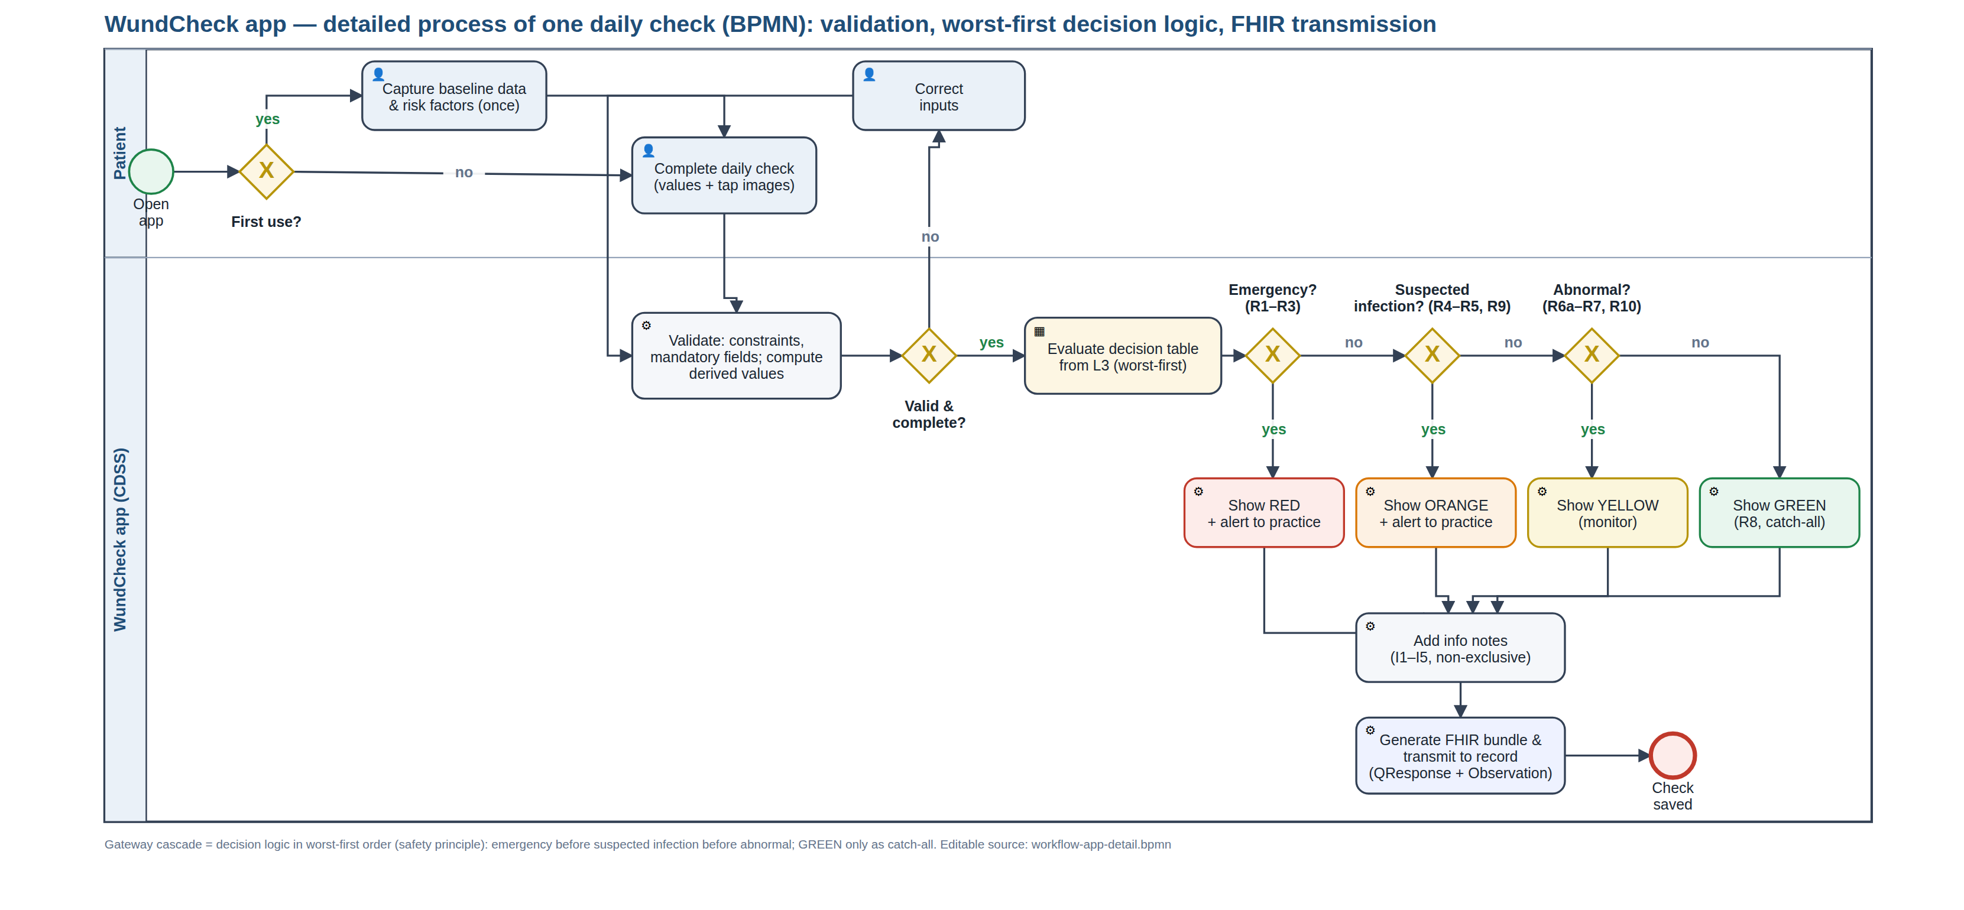
BACKUP · L2 · VALIDATION LOOP AND WORST-FIRST CASCADE
Detailed process inside the app

Slide 20
BACKUP · L3 / L4
The FHIR interface — a real transaction bundle, not a download
QuestionnaireResponse
every answer, typed and terminology-coded; canonical carries the L3 version
every run
Observation
traffic light, Southampton grade, triggering rule, L3 version, days post-op
every run
Communication
structured alert, priority urgent (ORANGE) or stat (RED)
ORANGE / RED only
The endpoint is configuration, not code
"fhir": { "endpoint": "https://…/baseR4", "patient_reference": "Patient/example",
"alert_recipient": "Organization/practice", "send_mode": "transaction" }
Redirecting to a hospital FHIR server or the Swiss EPD gateway is one line of JSON. If the endpoint is unreachable the bundle queues — the patient still gets the recommendation.

Slide 21
BACKUP · METHOD
Traceability — one finding, all the way through
L1
CDC/NHSN — “purulent drainage from the superficial incision”
▼
L2
DE-035 discharge · SNOMED 449736006 · rule R4 → ORANGE
▼
L3
"when": "secretion = 3 or secretion_smell = 1"
▼
L4
image selection “cloudy / purulent” → SUSPECTED INFECTION
▼
QA
T10, T15 — passed · challenge C-09 documents the severity/urgency split
▼
FHIR
QuestionnaireResponse.item[secretion] + Observation.component
Every element, rule, challenge, hazard, test and defect carries an ID that is identical in all artefacts.

Slide 22
BACKUP · L3 · WUNDCHECK-L3.JSON V0.3.3
The L3 in one screen — this file is the CDSS
{ "meta": {
Bilingual by construction
"version": "0.3.3", "languages": ["en","de"], "default_language": "en",
Every user-facing string is a language-keyed object. A further language is a content change, not a code change.
"l1_sources": [ CDC/NHSN · NICE NG125 · Southampton · Campwala 2019 ],
"thresholds": { "fever_orange": 38.0, // CDC — deep incisional SSI
"fever_red": 39.0, // group decision — challenge C-07
"normal_healing_days": 3 }, // group decision — C-03
"fhir": { "endpoint": "…/baseR4", "send_mode": "transaction" } },
Thresholds carry their source
"elements": [ {
Each constant names where it comes from — a guideline value or a documented group decision.
"id": "secretion", "de_id": "DE-035", "type": "select_one",
"label": { "en": "Is fluid coming out of the wound?",
"de": "Kommt Flüssigkeit aus der Wunde?" },
"options": [ 0 = none · 1 = clear · 2 = bloody · 3 = purulent, each with an image ],
Rules carry their reference
"terminology": { "snomed": "449736006" },
Every rule states its L1 source and an annotation, so a clinician can review it without reading code.
"fhir": "Observation.valueCodeableConcept",
"l1_source": "CDC/NHSN — purulent drainage · Southampton III–IV" } ],
"decision_rules": [ {
"id": "R4", "priority": "orange", "exclusive": true,
The endpoint is configuration
"when": "secretion = 3 or secretion_smell = 1",
"output": { "en": "SUSPECTED INFECTION — contact your practice today…" },
Redirecting to a hospital FHIR server is one line — no code change, no rebuild.
"annotation": "Purulent drainage is a primary criterion of superficial SSI.",
"reference": "CDC/NHSN superficial incisional SSI · Southampton IV" } ] }
48 elements · 18 rules · 54 KB · read by the L4 at runtime — swap this file and the app becomes a different CDSS.

Slide 23
BACKUP · L2 · EXCERPT OF 48 ELEMENTS
Data dictionary — the four required columns
ID
LABEL
TYPE
RESPONSE OPTIONS
CONDITIONAL LOGIC
CONSTRAINT
TERMINOLOGY
DE-020
Body temperature today
decimal
free numeric input, °C
—
34–43 °C
LOINC 8310-5
DE-023
Pain 0–10
integer
NRS 0–10
—
0–10
LOINC 72514-3
DE-026
How do you feel overall?
select_one
0 = well · 1 = tired · 2 = really unwell
—
—
SNOMED 386661006
DE-030
Which picture matches your wound?
select_one
1 = calm & dry · 2 = slightly red · 3 = markedly red & swollen · 4 = open / pus
—
—
SNOMED 225552003
DE-032
Does a red streak run away?
select_one
1 = yes · 0 = no
none — deliberately ungated (B-03)
—
SNOMED 46117009
DE-035
Is fluid coming out?
select_one
0 = none · 1 = clear · 2 = bloody · 3 = cloudy / purulent
—
—
SNOMED 449736006
DE-036
Does the discharge smell?
select_one
1 = yes · 0 = no
secretion ≥ 1
—
SNOMED 288227007
DE-037
One spot or the whole wound?
select_one
1 = small spot · 2 = along the wound
secretion ≥ 1
—
—
DE-038
For how many days?
integer
free numeric input, days
secretion ≥ 1
0–60
—
DE-025
Did pain disturb your sleep?
select_one
1 = yes · 0 = no
pain ≥ 4
—
SNOMED 301345002
DE-045
Southampton grade
calculated
0 · I · II · III · IV · V
derived from 5 elements
—
SNOMED 225552003
48 elements in total · 9 derived · 4 with conditional logic · 8 with constraints · 38 with a terminology binding · 47 with a FHIR mapping. Full table: docs/05.

Slide 24
BACKUP · DOCUMENTATION
Depth that did not fit into ten minutes
Testing types applied (Day 5 vocabulary)
The L3 implementation package (Day 3)
L2 verification — decision table ↔ BPMN cascade ↔ L3 rules reconciled
Functional testing — individual rules, exclusions, severity order, boundary values
Integration testing — derived elements → rules → output; conditional logic → rule reachability
Usability testing — image assignment by lay people: NOT carried out, our largest residual risk
Documentation — health need, personas, BPMN
Content / workflow — sections, relevant, decision rules
Terminology — SNOMED CT / LOINC / ICD-10 bindings
Validation — 19 test cases, test data, conformance checks
Interfaces — FHIR export · UI/UX — image options, traffic light
Stakeholders and where it could fail
What we would do with three more months
The critical group is the practice, not the patient
If Sandra experiences the alerts as a burden, the rollout fails — however good the classification is
Hence: alerts only from ORANGE upwards, structured instead of free text, alert load measured explicitly
1 · Clinical sign-off on every threshold and rule — it settles all nine L1→L2 decisions at once
2 · Usability study on the image assignment — validates the central design idea
3 · Graphics for several skin tones and body regions
4 · Convert the L3 to a FHIR Questionnaire — the software neutrality we consciously gave up

Slide 25
BACKUP · REFERENCES
Sources
Woelber E et al.
Proportion of Surgical Site Infections Occurring after Hospital Discharge: A Systematic Review. Surg Infect 2016;17(5):510–19.
60.1 % post-discharge
ECDC
Healthcare-associated infections: surgical site infections — Annual Epidemiological Report 2017.
0.5–10.1 % by procedure
CDC / NHSN
Surgical Site Infection Event (SSI). Patient Safety Component Manual.
30 / 90-day window
NICE
Surgical site infections: prevention and treatment. NG125, 11 Apr 2019, upd. 19 Aug 2020.
nice.org.uk/guidance/ng125
Bailey IS et al.
Southampton Wound Scoring System.
grades 0–V
Campwala I, Unsell K, Gupta S
A Comparative Analysis of Surgical Wound Infection Methods: CDC, ASEPSIS and Southampton in breast reconstruction SSI. Plastic Surgery, 2019.
PMID 31106164
WHO
Monitoring and Evaluating Digital Health Interventions: a practical guide. 2016.
maturity stages
WHO
SMART Guidelines — the L1–L5 knowledge layers.
who.int
IMDRF
Software as a Medical Device: possible framework for risk categorisation.
categories I–IV
HL7
FHIR R4 — QuestionnaireResponse, Observation, Communication.
hl7.org/fhir/R4

