Slide 1
Events Inside VIT
Sivanesan A (12MSE0239)
Balaji S (12MSE0126)

Slide 2
AIM
To provide easy access to the event being conducted in our university by making a web application which may serve as single home for all events.

Slide 3
OBJECTIVE
To make the event announcement more effective for easy maintenance of all events than normal conventional method of announcement.
To integrate the events in a single environment that are conducted in the university .This benefits the students while reducing the need to look at different website for different events.

Slide 4
DRAWBACK OF EXISTING SYSTEM
The existing system for events sharing is announcing which is conventional method. This method is outdated and unparalleled mode of communication.
It lacks the communication of audience. It is lot slower, difficult to update.
The most audience are unable to perceive information from the announcement as its incomplete data.

Slide 5
CONTD..
Some common methods of propaganda are through
Poster
Announcements
Facebook pages
Banners
Sticking posters along the pedestrian pathway
Websites for every club events.

Slide 6
OBJECTIVES OF PROPOSED SYSTEM
To make the event announcement more effective for easy maintenance of all events than normal conventional method of announcement.
To integrate the events in a single environment that are conducted in the university .This benefits the students while reducing the need to look at different website for different events

Slide 7
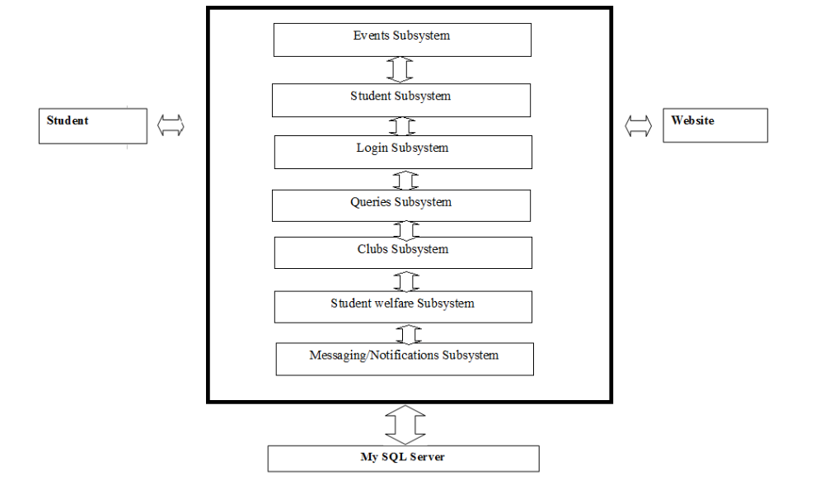
SYSTEM DESIGN - ARCHITECTURE

Slide 8
MODULE DESCRIPTION
Login
Student
Event Owner
Club
Bulletin board
Student welfare

Slide 9
CONTD..
Filtering and Subscription
Messaging and Notification
Querying

Slide 10
SCM Concepts
Process management - Ensuring adherence to the organization's development process
Build management - Managing the process and tools used for builds
Configuration status accounting - Recording and reporting all the necessary information on the status of the development process.
Version Control - allows you to control and monitor changes to files
Teamwork - Facilitate team interactions related to the process.

Slide 11
SCM Concepts
Configuration status accounting - Recording and reporting all the necessary information on the status of the development process.
Configuration auditing - Ensuring that configurations contain all their intended parts and are sound with respect to their specifying documents, including requirements, architectural specifications and user manuals.

Slide 12
Tools for configuration management
Chef
Puppet
CFEngine
Juju
IBM ClearCase
SaltStack Enterprise DevOps
Capistrano

Slide 13
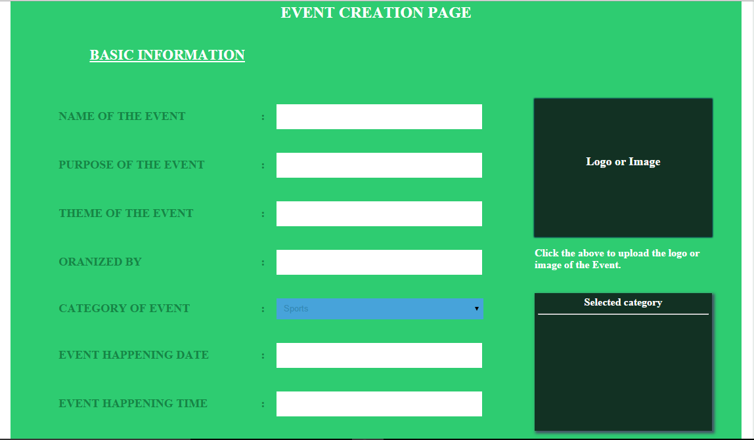
EVENT CREATION

Slide 14
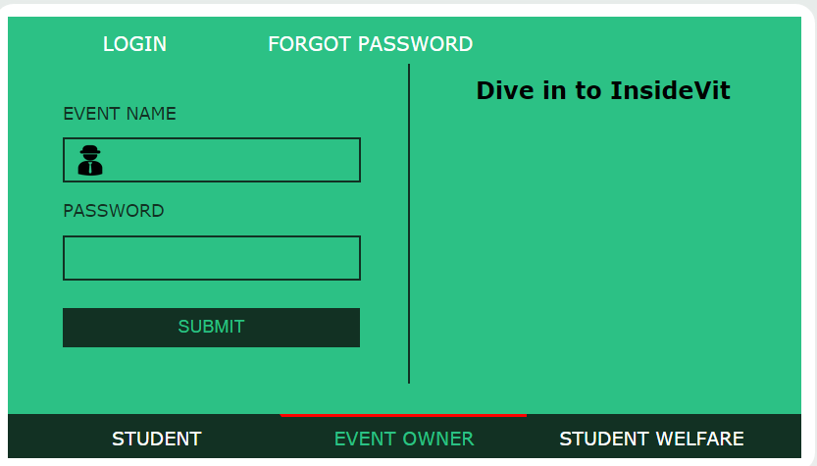
EVENT OWNER

Slide 15
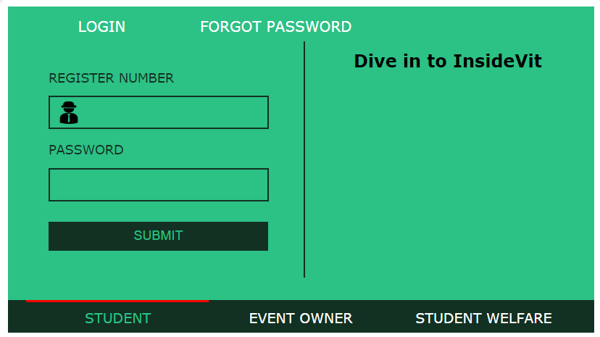
STUDENT

Slide 16
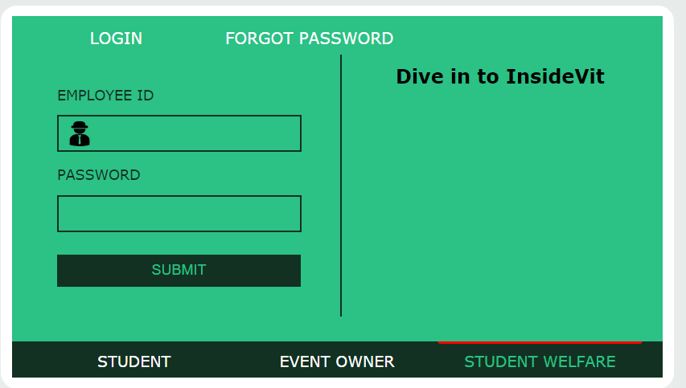
STUDENT WELFARE

Slide 17
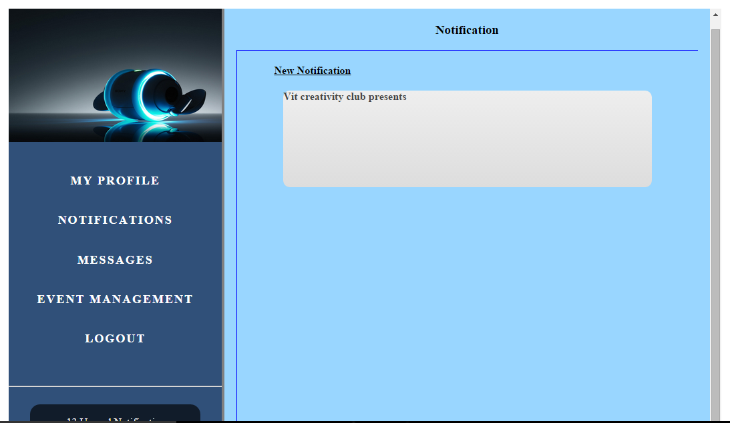
NOTIFICATION

Slide 18
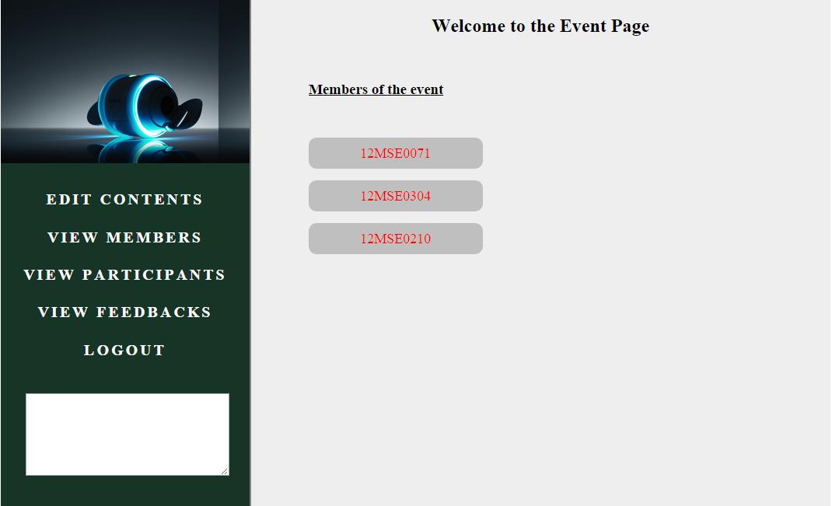
MEMBERS

Slide 19
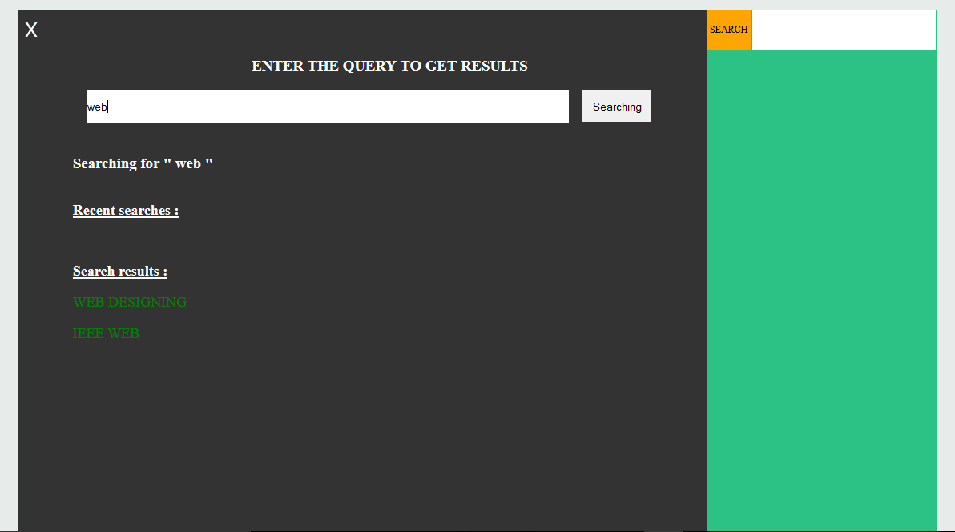
SEARCHING

