Slide 1
Customer Segmentation
for Marketing Optimization
ML Project 1 · Credit Card Behavioural Clustering · 29 May 2026
8,500
18
4
90%
Customers
Columns
Segments
Variance Retained

Slide 2
Problem Statement & Objective
01
THE PROBLEM
OUR OBJECTIVE
Banks cannot serve all customers with one-size-fits-all campaigns
Credit card customers differ vastly in behaviour — spenders, revolvers, cash users, dormant accounts
Without segmentation, marketing spend is wasted on low-intent users
6 months of credit card activity data across 8,500 customers is available but not yet utilised
Discover meaningful, distinct customer groups from behavioural data using unsupervised learning
Identify what each group looks like — their spending habits, balance levels, payment patterns
Translate clusters into actionable marketing recommendations for each segment

Slide 3
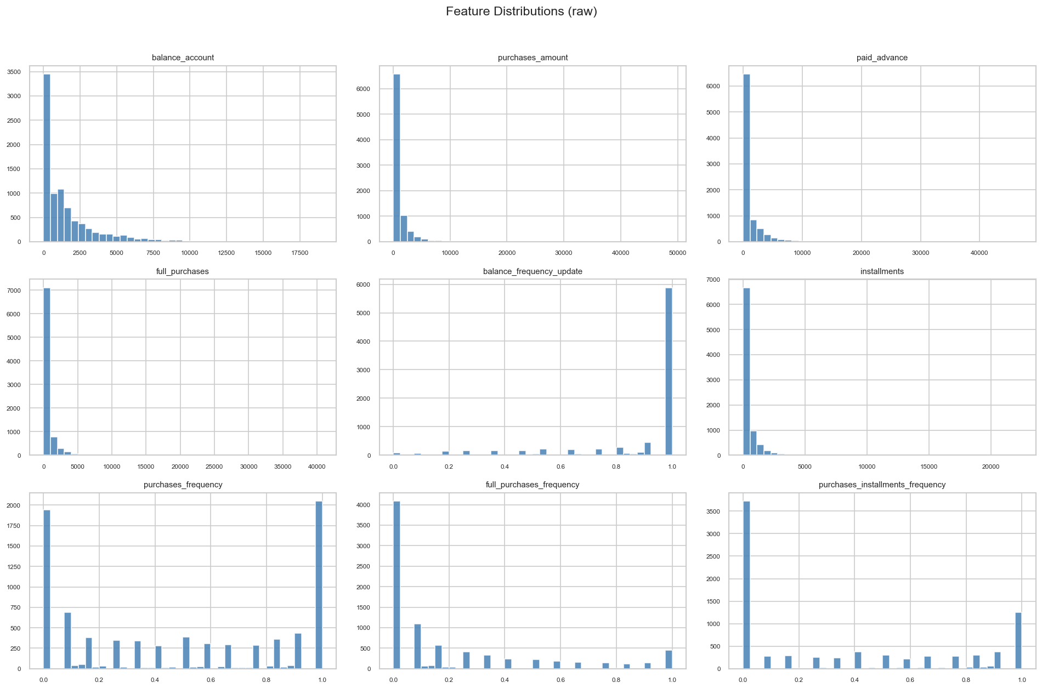
02

Slide 4

Key EDA Finding: Feature Distributions
03
WHY THIS MATTERS
Nearly all monetary features (balance, purchases, payments) are heavily right-skewed
Most customers cluster near zero with a long high-value tail
Frequency features are bimodal: customers either use a feature always or never
→ Decision: Apply log1p transformation to all monetary & count columns before modelling

Slide 5
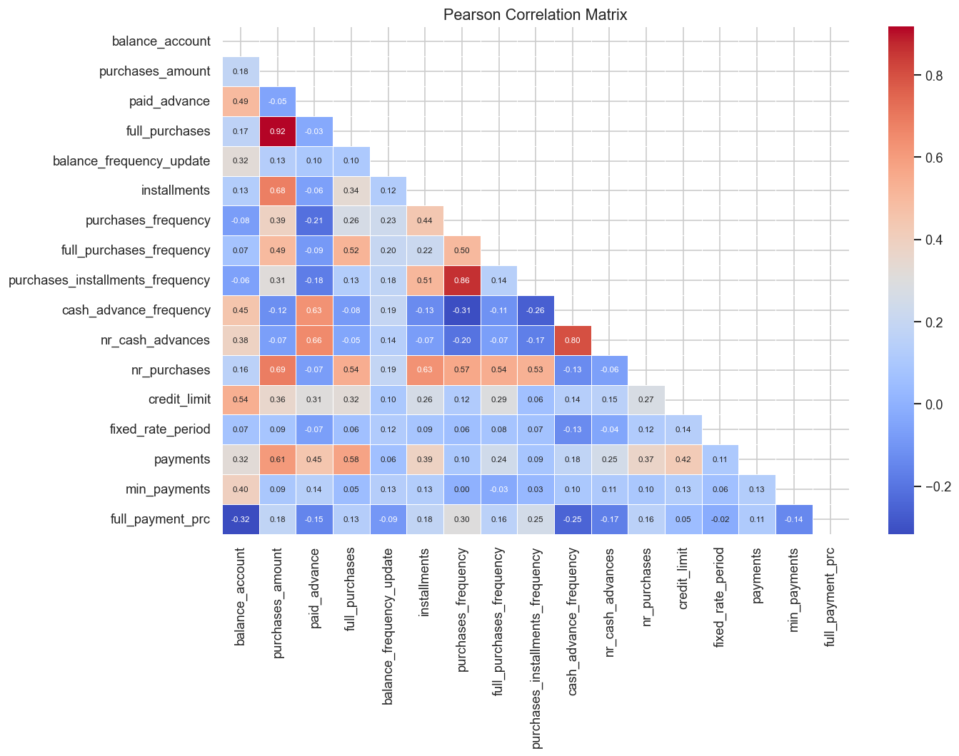
EDA: Correlations & Outlier Structure
04
Pearson Correlation Matrix
Correlation: purchase features (r>0.7) & cash-advance features form 2 correlated clusters → PCA orthogonalises them.

Slide 6
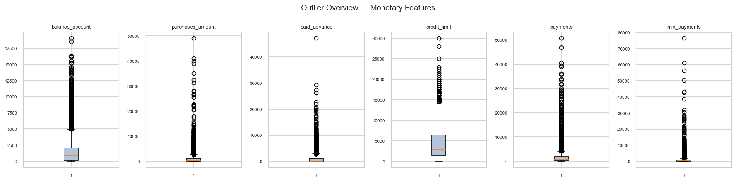
05
Outlier Overview — Monetary Features
Outliers: extreme values in all monetary cols → RobustScaler (IQR-based) applied after log transform.

Slide 7
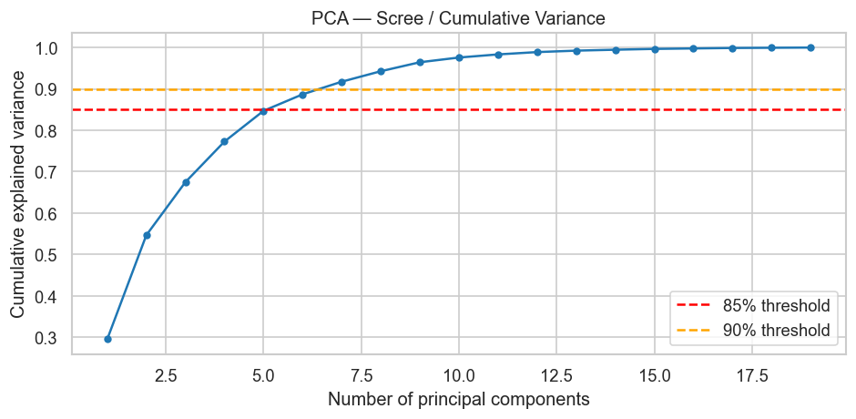
Preprocessing Pipeline & PCA
06
PREPROCESSING PIPELINE
PCA Scree — Cumulative Explained Variance
1. Drop customer_id
Identifier — no predictive value
2. Median imputation
credit_limit (1 missing), min_payments (298 = 3.5%)
3. log1p transform
10 monetary/count cols — reduces right skew, handles zeros
4. Feature engineering
purchase_to_limit_ratio + cash_advance_ratio (relative context)
5. RobustScaler
6 PCs → 85% variance | 7 PCs → 90% variance
We chose 7 PCs: eliminates noise, retains dominant structure
Removes multicollinearity between correlated features
IQR-based scaling — double protection against outliers

Slide 8
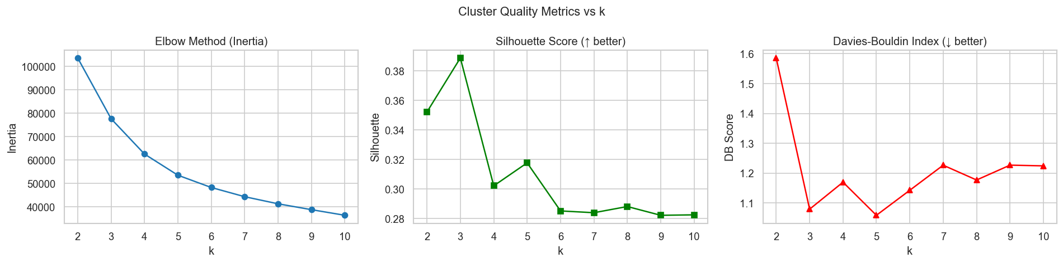
Choosing the Optimal Number of Clusters
07
3 complementary metrics evaluated for k = 2 to 10
WHY k = 4?
Elbow plot: clear inflection point at k=4 — inertia drops sharply before, only marginally after
Highest Calinski-Harabasz score (3,417) at k=4 — best between-cluster to within-cluster dispersion ratio
k=3 collapses revolvers & cash users into one group — loses marketing actionability
k≥5 produces small, unstable, hard-to-interpret fragments with no additional business value

Slide 9
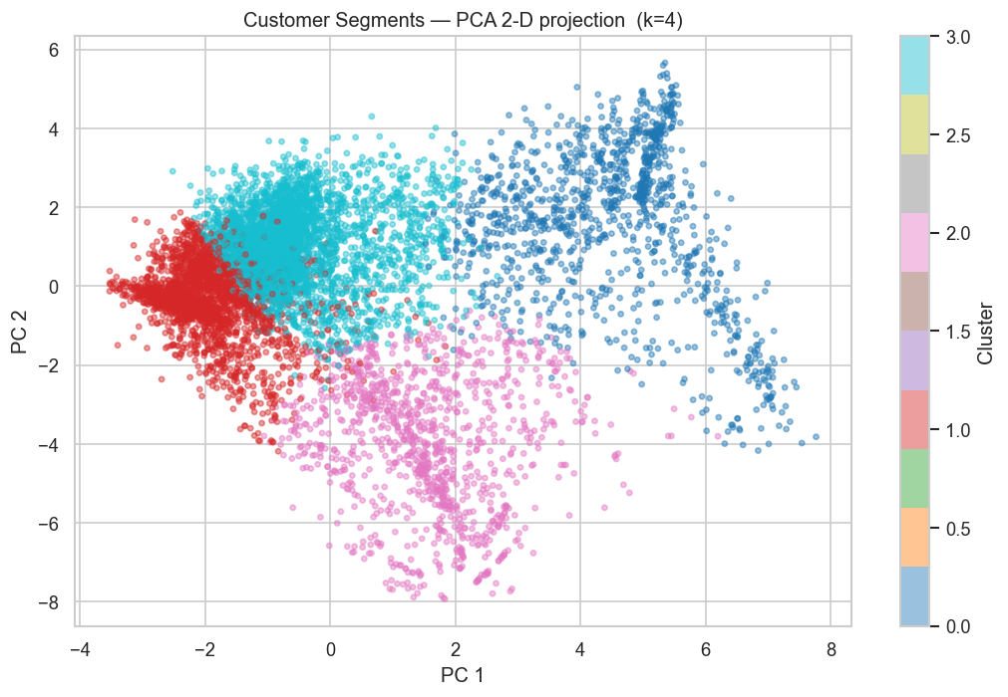
Clustering Results — PCA 2D Projection
08
Cluster 0
14%
Active Full-Payers
Cluster 1
30%
Cash-Advance Dependents
Cluster 2
13%
Inactive / Dormant
Cluster 3
43%
Instalment Revolvers
Clusters 0 (red) & 1 (teal) clearly separate on PC1 (purchase vs cash axis). Clusters 2 & 3 overlap in 2D but are well-separated in 7D PCA space.

Slide 10
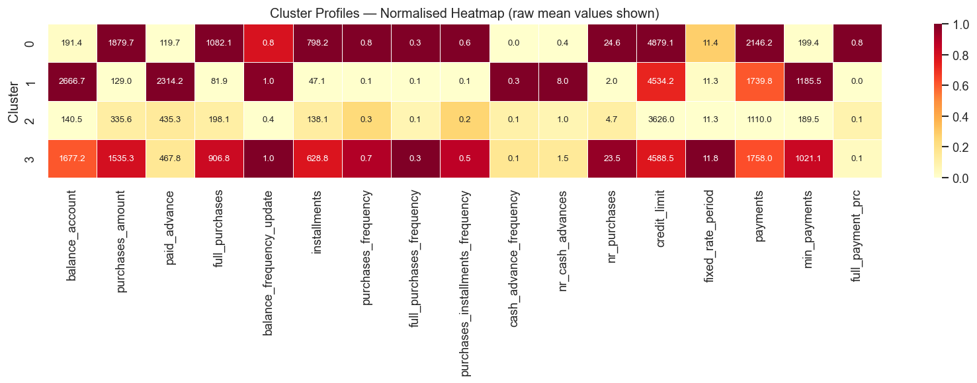
09
Cluster Profiles — What Each Segment Looks Like
Normalised heatmap — darker = relatively higher; raw means annotated in each cell

Slide 11
Marketing Insights & Recommendations
10
Active Full-Payers (14%) · Retain & Upsell
Cash-Advance Dependents (30%) · Risk Control
Premium card upgrade (travel rewards, cashback)
Higher credit limit offers + loyalty enrolment
Referral incentives — lowest churn risk, highest LTV
Debt consolidation loans at competitive rates
Financial health tools + lower-cost alternatives
Instalment plan offers to shift behaviour away from cash advances
Inactive / Dormant (13%) · Re-engagement
Instalment Revolvers (43%) · Grow Wallet Share
Time-limited bonus: spend £50 → get £10 back
Personalised category incentives based on demographics
Proactive outreach before account lapses — acquisition cost sunk
Targeted instalment promotions + merchant partner offers
Balance transfer with introductory rate
Cross-sell insurance / payment protection products

Slide 12
Challenges, Limitations & Next Steps
11
CHALLENGES & LIMITATIONS
NEXT STEPS
Temporal scope
Validate segment stability with different random seeds and time windows
A/B test recommended marketing actions per segment to measure uplift
Explore DBSCAN and Gaussian Mixture Models as alternative approaches
Incorporate churn and default labels (if available) to validate predictive relevance of segments
Enrich with demographic data (age, income, region) for more precise targeting
Only 6 months — seasonal patterns and long-term trends not captured
No demographics
Pure behavioural segmentation; age/income data would improve targeting precision
KMeans assumptions
Assumes spherical clusters; 13%–43% size imbalance suggests DBSCAN/GMM worth exploring
Silhouette = 0.30
Moderate overlap expected in real consumer data — behaviours form a continuum, not discrete bins
PCA interpretability
Cluster centroids in PCA space not directly readable — raw-feature profiles used as workaround

