Slide 1

SDU BOS – Monetization Asset Snippet
Feb – 2026

Slide 2
2026 Asset Reuse Savings - Hours

Slide 3
2026 Asset Reuse Savings - Percentage

Slide 4
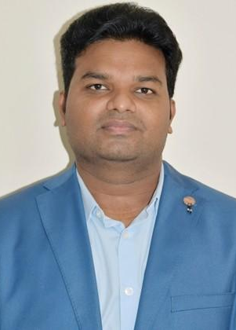
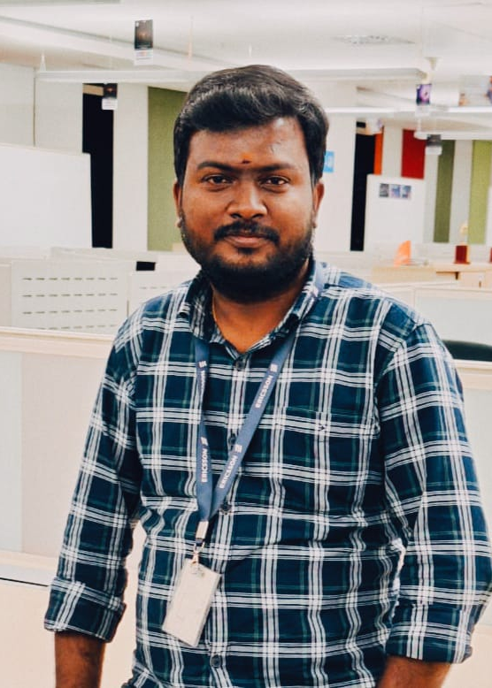
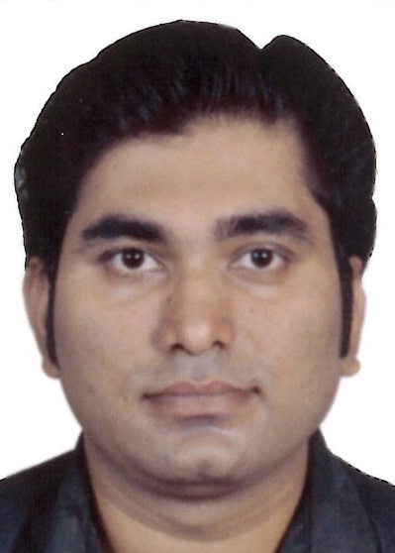
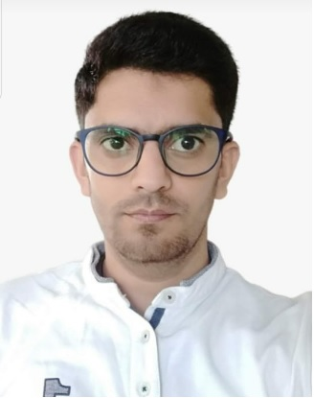
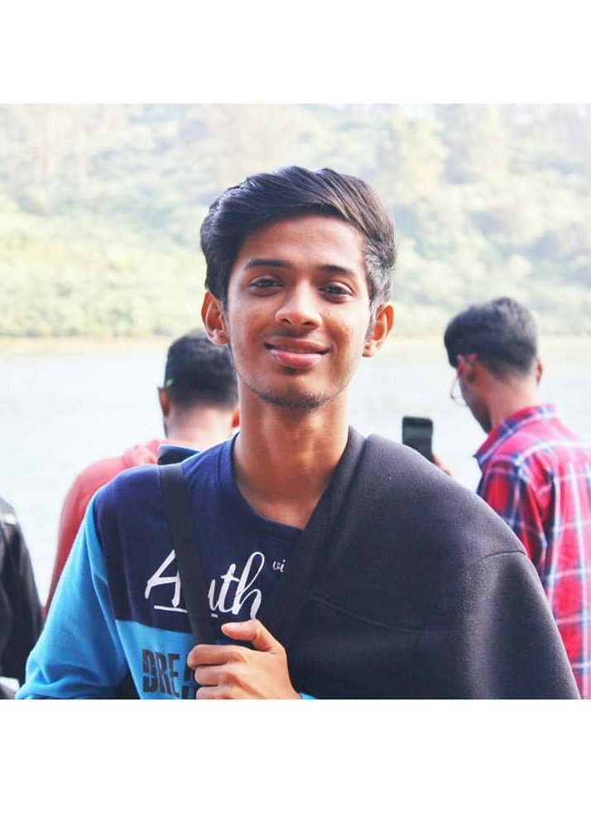
Top Asset Users Charging – Feb 2026
Amit Kumar QQ
Udayakumar S
Sudhanshu B Dubey
Yaser Majeed
Ateesh Varun

Slide 5
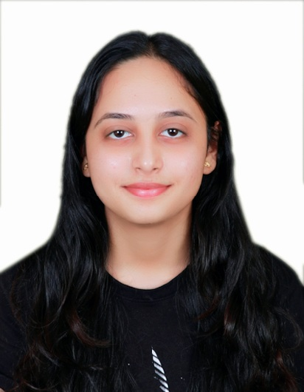
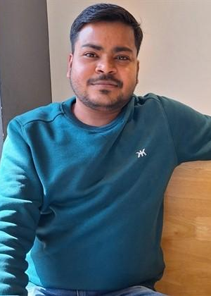
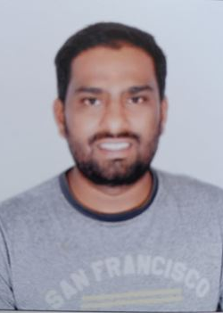
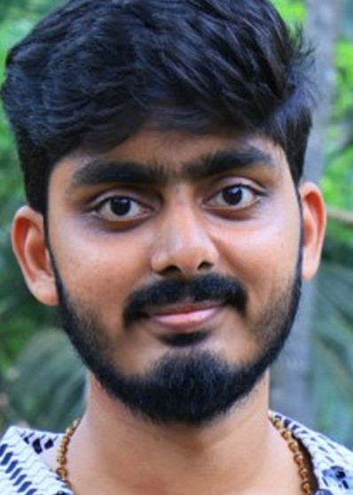
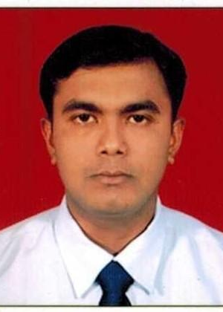
Top Asset Users Billing – Feb 2026
Suparba Roy Mahapatra
Prashant Kumar Gupta K
N Sudarvanna Pillai
Thota Arun Kumar
Badal Chandra Das

Slide 6
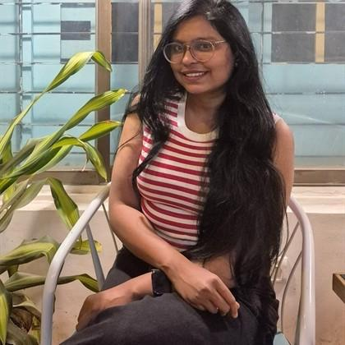
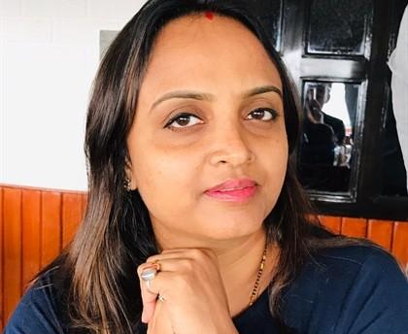

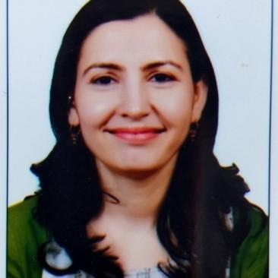
Top Asset Users SDC CS&DFE – Feb 2026
Anshu Jaiswal
Shilpi Srivastava
Padmendra Sengar
Savita Choudhary
Aruna .

Slide 7
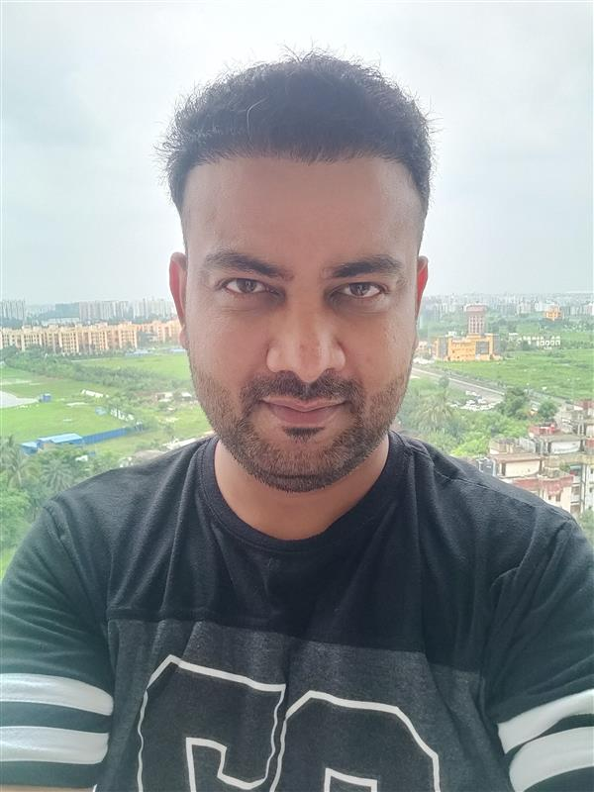
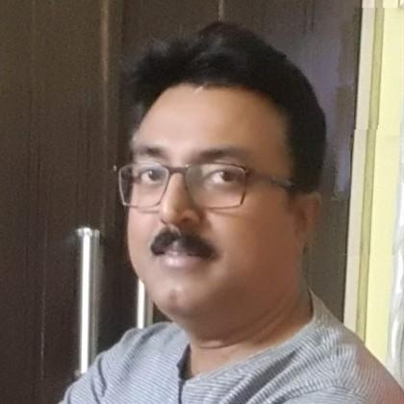
Top Asset Users SDC Billing&MW
Manish Kumar S
Santanu Sadhu

Slide 8


Thank You

