Slide 1
CHATBOT
- Swetha S Nair(593509)

Slide 2
Overview
I have used AngularJs to create a chatBot.
IDE used: Sublime text 3.
Images were taken from google to create the banner.

Slide 3
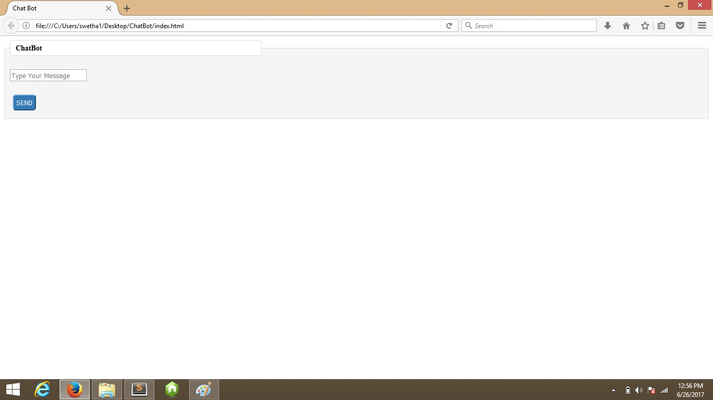

Slide 4
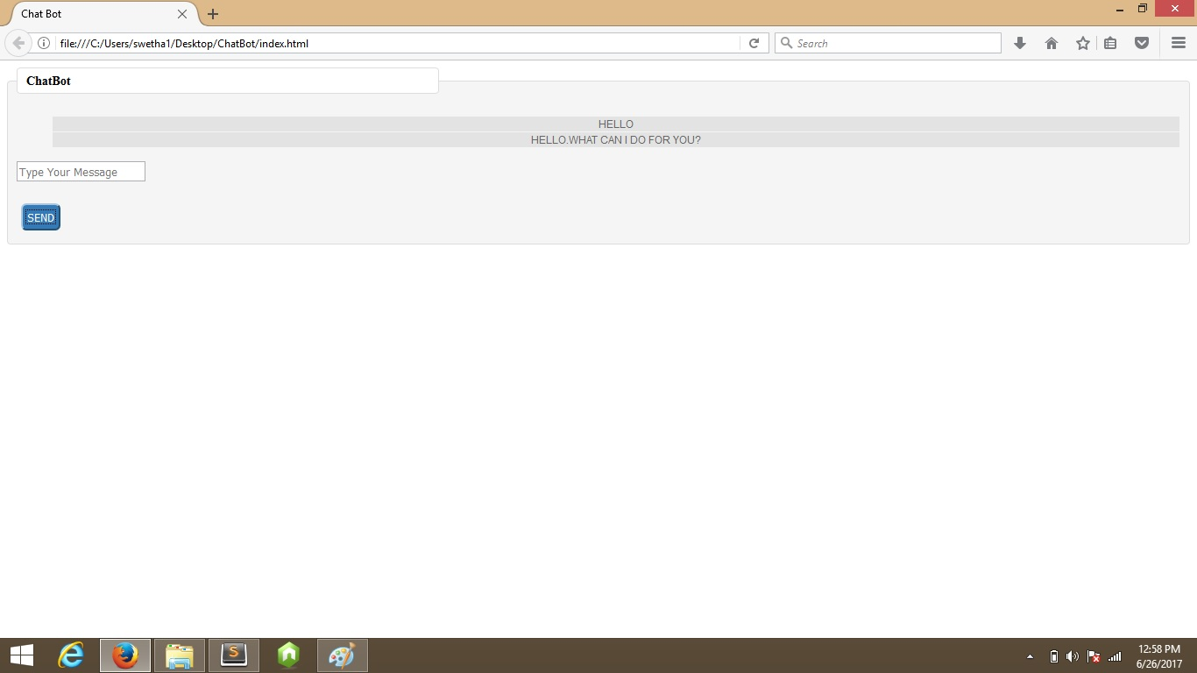

Slide 5
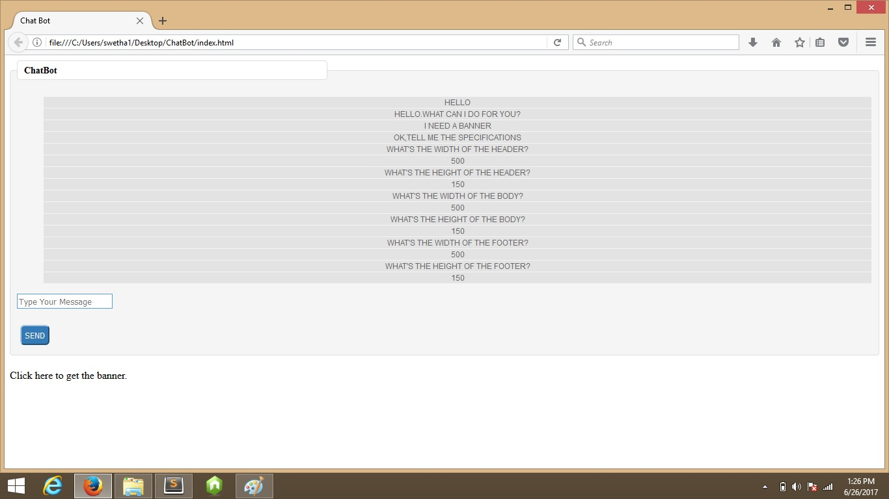

Slide 6
