Slide 1
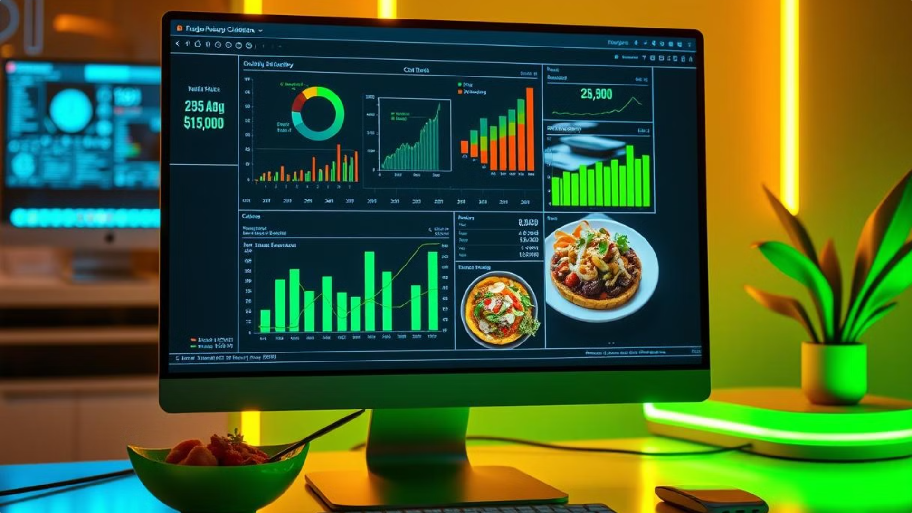



Predicting Live Recipe Costs Made Easy
Leverage data-driven insights to plan delicious and budget-friendly recipes.

Slide 2

Webscraping Ingredients, Quantities and Prices from Bigbasket
1
Identify Ingredients
Scrape the bigbasket website to extract a comprehensive list of ingredients, their corresponding quantities and prices.
2
Store Data
Organize the ingredient, quantity and price information in a structured database for efficient access and analysis.
3
Maintain Updates
Regularly update the database to ensure the pricing information remains accurate and up-to-date.

Slide 3
Predicting Live Cost of Selectable Recipes
Analyze Ingredient Costs
Consider Serving Sizes
Apply Machine Learning
Factor in the number of servings for each meal to accurately predict the total cost.
Develop a predictive model to forecast the live cost of recipes based on historical data and serving information.
Leverage the webscraping data to understand the fluctuations in ingredient prices over time.

Slide 4



Integrating the Prediction Model with the Website
Smart Search
Live Cost Prediction
Recipe Showcase
Provide an intuitive search functionality to help users find the perfect meal based on cost, ingredients, or dietary preferences.
Seamlessly integrate the predictive model to display the live cost of each meal based on the user's selected options.
Present the recipe details, including ingredients, instructions, and serving information, for the user's selected meal.

Slide 5


Conclusion and Next Steps
Enhance Predictions
Expand Recipe Database
Continuously refine the predictive model to improve accuracy and responsiveness to market changes.
Continuously expand the recipe database to offer a wider variety of meal options and dietary preferences.
By leveraging data-driven insights and a user-friendly interface, our platform empowers consumers to plan delicious and budget-friendly meals with ease.

