Slide 1
AUTOMATED PARKING SPACE DETECTION
By
E.SIVANI(N180202)

Slide 2
Abstract
Automated parking detection aims detect available space for parking,optimizing space usage and reducing traffic congestion in urban areas,ultimately enhancing user experience.The proposed methodology involves segmenting the parking slot into rectangular blocks to specify parking spots,acquiring live footage from a top-down view camera of the parking lot,and employing image processing techniques to count the number of foreground and background pixels to determine the occupancy status of each parking spot.To mitigate the influence of environmental factors, a threshold value of 900 pixels is used to differentiate between foreground and background pixels.If the count of foreground pixels in a block exceeds 900, the spot is considered occupied;otherwise,if the count of foreground pixels is less than 900,the spot is considered vacant. This system displays the number of available parking spots and total parking spots on a screen.

Slide 3
Introduction
Automated parking systems have become increasingly popular in recent years, as they offer a convenient and efficient solution to the growing problem of parking space scarcity in urban areas.One of the critical components of an automated parking system is the detection of parking spots and the determination of their occupancy status.This project aims to provide an automated parking detection system using OpenCV,image processing, object detection,and machine learning.The proposed system uses a bird-eye view camera to capture real-time video footage of the parking area,and the OpenCV library is used to perform various image processing techniques to identify and track vehicles in the parking lot.

Slide 4
Motivation for the Work
Addressing Urban Congestion:Urban areas often suffer from traffic congestion due to the struggle to find available parking spots.By developing an automated parking detection system,you can contribute to reducing traffic jams and improving the overall flow of vehicles in cities.
Optimizing Space Utilization:Many parking lots have underutilized or poorly managed spaces, leading to wasted resources.An automated system can help optimize parking space usage,ensuring that available spots are efficiently allocated to incoming vehicles.
Enhancing User Experience:Finding parking can be a time-consuming and frustrating experience for drivers. Implementing a reliable parking detection system provides drivers with real-time information on available spaces,enhancing their experience and reducing stress

Slide 5
Real-world Applications
Smart Cities: As cities become more connected and data-driven,an automated parking system can play a crucial role in optimizing parking space utilization.By providing real-time information about available parking spots, the system helps reduce traffic congestion,lower carbon emissions,and enhance overall urban mobility.
Shopping Malls:Automated parking systems enhance the shopping experience by guiding customers directly to available parking spaces.This reduces frustration and makes the shopping process more convenient,ultimately increasing foot traffic and customer satisfaction.
Tourist Attractions: At tourist destinations, the system simplifies the parking process for visitors, making their experience more enjoyable.This can boost tourism and enhance the reputation of popular attractions.

Slide 6
Research Gaps Identified
Limitations of Traditional Sensor-Based Methods:Traditional methods for automated parking systems relying on ultrasonic or magnetic sensors suffer from susceptibility to interference and environmental factors. Researching ways to improve the accuracy and reliability of these sensor-based systems in challenging conditions can be a valuable research gap.
Human-Centric Design:Research gap exists in emphasizing user experience and human-centric design. Exploring how to design intuitive user interfaces that provide clear and actionable information to users could enhance the adoption and usability of automated parking systems.

Slide 7
Research Gaps Identified
Real-World Validation:Conducting real-world validation and robustness testing of OpenCV-based systems is vital. Evaluating the system's accuracy, resilience, and reliability across different parking scenarios and environmental conditions ensures its practical applicability.
Algorithm Evaluation for Vehicle Detection:Comparing image processing algorithms such as Haar Cascade, YoloV3, and SVM within the context of automated parking systems is essential. Researching the strengths and weaknesses of each algorithm for accurate vehicle detection can guide the selection of the most suitable approach

Slide 8
Proposed Method
Capture top-view live video of parking area.
Segment frames and extract keyframes for efficiency.
Generate virtual parking lines, assign numeric labels.
Process live video: grayscale, binary transformation.
Use dilation for pixel classification and accuracy.
Count white pixels in blocks, set occupancy threshold.
Analyze blocks in rows/columns for occupancy status.
Continuously update real-time parking availability.
Adjust occupancy based on vehicle entry/exit.

Slide 9
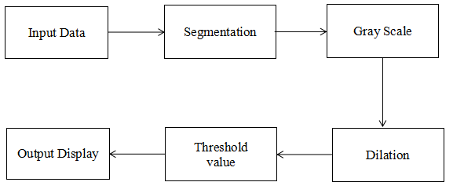
Flowchart

Slide 10
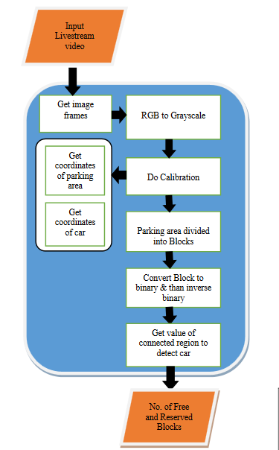
Algorithm of Proposed Method

Slide 11
Input Data
The methodology proposed is firstly,live footage is acquired from a top-down view camera of the parking lot.
The camera is positioned such that it provides a clear view of all the parking spots in the lot.
The captured video footage is subjected to pre-processing steps aimed at eliminating noise and artifacts that could potentially interfere with the accuracy of the subsequent detection algorithm.
By effectively removing noise and refining the input data, the methodology sets the foundation for precise parking space detection, enhancing the reliability and effectiveness of the algorithm used for this purpose.

Slide 12
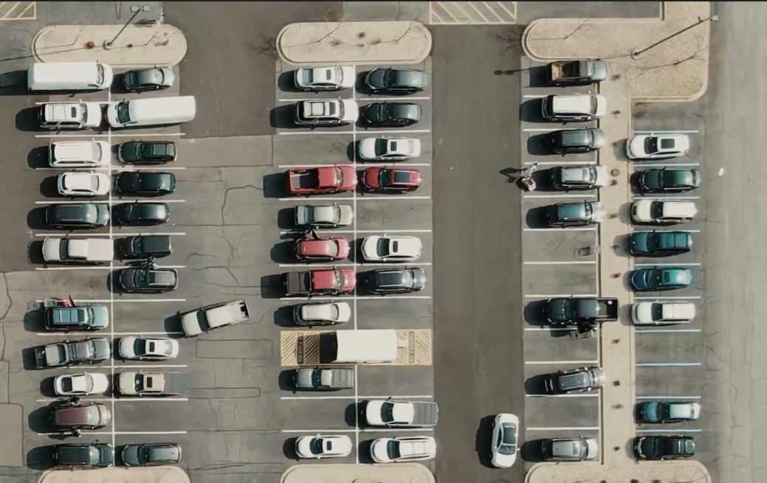

Slide 13
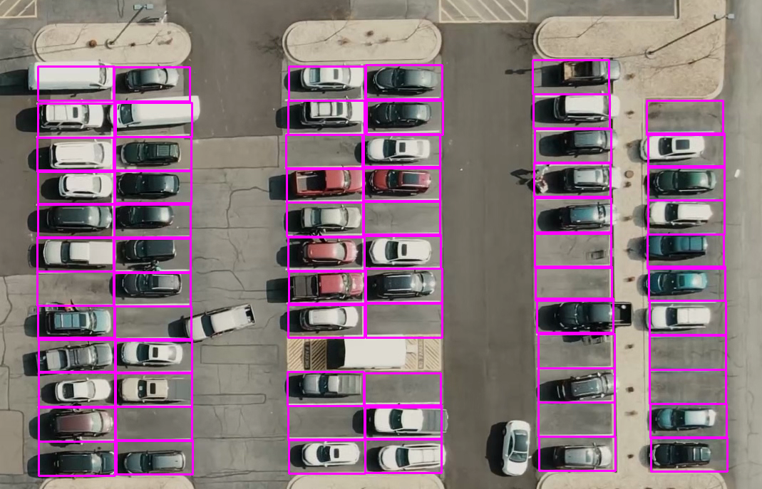
Segmentation of Parking spaces
The parking lot is segmented into rectangular blocks to specify parking spots.
The size of the blocks can be customized based on the size of the parking lot and the size of the vehicles that will be parked in the lot.
The blocks are arranged in rows and columns to cover the entire parking lot.
.

Slide 14
Gray Scale
The pre-processed footage is transformed into grayscale to convert into monotones. Thus a binary product is obtained.
One important reason for gray scaling is that by converting to grayscale, it separates the luminance plane from the chrominance planes. Luminance is also more critical for distinguishing visual features in an image.
This prevents any ambiguity in detection due to any presence of shadows.
Thresholded to segment the foreground and background pixels.A threshold value of 900 is used to differentiate between foreground and background pixels.
If the count of foreground pixels in a block exceeds 900, the spot is considered occupied;otherwise,if the count of foreground pixels is less than 900,the site is considered vacant.

Slide 15
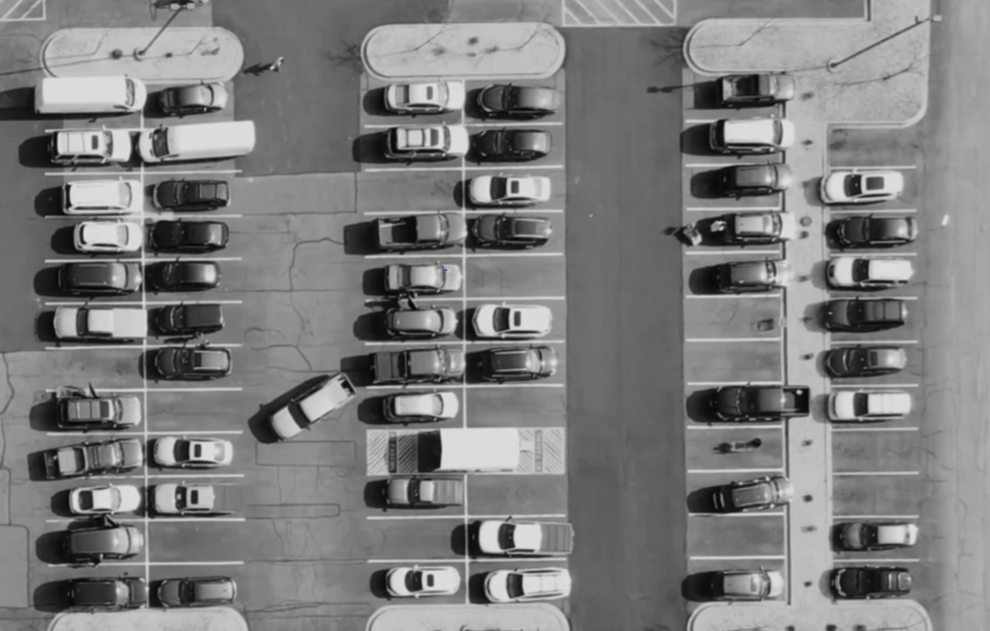

Slide 16
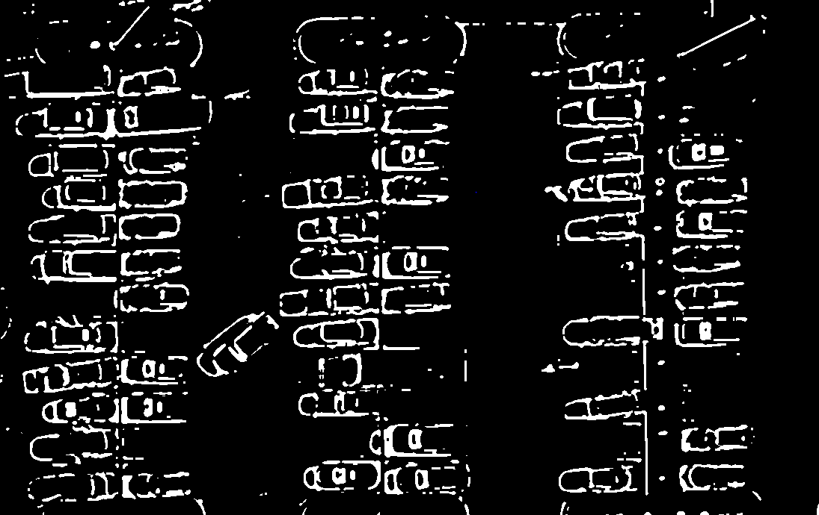
Dilation
Dilation of an image is the process by which the object area in the image is increased and emphasizing their features.
This process is used to accentuate features in the image.It increases the white region in the image or the size of the foreground object increases. This process helps in the classification of pixels black and white pixels.Which is integral to the accurate identification of parking spaces and vehicle presence.

Slide 17
Threshold value
A threshold is set to segment the foreground and background pixels.A threshold value of 900 pixels is efficiently set to differentiate between foreground and background pixels.
If the count of foreground pixels in a block exceeds 900 pixels,the spot is considered to be occupied; otherwise,if the count of foreground pixels is less than 900,the site is considered vacant and is available for parking.
After detecting the occupancy status of the parking lot.It displays the number of available parking spots to the total parking spots on a screen.
Available spaces are marked in green and the occupied ones in red.

Slide 18
Experimental setup
Technologies/libraries used
Datasets
System Hardware
Results table/screenshots/any
Results comparison with other approaches

Slide 19
Technologies/libraries used
Programming Language:
Python version-3.11.0
Libraries:
OpenCV
numpy
Cvzone
Pickle
Platform used:
Visual studio

Slide 20
Libraries
OpenCV: Open source computer vision
To read a video capture/ Image capture from webcam.
Numpy: Numerical python
Numpy is used to work with arrays and used for mathematical functions
Cvzone:
Python library that extends OpenCV's capabilities by providing useful utilities for drawing, text annotation, and interactive elements
Pickle:
To store and retrieve the list of parking space positions in a serialized format.

Slide 21
System Hardware
Processor: Intel core i5
Memory(RAM): 4GB
Disk: 320(approx.)

Slide 22
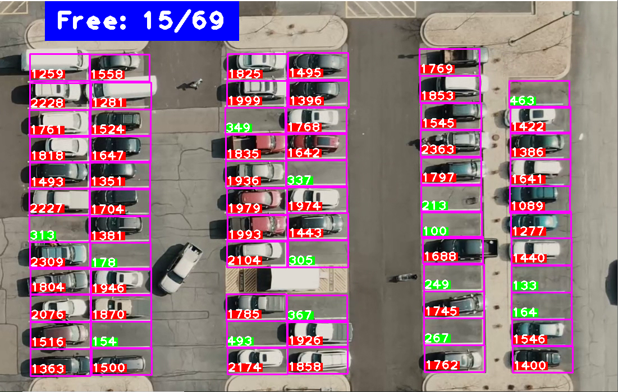
Results screenshots

Slide 23
Results comparison with other approaches
Traditional Sensor-based Systems:Conventional systems relying on ultrasonic or magnetic sensors may be prone to interference and environmental factors, leading to inaccuracies. The proposed visual-based approach offers better accuracy
Deep Learning Methods: Deep learning techniques, such as convolutional neural networks (CNNs), can achieve high accuracy but might require extensive training data and computational resources. The proposed methodology offers real-time performance without necessitating a massive training dataset.

Slide 24
Conclusion
Automated parking analysis using OpenCV is an efficient and accurate method for detecting the occupancy status of parking spots in a parking lot.The proposed methodology involves segmenting the parking lot into rectangular blocks,acquiring live footage from a top-down view camera,and applying image processing techniques to count the number of foreground and background pixels to determine the occupancy status of each parking spot.The use of a threshold value to differentiate between foreground and background pixels mitigates the influence of environmental factors,resulting in an accurate detection algorithm.The developed app provides real-time updates of the occupancy status of each parking spot,enabling users to find available parking spots quickly and easily.

Slide 25
References
Automated Parking Detection System(https://ijirt.org/master/publishedpaper/IJIRT159290_PAPER.pdf)
Car Parking Space Detection using opencv(https://easychair.org/publications/preprint_open/hVnT)

Slide 26
Future Scope
While the approach might work well for specific parking scenarios, it might need adjustments for different parking lot layouts or perspectives.
The approach might need further optimization to detect various types of vehicles accurately, including larger or uniquely shaped vehicles.

Slide 27
Thank You

