Slide 1
Relation Hallucination Analysis in Vision-Language Models
Datasets
MMRel: 1,632 image–question–answer pairs
R-Bench: 3,466 image–question–answer pairs
Each datapoint contains an image with a relational yes/no question
Closed-Source Model Evaluation
GPT
Gemini
Claude
Experiments
Original images + question pairs
Rotated images: 90° and 270°
Goal: evaluate robustness to spatial transformations

Slide 2
Corruption, Restoration & Open-Source VLM Inference
Image Corruption Experiments
Gaussian Blur
Impulse Noise
Pixelate
Saturate
Evaluation Scenarios
Corrupted image + question
Corrupted image + question + corruption information
Restored image + question
Image Restoration : SUPIR denoiser used to restore from corrupted images
Open-Source Models (R-Bench)
Qwen2-VL 7B
InternVL2 8B
LLaVA-Next 8B
DeepSeek-Janus 7B
Llama 3.2 11B

Slide 3
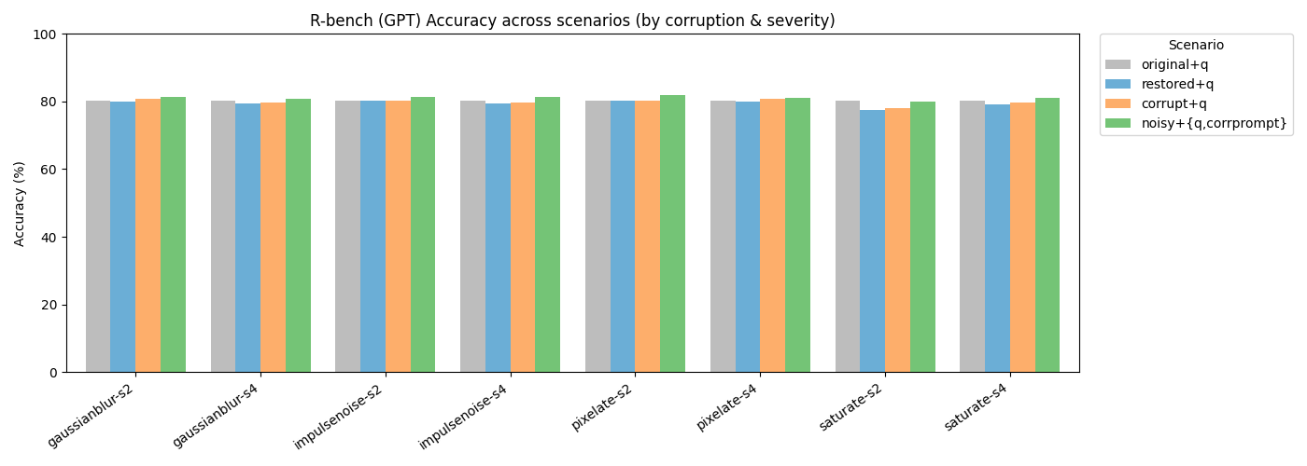
Results:Accuracy Comparision

Slide 4
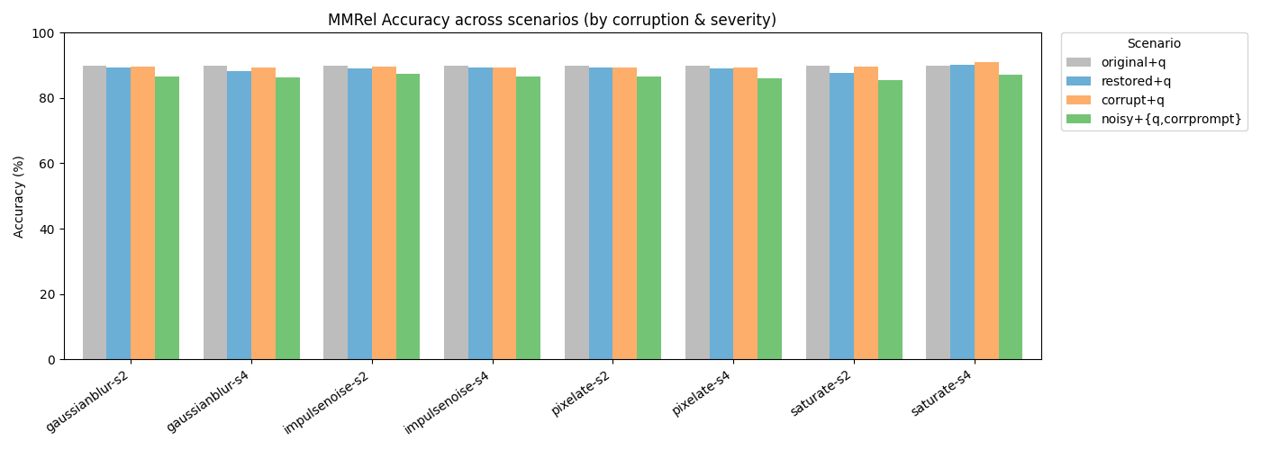
Results

Slide 5
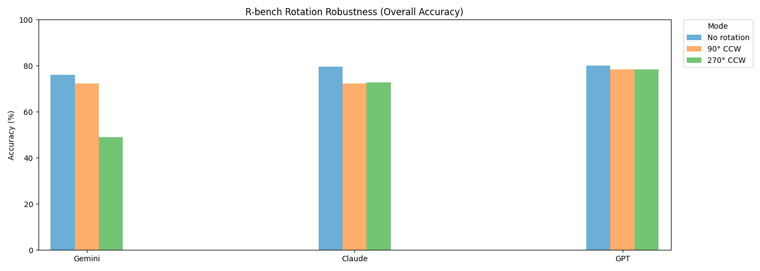
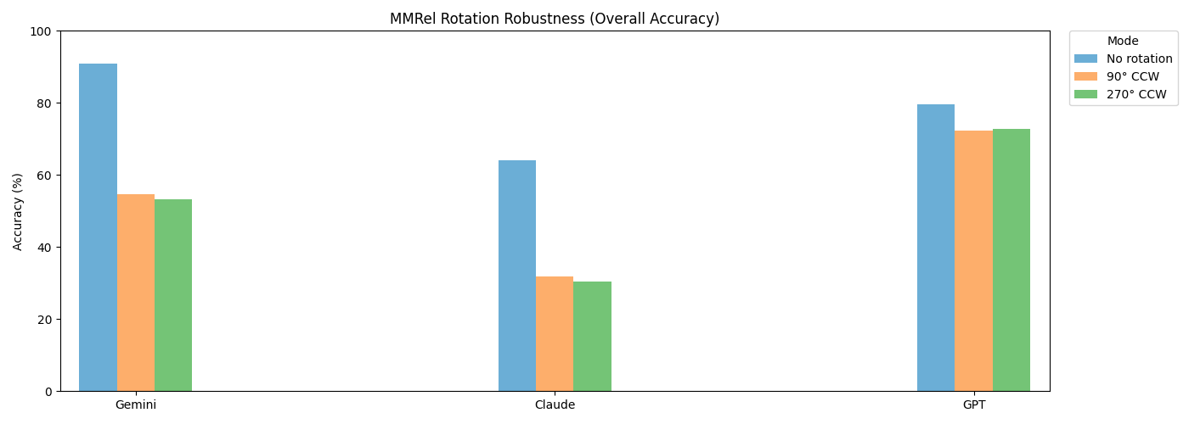
Rotation Results

Slide 6
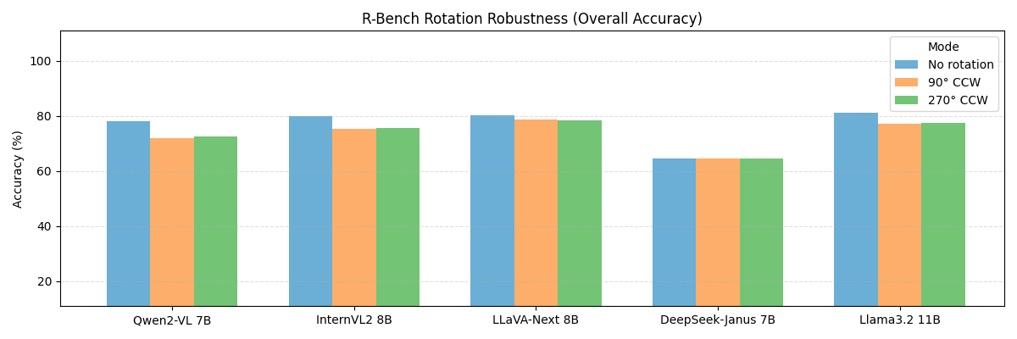
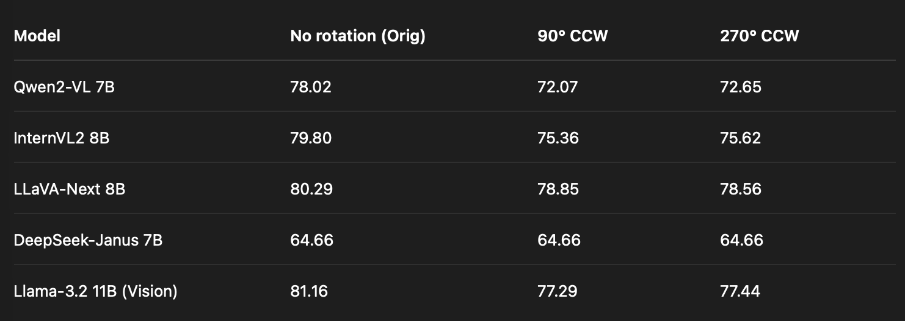
VLM Inference

