Slide 1
MOO in NAS
Nirosh Sivanesan

Slide 2
Introduction
Neural Architecture Search
A Field in Deep Learning that seek to automate the design of neural network architecture
From Complex Problem to Simplified Optimization
Notes:
Neural Architecture Search
A Field in Deep Learning that seek to automate the definition of neural network
I’d like to provide you some insight how the use of MOO has evolved in that field and how it can provide us some insight about the different MOO techniques, limitations and opportunities.
Let me start by providing you some context about this problem setting.

Slide 3
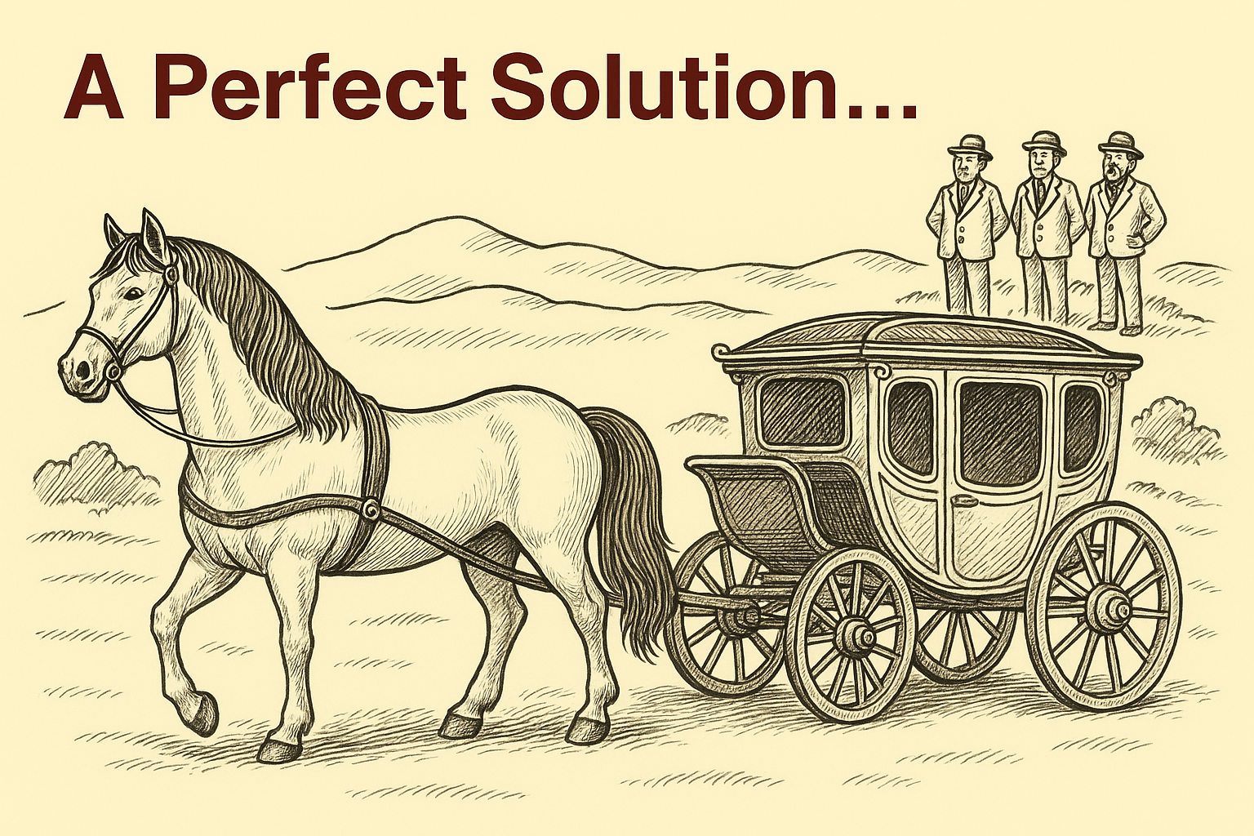
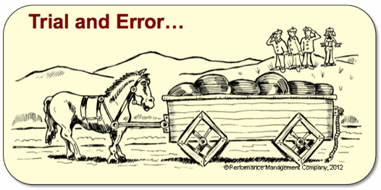
Motivation
Source : https://clear.ml/blog/how-to-do-hyperparameter-optimization-better
Almost perfect…
Generated with ChatGPT
Notes:
Over the years, researchers has come with very clever architecture like CNN, RNN, now Transformers and so on.
But this process requires often very techincal knowledge and the experience is build on long process of trial and errors, so the question is is there some ways to automatically discover very high performant architecture ?

Slide 4
Neural Architecture Search
Goal : Find automatically the optimal architecture that minimize multiple objectives.
Principal Objective :
Accuracy
Device related Objectives :
Latency
Model Size
Energy Consumption
…
Notes:
That is exactly the goal of the problem known as Neural Architecture Search. where on aims to automatically discover high performance neural network.
Historically it started by using Reinforcement Learning to find architecture that provide the best performance, so we consider only one single objectives.
But in reality, one has to consider more objectives than the accuracy, like for example the latency time, the model size or even the energy consumption and naturally this field evolves in a multi-objectives optimization settings.

Slide 5
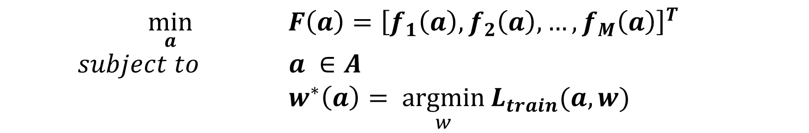
Formal Expression of NAS Problem
Equation 1
$\min_{a}{ F\left(a\right)={\left[f_{1}\left(a\right), f_{2}\left(a\right), …, f_{M}\left(a\right)\right]}^{T}}$ $subject to$ $a ∈A$ $w^{∗}\left(a\right)= \underset{w}{argmin}{L_{train}(a,w)}$
Notes:
We aren’t optimizing for just one metric; real-world deployment usually means trading off between accuracy, speed, and size.
In NAS, we often care about more than just accuracy; we may also want to minimize latency, memory usage, or energy consumption. Thus, we formulate the search as a multi-objective optimization problem
We want to find the architecture a in the set A that achieves the best trade-off between multiple objectives, where for each architecture, its weights are set to those that best minimize the training loss.
This formalism captures the essence of modern NAS: for every possible architecture, we find the optimal weights, and then compare architectures across multiple objectives. In practice, this leads to a set of Pareto-optimal solutions, not just a single ‘best’ architecture

Slide 6
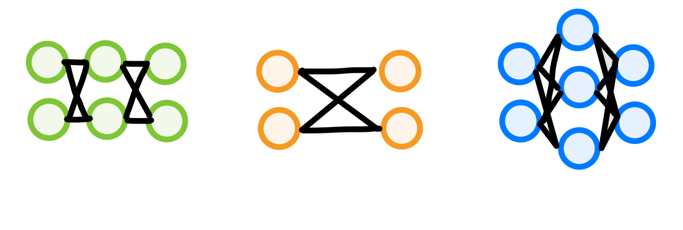
Neural Architecture Search
Cell-Based Search Space
Each node represent a feature tensor
Common Operations :
3x3 Convolution
Max-Pooling
Skip Connection
Identity
Zeroise
Each edge represent an operation
Building block are called «Cell»
Notes:
Let me also introduce basic concept of this problem settings
Each cells are directed acyclic graph (graph) that are defined as follows :
each node xi represents a tensor or alternatively said the feature computed in that particular position of the network
each edges represents operations from a set of operation that we want to use.
So the user has to defined a set of operation, the number of nodes.

Slide 7

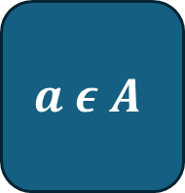
Neural Architecture Search
General Process
$$Search Space A$$
Sample one architecture
$$a ε A$$

Slide 8
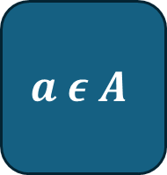

Neural Architecture Search
Goal : Find automatically the optimal architecture that minimize multiple objectives.
$$Search Space A$$
Sample one architecture
$$a ε A$$
Train
Evaluate
Peformance

Slide 9

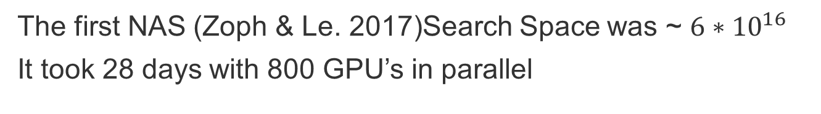
Challenges
Source : Zoph & Le (2017) Neural Architecture Search with RL
$$Search Space A$$
The first NAS (Zoph & Le. 2017)Search Space was ~ $6∗{10}^{16}$
It took 28 days with 800 GPU’s in parallel
Nowadays Search Space ~$10^{36}$
How to reduce the search and evaluation time ?

Slide 10
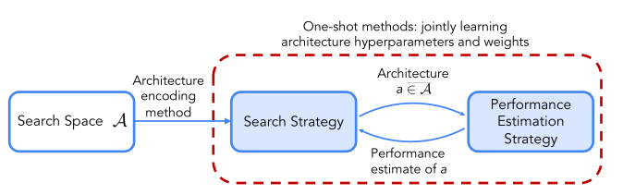
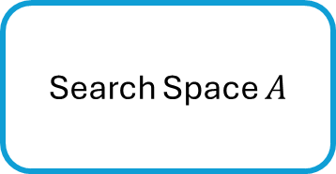
Solution
1. Reducing the Evaluation time – How to define our «fitness» value ?
2. Reducing the Search Time – Is there a better Search Strategy ?
Search Space $A$
Search Strategy
Performance Evaluation Strategy

Slide 11
Spoiler
Reducing Evaluation time
Use of SuperNetwork
Reducing Search Time
Using Gradient Based Method – Search direction
Involves a HyperNetwork and a continuous relaxation scheme

Slide 12

1. Reducing Evaluation Time
Training each individual architecture from scratch is unfeasible !
Idea – Use one overparameterized superNetwork
Notes:
Imaging having to train and evaluate millions of different architectures ?
It’s unfeasible in practice, so

Slide 13
1. Reducing Evaluation Time
SuperNetwork – Weight-Sharing Paradigm
Notes:
Use of SuperNetwork to drastically reduce the computational cost !

Slide 14
1. Reducing Evaluation Time
SuperNetwork – Weight-Sharing Paradigm
Notes:
Use of SuperNetwork to drastically reduce the computational cost !

Slide 15
1. Reducing Evaluation Time
SuperNetwork – Weight-Sharing Paradigm
Notes:
Use of SuperNetwork to drastically reduce the computational cost !

Slide 16
1. Reducing Evaluation Time
SuperNetwork – Weight-Sharing Paradigm
We have reduced the training cost from O(N) to ~O(1)
But we’ve introduced some biais with the weight of the supermodel being shared among the different architectures.
Notes:
Use of SuperNetwork to drastically reduce the computational cost !

Slide 17
2. Reducing Search Time
RL → Too slow
EA → still slow
Need search direction (gradient !)
Notes:
Evolutionary Algorithms (EA) present a natural alternative for this problem, as the search space is discrete.
Compared to RL, EA can be easily parallelized, making the search process faster and more scalable.
However, even with parallelization, EA can still be inefficient when the search space is huge or training each candidate is expensive.
A more efficient strategy is to use gradients to guide the search direction.
But how do you use gradients when your choices (architectures) are categorical?
Solution: Researchers propose a continuous relaxation of the discrete search space, allowing the use of gradient-based optimization for architecture search.

Slide 18
2. Reducing Search Time
Core Idea is :
Relax the search space to make it continuous
Use a HyperNetwork to drive the selection of the architecture
Use the gradient direction to improve the search strategy

Slide 19
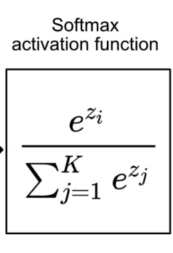
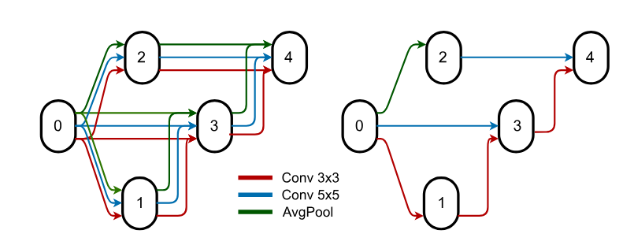


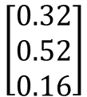

2. Reducing Search Time
Source : https://www.singlestore.com/blog/a-guide-to-softmax-activation-function/
Continuous Relaxation
$$\left[\begin{matrix}0.32 \\ 0.52 \\ 0.16\end{matrix}\right]$$
$$\left[\begin{matrix}0 \\ 1 \\ 0\end{matrix}\right]$$
$$ã$$
$$a$$
Categorical choice of operation
Mixture of operation
Notes:
The discrete argmax operation is replaced by a softmax function, forming a convex combination (weighted sum) of all operations.

Slide 20
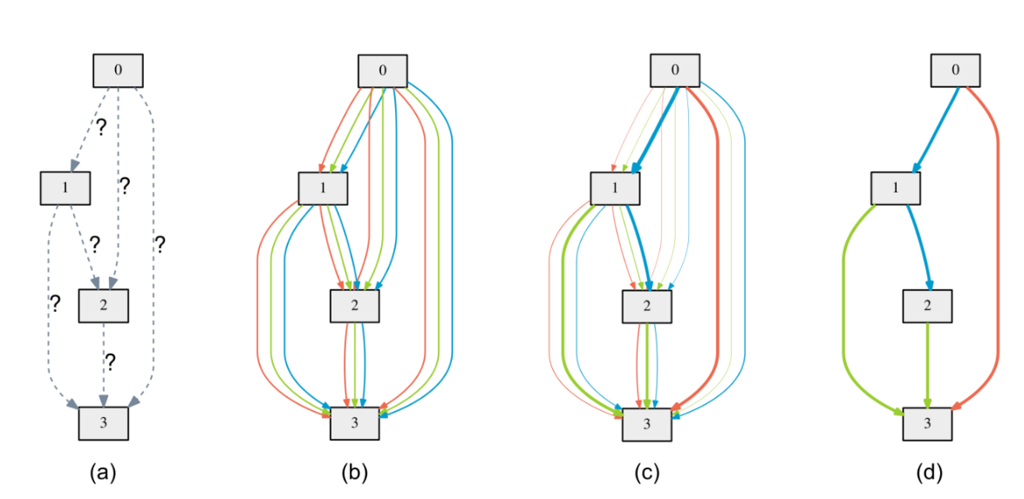
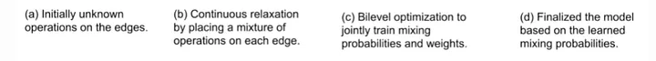
2. Reducing Search Time
Source : https://ag7982.medium.com/neural-architecture-search-nas-49d378fa04fe
Continuous Relaxation

Slide 21
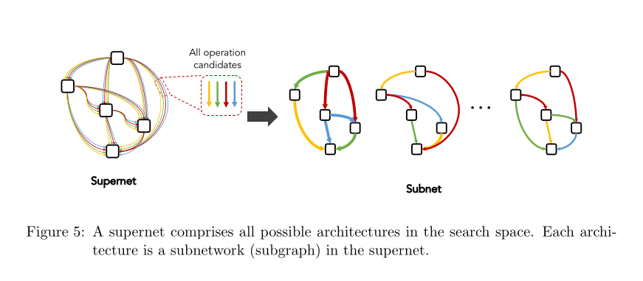
2. Reducing Search Time
Source : https://ag7982.medium.com/neural-architecture-search-nas-49d378fa04fe
Continuous Relaxation - SuperNetwork

Slide 22
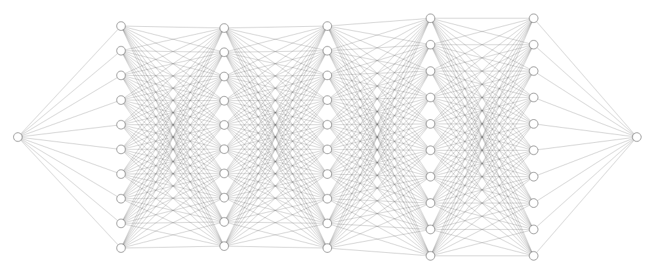
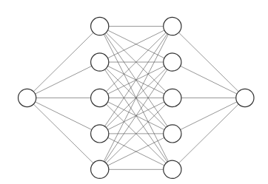

2. Reducing Search Time
HyperNetwork – Basic Idea
$$ã$$
Hypernetwork
Supernetwork
Notes:
Use a HyperNetwork to speed up the search process by having a Bi-Level Optimization :
The core idea is : ????????

Slide 23
2. Reducing Search Time
Source : https://ag7982.medium.com/neural-architecture-search-nas-49d378fa04fe
HyperNetwork – Basic Idea
$$ã$$
Hypernetwork
Supernetwork

Slide 24
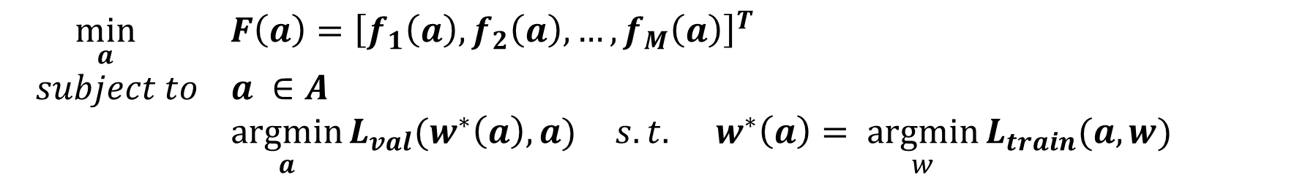
2. Reducing Search Time
Source : https://ag7982.medium.com/neural-architecture-search-nas-49d378fa04fe
Reframing the Problem as a Bi-Level Optimization
Network weights w : learned from the training data
Architecture Parameters a: chosen based on validation data
$\min_{a}{ F\left(a\right)={\left[f_{1}\left(a\right), f_{2}\left(a\right), …, f_{M}\left(a\right)\right]}^{T}}$
$subject to$ $a ∈A$ $\underset{a}{argmin}{L_{val}(w^{∗}\left(a\right), a)} s.t. w^{∗}\left(a\right)= \underset{w}{argmin}{L_{train}(a,w)}$

Slide 25
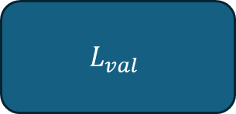


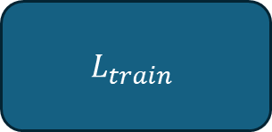
2. Reducing Search Time
Source : https://ag7982.medium.com/neural-architecture-search-nas-49d378fa04fe
Reframing the Problem as a Bi-Level Optimization
(H) Gradient flow
H
S
$$L_{val}$$
1. Update Hypernetwork (H) Parameter
$$ã$$
(S) Gradient flow
H
S
$$L_{train}$$
2. Update Supernetwork (S) Parameter
$$ã$$

Slide 26
Solution Overview
Source : https://ag7982.medium.com/neural-architecture-search-nas-49d378fa04fe
Reducing Evaluation time
Use of SuperNetwork
Reducing Search Time
Using Gradient Based Method – Search direction
Involves a HyperNetwork and a continuous relaxation scheme

Slide 27
Programming Project
Heavily Inspired from the paper MODNAS – (Multi-Objectives Differentiable NAS Sukthanker et al., 2025)
GOAL : Approximate the Pareto Front
OBJECTIVES : Accuracy + model size
TASK : Classification
DATASET : CIFAR-10

Slide 28
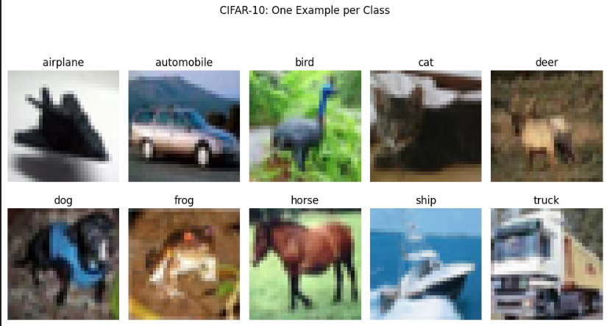
Programming Project
Source : https://ag7982.medium.com/neural-architecture-search-nas-49d378fa04fe
CIFAR-10
10 Classes
50k images

Slide 29
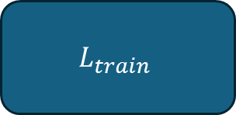
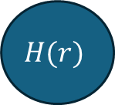
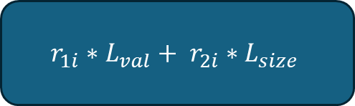


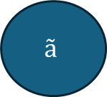
Programming Project
Source : https://ag7982.medium.com/neural-architecture-search-nas-49d378fa04fe
Architecture
MGDA
(H) Gradient flow
$$r_{1i}∗L_{val}+ r_{2i}∗L_{size}$$
$$r \sim Dir(β)$$
$$H(r)$$
$$ã$$
$$∆$$
a
S
$$L_{train}$$
(S) Gradient flow

Slide 30
Programming Project
Source : https://ag7982.medium.com/neural-architecture-search-nas-49d378fa04fe
The core of the optimization is done with :
Preference Vectors
Linear Scalarization
Multiple Gradient Descent Algorithm

Slide 31
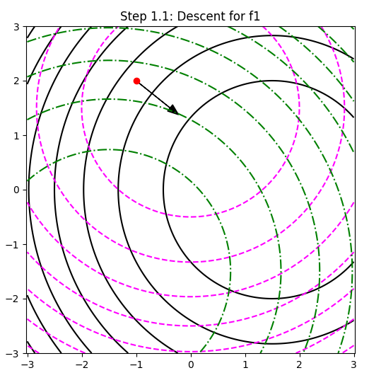
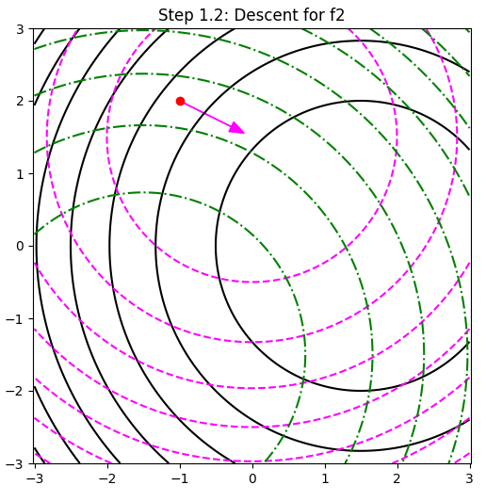
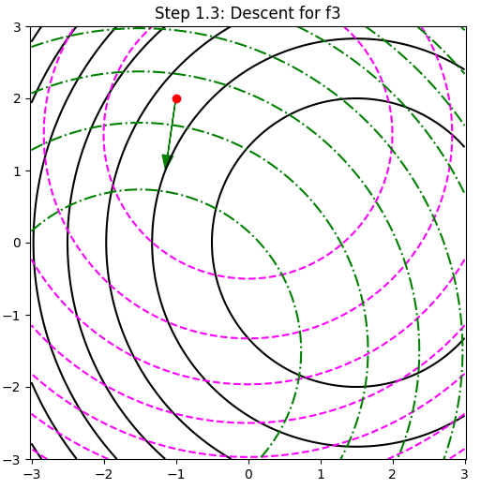
Programming Project
Source : https://ag7982.medium.com/neural-architecture-search-nas-49d378fa04fe
Building some intuition on MGDA

Slide 32
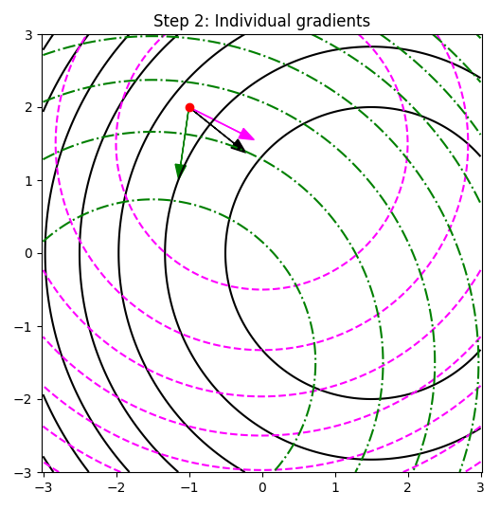
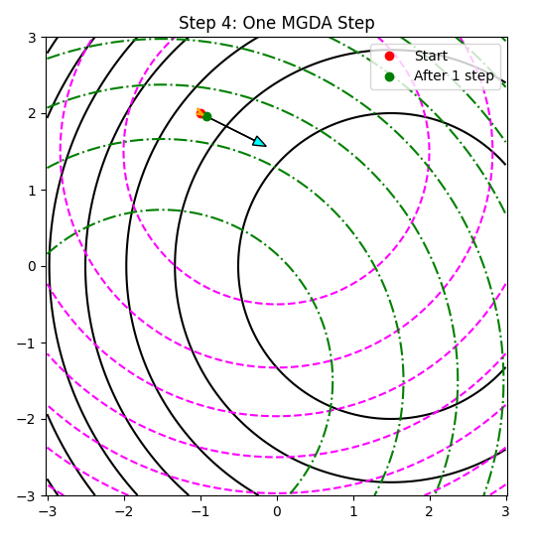
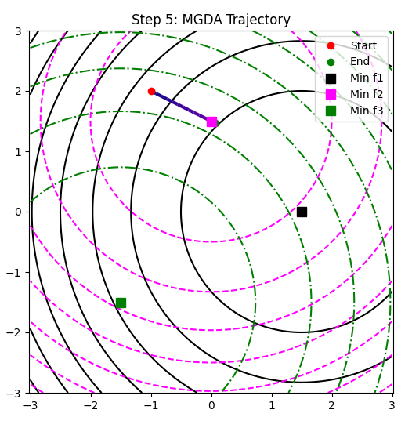
Programming Project
Source : https://ag7982.medium.com/neural-architecture-search-nas-49d378fa04fe
Building some intuition on MGDA

Slide 33
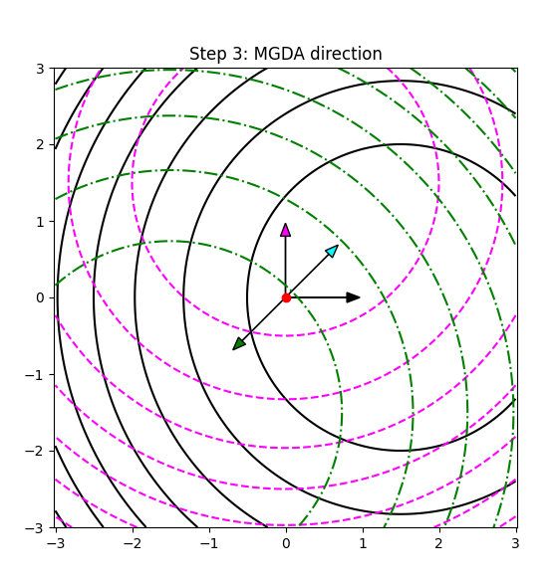
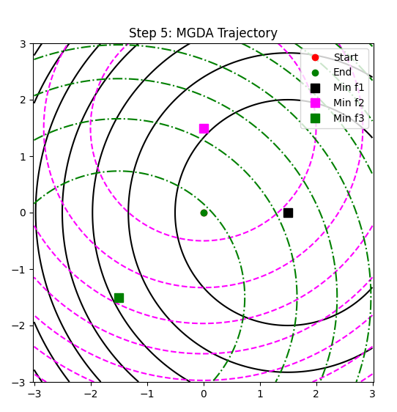
Programming Project
Source : https://ag7982.medium.com/neural-architecture-search-nas-49d378fa04fe
Building some intuition on MGDA

Slide 34
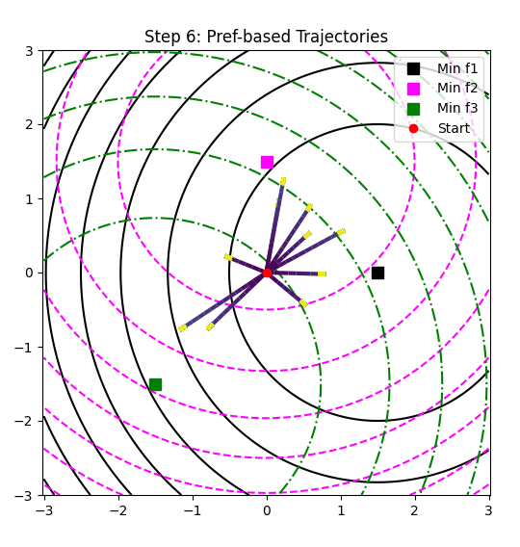
Programming Project
Source : https://ag7982.medium.com/neural-architecture-search-nas-49d378fa04fe
Building some intuition on MGDA

Slide 35
Programming Project
Source : https://ag7982.medium.com/neural-architecture-search-nas-49d378fa04fe
MGDA + enough Preference Vectors allows you to then reconstruct the whole Pareto Front

Slide 36
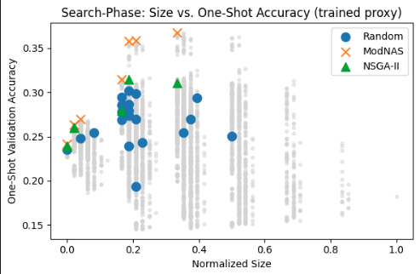
Programming Project
Source : https://ag7982.medium.com/neural-architecture-search-nas-49d378fa04fe
Pareto Set from NSGA-II and MODNAS
But this is an approximation of the Pareto Front given by the SuperNetwork !
Does it correlate with reality ?

Slide 37
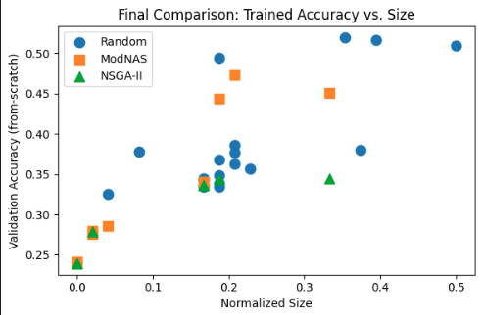
Programming Project
Source : https://ag7982.medium.com/neural-architecture-search-nas-49d378fa04fe
Actual Pareto Set of solutions after training each individual architecture from scratch for 30 epochs

Slide 38
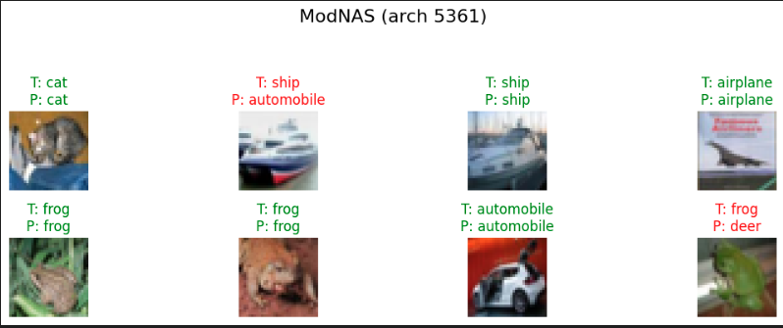
Programming Project
Result of the classification task on some examples

Slide 39
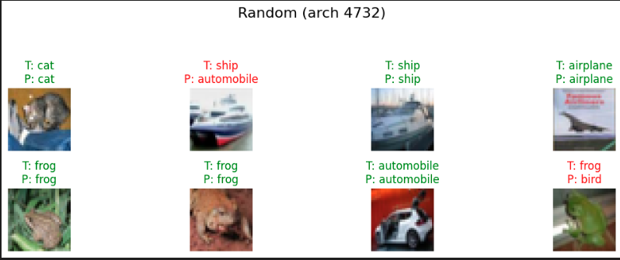
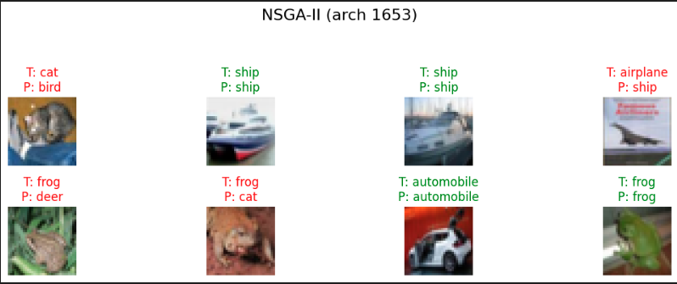
Programming Project
Result of the classification task on some examples

Slide 40
MODNAS RESULT
Source : https://ag7982.medium.com/neural-architecture-search-nas-49d378fa04fe
GOAL :
Same goal as my programming project but extended to more devices and more objectives.
Notes:
Use a HyperNetwork to speed up the search process by having a Bi-Level Optimization :
The core idea is : ????????

Slide 41
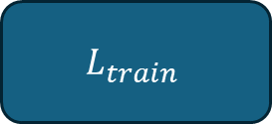
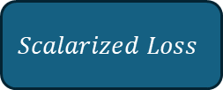
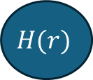






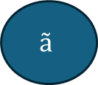

MODNAS Architecture
Source : https://ag7982.medium.com/neural-architecture-search-nas-49d378fa04fe
Architecture
MGDA
(H) Gradient flow
$$L_{val}$$
$$Scalarized Loss$$
$$r \sim Dir(β)$$
$$H(r)$$
$$ã$$
$$∆$$
a
S
$$L_{train}$$
$$Devices d_{t}$$
(S) Gradient flow
$$L_{Latency}$$
$$MetaPredictor$$
$$L_{Energy}$$
Notes:
Use a HyperNetwork to speed up the search process by having a Bi-Level Optimization :
The core idea is : ????????

Slide 42
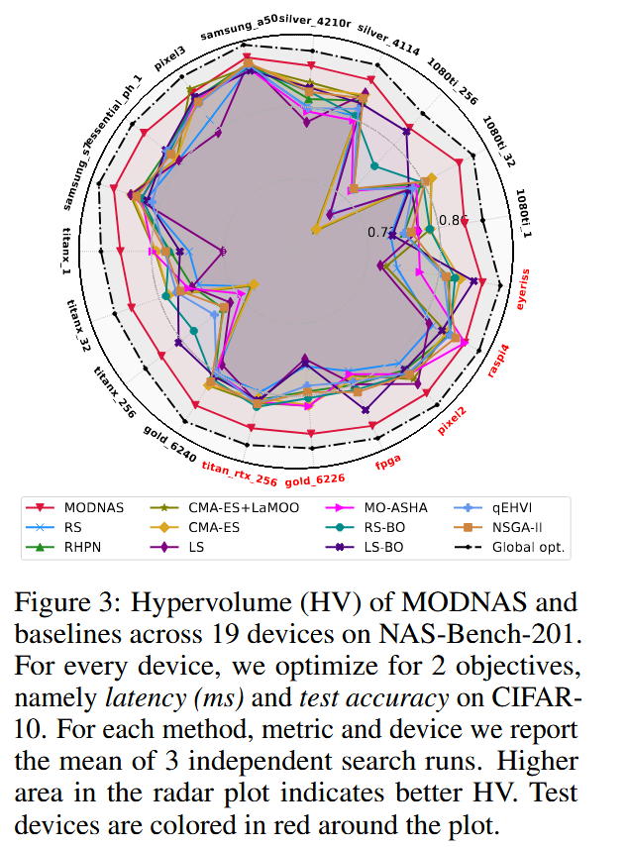
MODNAS RESULT
Source : https://ag7982.medium.com/neural-architecture-search-nas-49d378fa04fe
MODNAS Results

Slide 43
Conclusion
Source : https://ag7982.medium.com/neural-architecture-search-nas-49d378fa04fe
From Complex Problem to Simplified Optimization (~ 8 Years of research)
Limitations:
Weight Sharing Bias: Shared weights in the supernetwork can introduce optimization biases.
Imperfect Pareto Front: The approximated Pareto front may not represent the true Pareto front.
Implementation Challenges:
Methods is not trivial to implement in practice.
Gradient Descent Issues:
MGDA inherits similar challenges and limitations as standard gradient descent methods (e.g., local minima, sensitivity to initialization,…)

Slide 44
THANKS Q&A

Slide 45
ANNEXES

Slide 46
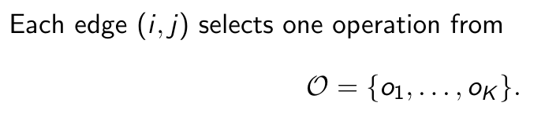
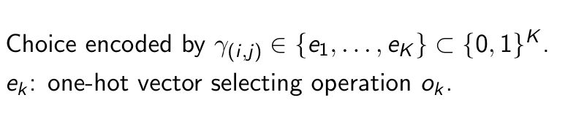
Discret Formulation
Notes:
We relax the choice of operations to a smooth, continuous mixture :
Instead of selecting exactly one operation from the set O, each edge (i,j) now considers all operations simultaneously, weighted by real-valued parameters (logits)
Softmax provide a nice relaxation : it’s positive and sums up to 1
We can think about it as the probability that we assign one given operation to a specific edge.

Slide 47
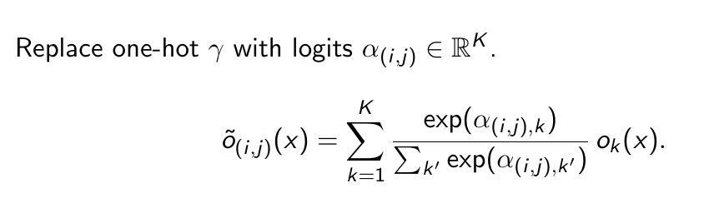
Continuous Relaxation
The discrete argmax operation is replaced by a softmax function, forming a convex combination (weighted sum) of all operations.
Notes:
We relax the choice of operations to a smooth, continuous mixture :
Instead of selecting exactly one operation from the set O, each edge (i,j) now considers all operations simultaneously, weighted by real-valued parameters (logits)
Softmax provide a nice relaxation : it’s positive and sums up to 1
We can think about it as the probability that we assign one given operation to a specific edge.

Slide 48
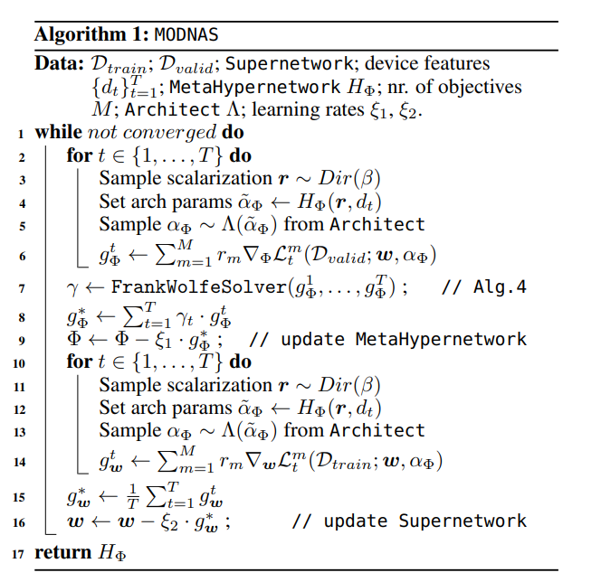

Slide 49
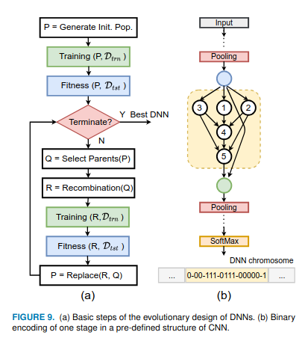

Slide 50
