Slide 1


SMART INDIA HACKATHON 2025
TITLE PAGE
Problem Statement ID – SIH25014
Problem Statement Title- SMART IOT WASTE DISPOSAL MANAGEMENT
Theme- Clean & Green Technology
PS Category- Software/Hardware- Hardware
Team ID-104836
Team Name (Registered on portal)- UNIVATE

Slide 2
SMART IOT WASTE DISPOSAL MANAGEMENT
UNIVATE
How it addresses the problem
Timely Collection & Cleaner Streets – IoT sensors and alerts stop overflowing bins, keeping streets clean.
Efficient & Sustainable Management – GPS tracking help recycling, save costs, and provide a scalable, eco-friendly solution.
PROPOSED SOLUTION
IoT Sensors – Sensors monitor waste level and send an alert when the bin is nearly full.
GPS Tracking – GPS shows the bin location, helping trucks plan efficient routes.
odor-free, durable garbage bin by using HDPE for the body, a rubber seal for a leak-proof lid, and an activated carbon filter to absorb smells.
Can segregation Like Degradable, Non-Degradable And E-Wasate And compress
Innovation and uniqueness of the solution
Integrated IoT Monitoring – Sensors and real-time notifications detect full bins and alert authorities and residents.
GPS-Enabled Smart Collection – GPS tracking helps municipalities optimize routes, saving time, fuel, and manpower city-wide.

Slide 3
FEASIBILITY AND VIABILITY
UNIVATE
Feasibility Analysis
Technical Feasibility – The idea uses Arduino/ESP32, ultrasonic sensors, GPS, and cloud platforms, making it technically implementable.
Economic Feasibility – Although smart bins have a higher initial cost, savings in collection, routes, and labor make it cost-effective.
Strategies to Overcome Challenges
Cost Management – Begin with pilot areas and gradually scale city-wide to manage investment costs.
Maintenance Plan – Implement scheduled maintenance and remote diagnostics to keep sensors and modules functional.
Potential Challenges and Risks
High Initial Cost – Smart bins and IoT modules are more expensive than traditional bins.
Maintenance Issues – Sensors, GPS modules, and solar panels may need regular maintenance.

Slide 4
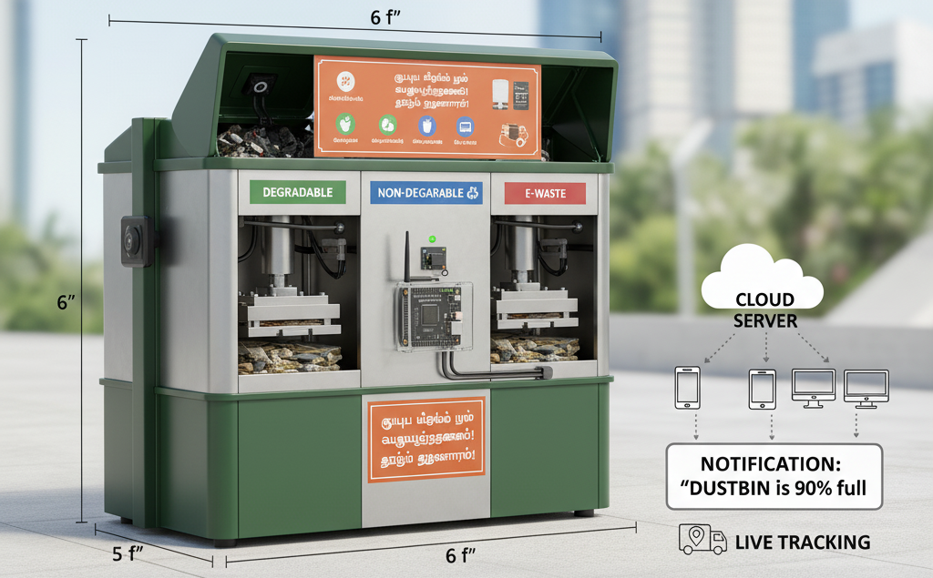
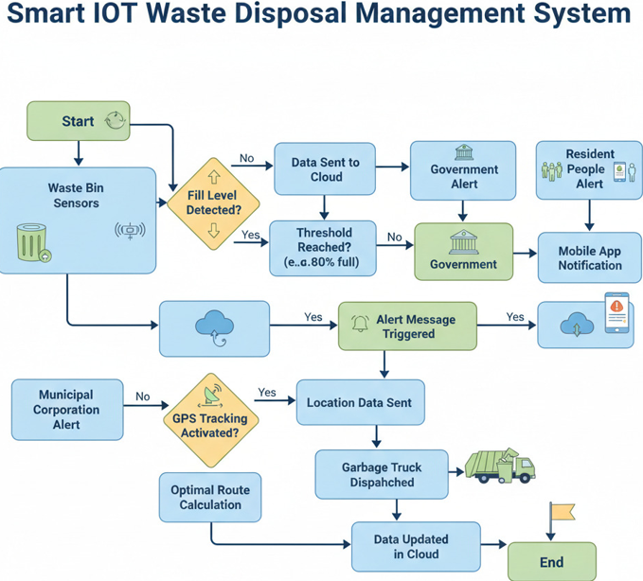
TECHNICAL APPROACH
UNIVATE
Hardware | Software | Purpose
Arduino / ESP32 | Python | Control sensors & data
Ultrasonic | Node.js | Backend services
Gas Sensor | HTTP | IoT communication
GPS Module | Firebase / AWS IoT | Real-time notifications
Wi-Fi / GSM | React | Dashboard & display

Slide 5
IMPACT AND BENEFITS
UNIVATE
Benefits of the Solution
Social: Promotes public hygiene, awareness, and responsible disposal.
Economic: Reduces collection costs, fuel usage, and labor requirements.
Environmental: Ensures proper waste segregation and lowers pollution.
Scalability: Can be deployed city-wide, providing a sustainable solution.
Potential Impact on the Target Audience
Residents: Experience cleaner streets and hygienic surroundings.
Notifications: Alerts help residents avoid dumping in full bins.
Municipal Authorities: Gain real-time monitoring and optimized collection.
Environment: Supports recycling and reduces landfill load.

Slide 6
RESEARCH AND REFERENCES
UNIVATE
References & Research Work
IoT-Based Smart Waste Management Systems
Paper: “IoT-Based Smart Waste Management System” – International Journal of Engineering Research & Technology (IJERT), 2020
Link: https://www.ijert.org/research/iot-based-smart-waste-management-system-IJERTV9IS12043.pdf
Smart Waste Collection Using IoT and GPS
Article: “Smart Garbage Monitoring System Using IoT and GPS” – International Journal of Computer Applications, 2019
Link: https://www.ijcaonline.org/archives/volume178/number1/30129-2019917620

