Slide 1
MENTAL HEALTH DETECTION USING AI
Submitted by:
SIVAPERUMALRAJ G (610921104344)
SANJAIKUMAR S (610921104038)
NANDHAN E (610921104027)
ARUNKUMER K (610921104303)
Project Guide: DR. J. PARTHASARATHI., M.E .,Phd.,

Slide 2

Assessing Mental Health with LLMs:
Project Overview
Key Technologies
Utilizing LLMs for mental health assessment.
Gemma 3:1B, Ollama, MySQL, Kivy, TextBlob.
Goal
Analyze patient data to identify mental health indicators.

Slide 3
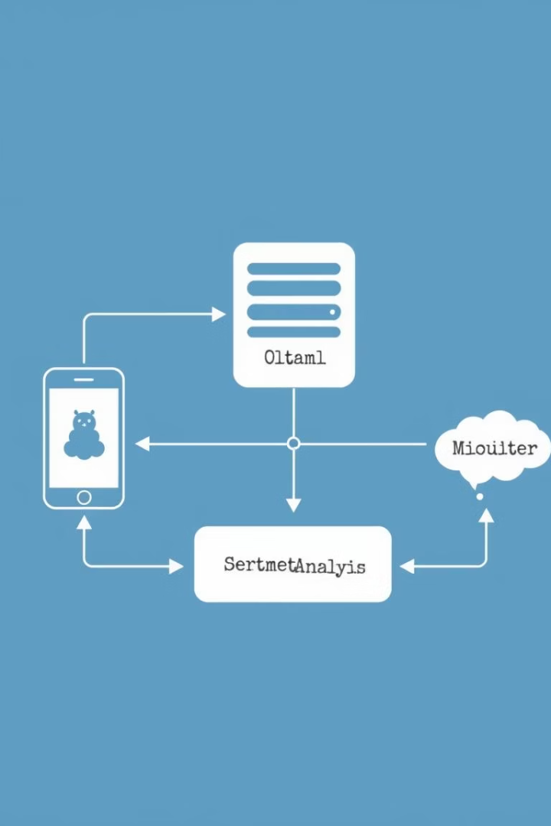




System Architecture
Kivy Frontend
User interface for data input.
Ollama Server (Gemma 3:1B)
LLM for text analysis and pattern recognition.
MySQL Database
Secure storage for patient data.
TextBlob
Sentiment analysis library for emotional tone detection.

Slide 4
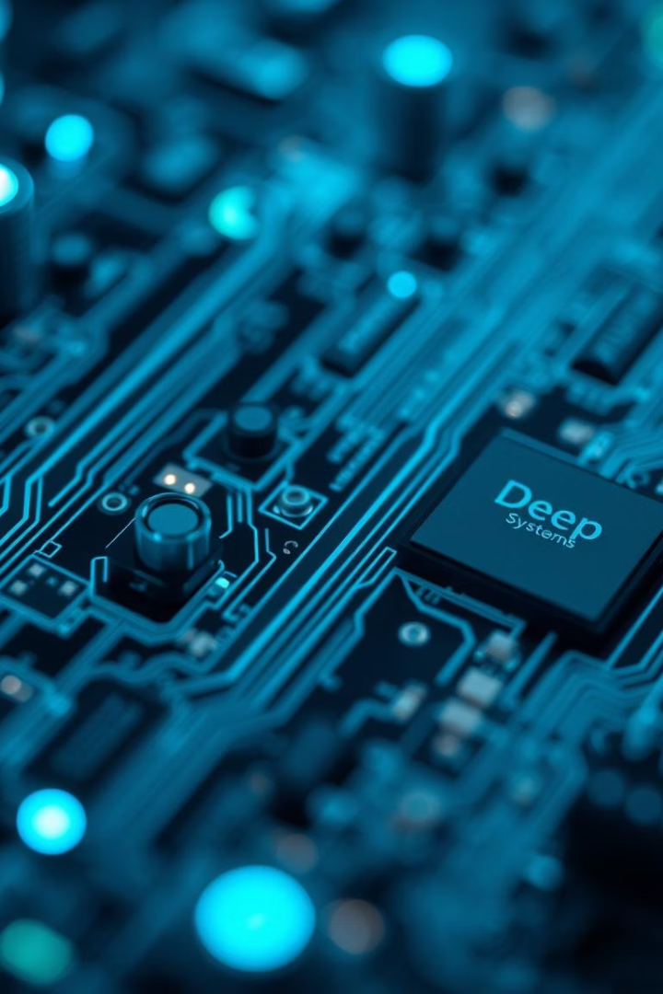




Technology Stack Deep Dive
Gemma 3:1B
Ollama
Kivy
Lightweight LLM optimized for local deployment, 1.1B parameters.
Streamlined LLM serving, low latency inference.
Cross-platform Python UI framework, touch-optimized.
MySQL
Relational database, ACID-compliant.

Slide 5
Data Collection Methodology
Data Sources
Data Types
Ethical Considerations
Dataset Size
Data anonymization.
Patient questionnaires.
Self-reported symptoms.
Informed consent.
500 patients.
Text-based interviews.
Emotional expressions.
10,000+ data points.
Surveys.
Behavioral patterns.

Slide 6

LLM-Powered Analysis
Risk Factor Identification
Symptom Extraction
Prompt Engineering
Severity scoring identified.
Based on established criteria.
Sentiment Analysis
Targeted mental health assessments.
TextBlob for initial emotional state.

Slide 7
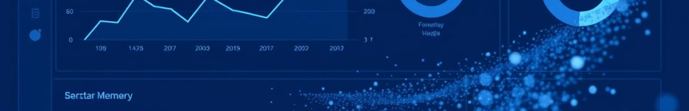
Key Metrics and Results
85%
80%
Accuracy
Precision
Identifying mental health conditions.
Symptom detection.
90%
82%
Recall
F1-Score
For patients at risk.
Harmonic mean of precision and recall.

Slide 8

Case Study Example
Patient A Profile
LLM Identifies
Exhibits anxiety and depression symptoms.
Increased negative sentiment, sleep disturbance, social withdrawal.
Recommendation
Consult with a mental health professional.

Slide 9








Future Improvements
Multi-modal Data
Fine-tune LLM
Incorporate audio and video for richer analysis.
With domain-specific mental health data.
Explainable AI
Telehealth Integration
Develop methods for transparent decision-making.
For remote patient monitoring.

Slide 10
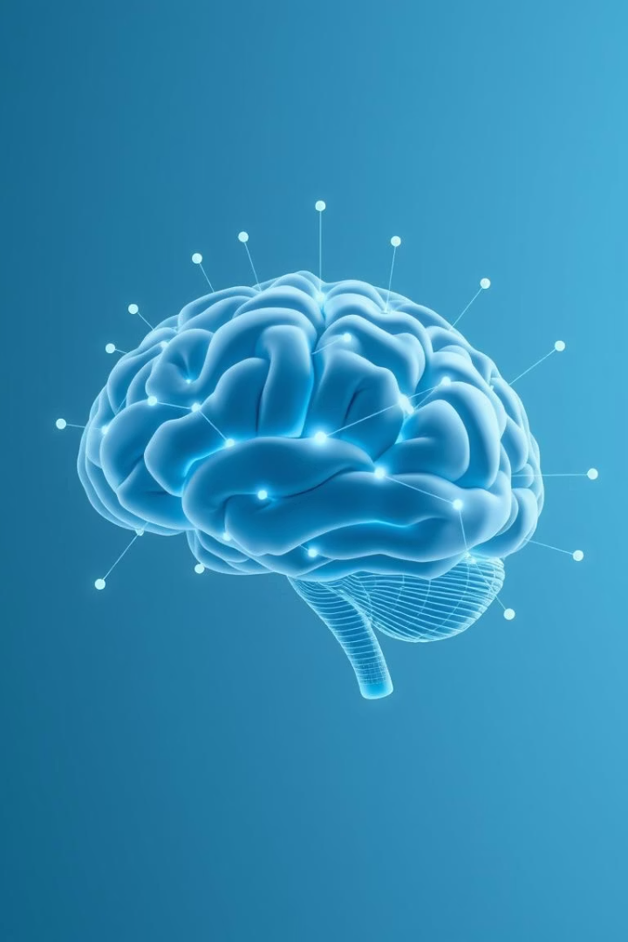
Conclusion
LLMs offer promising tools for mental health assessment.
Ethical considerations and limitations must be addressed.
Future research focuses on continuous improvement and refinement.

