Slide 1
ATM Fraud Detection System
MAHARAJ VIJAYARAM GAJAPATHI RAJ COLLEGE OF ENGINEERING
MAJOR PROJECT
BY:
GUIDE:
Dr. D. Rama Devi Prof
M.Tech., Ph.D
HOD
ECE
23335A0414
22331A04H0
22331A04H6
22331A04F3

Slide 2
Introduction
Nowadays, ATM frauds are increasing a lot. People steal cards, copy PINs, or use skimming devices. Normal ATMs only depend on card and PIN, which is not fully safe. So we thought: What if we add face recognition as an extra security layer? This way, even if someone steals a card, they can’t withdraw money without the correct face

Slide 3
Motivation
Our main motivation is to make ATM transactions safer.
PIN can be stolen,
card can be lost,
but the face is unique to each person. That’s why we used face recognition with the ATM. We also wanted to build a low-cost prototype using Arduino, servo motor, and laptop webcam, so we can practically show this idea.
Even if unauthorized access is attempted, our system immediately alerts the authorized person/bank via SMS using GSM module.

Slide 4
PROBLEM STATEMENT
Most ATMs today use only a card and PIN to verify users. This makes them vulnerable to fraud, such as card theft, PIN theft, or card cloning using skimming devices. If someone steals your card or finds out your PIN, they can easily access your account. Single-layer security is no longer enough to protect users’ money. To prevent unauthorized access, ATMs need an additional verification step. Our system uses face recognition through a laptop camera as a biometric layer. This ensures that only the registered user can perform transactions, making ATM operations safer and more secure.

Slide 5
ABSTRACT
Automated Teller Machines (ATMs) are highly vulnerable to frauds such as card skimming, PIN theft, and unauthorized transactions, posing serious risks to both banks and customers. Traditional security mechanisms are mostly hardware-based and lack intelligent fraud detection. To overcome these limitations, this project proposes an ATM Fraud Detection System using Embedded Systems and Machine Learning.
The proposed ATM fraud detection system uses Arduino as the central controller, integrated with a laptop camera, servo motor, and supporting modules. A servo motor functions as a switch, replacing the traditional card scratching process, while the laptop camera monitors users and captures facial data for analysis.
On the software side, machine learning algorithms process facial recognition, user behavior, and transaction patterns to identify anomalies. When irregularities such as abnormal withdrawals, repeated failed login attempts, or unauthorized access are detected, the system initiates a two-level alert mechanism:
Local Alerts – The Arduino activates a buzzer and displays a warning on the LCD screen. Simultaneously, prevents further transactions.
Remote Alerts – Through a Wi-Fi or GSM module, the system sends real-time SMS/Email notifications to the bank’s security team. The laptop camera captures evidence of the suspect, and details such as time, location, and fraud type are logged into the database/cloud.

Slide 6
OBJECTIVE
Enhance ATM Security
Implement multi-layer authentication using face Recognition
Prevent Fraudulent Activities
Detect card skimming, stolen card use, and PIN theft in real-time.
Real-Time Monitoring & Alerts
Use laptop camera and ML algorithms to monitor users.
Trigger instant local alerts (buzzer, display) and remote alerts (SMS via GSM module).
Cost-Effective and Practical Implementation
Build a low-cost prototype using Arduino, servo motor, and laptop camera.
Avoid expensive fingerprint sensors while maintaining reliable security
Increase User Confidence and Trust
Ensure that users feel safe during transactions by proactively preventing fraud.
Remote Data Storage and Monitoring (Optional )
Use cloud services to store logs, captured images, and alerts.
Enable bank or security personel to access historical records and evidence.

Slide 7
BENEFITS
Real-Time Notifications
Provides immediate alerts via SMS and buzzer, helping banks respond quickly.
Reduced Financial Loss
Prevents monetary loss by stopping unauthorized transactions before they occur.
Evidence Collection for Investigation
Captures images of suspicious users for fraud investigation and record-keeping.
Cost Efficiency
Uses low-cost hardware (Arduino, servo motor, laptop camera), making it affordable to implement.
Ease of Implementation
Can be integrated with existing ATM infrastructure without major hardware changes.
User Trust and Confidence
Gives customers peace of mind knowing transactions are monitored and secured.

Slide 8
TECHNOLOGIES INVOLVED
1. Machine Learning (ML) Technologies
Deep Learning (CNN) – for facial recognition and real-time image analysis.
Python Libraries – scikit-learn, TensorFlow, PyTorch, OpenCV for ML model training and deployment.
2. Embedded Technologies
Arduino Programming (Embedded C/Arduino IDE) – to control servo motor, buzzer, and display.
Servo Motor Integration – acts as a switch/lock in place of card scratching.
Sensor & Alert Modules – buzzer, LCD display for local alerts.
3. IoT Technologies
Wi-Fi / GSM Modules – to send fraud alerts to bank servers.
MQTT / HTTPS Protocols – for secure real-time communication.
Cloud Platforms (Firebase, AWS, Google Cloud) – for data storage, alert logging, and remote monitoring.

Slide 9
HARDWARE NEEDED
Arduino Board (UNO / Mega / ESP32)
Acts as the central controller of the system.
Manages inputs from the laptop’s camera recognition system, controls the servo motor, buzzer, and communicates with the laptop and IoT modules
Servo Motor
Functions as a switch or lock mechanism, replacing the need for card scratching.
Activates to block ATM access when fraudulent activity is detected.
Laptop Camera
Captures real-time facial images of the user.
Feeds the image data to the ML model for facial recognition and verification.
Buzzer
Provides instant local alerts in case of suspicious activity.
Emits sound to warn both the user and nearby personnel about possible fraud.
LCD / OLED Display
Displays status messages, warnings, or instructions.
Helps in communicating alerts clearly to the user.
Wi-Fi / GSM Module (ESP8266 / SIM800L)
Sends remote alerts (SMS or Email) to the bank server or security team.
Ensures real-time communication between the ATM system and bank authorities.

Slide 10
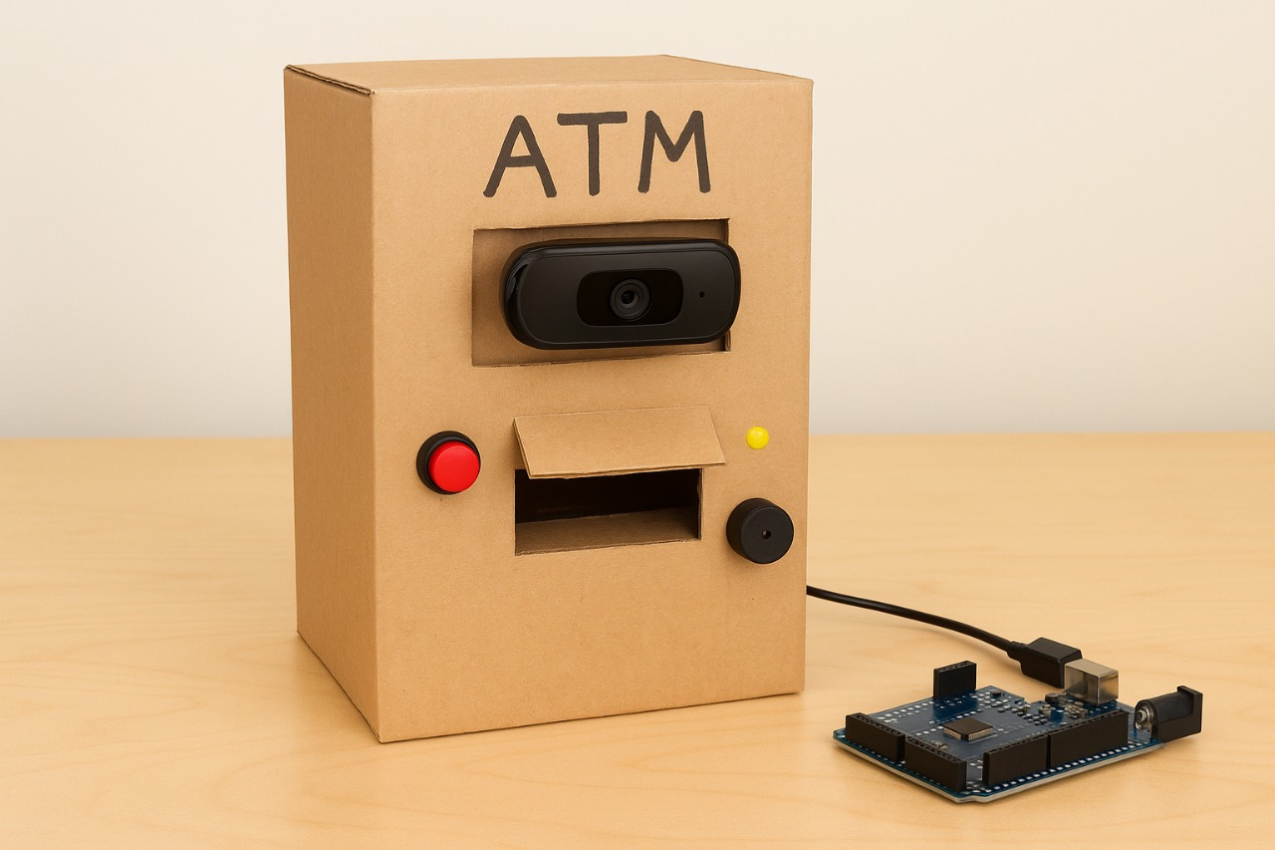
Prototype Model

