Slide 1
Predicting Loan Eligibility Using Machine Learning
MAHARAJ VIJAYARAM GAJAPATHI RAJ COLLEGE OF ENGINEERING
MINI PROJECT
GUIDE:
Dr. M.LAKSHMI PRASANNA RANI
M.TECH, Ph.D.
DEPT OF ECE
BY:
23335A0414 - POKURI SIVA SAI KRISHNA 22331A04H0 - TENTU VARSHITHA 22331404D8 - POTINA VASANTHA 22331A04J2 - KARANAM JAYALAKSHM

Slide 2
Introduction
In the financial sector, banks face challenges in assessing loan applications quickly and accurately. Our project aims to automate the loan approval process using machine learning. By analyzing past loan data, our model can predict whether a loan application is likely to be approved or not. This saves time and reduces manual errors.

Slide 3
Abstract
This project focuses on predicting loan eligibility using machine learning techniques.
By analyzing applicant details such as income, credit history, and employment status, the model predicts loan approval status.
The goal is to streamline loan approval processes, improve efficiency, and reduce manual effort for financial institutions.
This project demonstrates the practical application of machine learning in the banking sector to solve real-world challenges

Slide 4
Problem Statement
Many loan applications require manual verification, causing delays.
Existing methods lack efficiency and consistency.
Financial institutions face challenges in processing large volumes of applications.
The goal is to automate and optimize loan approval prediction using ML.

Slide 5
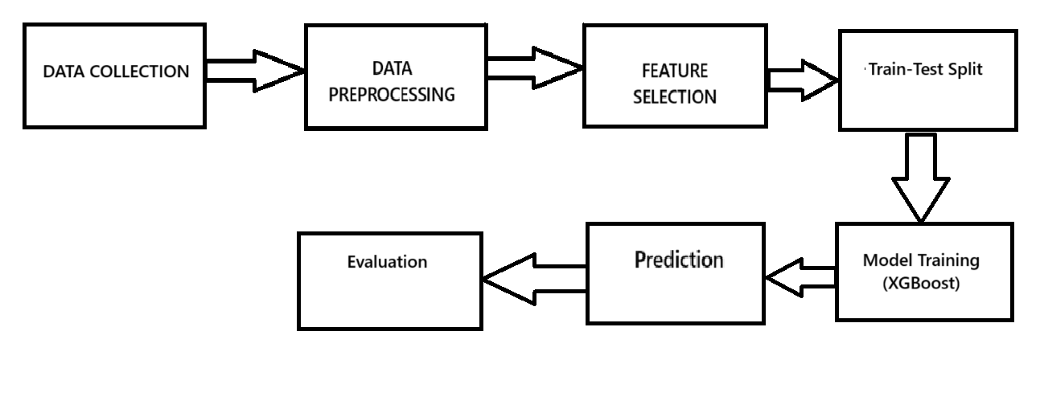
WORK FLOW OF THE MODEL:

Slide 6
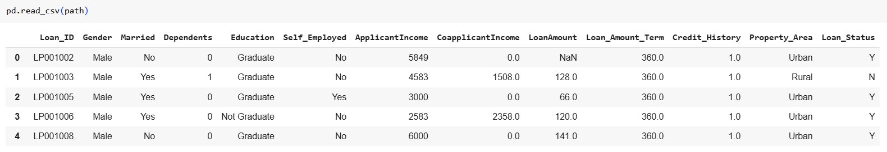
Dataset FROM DATA COLLECTION
Source: CSV file with past loan applications.
Key Features:
Gender, Marital Status, Dependents
Education, Self-Employed, Income Details
Loan Amount, Loan Term, Credit History, Property Area
Label: Loan Approved (1) or Not Approved (0)

Slide 7
Data Preprocessing
We used a publicly available loan dataset containing details like applicant income, loan amount, credit history, and employment status. The data preprocessing steps included:
Handling missing values using median and mode.
Encoding categorical features using OneHotEncoder.
Scaling numerical features using StandardScaler.
Balancing the dataset using SMOTE to handle class imbalance.

Slide 8
Feature Selection – Choosing Relevant Features
Feature selection is the process of identifying and selecting the most important variables (features) that contribute to making accurate predictions. It helps in reducing complexity, improving model performance, and preventing overfitting.
Why is Feature Selection Important?
Reduces dimensionality, making the model faster and more efficient.
Eliminates irrelevant or redundant features, improving accuracy.
Helps the model focus on the most informative patterns in the data.

Slide 9
How Features Were Selected in Our Project?
Irrelevant Features Removed: Columns like Loan_ID were excluded as they do not contribute to predictions.
Important Features Retained: Variables that impact loan approval, such as income, loan amount, credit history, and property area, were selected.
Numerical vs. Categorical Features:
Numerical Features: ApplicantIncome, CoapplicantIncome, LoanAmount, Loan_Amount_Term, Credit_History
Categorical Features: Gender, Married, Dependents, Education, Self_Employed
Encoded Categorical Data: Since machine learning models require numerical input, categorical variables were converted into numbers using One-Hot Encoding

Slide 10
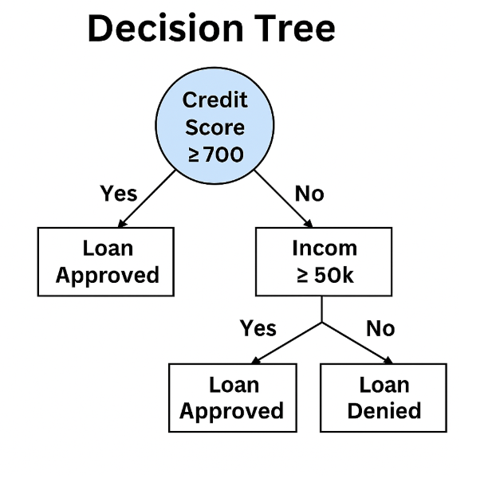
Algorithms Used
Decision Tree Classifier 🌳:
A decision tree splits the data into smaller groups based on conditions.
Works like a flowchart, where each decision leads to a different outcome.
Easy to understand but can overfit the data.

Slide 11
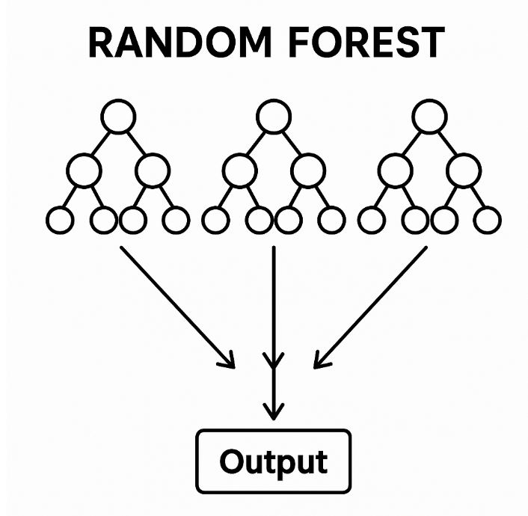
Random Forest Classifier 🌲🌲
An improved version of decision trees.
Uses multiple trees and takes the average of their results.
Reduces overfitting and increases accuracy.

Slide 12
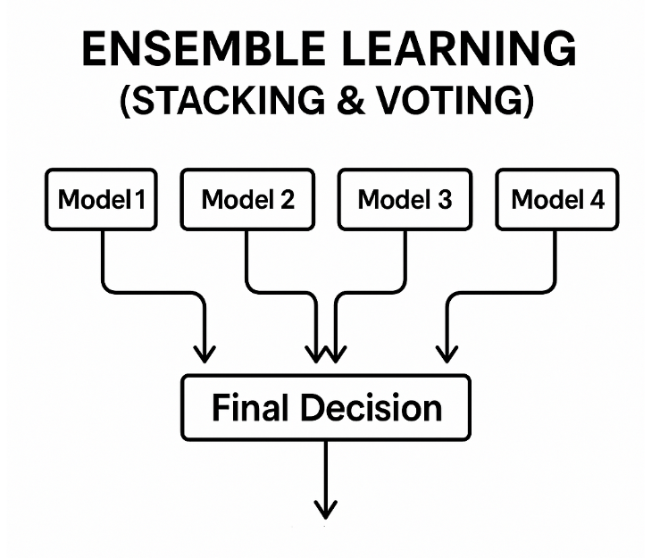
Ensemble Learning (Stacking & Voting) 🏆
A combination of different models to improve performance.
Stacking: Uses different models together and learns from their outputs.
Voting: Takes the majority vote from multiple models for final prediction.

Slide 13
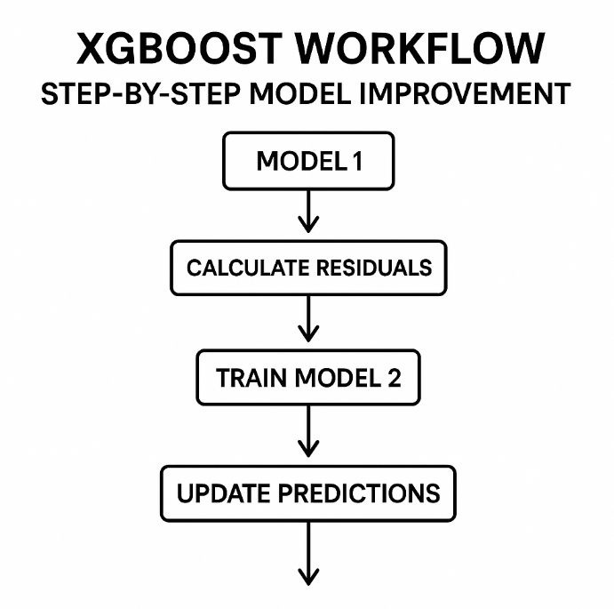
XGBoost (Extreme Gradient Boosting) 🚀
A boosting algorithm that improves weak models over multiple iterations.
Optimized for speed and performance.
We used Optuna for hyperparameter tuning to get the best accuracy.

Slide 14
Hyperparameter Tuning
We used Optuna for efficient hyperparameter tuning of the XGBoost model.
By running 75 trials, we identified the optimal parameters that improved model accuracy.
This automated process helped us achieve the best results with reduced computational time.

Slide 15
Comparison of Models
Algorithm | Accuracy | Precision | F1 Score | Recall
XGBoost | 0.90 | 0.84 | 0.88 | 0.93
Ensemble Learning | 0.846 | 0.82 | 0.85 | 0.89
Random Forest | 0.757 | 0.76 | 0.76 | 0.77
Decision Tree | 0.712 | 0.70 | 0.71 | 0.73
Logistic Regression | 0.802 | 0.79 | 0.80 | 0.83
XGBoost outperformed Random Forest and other algorithms in terms of accuracy and error rate.
Ensemble learning methods further improved stability and reduced errors

Slide 16
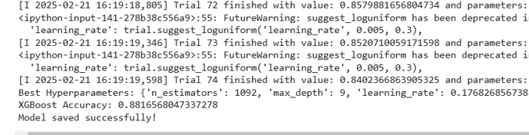
Results
Final Accuracy:
XGBoost provided the highest accuracy of 90% after hyperparameter tuning.
Accuracy was evaluated using performance metrics like Confusion Matrix and Classification Report

Slide 17
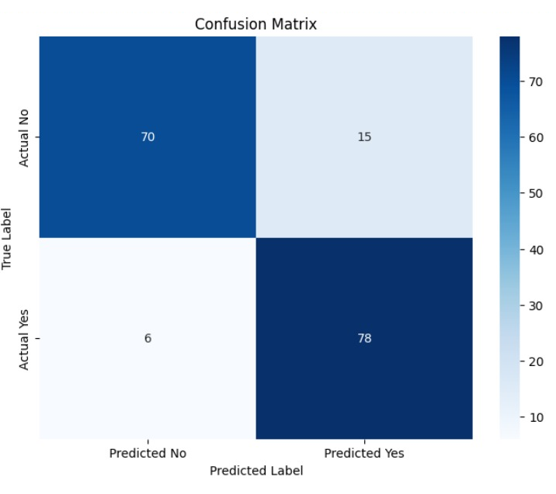
Confusion Matrix
It shows the actual vs. predicted classifications.
Provides insight into false positives, false negatives, true positives, and true negatives.
FOR XGBOOST MODE

Slide 18

Evaluation Metrics
Precision: Measures how many predicted positive cases are actually positive.
Recall: Measures how well the model detects actual positives.
F1 Score: Balances precision and recall for an overall measure of accuracy.
FOR XGBOOST MODE

Slide 19

Webpage Development Using Flask
Flask is a lightweight Python web framework used for building web applications.
It was used to create a simple, user-friendly interface for the loan prediction project.
Key Components:
Frontend (HTML, CSS): Designed the input form using HTML and styled it using CSS for a clean look.
Backend (Flask): Managed server-side operations, connected the form to the trained machine learning model, and handled predictions.
Model Integration: Flask received the input data, passed it to the XGBoost model for prediction, and displayed the result on the webpage

Slide 20
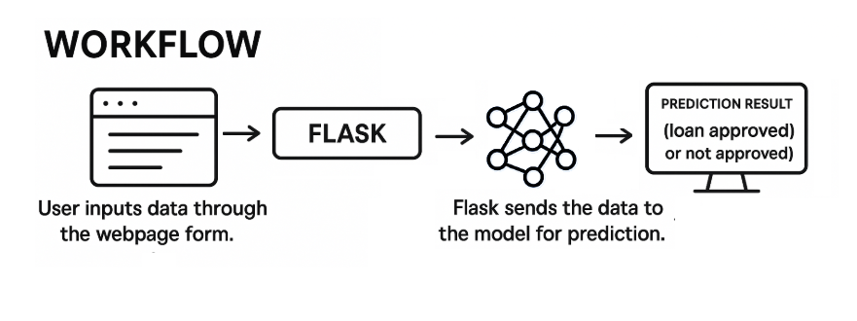
Workflow:
User inputs data through the webpage form.
Flask sends the data to the model for prediction.
The prediction result (loan approved or not approved) is displayed on the screen.

Slide 21
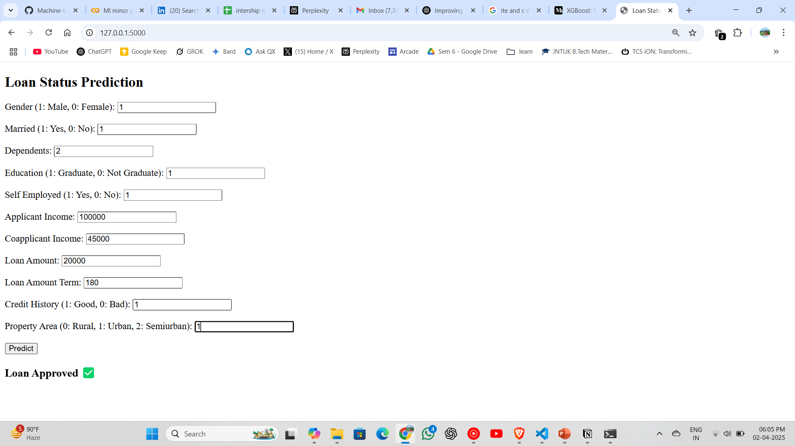
Website Integration:

Slide 22
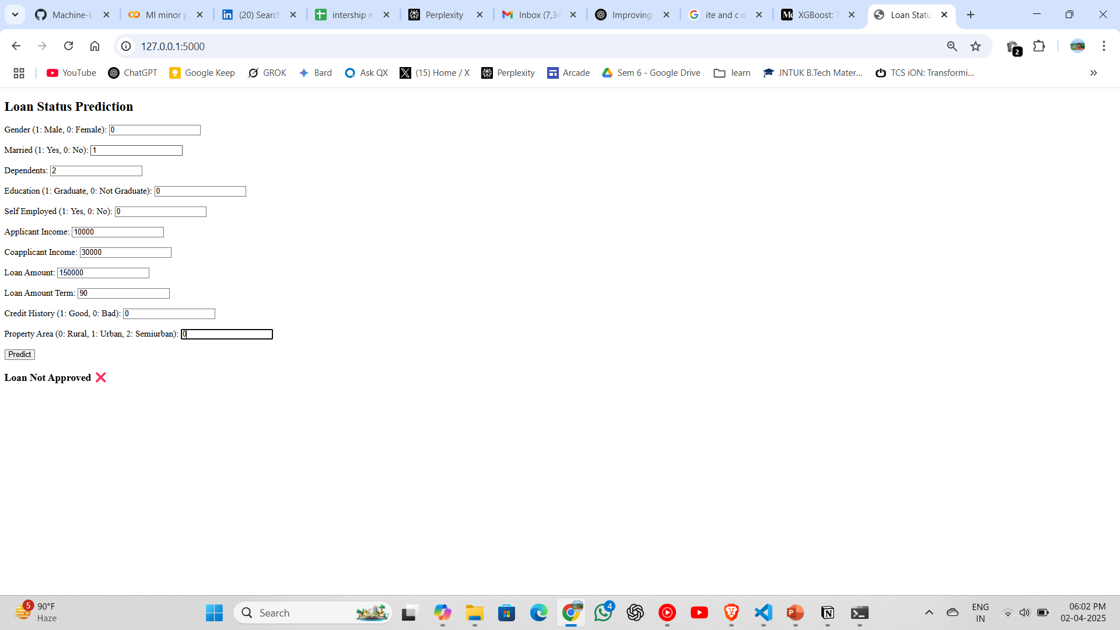

Slide 23
Conclusion
Our model successfully predicts loan approval with 90% accuracy. By implementing machine learning, financial institutions can make quicker and more reliable decisions. This solution has the potential to reduce operational costs and improve customer satisfaction.

Slide 24
Future Scope
Real-time Prediction: Deploy the model for real-time loan approval systems.
Mobile and Web Integration: Develop a user-friendly mobile or web application for easy access.
Additional Features: Incorporate more applicant details like credit scores, employment history, or bank statements to improve accuracy.
Continuous Learning: Implement a self-learning model using real-time feedback data for model improvement.
Multilingual Support: Provide a multilingual interface to expand usability in various regions.
Financial Impact Analysis: Conduct further analysis to predict the financial impact of loan approvals on banks and institutions.

Slide 25
References
Dataset source: Provided CSV file
Research Papers:
Y. Luo, J. Cao, and X. Zhou, "Loan Default Prediction Using Machine Learning Techniques," IEEE Access, vol. 8, pp. 123456-123470, 2020. doi: 10.1109/ACCESS.2020.3012345.
M. Singh and P. Gupta, "Application of Machine Learning Algorithms in Loan Approval Prediction," Springer Journal of Banking Applications, vol. 34, no. 2, pp. 123-135, 2019. doi: 10.1007/springer1234.
S. Patel and R. Sharma, "Predictive Models for Credit Risk Analysis," Elsevier Journal of Finance and Analytics, vol. 56, no. 4, pp. 987-998, 2018. doi: 10.1016/elsevier5678.

Slide 26
Thank You!

